Slide 1
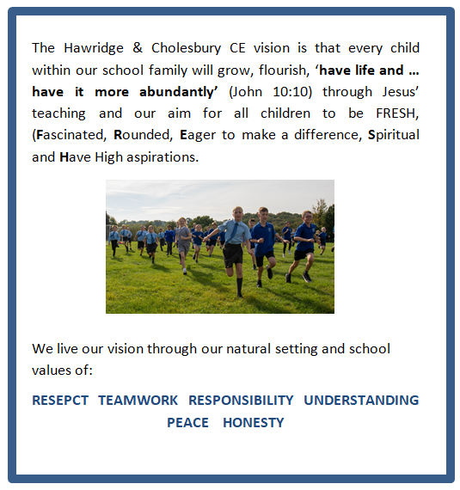
Friday 19th July 2024

Slide 2
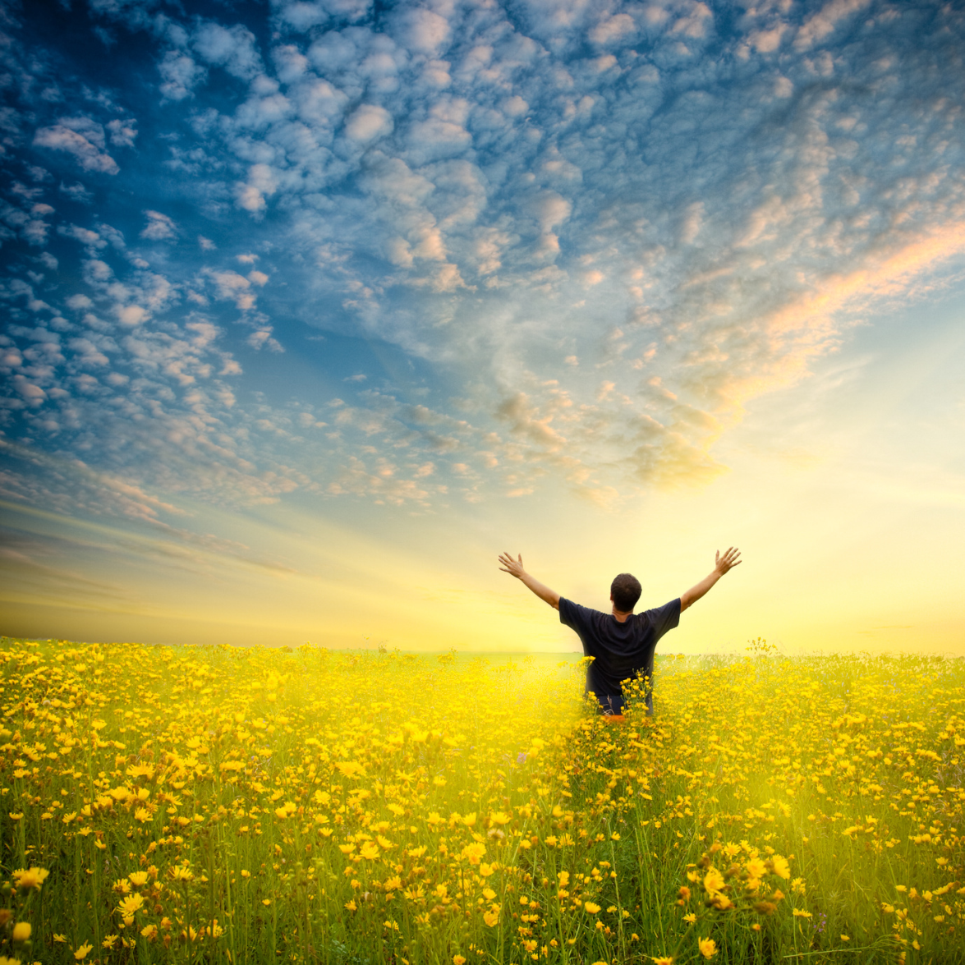
‘have life… and have it more abundantly’ John 10:10

Slide 3
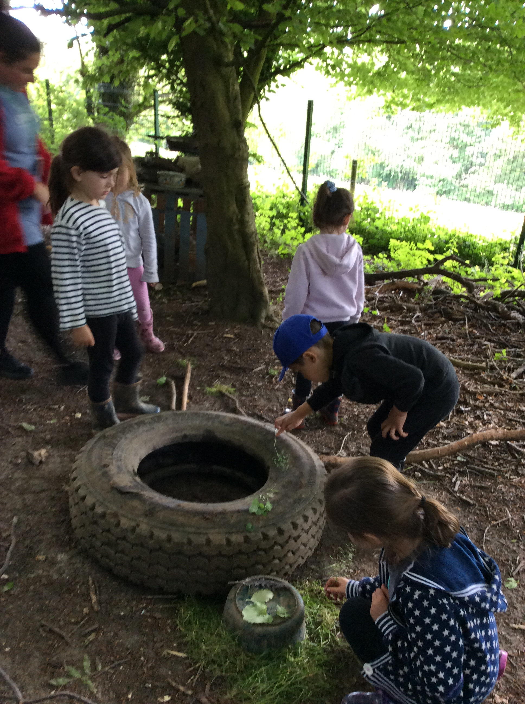
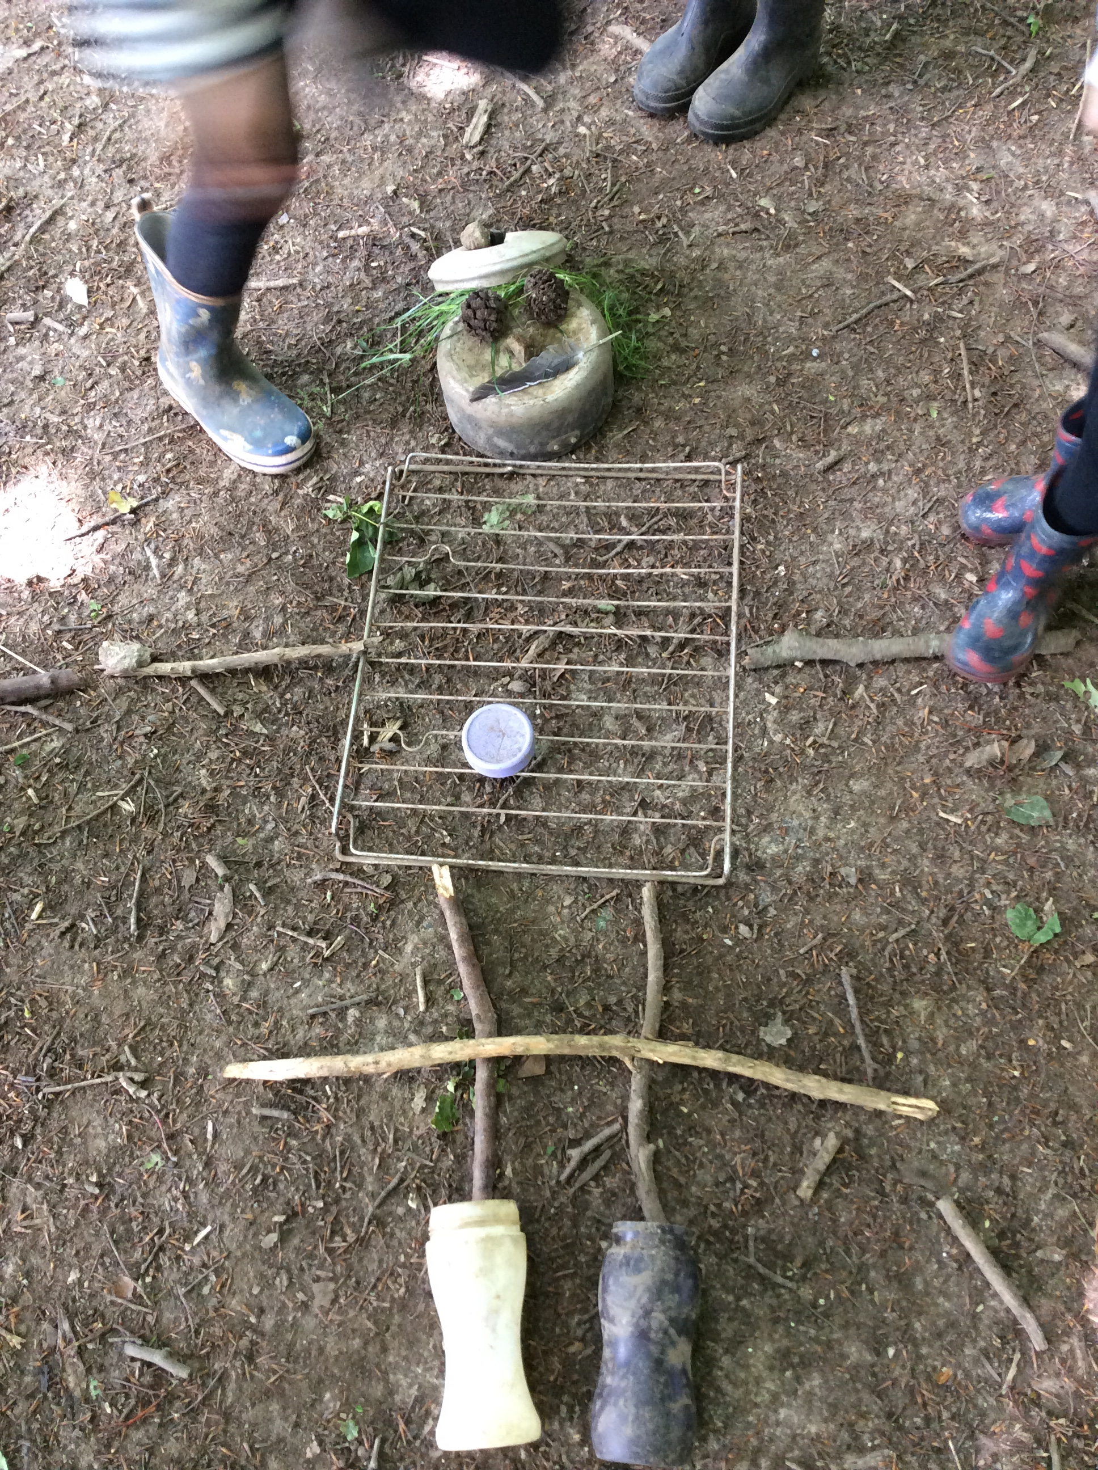
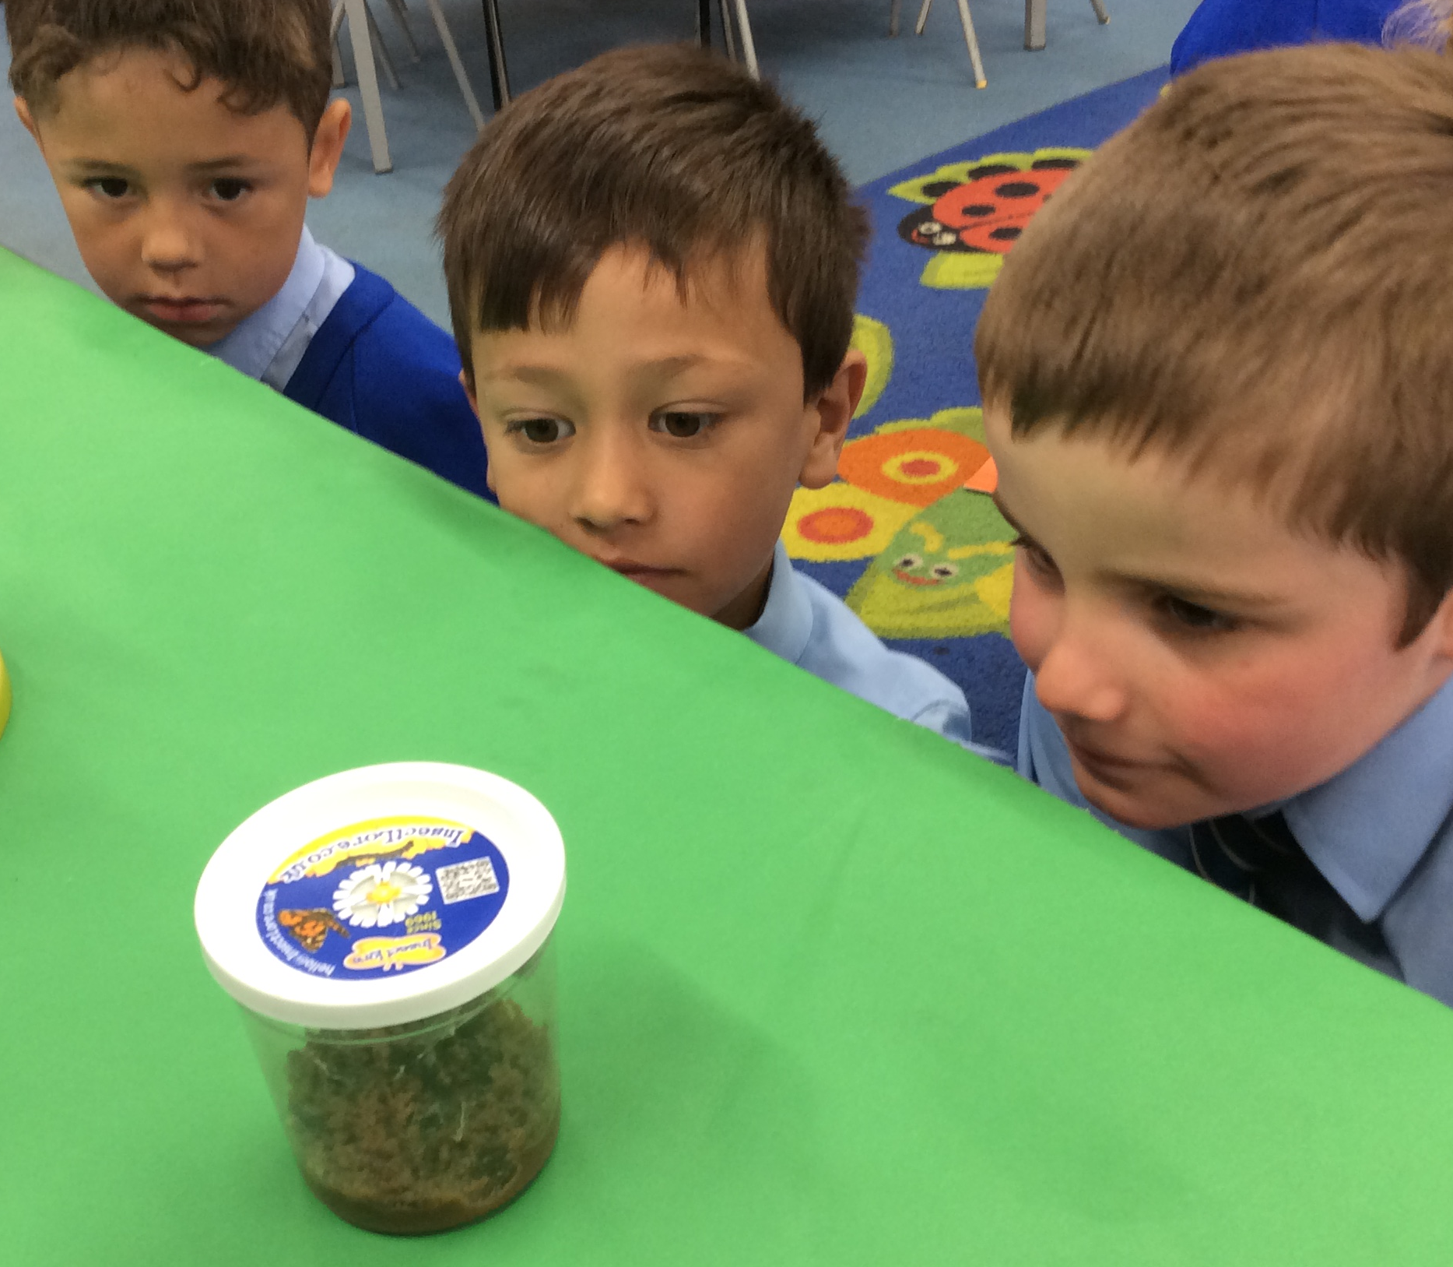
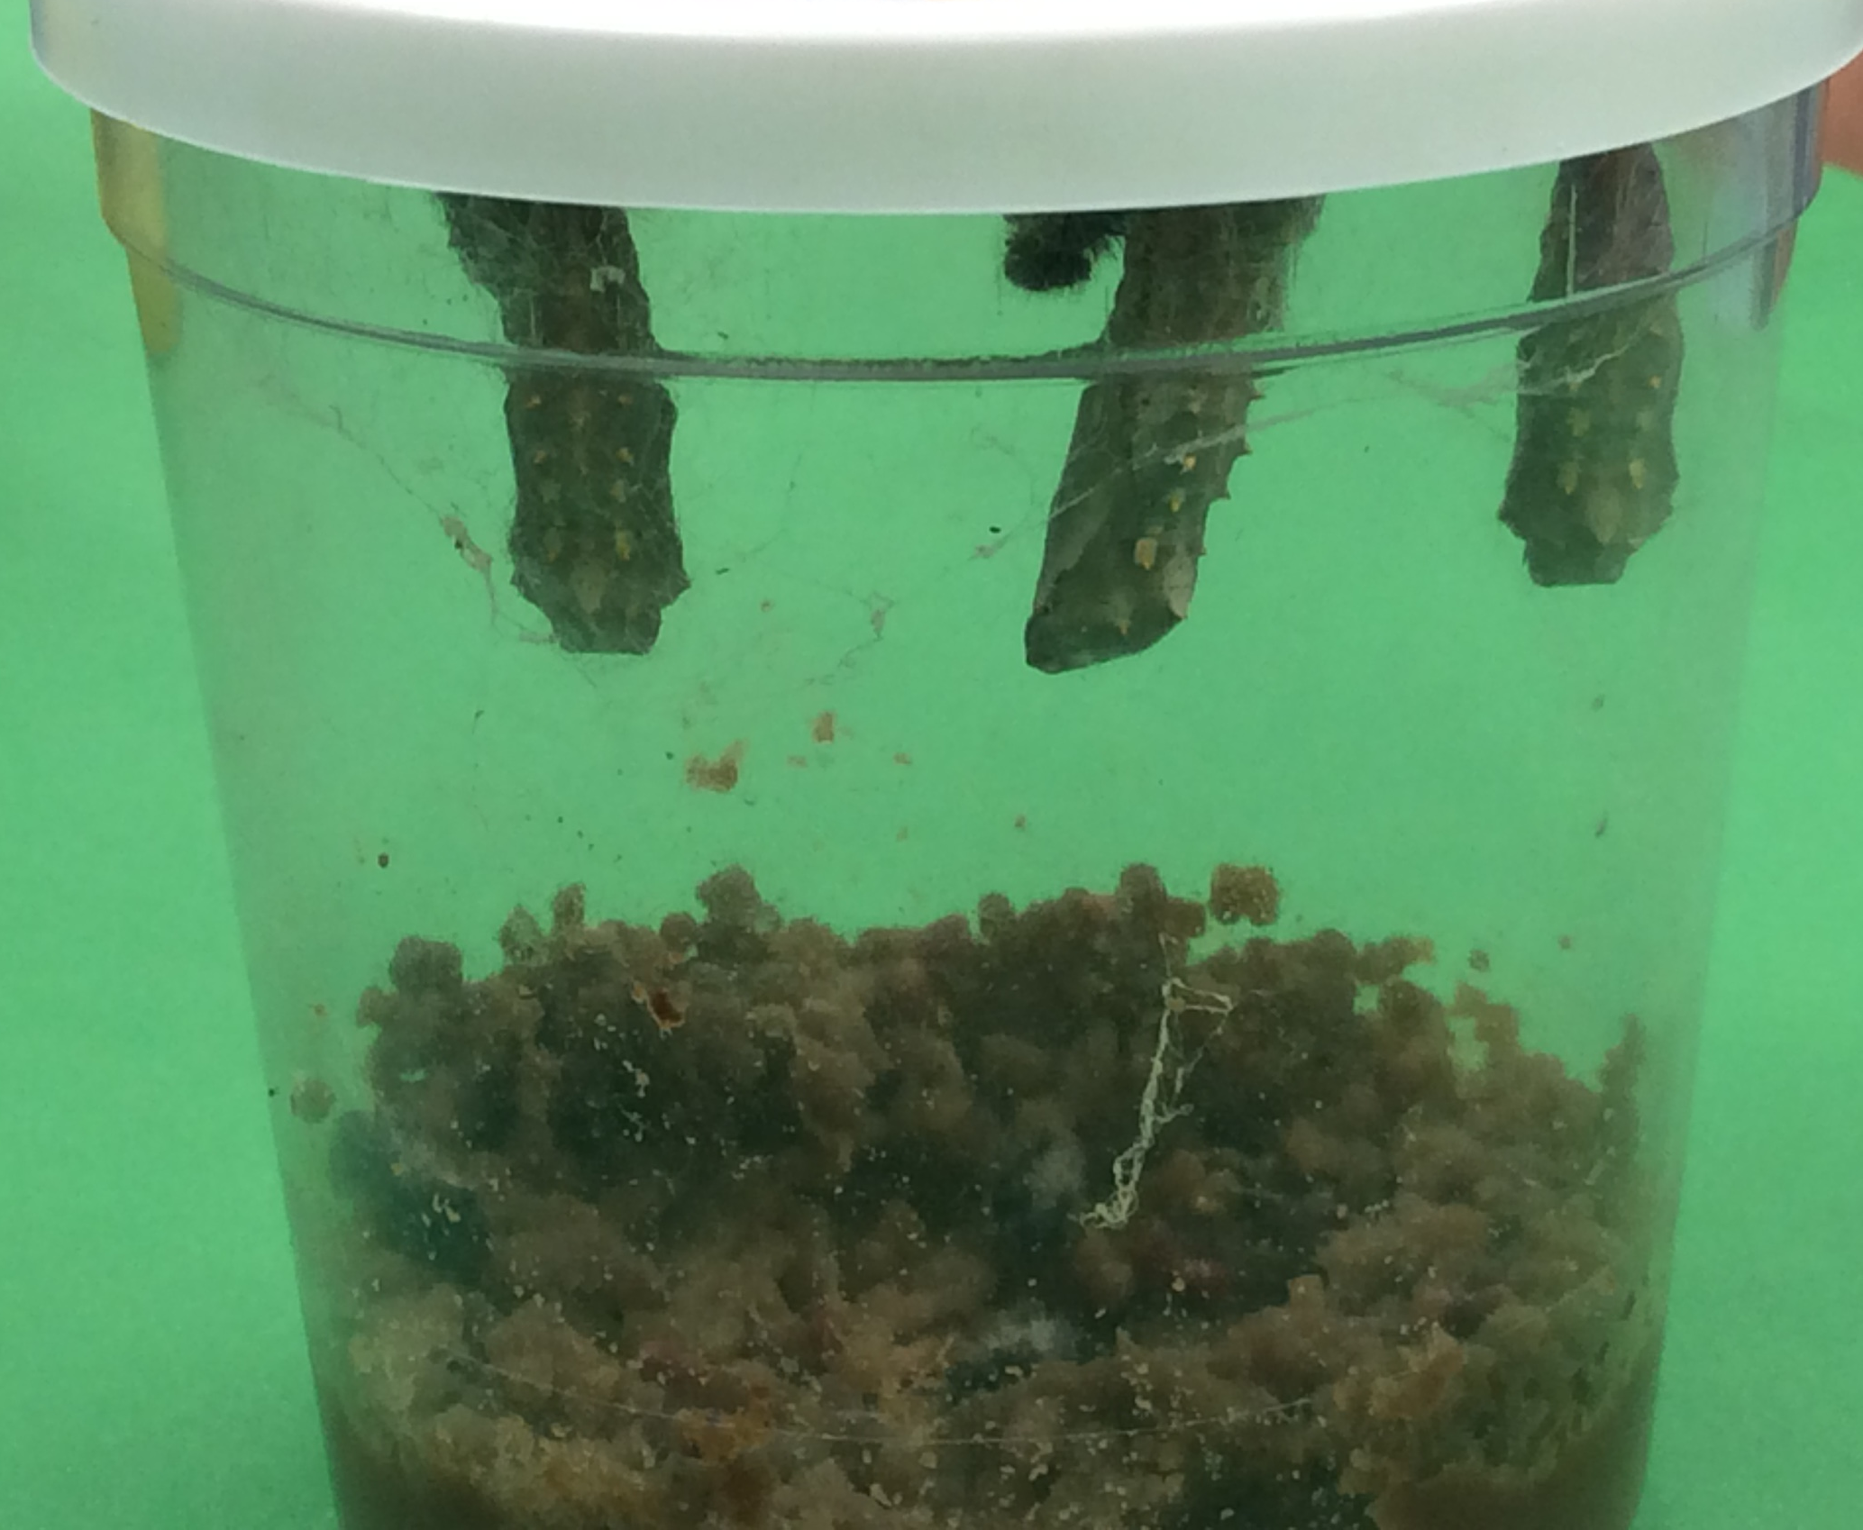
Windmills
Windmills
The children have been working hard in all areas of the curriculum. In Literacy, they had high aspirations when writing about George’s Marvellous Medicine. The children wrote about what their own potion would do to Grandma!
Windmills had a spiritual experience when using our imagination to describe what kind of world we would like to live in. We have been learning about teamwork, Wilf and Krish played cooperatively to build a marble run. In Forest school we worked in teams to create artwork of people using things we found in Forest School, helping us to become more rounded learners.
Our Caterpillars
Windmills were fascinated to see the our caterpillars grow, change and emerge into beautiful Painted Lady butterflies.

Slide 4
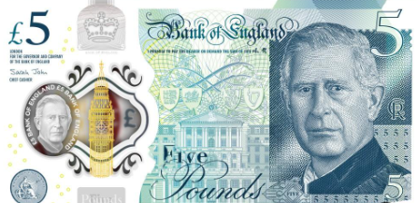
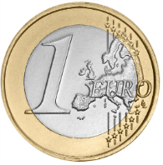
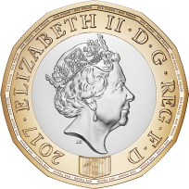
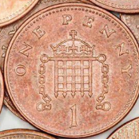
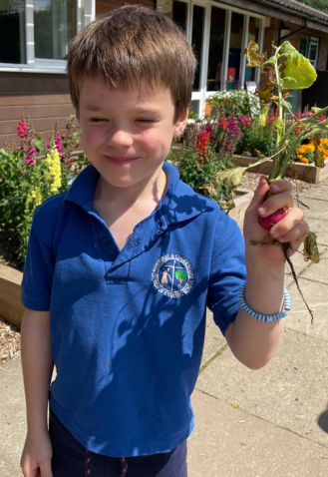
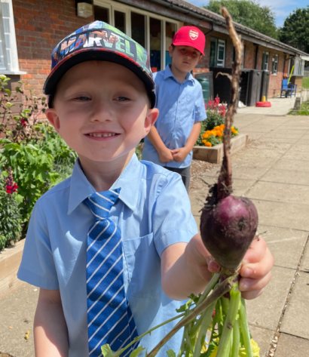
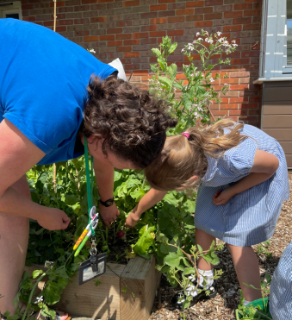
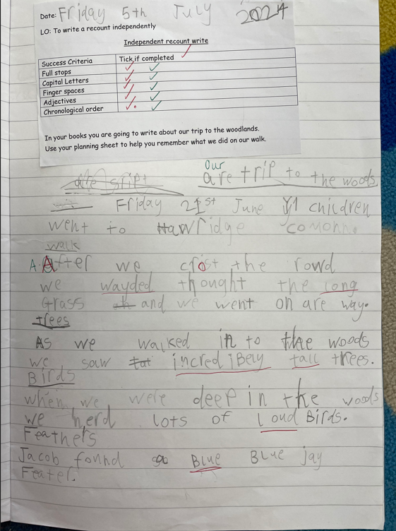
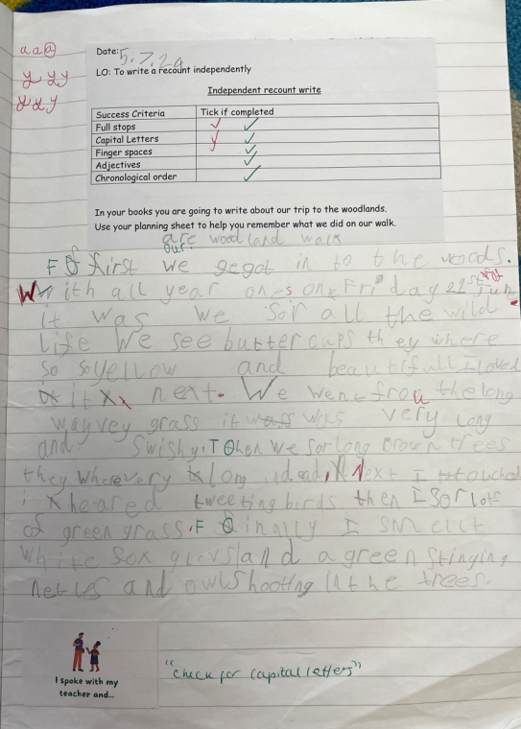
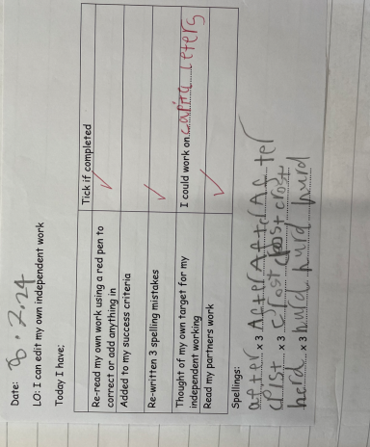
Year 1
F
R
E
S
H
F
R
E
S
H
In Maths we have been fascinated to learn about Money this half term
We learnt about new money that has been made with King Charles on it and the money used in other countries.
In Maths we have been fascinated to learn about Money this half term
We learnt about new money that has been made with King Charles on it and the money used in other countries.
In Science we have been learning about the weather and thinking about how
we can keep ourselves in the Summer. We also have been planting some vegetables
rounded learners.
We had high aspirations for our writing in Year 1.
We have been working hard on our handwriting
and our recount stories about our trips to the woods.
We had high aspirations for our writing in Year 1.
We have been working hard on our handwriting
and our recount stories about our trips to the woods.

Slide 6
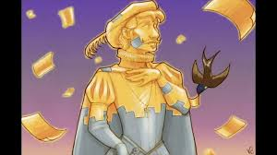
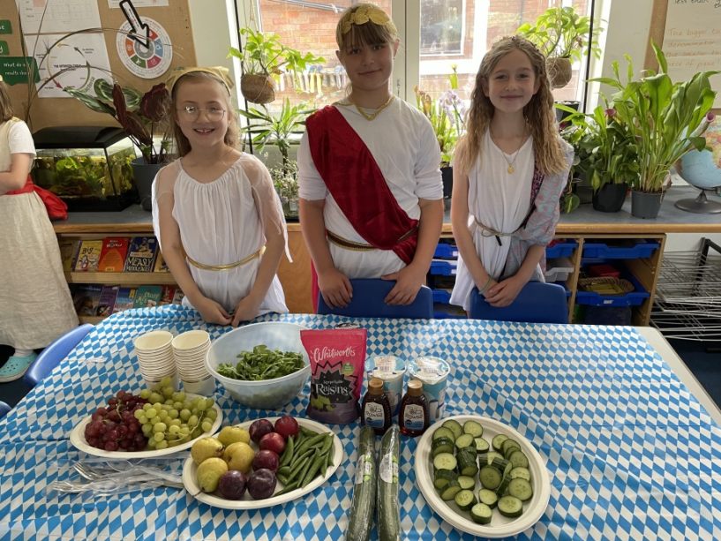
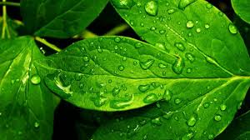
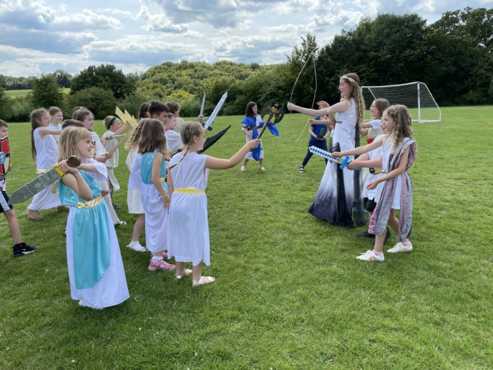
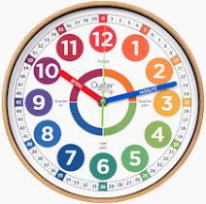
Year 3
We were EAGER TO MAKE A DIFFERENCE when we thought about how important it is to play our part in our democracy.
We have been SPIRITUAL when we have learnt about the story of the Happy Prince.
FRESH
We were FASCINATED when we did a scientific enquiry into transpiration.
We have been FASCINATED learning about Ancient Greece: things like the story of Theseus and the Minotaur, and all about the ancient Olympics.
We were very FASCINATED learners on Ancient Greek Day. We were ROUNDED when we thought about how our prayers are different from ancient prayers.
We have had HIGH ASPIRATIONS
when we have been learning to tell the time in Maths.

Slide 7
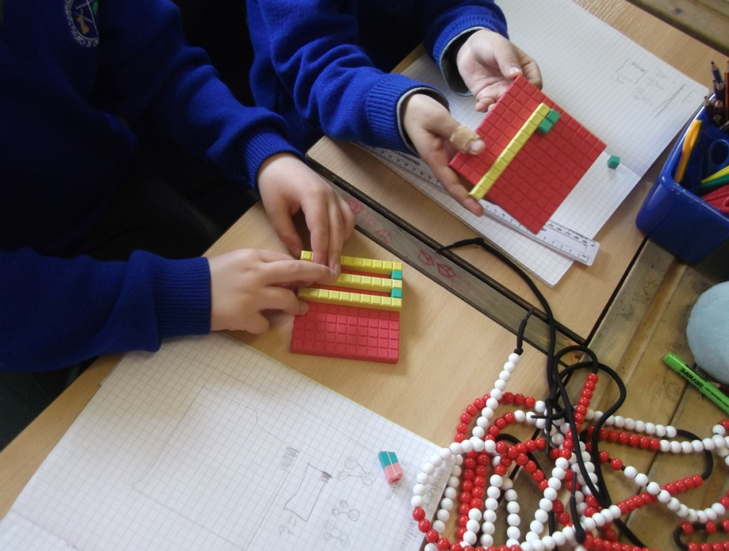
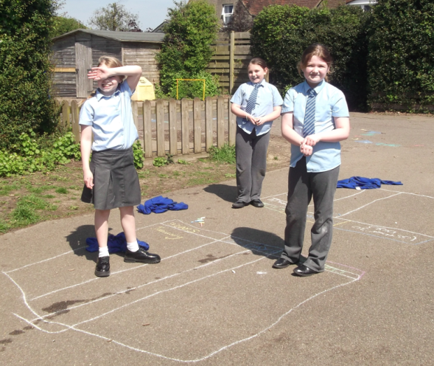
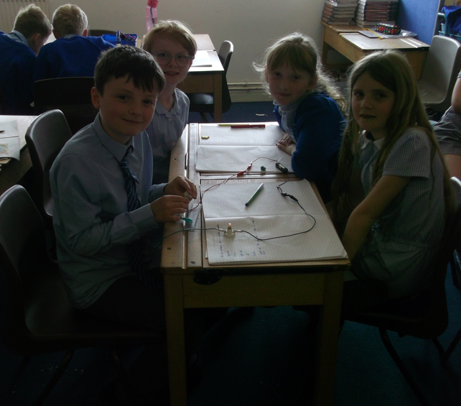
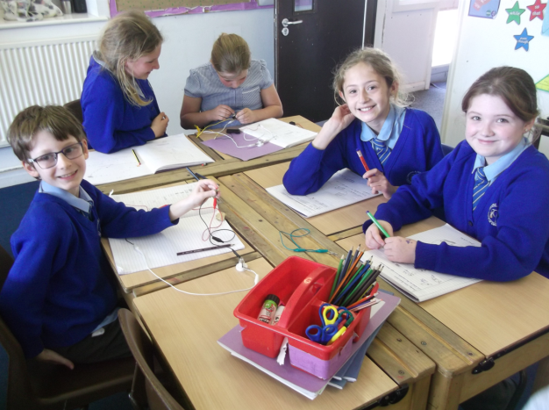
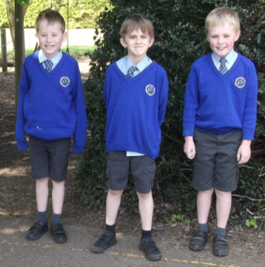
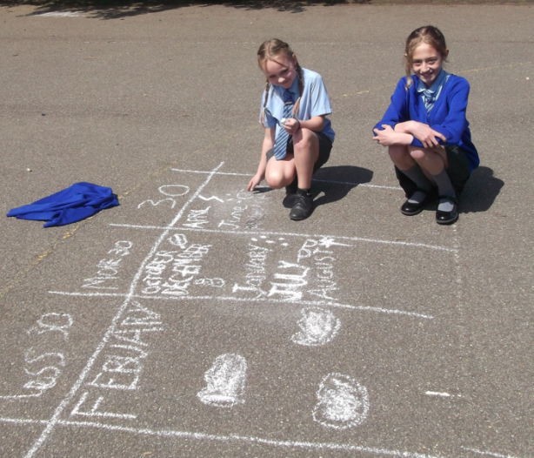
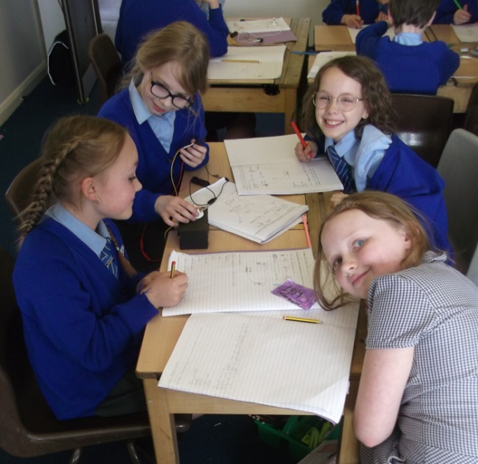
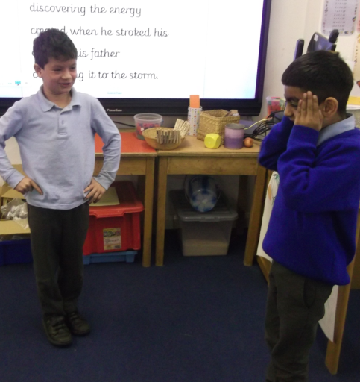
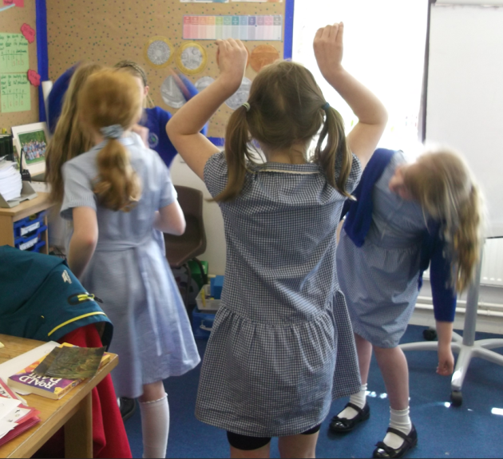
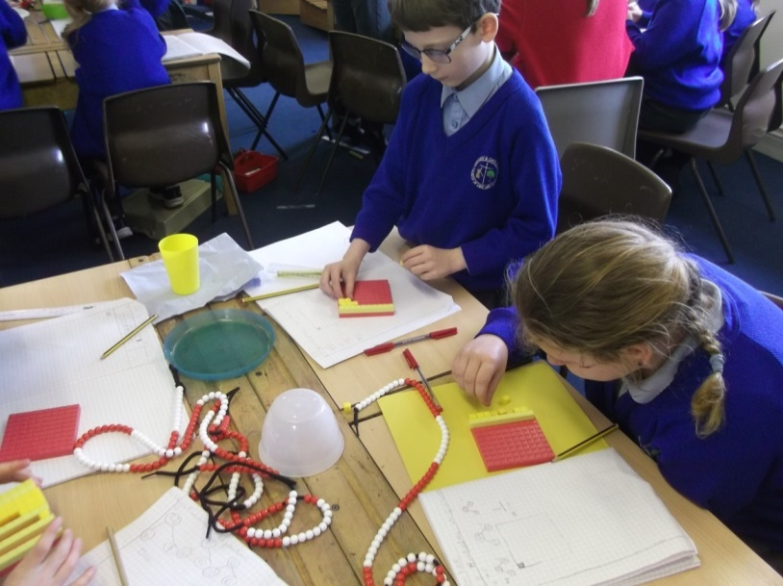
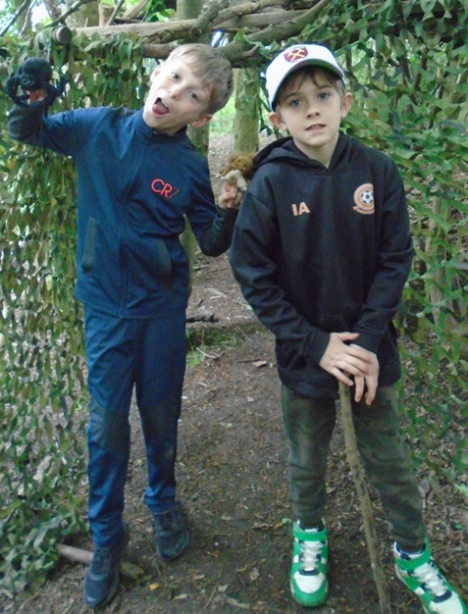
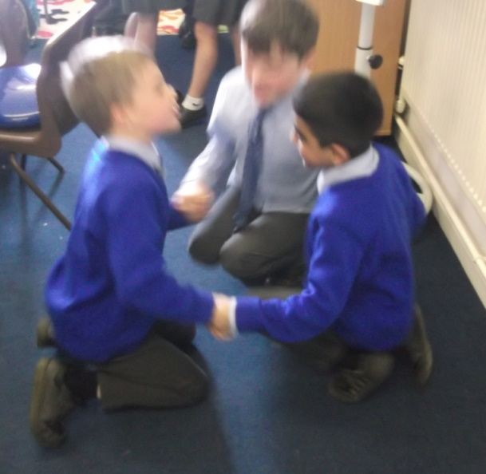
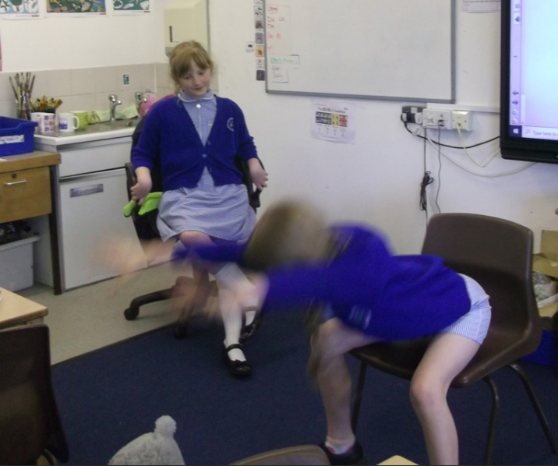
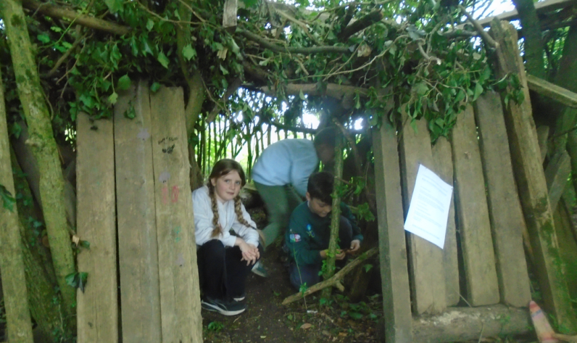
Year 4
We have had high aspirations in science making circuits
Year 4 have had high aspirations learning about decimals
Year 4 have been spiritual at Forest School
We have been fascinated by Nikola Tesla

Slide 8
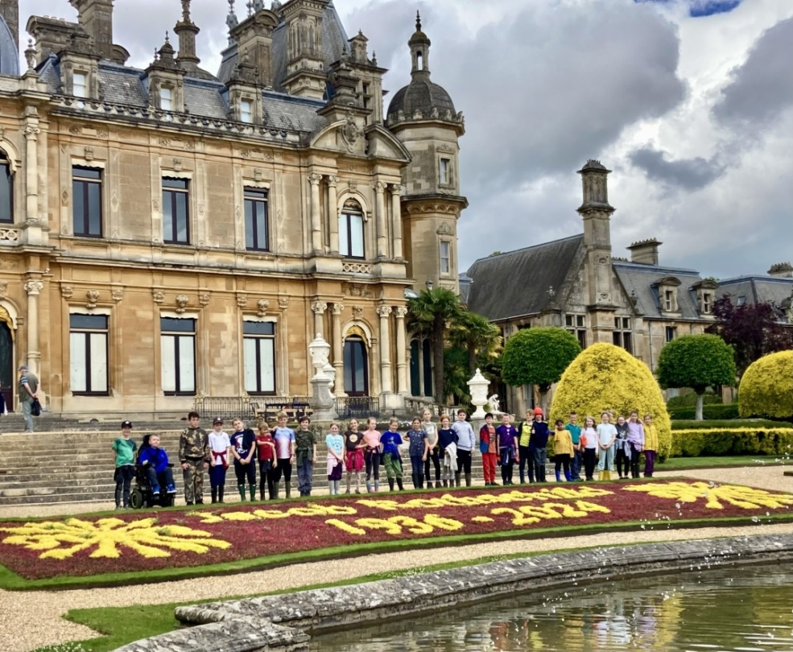
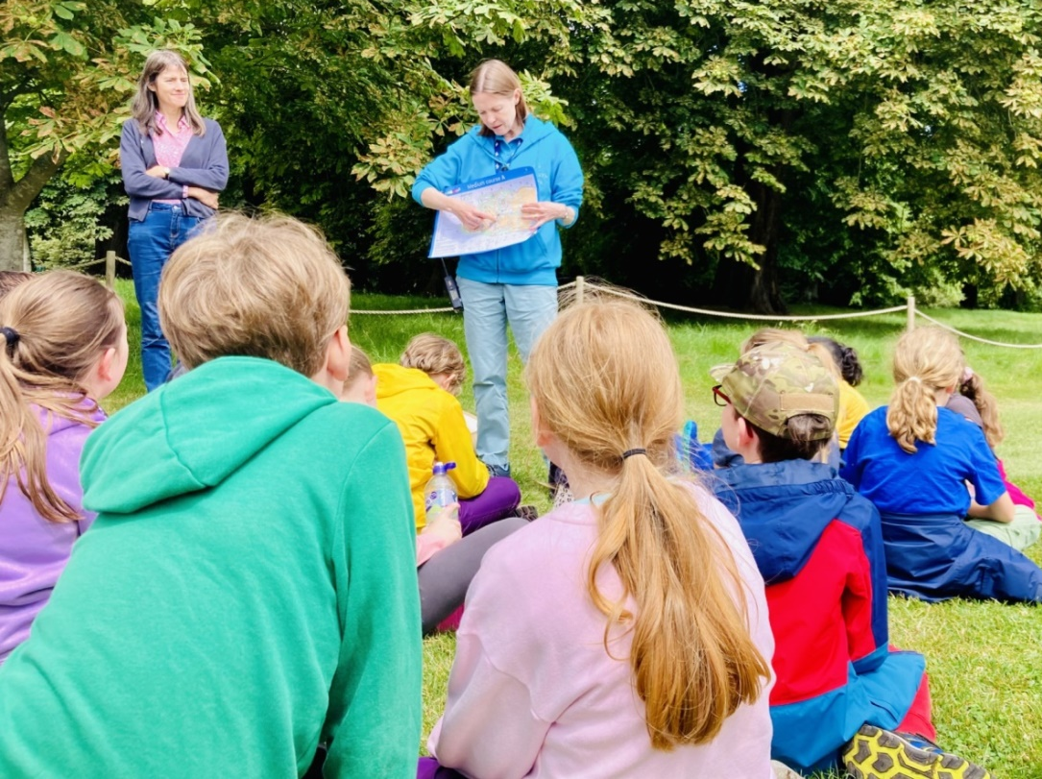
At Waddesdon Manor we didn’t get lost at the ‘Don’t Get Lost’ workshop! We showed great team work when we read each others’ maps. We showed respect to the staff at Waddesdon Manor who helped us (Mia)
Year 5
We learnt new skills at swimming becoming more rounded swimmers. We had high aspirations by trying our best to show the correct technique. (Keiran )
In RE, we have learnt about Pentecost and Jesus’ disciples and we became more rounded learners by understanding different religions. (Seb)
We had a spiritual experience at forest school by greeting the woodland and making dens. We had high aspirations by making ladders for squirrels and making our own bread. (Harry)
In English this term, we have learnt about the difficulties we face from plastic pollution and how it affects the ocean life and land all around the world. We were eager to make a difference to the wellbeing of our planet so we created a persuasive speech about our concerns which we can read out now! (Teigan)
In Geography, we have been fascinated by lots of new countries in Africa that we haven’t heard of before, for example: Zimbabwe and Nigeria. (Annabelle)

Slide 9
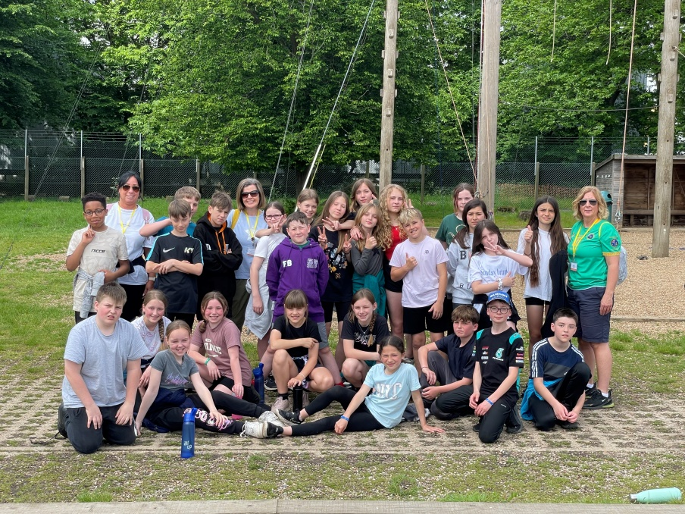
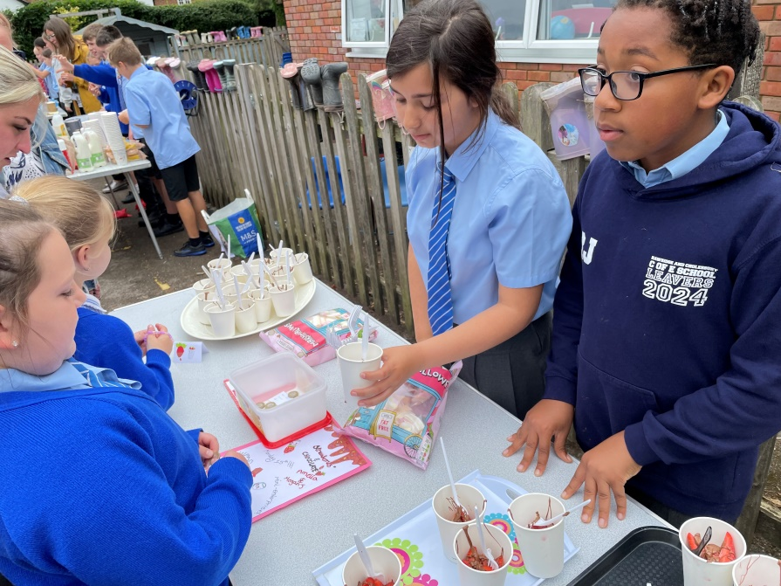
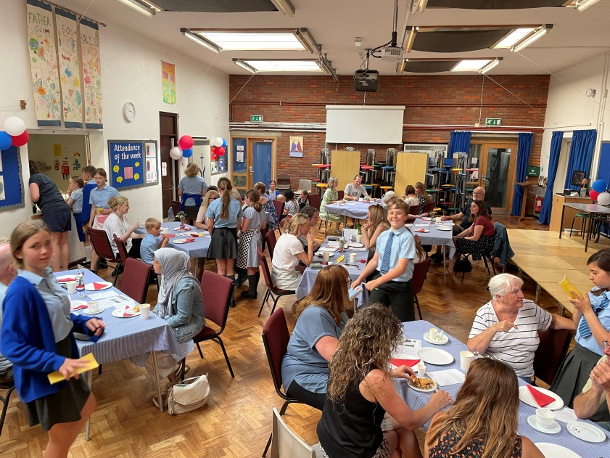
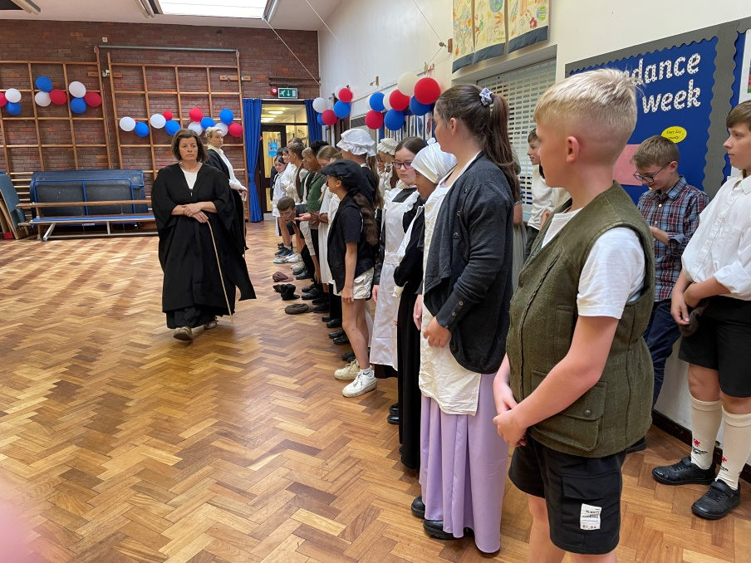
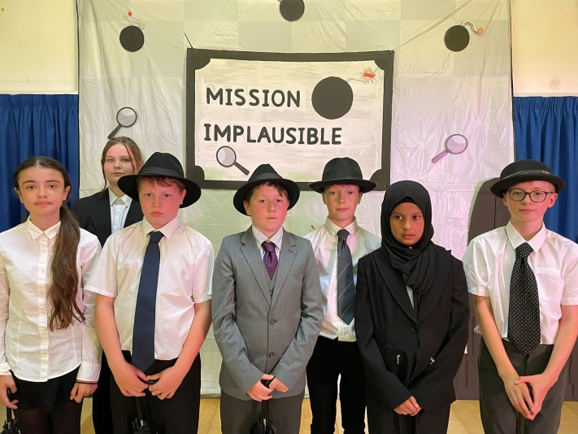
Year 6
Fascinated to learn about Victorian life
Rounded when learning about French culture in our French café
Eager to make a difference in Mini Enterprise stalls
Spiritual when singing songs for our Leaver’s service
Have high aspirations to achieve the wonderful production of Mission Implausible.

