Slide 1
Wraparound Care Parent Survey
July 2024
83 responses to the survey from classes going into R-Y6 in September 2024 (represented by larger charts)
13 responses to the survey from our Y6 leavers (represented by smaller charts)
Current number of families inc. new intake around 117

Slide 2
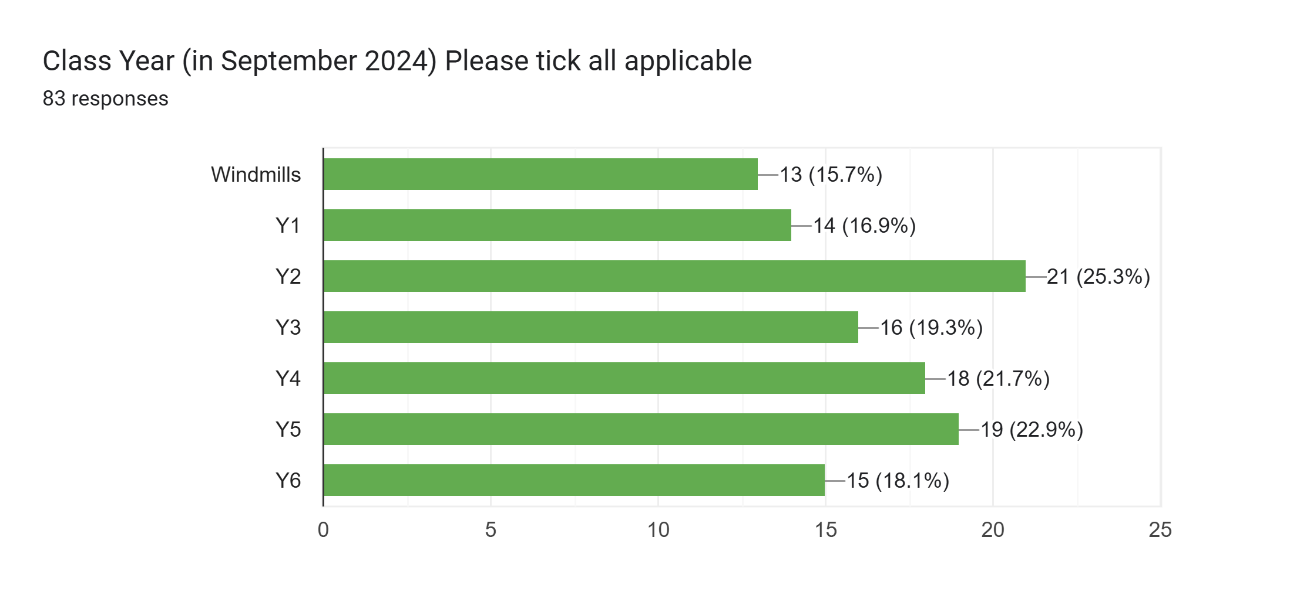
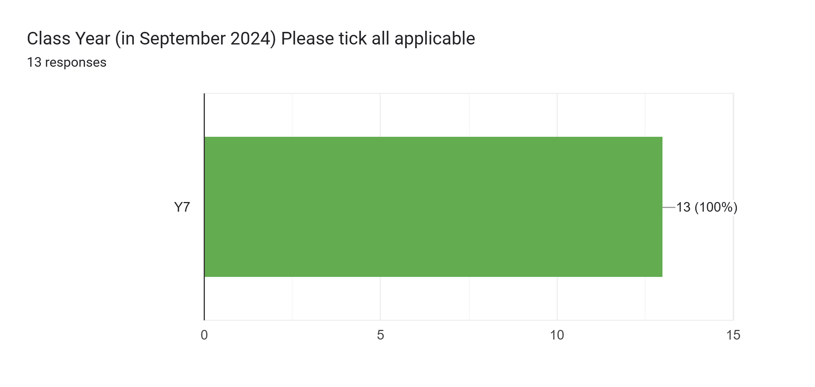
Response by Class (for September 2024)

Slide 3

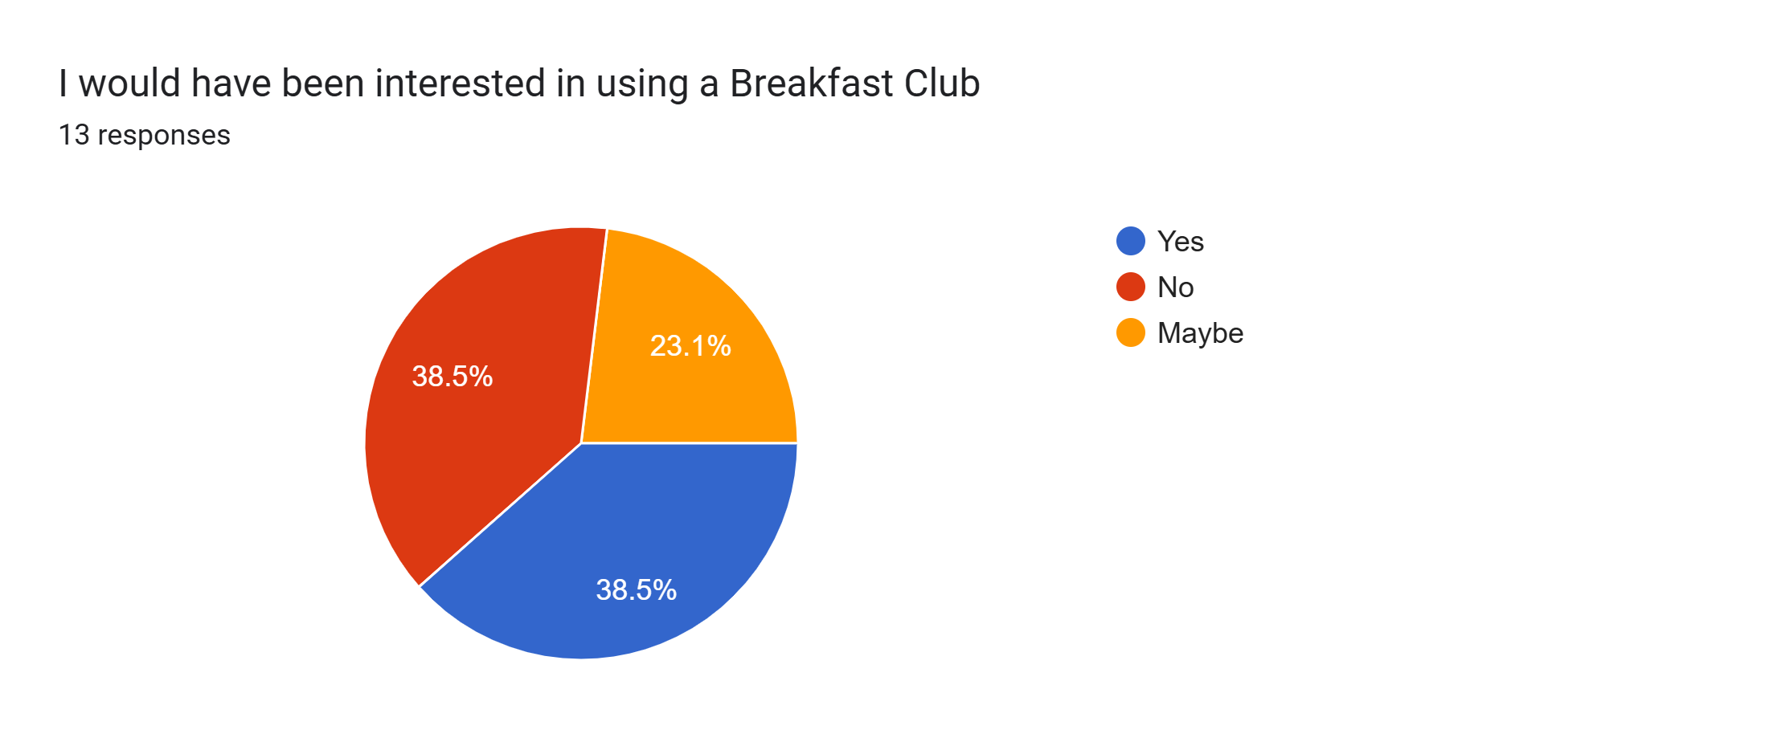

Slide 4
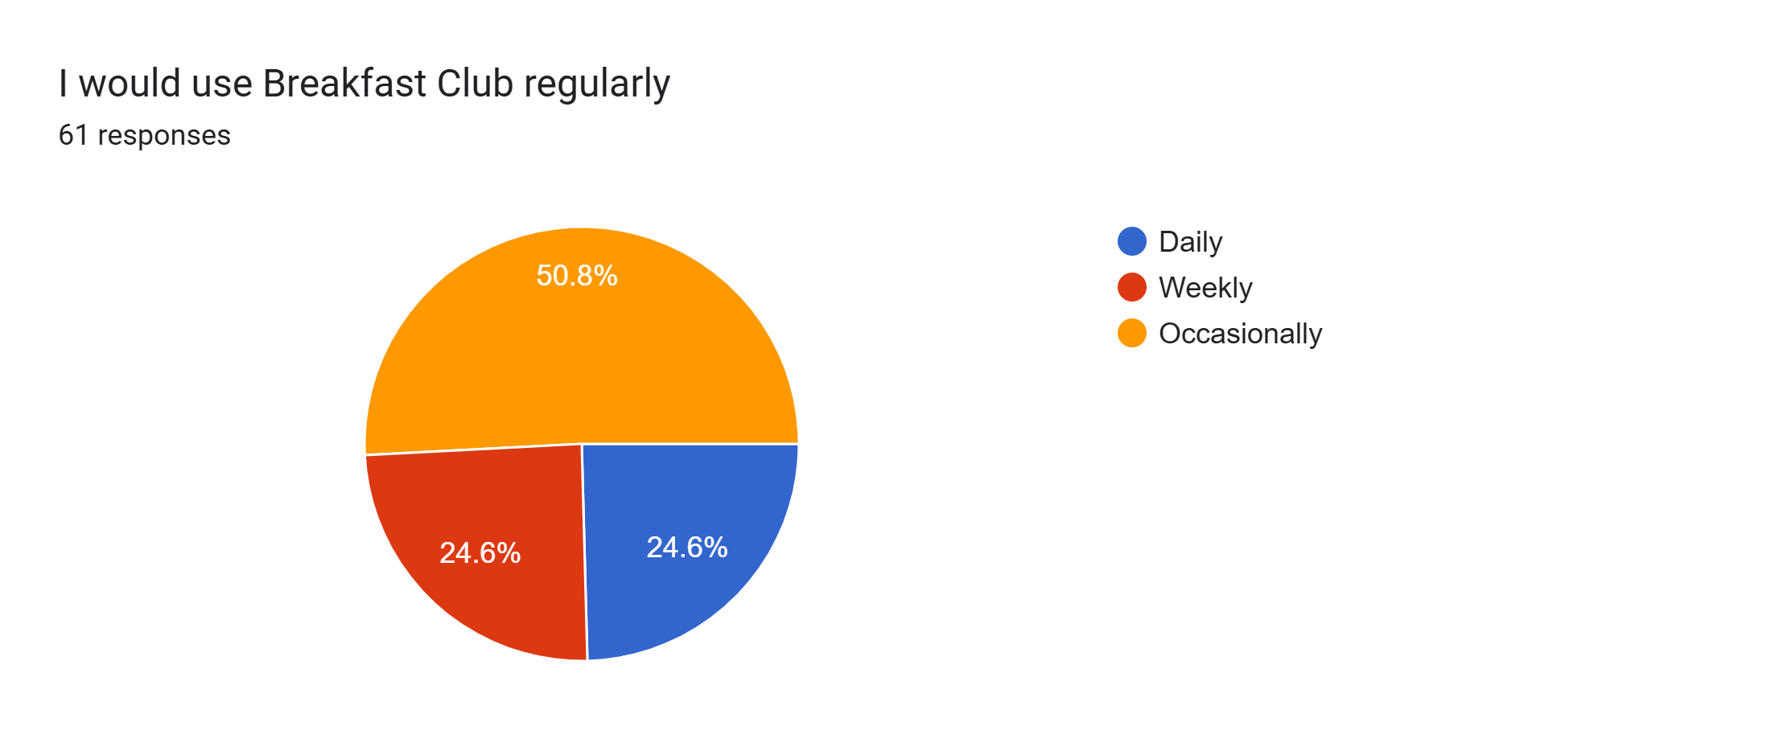
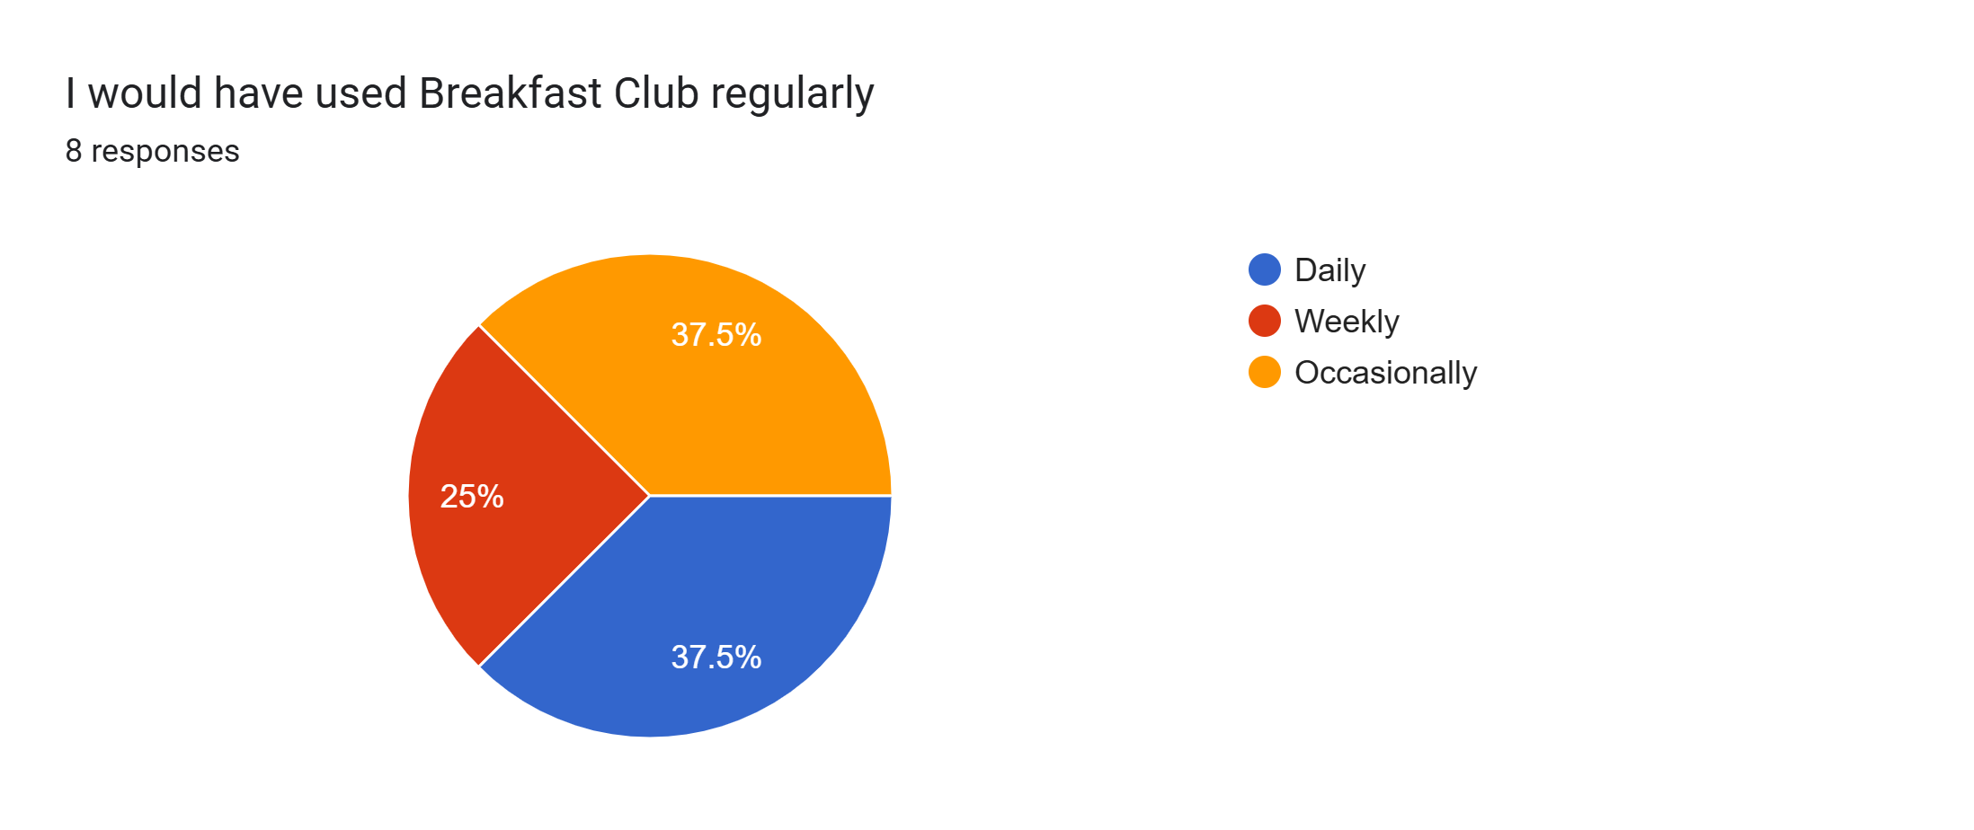

Slide 5



Slide 6
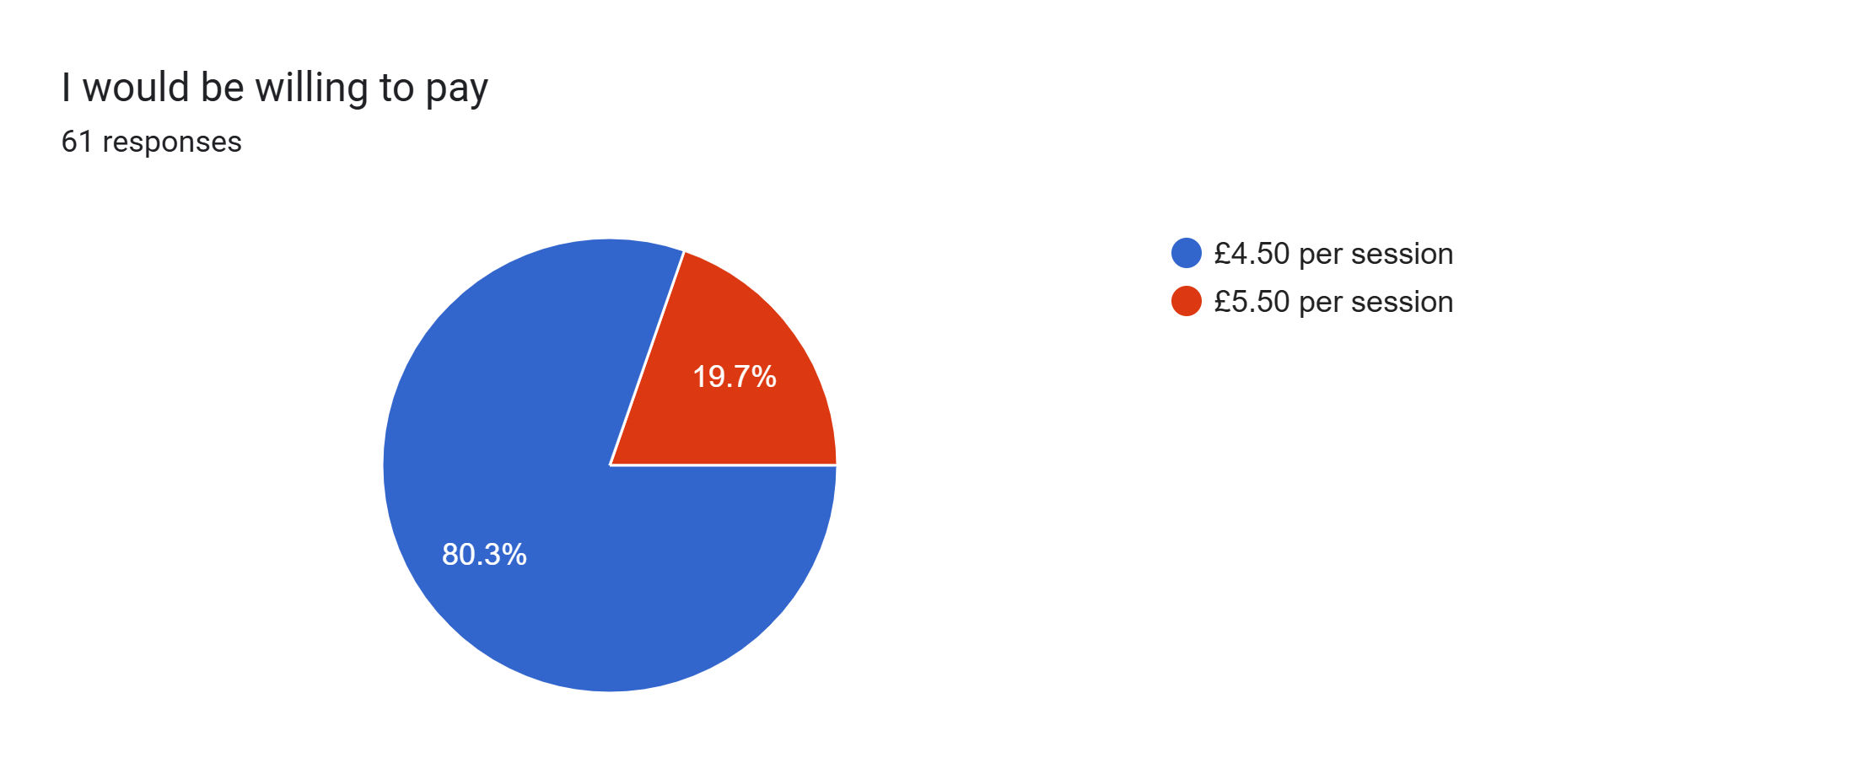
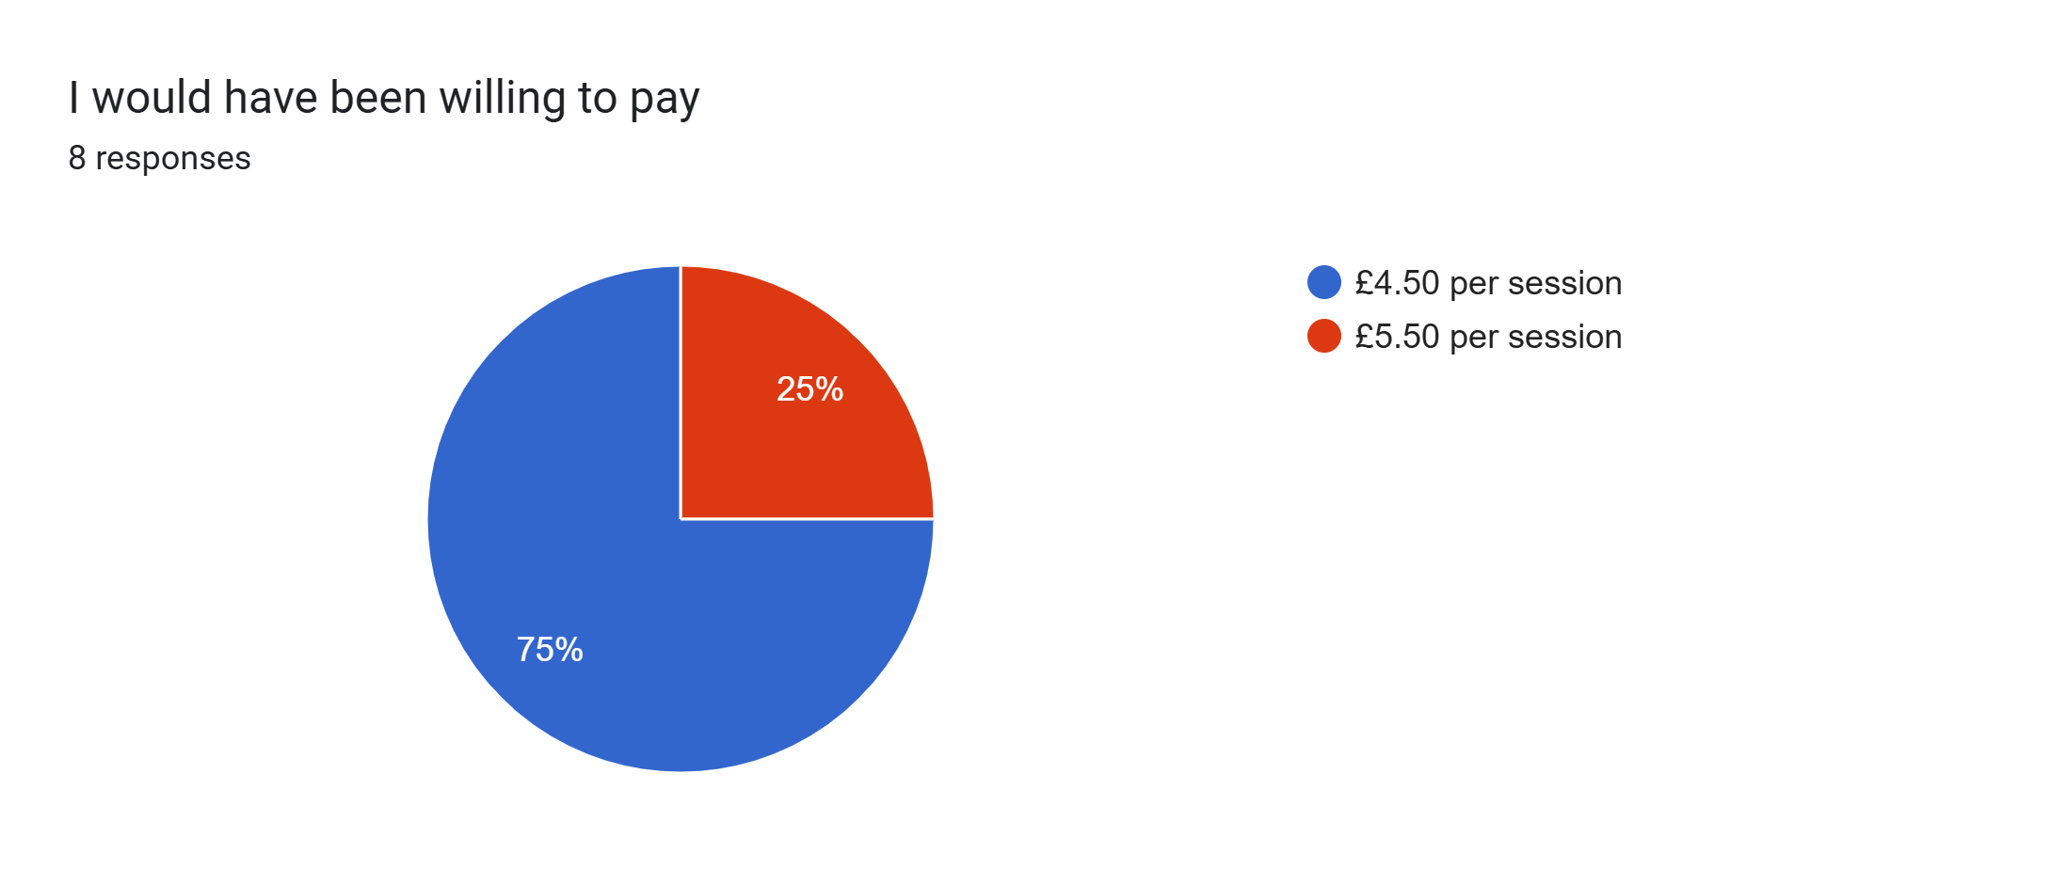

Slide 7
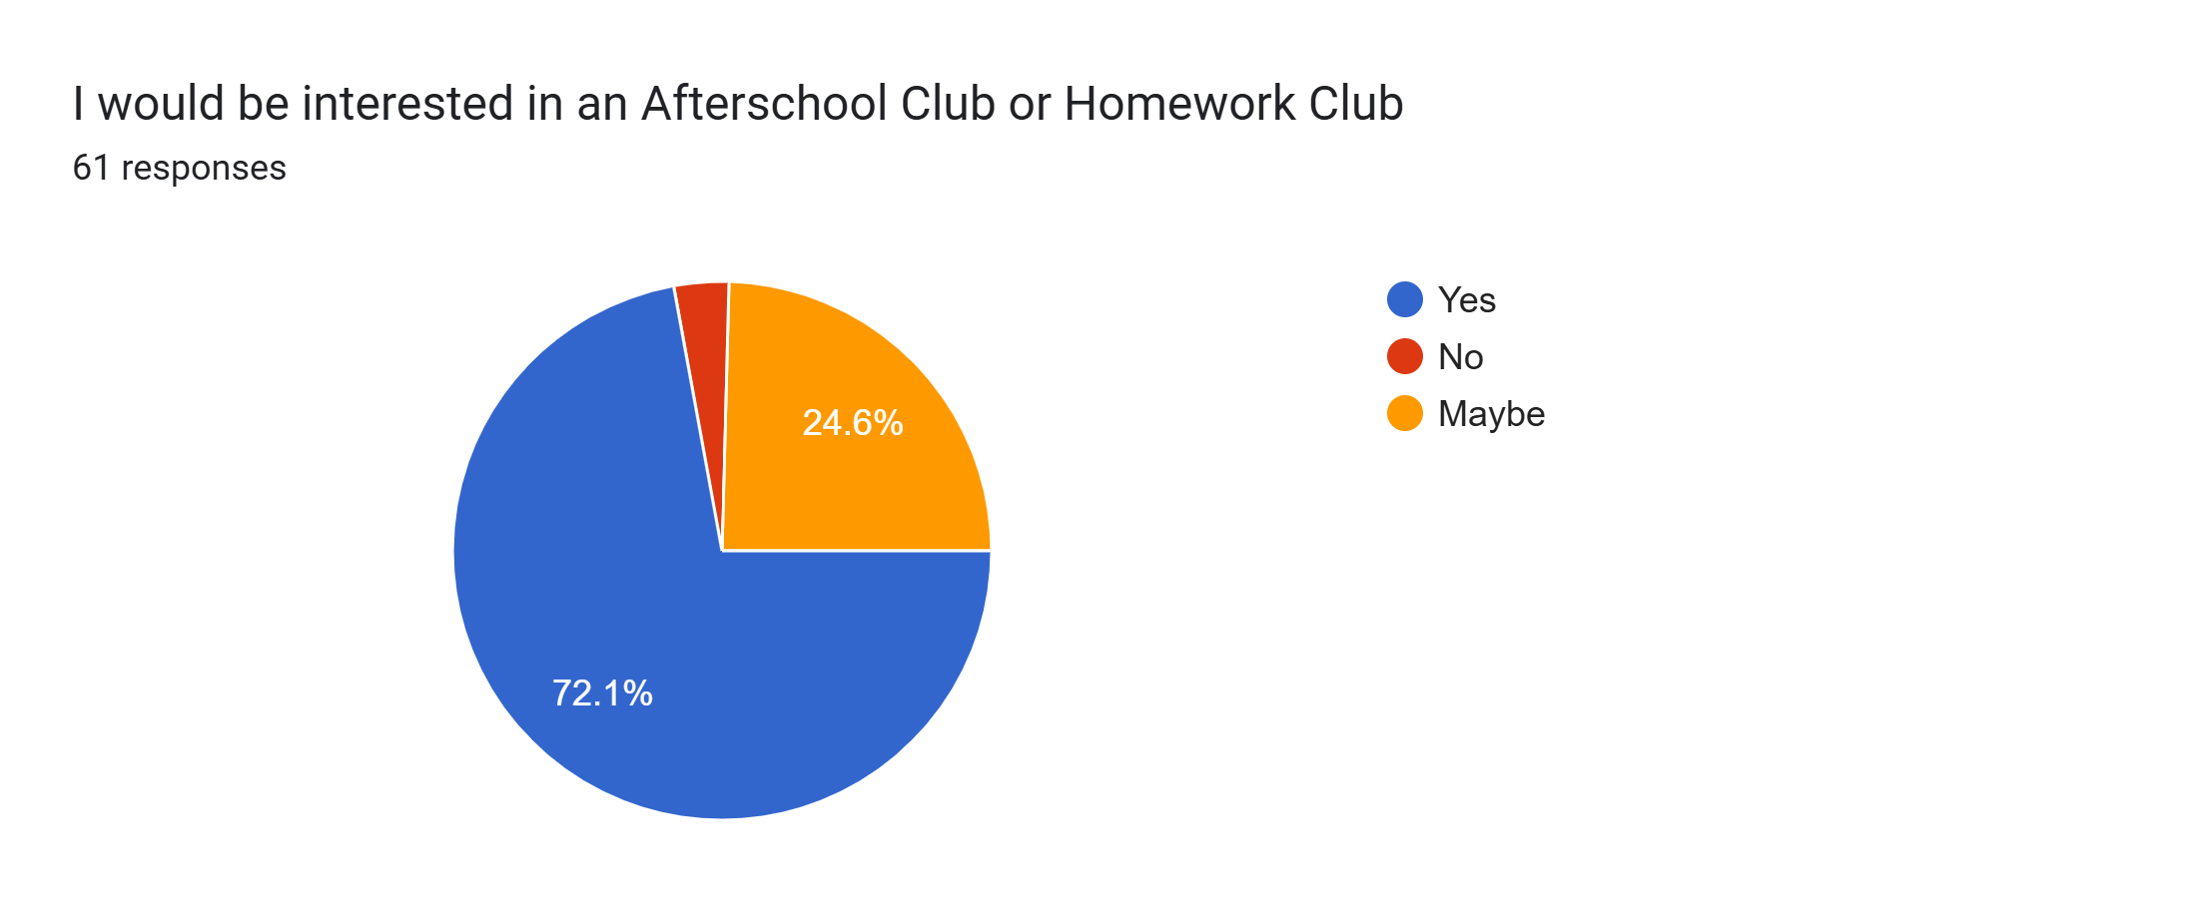
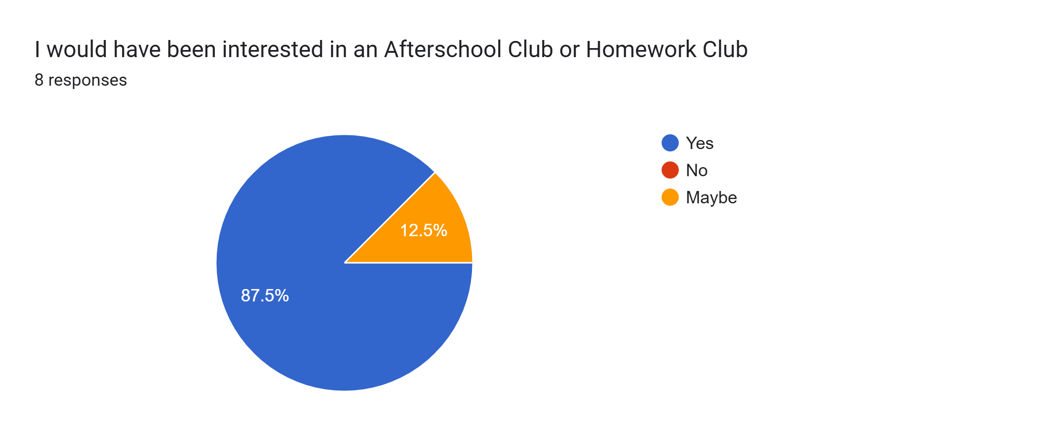

Slide 8
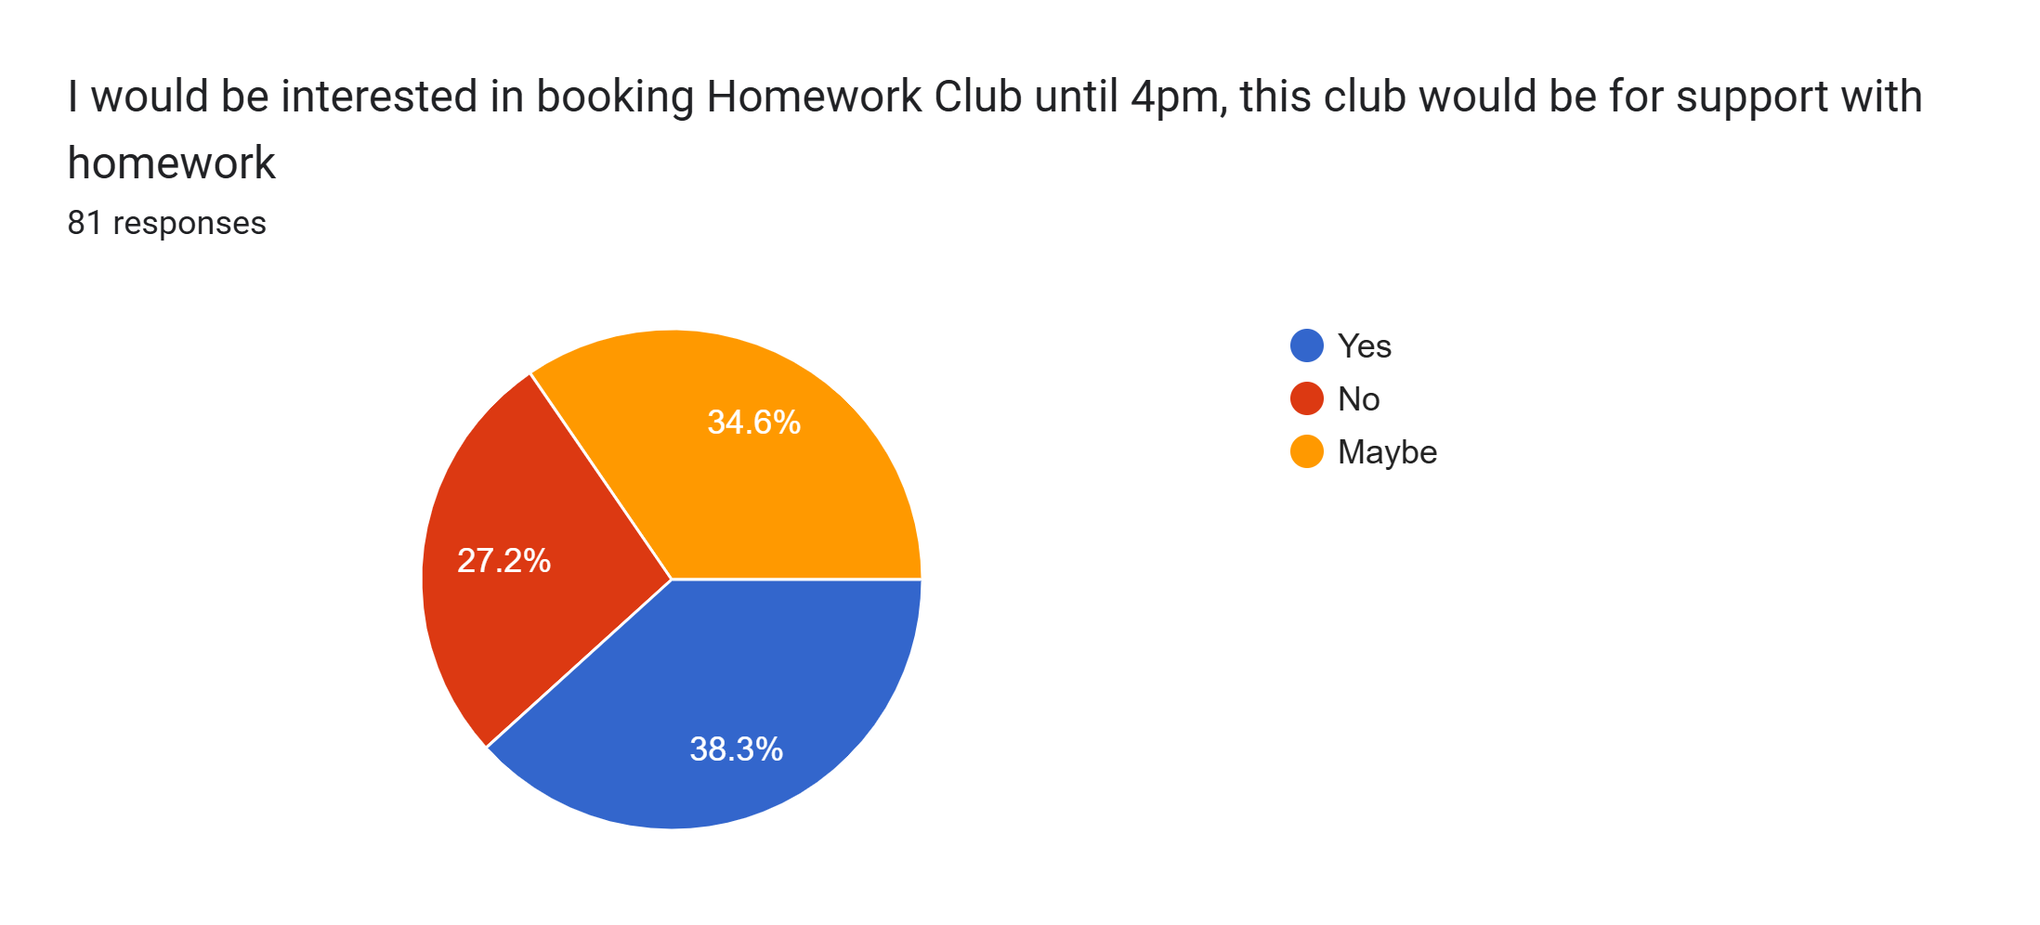
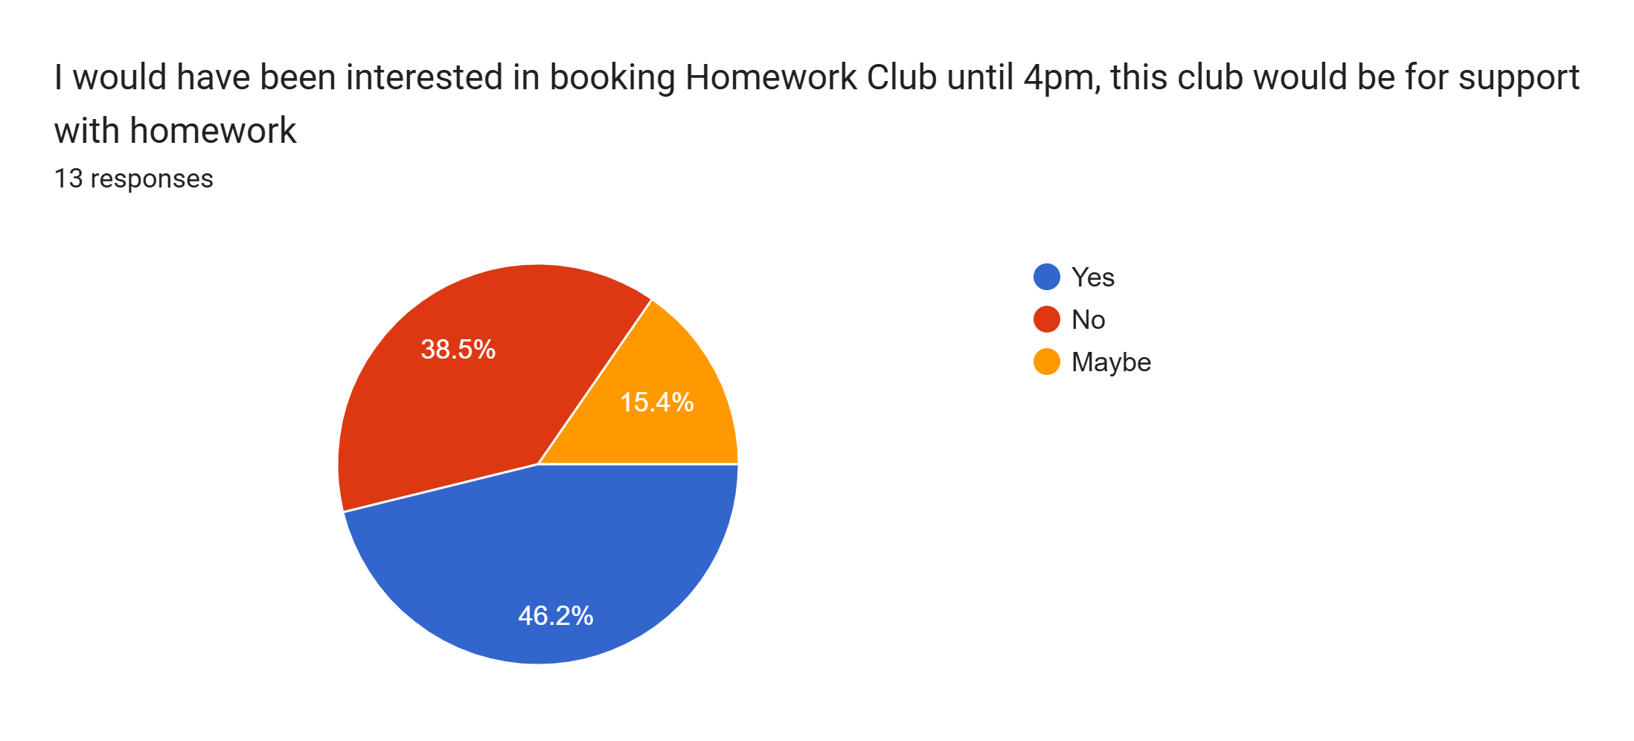

Slide 9
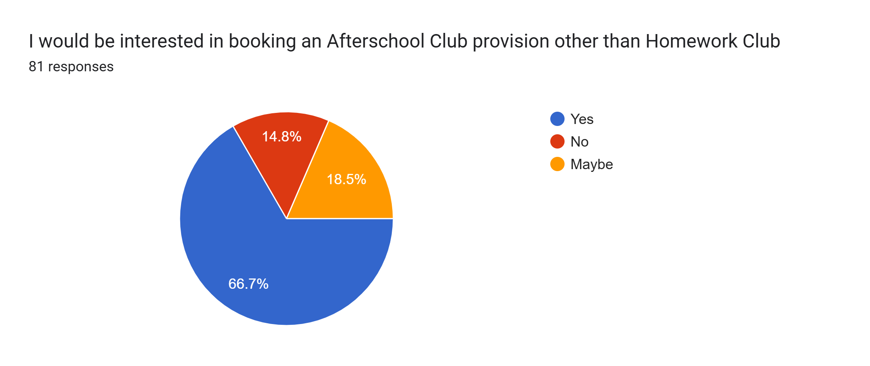
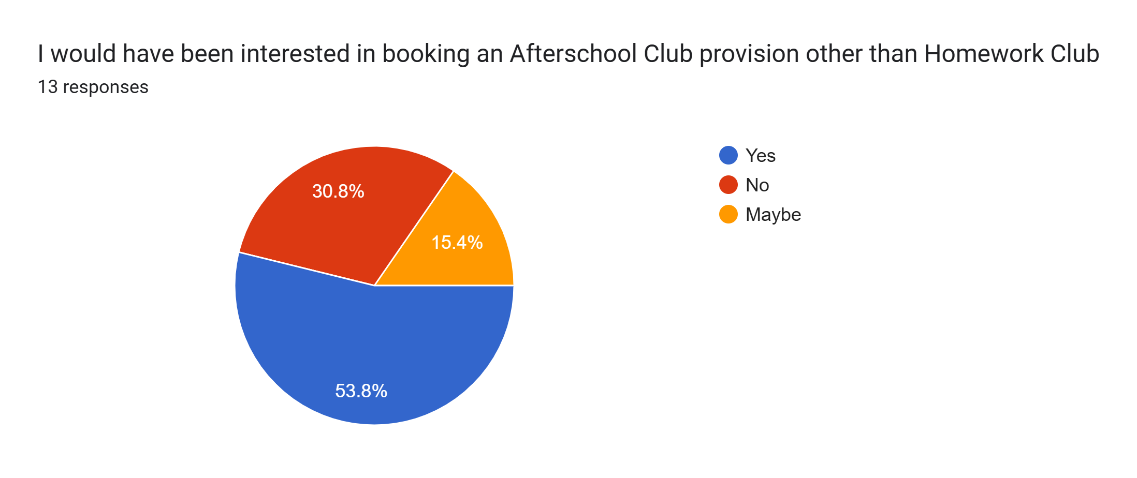

Slide 10
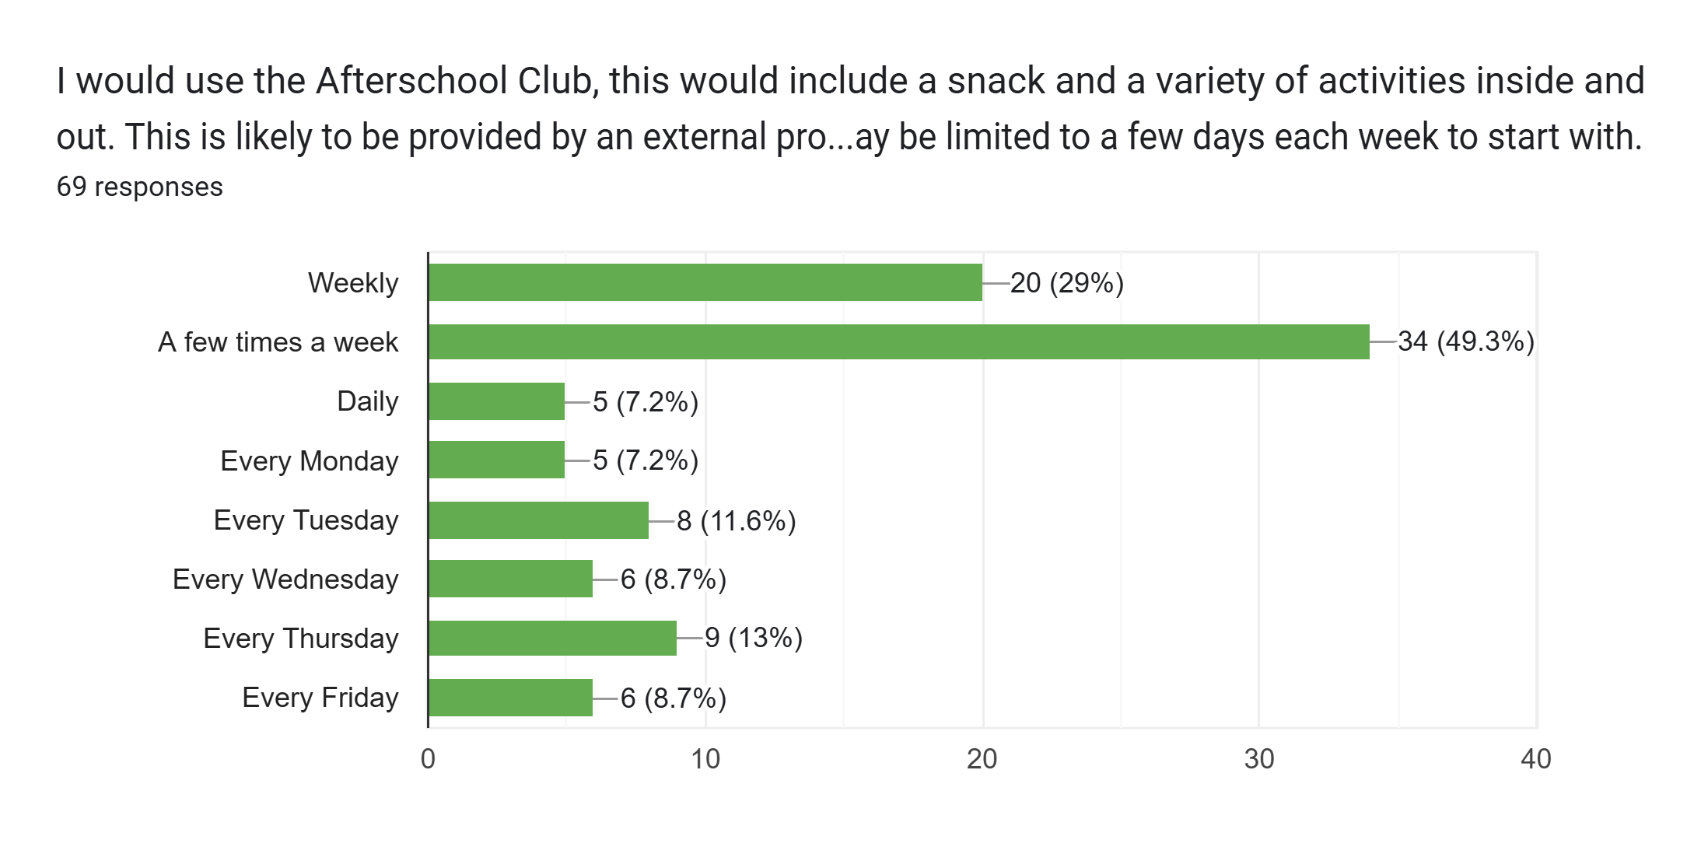
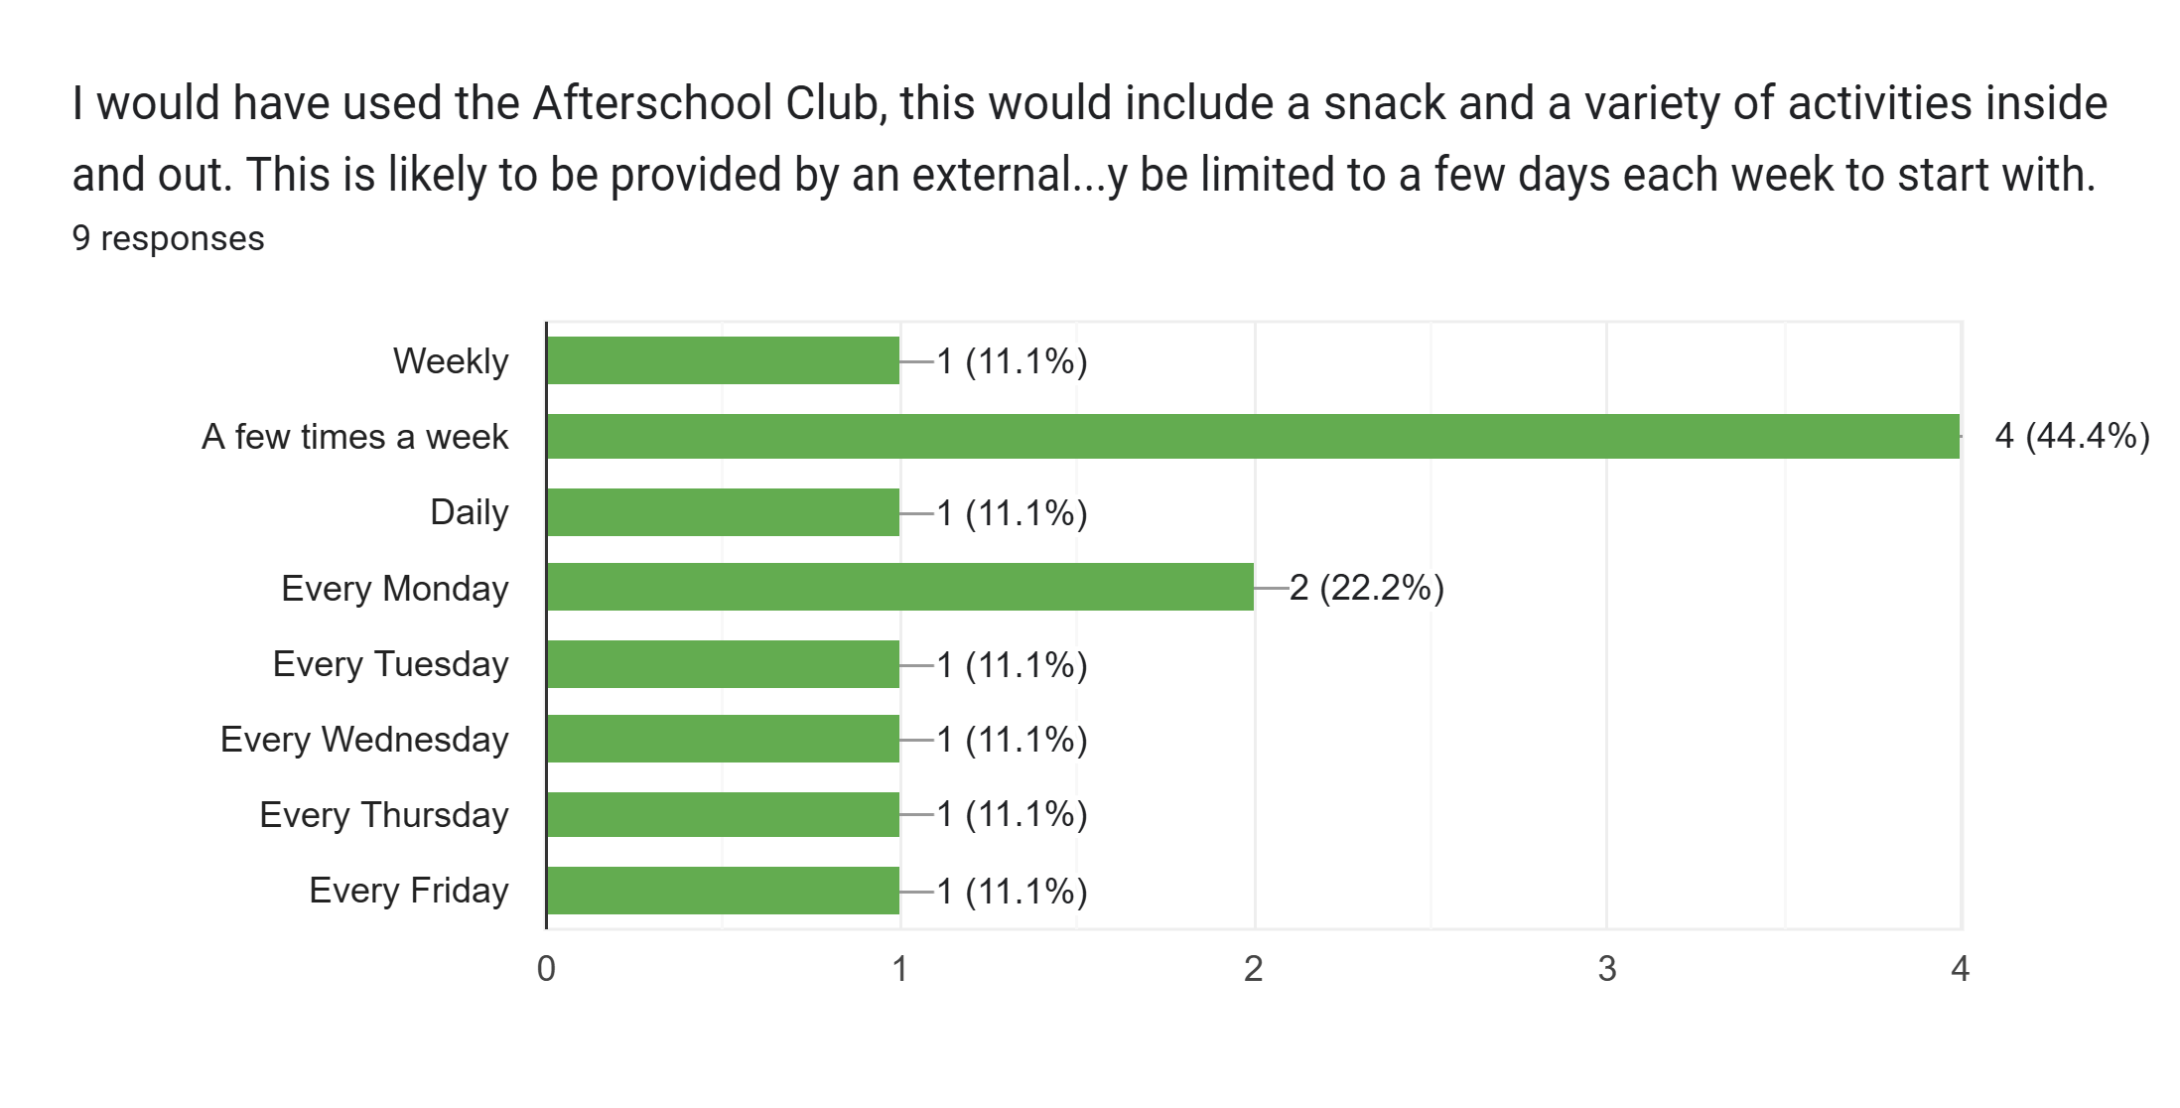

Slide 11
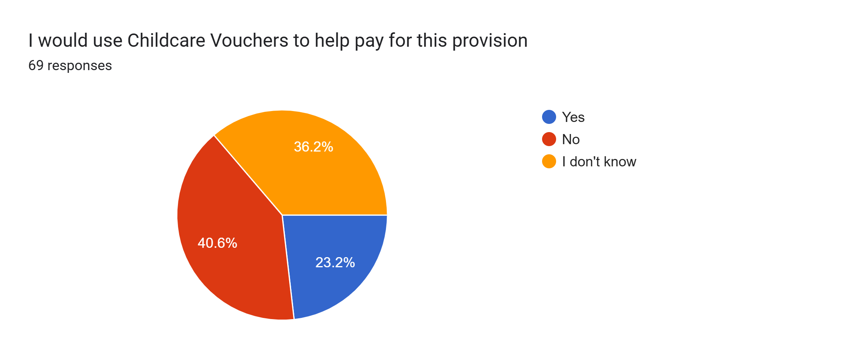
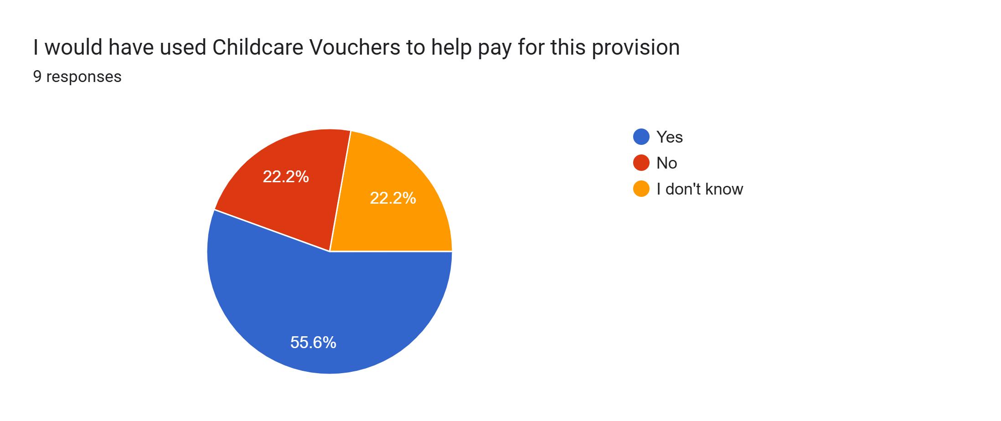

Slide 12
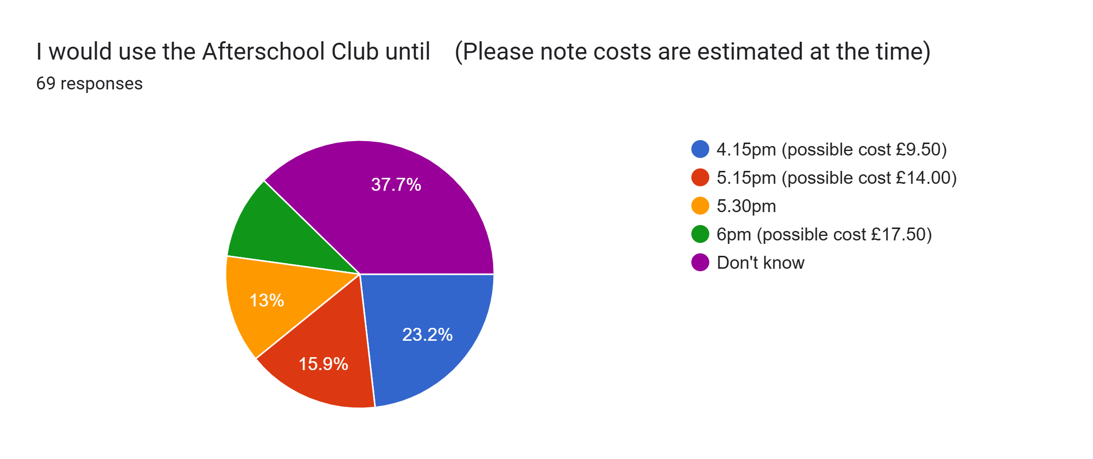
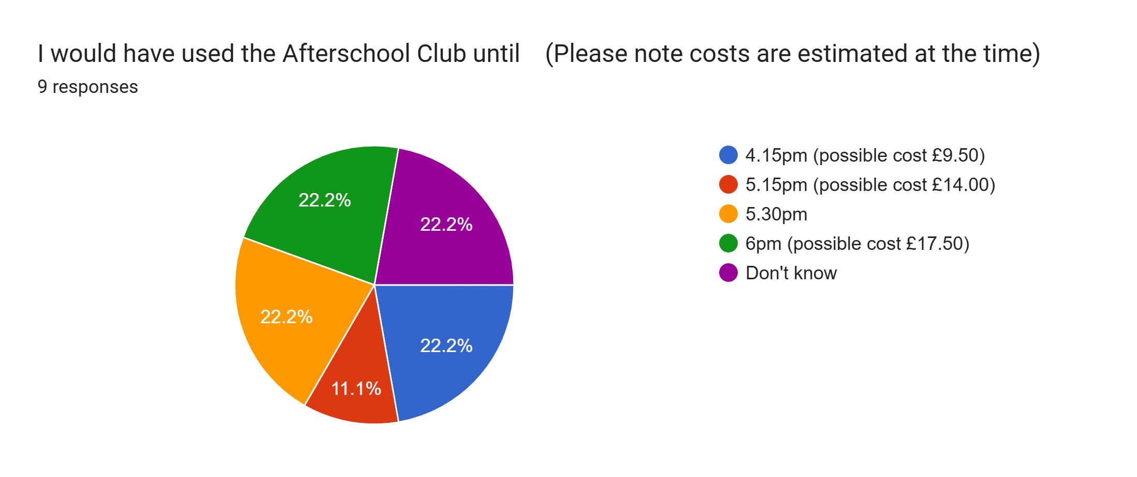

Slide 13
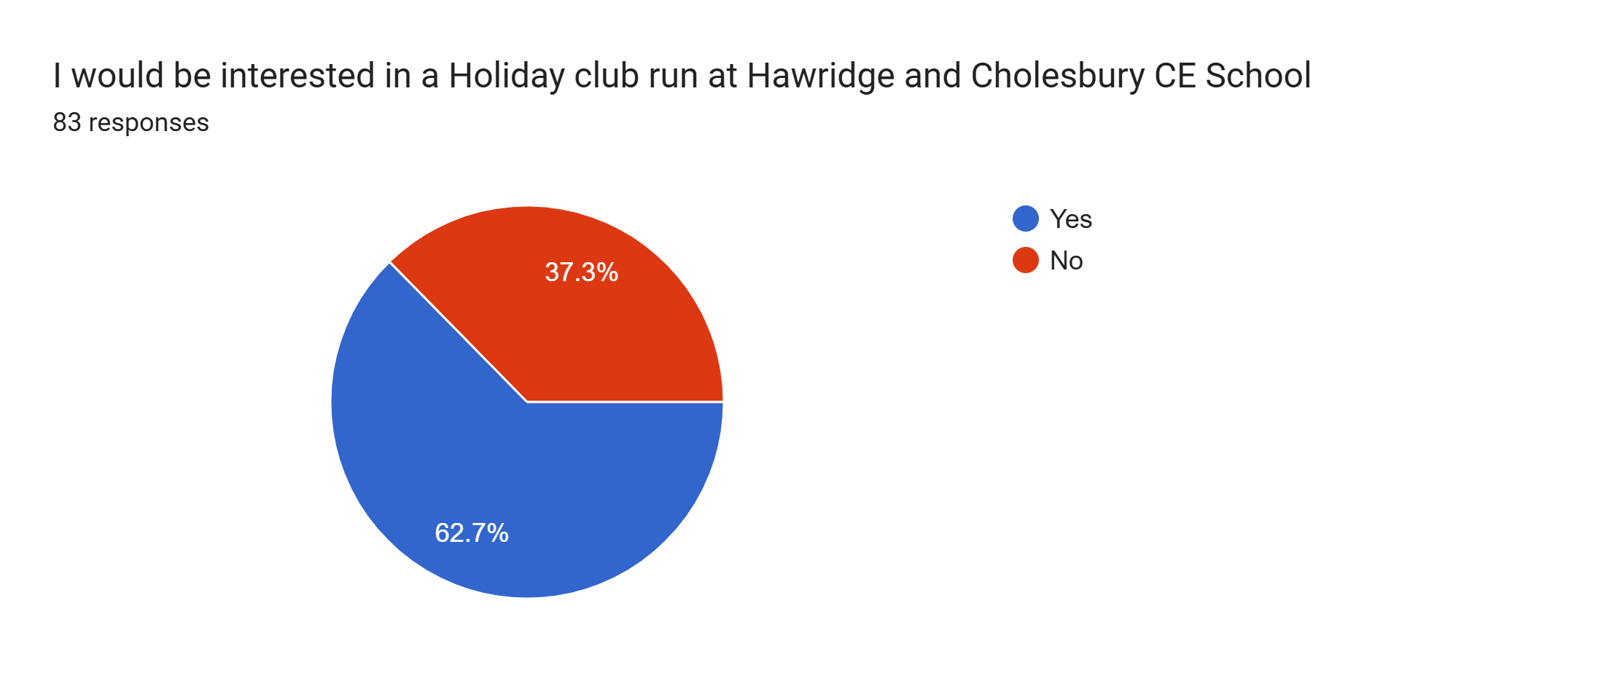
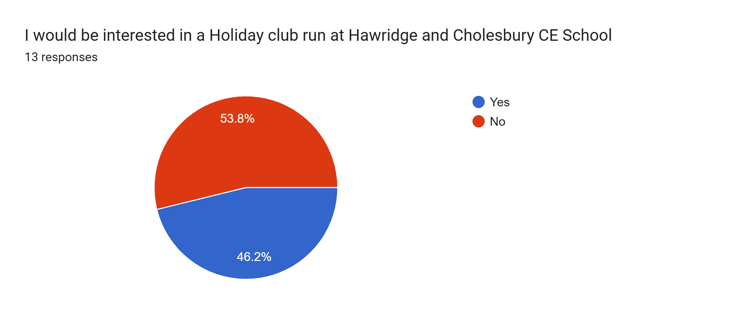

Slide 14
Any other comments
Some clubs with activities would be welcome, sports, crafts etc
I am very interested in this but i cannot give a full 100% commitment at this point
I’m a full time working mum and I really struggle to jungle my life with the current lack of wrap around the school offers when most schools in Chesham all offer something The afterschool sessions would be so good and if they had Lego club and different activities each day
This would depend on whether I decided to work full time but great to have the option to increase work hours - thanks
This would massively help us out as my working hours are 8am-5pm and it costs a lot of money trying to juggle childcare and do school runs or relying on people
It would be nice to see more variety in after-school clubs like drama & dance for little ones
I’m freelance so may well have additional requirements on top of the days suggested
The current club is really great and proving to be very educational.
Would like more information regarding, cost, time and activities that my child would be doing whilst at wraparound care before making a decision
Great idea!

Slide 15
Current homework club days for us is currently dependent on other clubs running so we have used this on the days needed where there are no clubs that the children do. Thank you for considering the wrap around options for the school.
More after club activity welcome like sports and crafts
Would love a holiday club at Hawridge and Cholesbury as they’d be in a familiar setting with people they know. The same with breakfast or after school club.
If homework club continues, I would be interested in an alternative after school club only on an occasional basis if it were possible to book only when needed, but will probably still need either homework club or after school club daily. Breakfast club is not something I would expect to need on a regular basis, but if it existed, it would be good to be able to book it for the occasional emergency. However, due to an impending change of circumstances all of my answers are subject to change at the moment.
Homework club would.like to be until 4.15/4.30
This would be fantastic if this was provided.
More info needed in what holiday club would offer.
We find it very hard to plan childcare in advance due to the nature of our work and both being self employed. It would be great to have options for after school clubs which the children would enjoy but both in the same days for KS1 & KS2.
Year round or termly after school clubs providing netball/football/rugby training or singing/music/art would really help with children’s morale and performance when taking part in leagues and competitions and other events rather than starting up training near to the event. At some other schools I have encountered all teachers have to run a club/activity as part of their working week.

