Slide 1
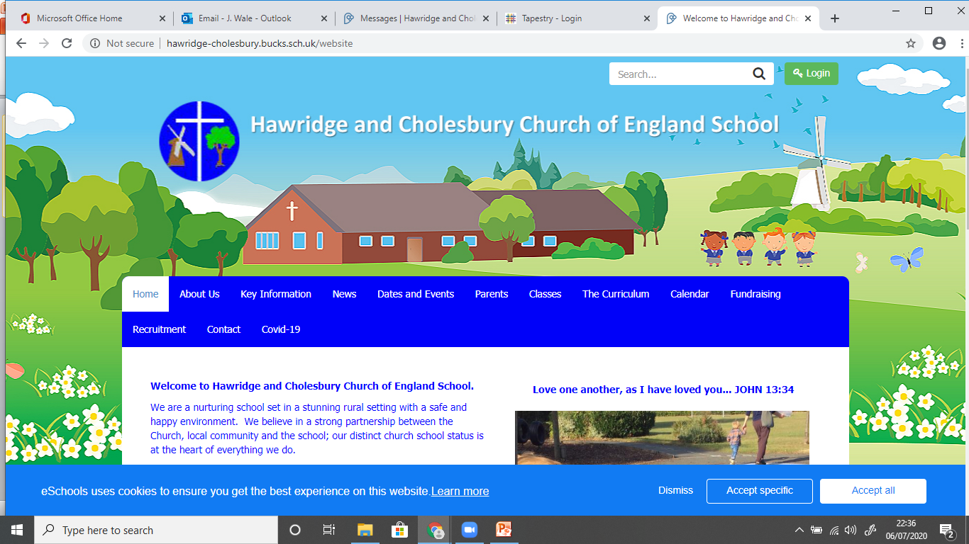
Welcome to Windmills Class
New Entrants Information for Parents

Slide 2

Early Years Staff
Mrs Rosie Phillips – Head teacher
Miss Muckell – Reception Teacher

Slide 3


School Vision

Slide 4

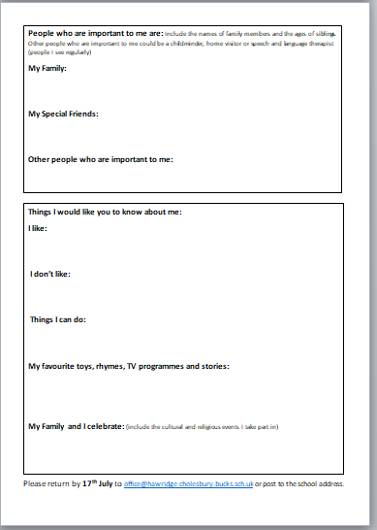
All about me

Slide 5
Settling in to School
Beginning of term arrangement for Windmills:
The school year begins on Thursday 3rd September 2026 at 8.35am. To support with transition, we are inviting our Windmills children to attend the morning from 8.35-1.15pm for the first two days of term (Thursday 3rd September and Friday 4th September). This will allow the children to experience lunch time and prepare them for their first full week of school. The children will be in school all day from Monday 7th September, starting at 8.35am and finishing at 3.15pm.

Slide 6


Separation Anxiety
Separation anxiety
‘Come and Play’ sessions
Hug button
Positive parents
Swift exit and teacher to hold child’s hand
If your child has specific separation anxiety issues please contact us to discuss

Slide 7
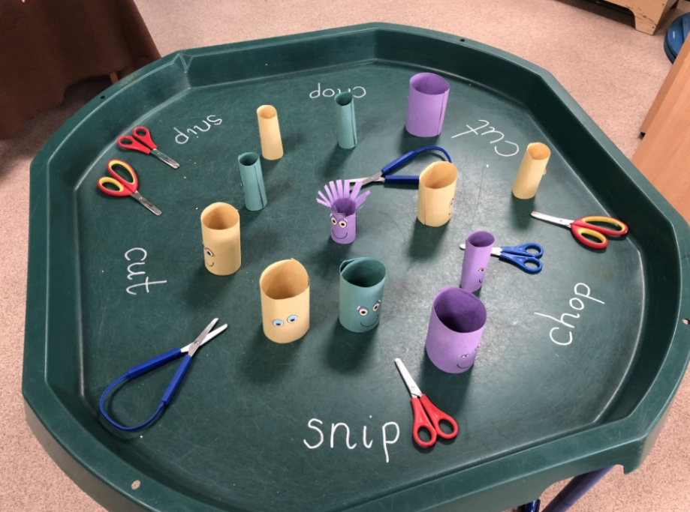
Beginning of the day
Put belongings away
Find name
Funky Fingers activities

Slide 8
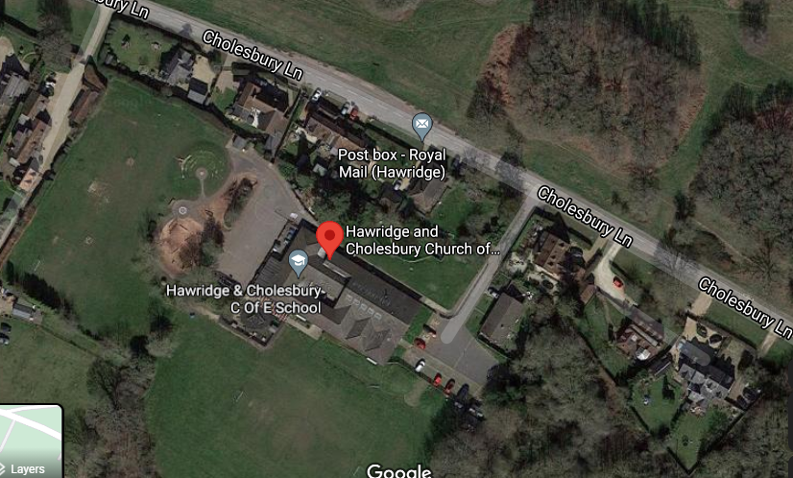
School Map
Parking – not in front of driveways

Slide 9
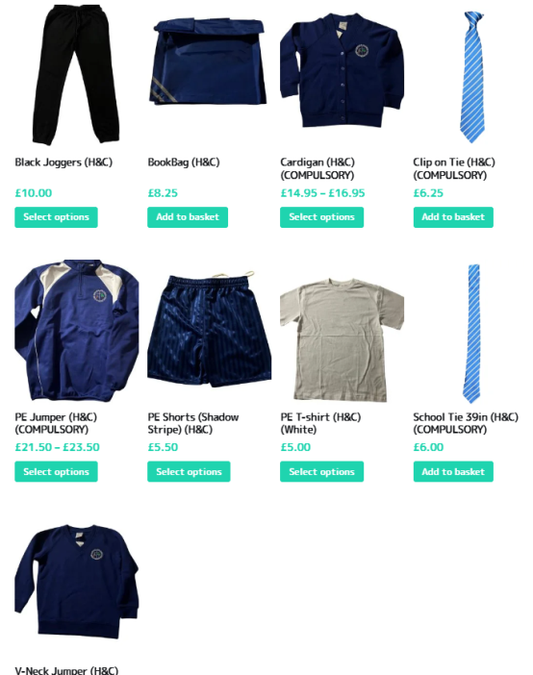

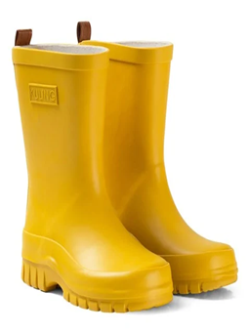


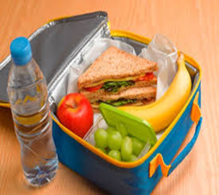

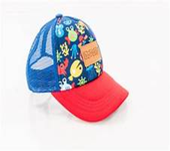

What your child will need
wellies
coat
Water
bottle
School Uniform
PE kit
Bag in school containing a change of clothes
Book bag
Sun cream already applied. Children can bring in a named bottle of sun cream to reapply at lunchtime. Please check it is nut oil free.
hat
Lunch box

Slide 10

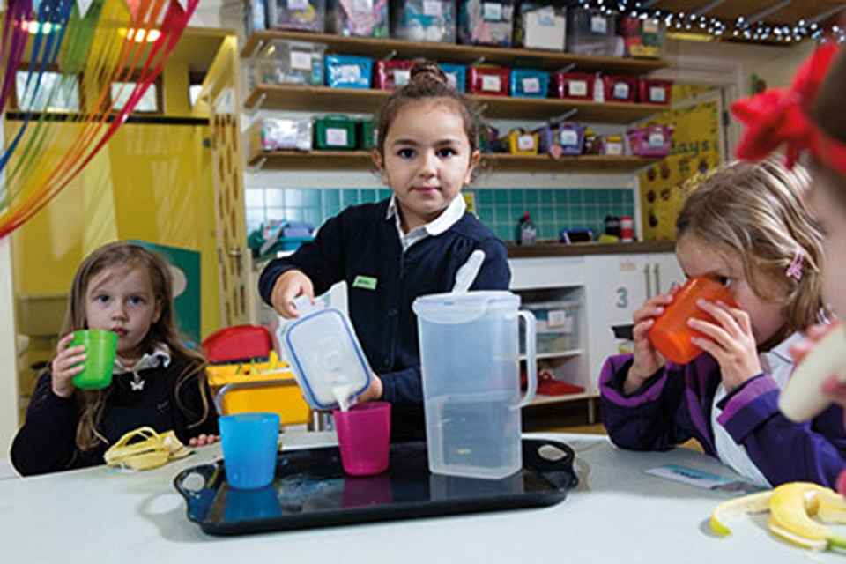
Fruit time and Lunchtime
Children are provided with fruit and milk. You may provide a piece of fruit in a container.
At lunchtime we will eat lunch in the hall or have a picnic outside. All children are entitled to free school lunches from Reception – Year 2. You will receive an email about how to order.

Slide 11
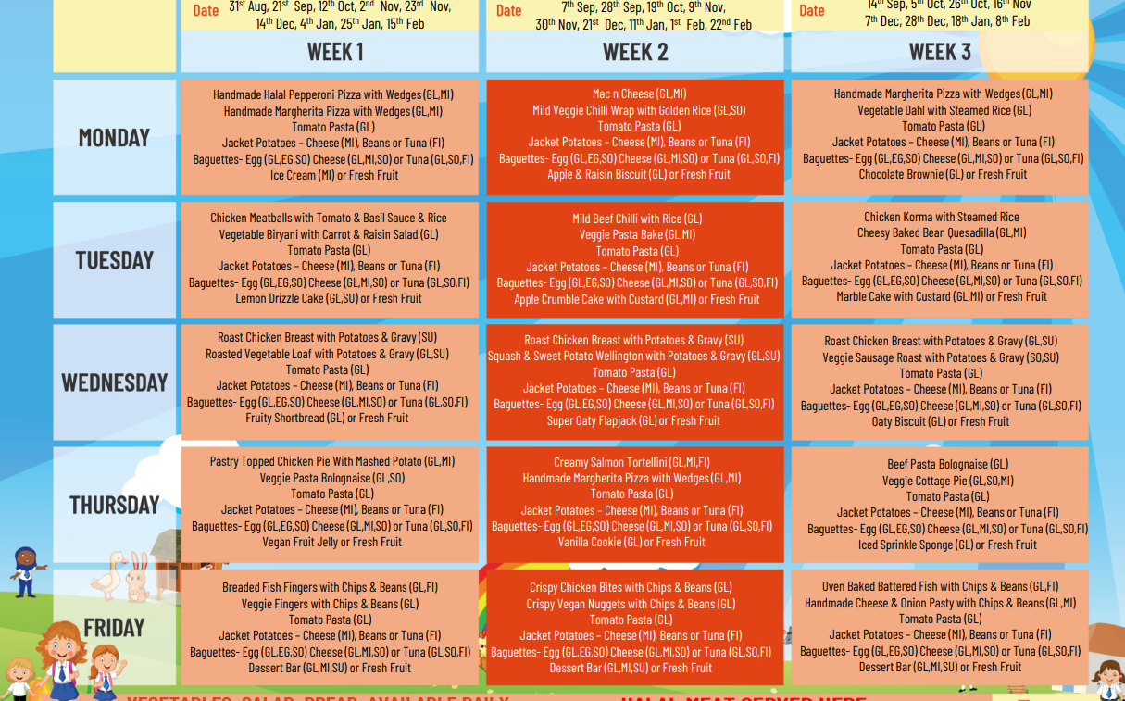
School Lunches
Our school lunches are being provided by a company called ‘The Pantry’.

Slide 12

End of the Day
Parents/Adults wait in the playground until the teacher brings the children to the Early Years garden gate.
Regular collection arrangement forms
Please notify the office of any changes including Last minute changes – use password and call school office.

Slide 13
Friendships and Positive Behaviour
School Values
Morning Welcome
House points
Stamps and stickers
Celebration assembly - Star of the Week awards
School Values
Respect
Teamwork
Responsibility
Understanding
Peace
Honesty

Slide 14
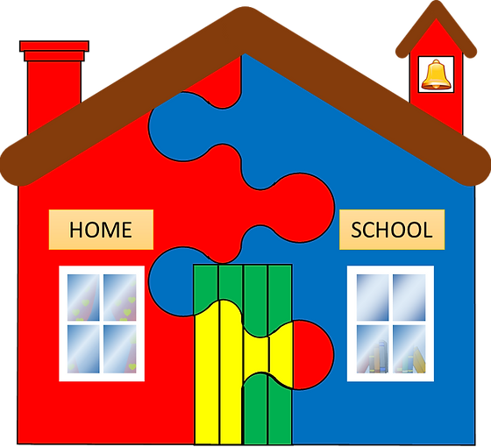
Communication between
Home and School
Class Updates/School Newsletters
Class Floor Book – photos and examples of child-led learning
Reading record/Home Learning
Show and Tell/Mystery Reader
Parent workshops (e.g. Phonics workshop)
Absence Notification / Phone Call
Parent Consultation appointments
End of year report
Come and talk to us –
appointments or general queries welcome

Slide 15
EYFS
What is the Early Years Foundation Stage?
The Foundation Stage is the stage of education for children from three to the end of the Reception year.
The Early Years Foundation Stage Curriculum is based on the recognition that children learn best through play and active learning.

Slide 16
Seven Areas of Learning
Communication and Language
Physical Development
Personal, Social and Emotional Development
Literacy
Mathematics
Understanding the World
Expressive Arts and Design

Slide 17


Communication and Language
The children will learn to:
talk confidently and clearly
enjoy listening attentively to and participating actively in stories, songs and poems
follow instructions and demonstrate understanding.
Emphasis on rich range of vocabulary and extending vocabulary

Slide 18


Physical Development
The children will learn to:
move confidently and control their body using large and small movements;
handle equipment effectively including pencils for writing letters correctly
Separation of fine motor skills and gross motor skills

Slide 19


Personal, Social and Emotional Development
The children will learn to:
be self-confident
take an interest in things
know what their own needs are
tell the difference between right and wrong
be able to dress and undress.
Emphasis on self regulation and self care including dental hygiene

Slide 20

Literacy
The children will:
develop a love of reading
become skilled and speedy word readers using phonics and recognition of familiar words
write a range of simple words including their name and compose sentences which they can read.
Greater emphasis on language comprehension and speedy word recognition

Slide 21

Phonics
The children will be taught to read and write using the phonics scheme Read Write Inc.
There will be a phonics meeting at the beginning of the Autumn Term.

Slide 22
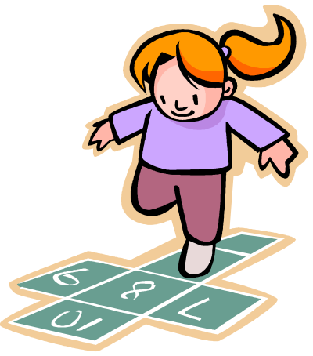
Mathematics
The children will:
develop a positive interests and attitudes in maths through stories, songs, games and imaginative play
Develop a strong grounding in number and a deep understanding of numbers to 10 and patterns in numbers.
Secure understanding of mathematical vocabulary
Develop spatial reasoning skills (shape, space and measure) but this will no longer be assessed

Slide 23

Understanding the World
The children will:
find out about past events in their own life and their families’
understand similarities and differences between themselves and others
explore and find out about the world around them, asking questions about it
Greater definition in terms of early science, geography and history skills

Slide 24


Expressive Arts and Design
colour mixing
making things and different materials
movement
making music
express their own ideas and feelings imaginatively.
Using vocabulary from books, poems and songs they
have learnt in their play and retelling stories
The children will explore:

Slide 25
Monitoring progress and assessment
Baseline Assessment
Observations during Playing and Learning Time
Tracking progress of Phonics, Reading and Maths
Speech Link Assessment
Each of the 7 areas of learning have ‘Early Learning Goals’ which determine what most children are expected to achieve by the end of reception class.
Early Years Foundation Stage Profile
New emphasis on less paperwork for teachers and more time interacting with the children

Slide 26
Characteristics of Effective Learning
We observe children to see how they are learning and their attitudes towards learning. We look at these three areas:
Playing and exploring- Engagement- Do they show curiosity and a ‘can do’ attitude?
Active Learning - Motivation- Can they persevere when a challenge occurs? Can they concentrate and focus?
Creating and thinking critically- Can they problem solve? Can they test out their ideas and review how well an approach is working?

Slide 27
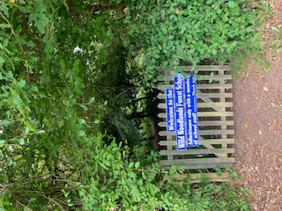
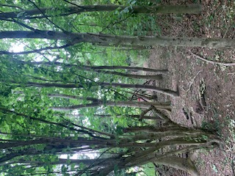
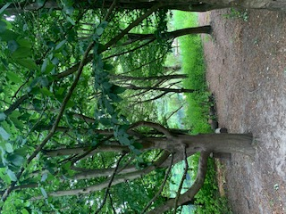
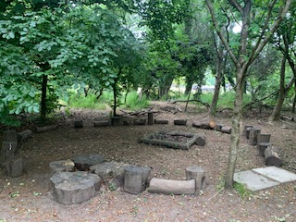
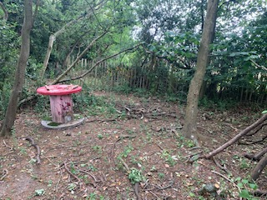
Wild Wood
Learn through nature
Take risks and problem solve
Be adventurous and curious
Details and days tbc
Forest School Clothes

Slide 28
Any questions?
Email the school office
More information to come re. PE days and Forest School

Slide 29
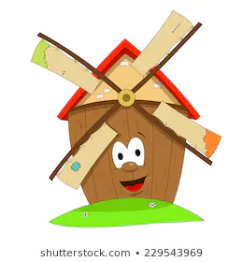
We are looking forward to sharing lots of fun times in Windmills Class.
See you in September!

