Slide 1

Reception Curriculum Meeting
Thursday 12th September 2024

Slide 2
Welcome and thank you very much for coming along this morning.
For those who have not met me, I am Mrs Apuzzo and together with Mrs Wade will be teaching your children in Windmills.
Mrs Wade will be working from Monday to Wednesday and I will be in school on Thursdays and Fridays.
Mrs McCall will be with us every day.

Slide 3
Over the first half of this term the Windmills staff will be spending lots of time getting to know the children. We will be providing them with a mixture of opportunities for learning through play and adult led activities. We will focus on classroom routines, developing personal, social and emotional skills as well as learning to build friendships. We will also be learning to take responsibility for our belongings and ourselves.
We will use our observations together with information gathered from Baseline Assessments, which are soon to be done, to identify areas of strength and areas for development for each child.

Slide 4
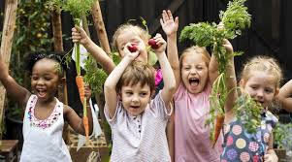
Autumn - I Can Grow

Slide 5
We start this term by finding out about Windmills, Harvest and Bread. We learn about these through a variety of wonderful stories.
We will be acting out these stories as this helps us to develop greater understanding which in turn helps us to find out how our food is grown.
We then move on to finding out about how we grow and change.
In addition to learning about families and different celebrations.

Slide 6

Spring - Fly High and Explore

Slide 7
An exciting topic to start this term where the children will be exploring space, rockets, planets, stars, aliens and life as an astronaut!
We will then move on to finding out about nocturnal animals and focus particularly on owls. We also hope to have a visit from some owls and a Planetarium.

Slide 8

Summer - Out and About

Slide 9
In the summer term we will explore different types of homes and transport through stories.
We will go on a school trip, visit our local area and have fun at our ‘Scooter Day’.
We will also learn about the animals that live in our school grounds.

Slide 10
Reading
We will be focusing on encouraging ‘Reading for Pleasure’ and the ‘Love of Books’
Borrowing School Library books and School Reading books
Access to Oxford Owl
Our Mystery Reader Initiative
Reading, sharing and acting out stories
Poetry Basket
Learning to read using Phonics

Slide 11

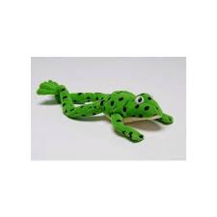
Reading
Reading is an important skill as it has an exponential affect across all subjects.
If at all possible, please set aside a designated quiet place and time when you read with your child.

Slide 12
Phonics
The children have daily RWI phonics sessions in school where they learn the letter sounds and practise segmenting and blending sounds together. ‘Fred the Frog’ will help us listen to sounds in words for reading and writing. Then they will start to apply these skills to reading RWI books.
There is more information on the school website so please have a look as some of the letter sounds are said slightly differently from other schemes you may have come across

Slide 13
Maths
Throughout the year in daily maths sessions, we will be focussing on encouraging Maths Talk and building confidence to use Mathematical vocabulary to describe numbers, shapes, size and patterns. This term we will be focussing on developing key mathematical principles which will build a strong foundation for future maths learning:
One to One principle – one number name for each object
Cardinal Principle – How many? A number can be assigned to a group
Stable order principle – numbers have to be said in a certain order
Abstraction principle – Anything can be counted – concrete or imaginary
Subitising – recognising how many in a group without counting

Slide 14
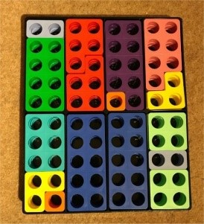

The children will have access to a range of manipulatives (e.g. Numicon, counting objects, bead strings) to help them explore how numbers are made (e.g. finding different ways to make 5). We will develop the children's understanding of key mathematical concepts by using concrete objects in the first instance and then moving on to using pictorial representations followed by abstract examples such as number sentences e.g. 2+2=4

Slide 15
Fun Outdoors
PE sessions will be on a Thursday. Please send your child into school wearing their PE kit. This will change after the October 1/2 term.
Forest School is on a Friday morning. Please send your child into school wearing warm old clothes and with waterproofs in a bag. In addition to this, please could you send in your child’s school uniform in case they need to change because of wet/muddy clothing.
Wellies should be kept in school, as we are outside in the Windmills garden every day!

Slide 16
Home Learning/Home School Communication
Sharing books and stories at home (watch out for the yellow Reading Record)
Practising fine motor skills, writing their name and forming letter shapes (please ensure you check the letter formation sheet)
Please be reassured that if for any reason you have any questions or concerns
Mrs Wade and myself are always here. The mornings are sometimes rather busy so it may need to be in the afternoon but if something is urgent let us know and we will attend to the issue sooner.

Slide 17
Does anyone have any questions?

Slide 18
Thank you for coming

