Slide 1
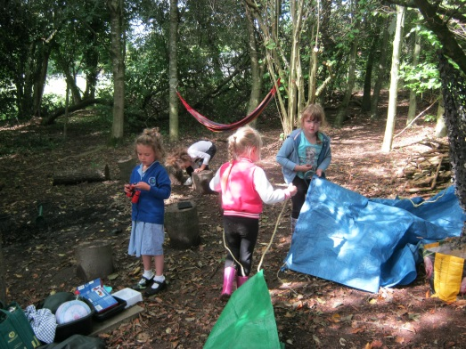
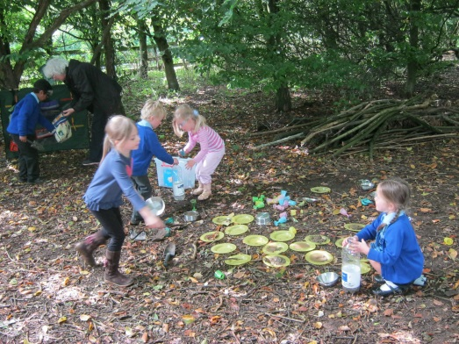

Welcome to our Parents Forum
Please sign in and help your self to a drink, take a seat at a table and introduce yourself to your neighbours. If possible - a mixture of EYs/ KS1/ KS2 parents on each table please.

Slide 2
Agenda
Introductions and the purpose of Parent Forums
Our children’s education: our hopes and aspirations?
The uniqueness of Hawridge & Cholesbury C of E School
Kith and Kin – the place of nature
How? What? And But … what are the drawbacks and how will these be managed?

Slide 3
Purpose of Parent Forums and
Why?: To engage parents/ carers, staff and governors in consideration and discussion of aspects of the school .
To develop a cohesive picture of the school we want Hawridge & Cholesbury C of E School to be.

Slide 4
Ground Rules
School is considered as a whole, with general issues being discussed rather than specific concerns.
Specific issues/ concerns should be addressed with the class teacher initially.
Be positive.

Slide 5

Education – what’s it all for?
Notes:
What do we want for our children? On your tables discuss what will a ‘successfully educated’ child look like? What will make you think – a good jub has been done?
Jot ideas down on paper. Share one per table.

Slide 6


Thoughts…

Slide 7
What do the experts say?
In 1947, Dr Martin Luther King in his lecture The Purpose of Education said that the goal of true education was, "intelligence plus character".
Last year came a report from the all-party parliamentary group (APPG) said that along with history and maths, teaching 'character and resilience' should be an essential part of every school's ambition.
All too often the development of attributes associated with character and resilience - that is, the development of the pupil as a rounded individual - are neglected or, at best, given second billing,"

Slide 8
October 2013, an LSE report, asking What Predicts a Successful Life, noted:
"The most powerful childhood predictor of adult life-satisfaction is the child's emotional health. Next comes the child's conduct. The least powerful predictor is the child's intellectual development."

Slide 9


How? What’s on the menu?
Shared philosophy – culture of the school
Common expectations – staff, parents, each other
Curriculum – what ‘diet’ are we offering our children?

Slide 10

What is so special about Hawridge & Cholesbury C of E School?
Protect and build | Unique School Features
Spirit – includes all staff and PSA/ church/ stakeholders Happy children Values: central to all we do | Location, surroundings & grounds Village/ small school atmosphere Small class sizes (some)

Slide 11
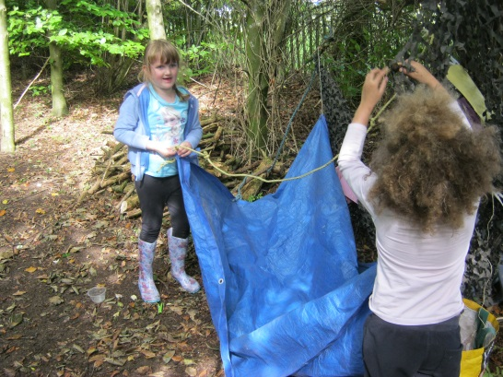

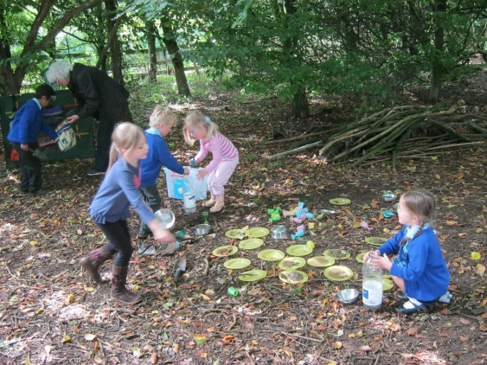
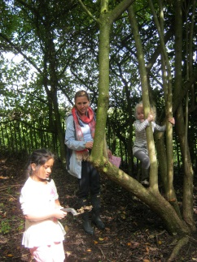
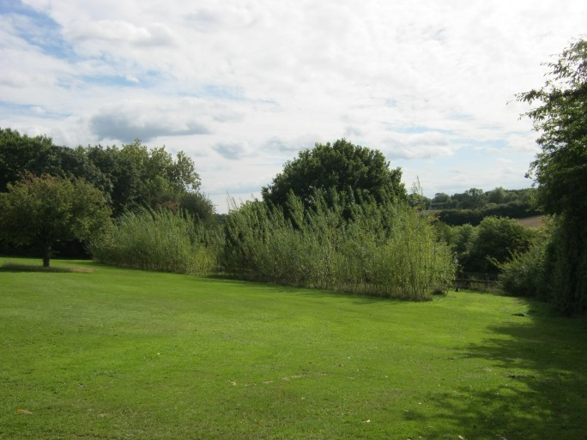
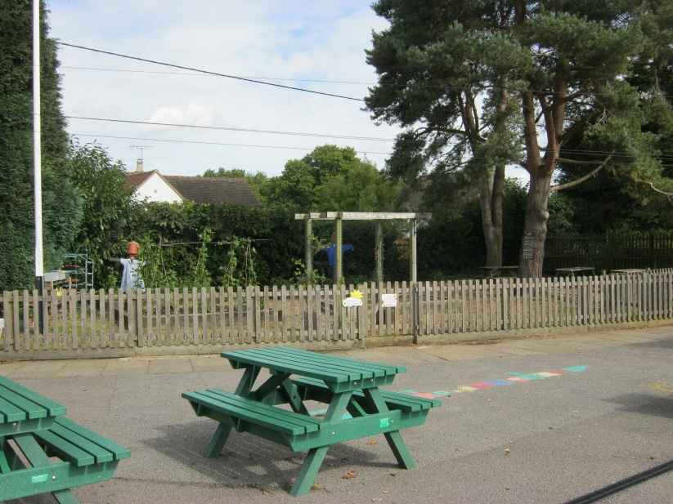
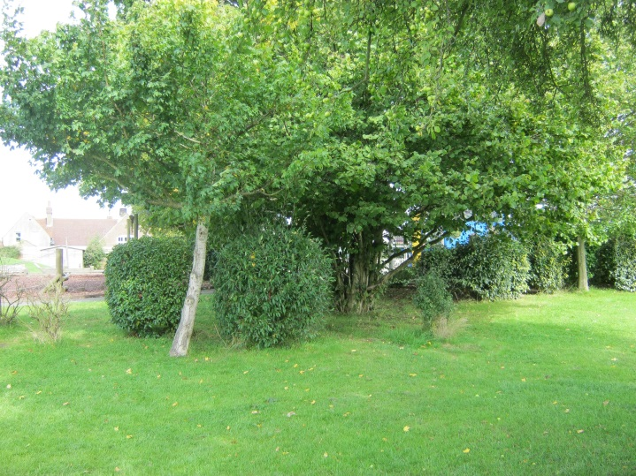
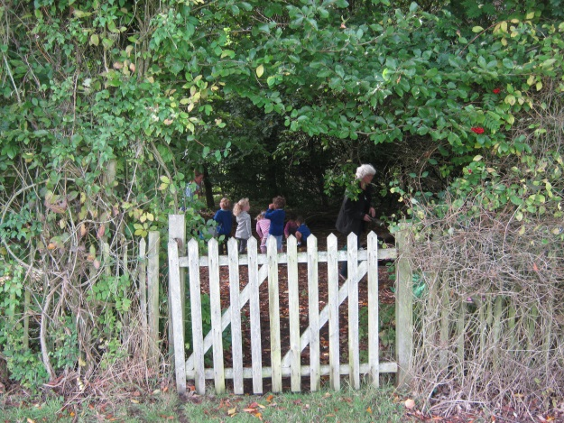
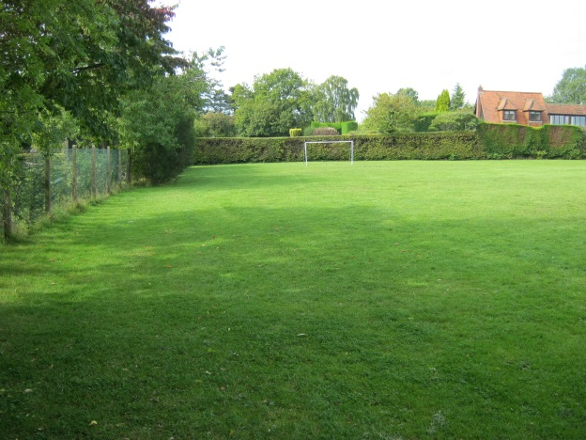
Location, Location, Location

Slide 12

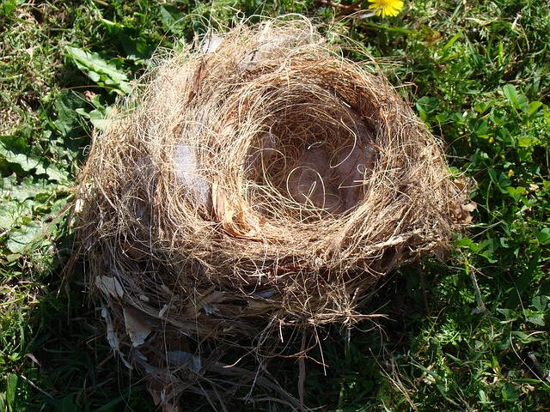
Kith and Kin – what’s that all about?
‘Kith, The Riddle of Childscape’ by Jay Griffiths

Slide 13

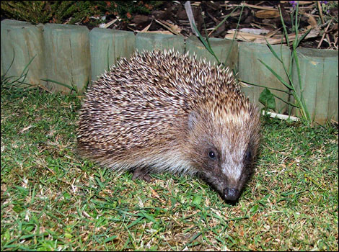
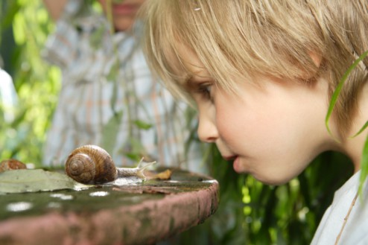
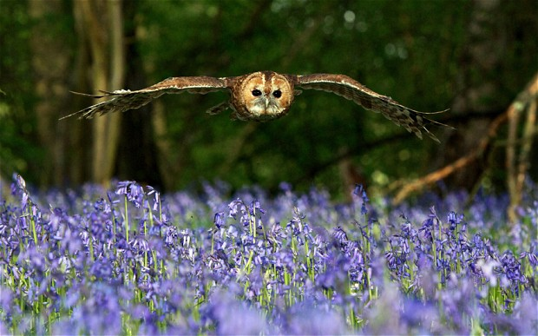
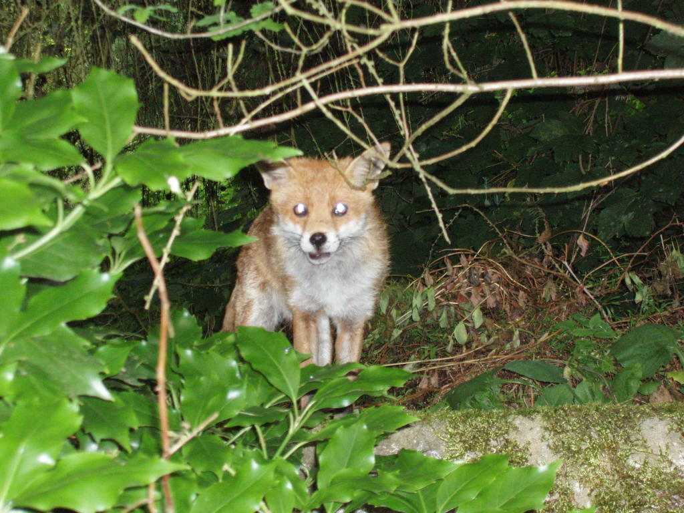
Nature in our lives … memories

Slide 14
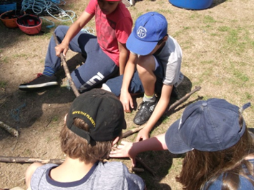
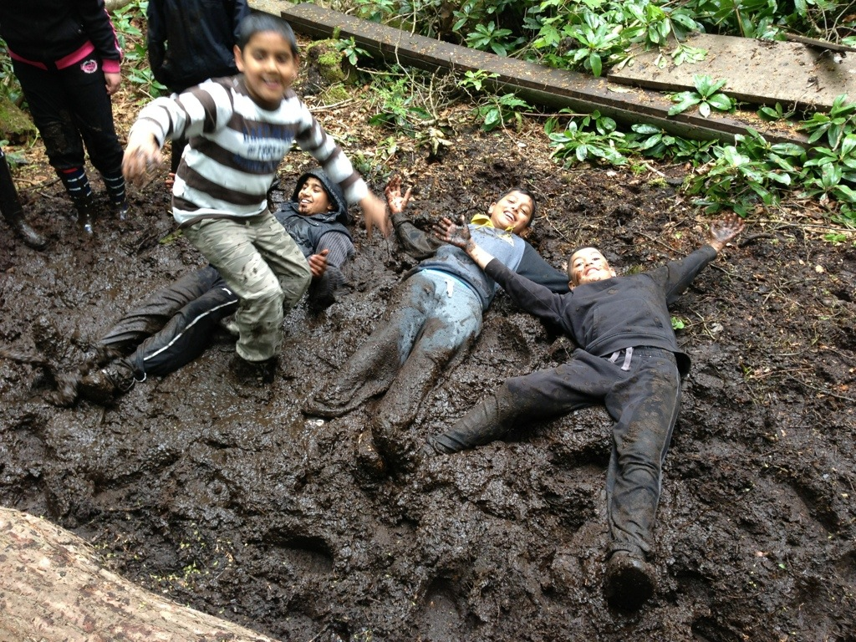

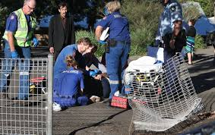
Doing it the H & C way …
Thoughts and ideas
Plusses and Minuses …
But what about …
Notes:
On tables brainstorm ideas of how to include nature in curriculum/ in children’s experience
On tables consider the possible drawbacks/ concerns fo parents. How can these be managed effectively?

Slide 15
The vision for Hawridge & Cholesbury C of E School
‘Every child leaves the school as a rounded, confident, caring individual, recognising their own brilliance and having a genuine fascination for the world and all that is in it.’
‘Every child at the end of every day will leave school so inspired by their experience that they look forward with excitement to discovering more tomorrow.’

Slide 16
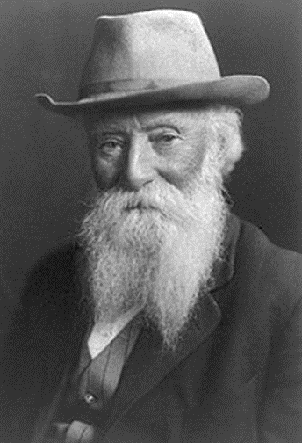
"I go to nature to be soothed and healed, and to have my senses put in order." - John Burroughs (American naturalist in 19th century)

Slide 17
Thank you for coming.
Please complete an evaluation form before you go .
We hope you found it useful.

