Slide 1

Welcome to Year 1
2026-2027

Slide 2
Key adults
Mrs Smith - Class Teacher
Ms. Shaw- Class LSA
Ms Brown – Class LSA
Mrs Marsden – Class LSA
Mrs Williams – Class LSA (afternoons)
Mrs Nash - PPA cover Thursday afternoons

Slide 3

Phonics
Consists of;
Speaking
Listening
Reading
Handwriting
Spelling

Slide 4


Reading
RWI Phonics - We teach reading and phonics through the Read, Write, Inc (RWI). This is taught in class 5 days a week for an hour
An adult will read a book with your child once a week and write a comment in their reading diary
The books that are taken home will be changed every Monday.
Please sign and date when you have read with your child at home
Consistent home readers will be entered into a termly readers raffle.

Slide 5
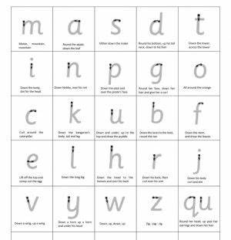
Handwriting expectations
All lower case letters formed correctly
• Write capital letters taller than lower case letters
• Write on the lines
• Write descenders under the line all the same length
(f, g, j, p, q, y)
• Write ascenders taller than other lower case letters and make them all the same height (b, d, h, k, l, t)
Support in school – daily handwriting practice, pencil grips, extra 1:1 interventions if needed

Slide 6
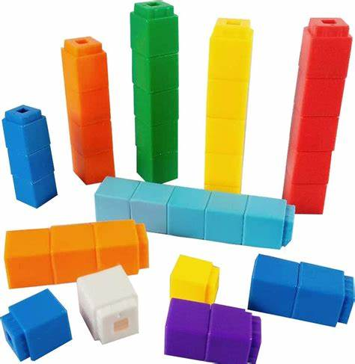
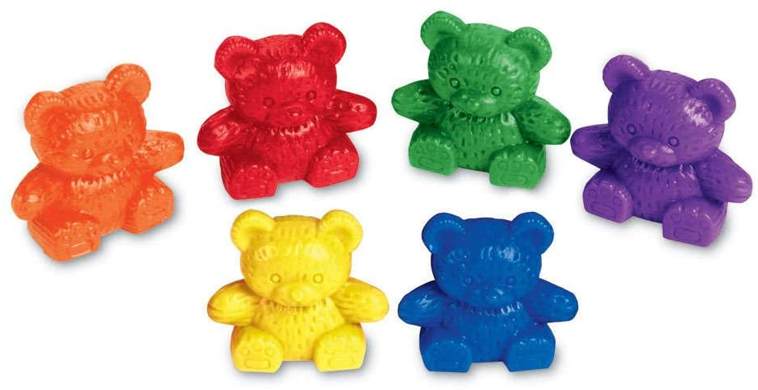
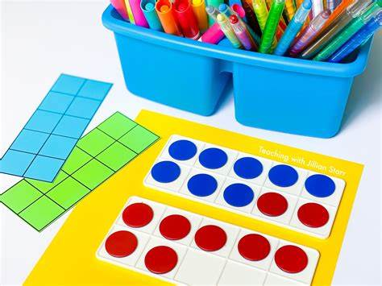
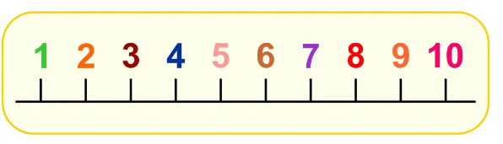
Maths
Count forwards and backwards in 1s within 100 starting at any number.
Count forwards and backwards in 2s, 5s and 10s.
Know 1 more and 1 less than a given number up to 100.
To understand place value of a number within 100 – how many tens and ones.
To fluently recall number bonds to 10 and 20.
To fluently add and subtract numbers within 10 understanding the relationship of parts and wholes.
Add and subtract numbers within 100 using concrete resources and pictures.
Fluently recall the related addition and subtraction facts up to 20.
2-digit add and subtract 1-digit not crossing 10s
e.g. 36 + 3 = 75 - 2 =
Understand mathematical symbols + - and =
Use the language of comparisons (greater than / less than).
Measure weight, length and capacity.
Recognise and describe simple 2D and 3D shapes.
Tell the time (half past, o'clock).
Recognise half, quarter and whole of amounts, shapes and number (1/2).

Slide 7


Science
Identifying changes throughout the seasons
Comparing objects and their properties

Slide 8


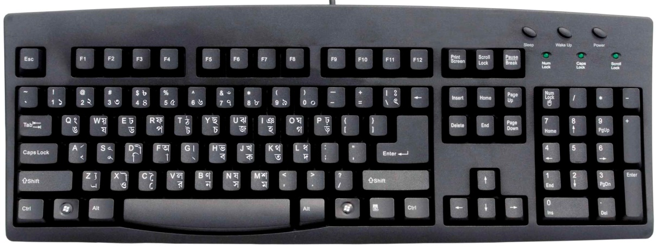
Computing

Slide 9
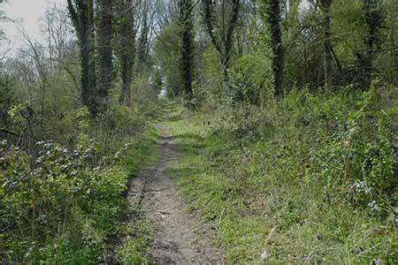
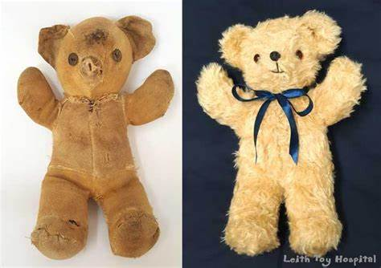
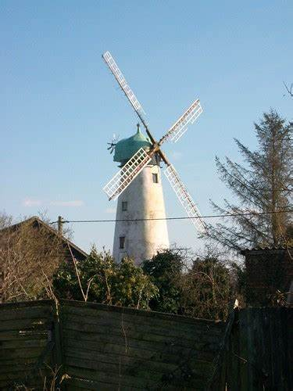
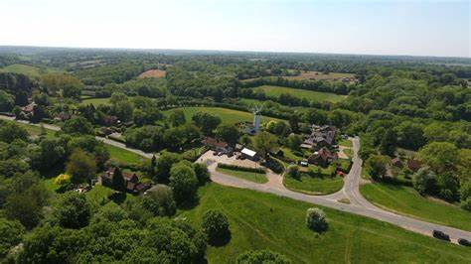
History and Geography
Toys throughout Time
Our Local Area

Slide 10

RE
What makes us special?
Key stories to deepen their understanding of Harvest Festival and Christmas

Slide 11

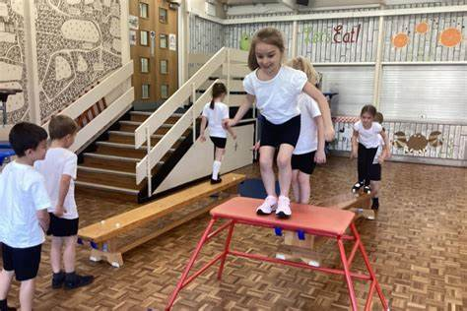
PE/Game On
Game on – Monday
PE - Wednesday
Throwing and catching
Team work
Gymnastics

Slide 12
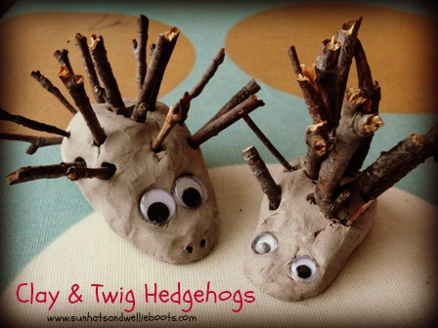

Art and DT
Colour theory and printing techniques
Forest School
Clay hedgehogs

Slide 13

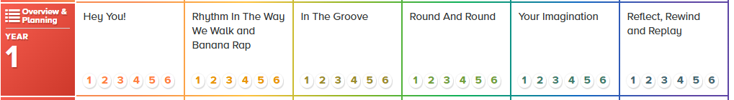
Music
Rhythm, pulse, pitch, singing, dancing and composing
Genres: Hip-hop, Reggae, Blues, Baroque, Latin, Bhangra, Folk, Funk, Bossa Nova, Classical and Pop

Slide 14

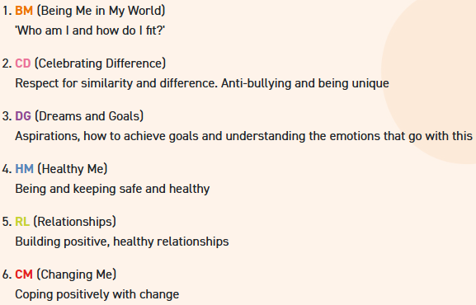

PSHE

Slide 15
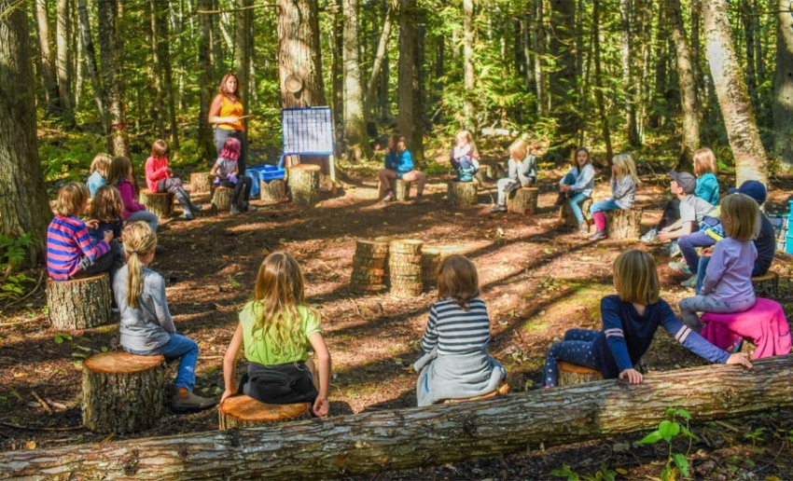
Outdoor learning.
Tuesday afternoons.
We will go out, whatever the weather!
This year we will have a half term of forest school session – we will be in touch when this is.
Please ensure your child has a change of outdoor clothes, to include:
  Waterproof coat
  Wellies
  Waterproof/ over trousers
  Warm layers – a fleece, or jumper

Slide 16

Homework
Homework consists of;
Reading (5 x per week)
Phonics (Oxford owl and Phonics play)
In Spring term:
Maths or Writing activity
Spellings

Slide 17
Curriculum Enrichment
Visit from the Chesham Museum- Toys
Walks to the Common
Harvest Festival
Christmas Nativity
Trips

Slide 18
How can you help?
Read with your child 5-6 days a week
Support your child with writing their name
Support and encourage your child to dress independently
Availability to help with walks to common/ trips
Voluntary readers
Mystery Reader

Slide 19
Upcoming Key Dates
Kith and Kin:
Phonics parents meeting:
INSET day: Friday 23rd October
Roving bookshop: Tuesday 17th November
Parents evening: TBC
Nativity dates: Monday 7th and Tuesday 8th December at 9:30am.

