Slide 1
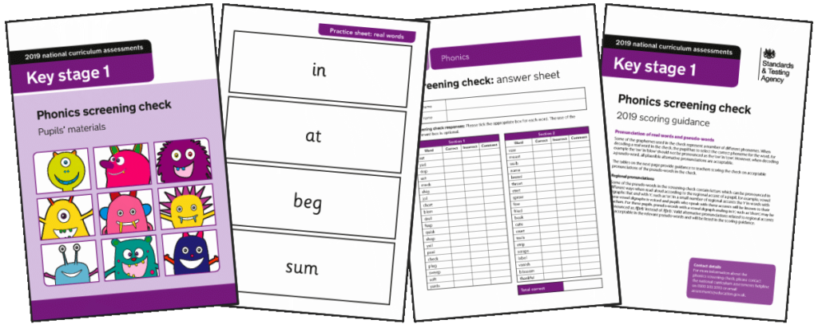
EYFS & KS1 Phonics Meeting
Friday 7th October 2022

Slide 2
Aim:
To explain our approach to teaching phonics and early reading, enabling you as a parent/carer to support your child more easily and more effectively at home
To discuss the Year 1 Phonics Screening Check

Slide 3
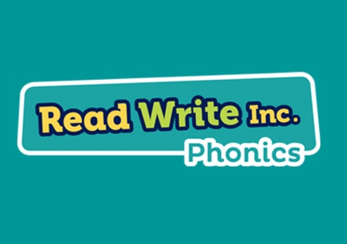
Phonics teaching
In our school we use the Read Write Inc. Phonics programme. This is a national programme we find the children enjoy.
Children learn to read sounds and blend them into words. They apply this phonic knowledge to read and comprehend Storybooks that are carefully matched to the sounds they know.
Children learn to read these books with a storyteller’s voice.

Slide 4
‘Understanding Phonics’ Video

Slide 5
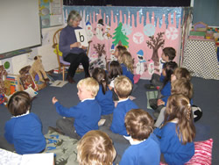
A Phonics Lesson
Phonics lessons are taught using the following structure:
- See/hear the new sound
Recognise the new sound
Write the new sound
Write previous sounds

Slide 6
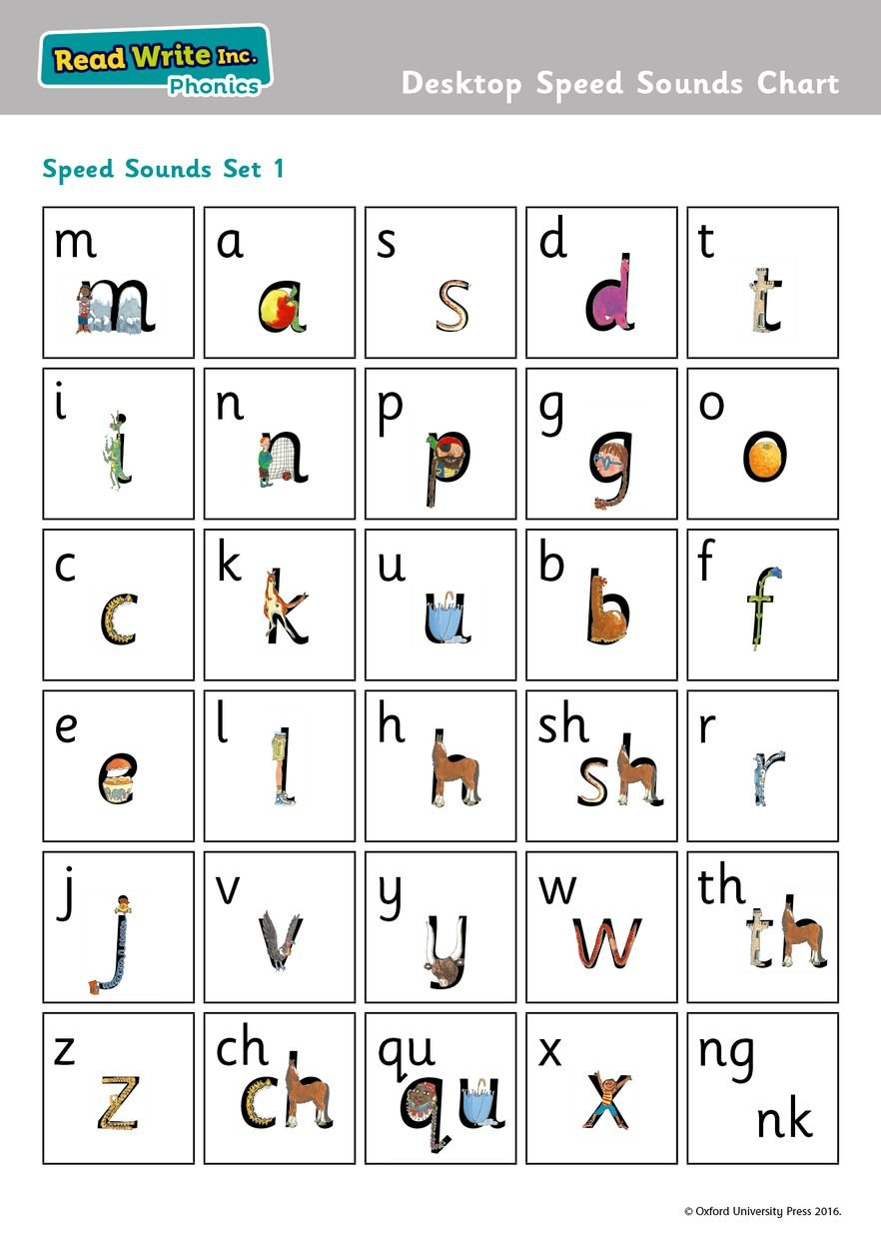
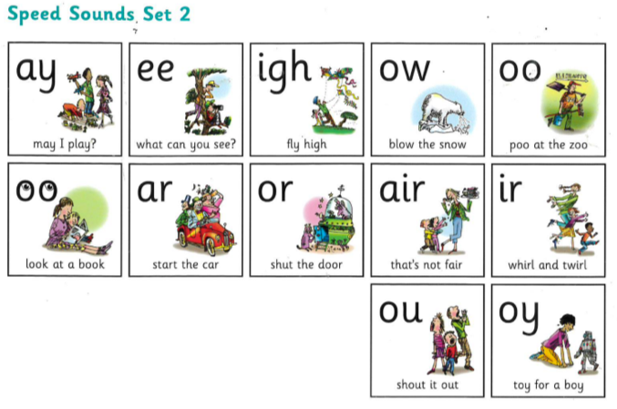
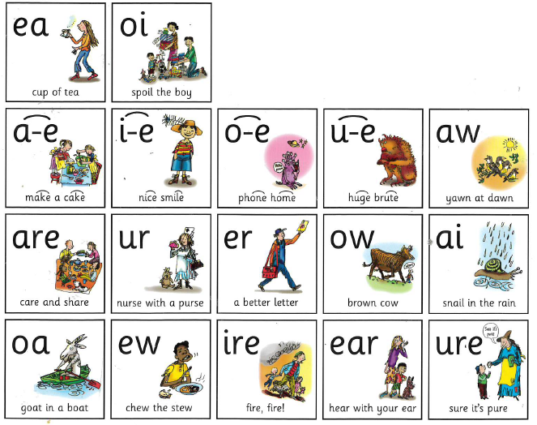
Speed Sounds

Slide 7
Sound Guide Video

Slide 8
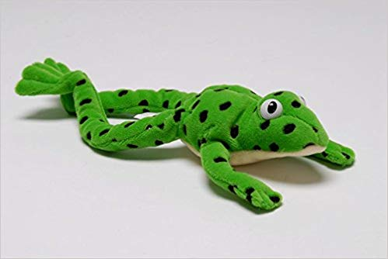
Blending Green Words
c-a-t
The children will begin to blend simple words e.g. s-a-t,
s-i-t, m-a-t using Fred talk
The children will then blend more complex words e.g.
b-l-ew, z-oo-m, s-n-ai-l, y-aw-n, b-oo-k
They will be able to read hundreds of words using the following 3 methods;
Blending them aloud (Fred talk)
Blending quickly and silently as blending and sounding is routine (Fred in your head)
Automatically reading familiar words (including red words)

Slide 9
Blending Supporting reading
c-a-t
When your child reads the story, ask him or her to sound out the words that he or she can’t read automatically. Don’t allow your child to struggle too much. Remind them to use Fred talk. Praise your child when he or she succeeds.
Read back each sentence or page to keep the plot moving. (Your child’s energy is going into reading the words not the story.)
Help your child to use the pictures and context to read the word.
Ask your child questions about the book/story eg. What do they think will happen next? Can they relate it to their own life?
Read the story more than once so that children become more confident and fluent readers.
Do it all with patience and love!

Slide 10
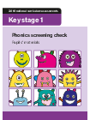
Phonics Screening
The Year 1 Phonics Screening check was introduced 2012 as part of a policy to strengthen Phonics teaching in Primary Schools and reflect the emphasis of teaching it synthetically and systematically.
The screening takes place in the Summer Term (June) for all Year 1 children
During the check your child will be asked to read a list of 40 words to check their grapheme recognition and decoding skills. The word are made up of 20 real words and 20 alien words that they must read to teacher

Slide 11
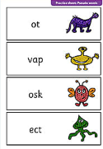
Phonics Screening
Reading non-words (or alien words) can act as a useful tool to check whether children are secure in their phonic knowledge and can apply it to read any word. They can check to see if children are using their decoding skills rather than relying on memorising skills.

Slide 12
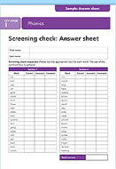
Phonics Screening
The check will normally be administered by a familiar adult in a familiar environment and usually take less than 10 minutes. We will try and keep as low key as possible, despite being a test.
Each the score that children need to achieve in order to pass the screening isn’t announced until after the check has been administered. For the past several years though the pass score has remained 32/40.
If you child does not meet the pass mark, they will have the opportunity to retake the screening check in Year 2.

Slide 13
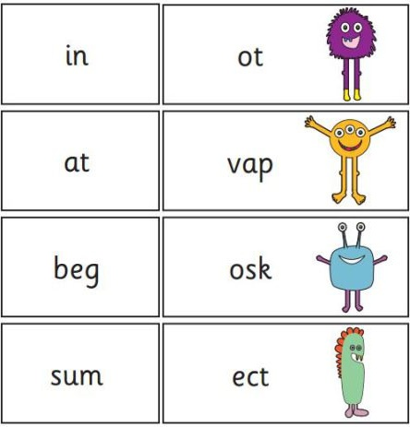

Slide 15
Phonics in Year 2
We will continue to strengthen the children’s phonics in year 2 however phonics sessions will be shorter and we will focus on the following:
Guided reading – reading a variety of texts in small groups and answering relevant questions verbally.
Comprehension – reading a text and be able to answer questions about what they have just read.
SPAG - Spelling, Punctuation and Grammar. Teaching the children the correct spellings.

Slide 16
How can you help your child at home?
Listen to your child read at least x5 a week
Regularly read to your child
Practise segmenting and blending real words and alien words
Read Write Inc resources are available online
Play phonic games on the following website. Click on free resources:
https://www.phonicsplay.co.uk/BuriedTreasure2.html

Slide 17
Read Write Inc resources

Slide 18
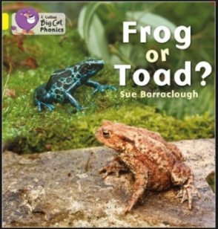
Phonics and Reading
At Hawridge and Cholesbury we aim to develop a reading community where children become confident and enthusiastic readers. For us to achieve this we need to take reading beyond the classroom. We want to create a rich reading environment where reading is encouraged by everyone and everywhere.

Slide 19
Summary of Phonics terminology
phoneme | the smallest unit of sound that can be heard in a word
grapheme | the recorded letters representing a phoneme, e.g. ai, igh, m
CVC words | consonant-vowel-consonant words, e.g. c-a-t, sh-ee-p
blend | joining phonemes together to read a word
segment | using phonetic knowledge to break down a word to read it
tricky words | words that cannot be segmented or blended using only phonics
digraph | a phoneme made of two letters e.g. sh, ee, oi.
trigraph | a phoneme made of three or more letters e.g. igh, air, eigh.

