Slide 1
KS1 READING WORKSHOP
January 2016
A review of research for the Reading Agency found that adults and children who read regularly are less likely to experience stress and depression. They also have more self-esteem, sleep better, and are more able to deal with difficult situations. 2015

Slide 2
The National Curriculum
AIM:
The national curriculum provides pupils with an introduction to essential knowledge that they need to be educated citizens. It introduces pupils to the best that has been thought and said: and helps engender an appreciation of human creativity and achievement.

Slide 3
The Early Years Framework
Communication and language
Listening and attention: children listen attentively in a range of situations. They listen to stories, accurately anticipating key events and respond to what they hear with relevant comments, questions or actions. They give their attention to what others say and respond appropriately, while engaged in another activity.
Understanding: children follow instructions involving several ideas or actions. They answer ‘how’ and ‘why’ questions about their experiences and in response to stories or events.
Speaking: children express themselves effectively, showing awareness of listeners’ needs. They use past, present and future forms accurately when talking about events that have happened or are to happen in the future. They develop their own narratives and explanations by connecting ideas or events.

Slide 4
The National Curriculum
There are two aspects to the reading curriculum:
Decoding
and
Comprehension

Slide 5
The National Curriculum
KS1 – Year 1
Decoding
apply phonic knowledge and skills as the route to decode words
respond speedily with the correct sound to graphemes (letters or groups of letters) for all 40+ phonemes, including, where applicable, alternative sounds for graphemes
read accurately by blending sounds in unfamiliar words containing GPCs that have been taught
read common exception words, noting unusual correspondences between spelling and sound and where these occur in the word
read words containing taught GPCs and –s, –es, –ing, –ed, –er and –est endings
read other words of more than one syllable that contain taught GPCs
read words with contractions [for example, I’m, I’ll, we’ll], and understand that the apostrophe represents the omitted letter(s)
read books aloud, accurately, that are consistent with their developing phonic knowledge and that do not require them to use other strategies to work out words
reread these books to build up their fluency and confidence in word reading
Fluent word reading greatly assists comprehension, especially when pupils come to read longer books.

Slide 6
The National Curriculum
KS1 – Year 1
Comprehension
develop pleasure in reading, motivation to read, vocabulary and understanding by:
  listening to and discussing a wide range of poems, stories and non-fiction at a level beyond that at which they can read independently
  being encouraged to link what they read or hear to their own experiences
  becoming very familiar with key stories, fairy stories and traditional tales, retelling them and considering their particular characteristics
  recognising and joining in with predictable phrases
  learning to appreciate rhymes and poems, and to recite some by heart
  discussing word meanings, linking new meanings to those already known
understand both the books they can already read accurately and fluently and those they listen to by:
  drawing on what they already know or on background information and vocabulary provided by the teacher
  checking that the text makes sense to them as they read, and correcting inaccurate reading
  discussing the significance of the title and events
  making inferences on the basis of what is being said and done
  predicting what might happen on the basis of what has been read so far
  participate in discussion about what is read to them, taking turns and listening to what others say
  explain clearly their understanding of what is read to them

Slide 7
The National Curriculum
KS1 – Year 2
Decoding
continue to apply phonic knowledge and skills as the route to decode words until automatic decoding has become embedded and reading is fluent
read accurately by blending the sounds in words that contain the graphemes taught so far, especially recognising alternative sounds for graphemes
read accurately words of two or more syllables that contain the same graphemes as above
read words containing common suffixes
read further common exception words, noting unusual correspondences between spelling and sound and where these occur in the word
read most words quickly and accurately, without overt sounding and blending, when they have been frequently encountered
read aloud books closely matched to their improving phonic knowledge, sounding out unfamiliar words accurately, automatically and without undue hesitation
reread these books to build up their fluency and confidence in word reading

Slide 8
The National Curriculum
KS1 – Year 2
Comprehension
develop pleasure in reading, motivation to read, vocabulary and understanding by:
  listening to, discussing and expressing views about a wide range of contemporary and classic poetry, stories and non-fiction at a level beyond that at which they can read independently
  discussing the sequence of events in books and how items of information are related
  becoming increasingly familiar with and retelling a wider range of stories, fairy stories and traditional tales
  being introduced to non-fiction books that are structured in different ways
  recognising simple recurring literary language in stories and poetry
  discussing and clarifying the meanings of words, linking new meanings to known vocabulary
  discussing their favourite words and phrases
  continuing to build up a repertoire of poems learnt by heart, appreciating these and reciting some, with appropriate intonation to make the meaning clear
understand both the books that they can already read accurately and fluently and those that they listen to by:
  drawing on what they already know or on background information and vocabulary provided by the teacher
  checking that the text makes sense to them as they read, and correcting inaccurate reading
  making inferences on the basis of what is being said and done
  answering and asking questions
  predicting what might happen on the basis of what has been read so far
participate in discussion about books, poems and other works that are read to them and those that they can read for themselves, taking turns and listening to what others say
explain and discuss their understanding of books, poems and other material, both those that they listen to and those that they read for themselves

Slide 9
What we do
1 – to – 1 reading
Guiding reading
Children have time to read on their own
Class books
Celebrated authors / author of the term
Visit to the well stocked school library
World Book Day
Author visits
Books used within writing units
Book reviews and recommendations
Reading across all subjects
Library summer reading challenge
School reading challenges

Slide 10
How children learn to read
Children often learn stories and rhymes off by heart. When reading, children rely a lot on memory, they appear to be reading when really they have remembered the pattern of the story. This is not cheating! It shows us that your children are on their way to becoming a reader as they are making the connection between print and a story.

Slide 11
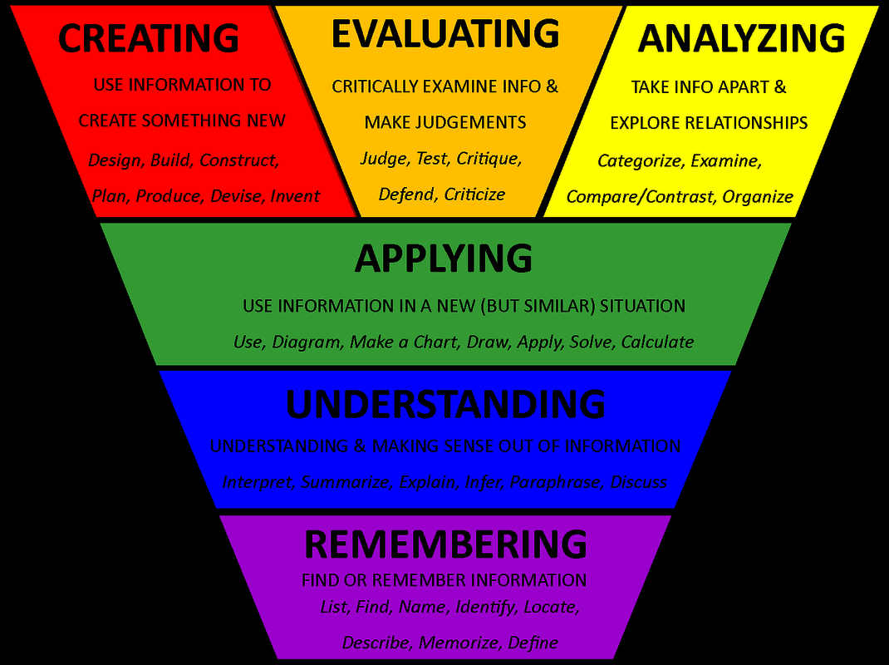

Slide 12
REMEMBERING
Recognise, Describe, Identify, Retrieve, Name…
List the characters in the story? Who was unhappy?
What was the setting at the opening?
UNDERSTANDING
Interpret, Exemplify, Summaries, Paraphrase, Explain, Classify, Compare
Explain why the character acted that way? Retell the story in your own way.
APPLYING
Implement, carry out, use
Construct a model to show how it works. Take a collection of photographs to demonstrate a particular point.

Slide 13
At Hawridge and Cholesbury we aim to develop a reading community where children become confident and enthusiastic readers. For us to achieve this we need to take reading beyond the classroom. We want to create a rich reading environment where reading is encouraged by everyone and everywhere.

Slide 14
What you can do
Find time - Spend 10 minutes a day reading together, choose: books, magazines, brochures, catalogues, menus, recipes, posters, newspapers that you both enjoy.
Encourage the children to make up their own characters and stories.
Buy books as presents.
Make a special place to keep reading books.
Join the library, they have lots of fun and free events and
they have free internet access.
Let your child see you reading, talk about what you like and don’t like to read.

Slide 15
Children learning to read
Encourage your children to spot letters that they recognise on posters, signs etc.
Point out various signs that are all around us.
Children from a very early age recognise (and read) McDonalds,
Tesco, Asda etc.
Read words together on food packets and tins when shopping, can they find the baked beans? tomato sauce? etc.
Read a book to the children that they know well, miss out words and encourage the children to fill in the blanks.
Spend time reading together talk about the pictures or make up their own stories. Bed time is the perfect time for doing this.
Make cakes and biscuits together, read the recipe together. You could try to make biscuits in the shape of letters.

Slide 16
The next stage …
Read books about topics that you know your child will like such as dinosaurs, football, rugby, TV programmes etc.
Take books, magazine, comics, when going shopping or on a journey.
Read match reports or articles about their favourite team or sport.
Research on the internet together. You could look at team websites, or find their favourite author or TV programme and find out more about them.
Talk to the children about books that you enjoy reading now and books you enjoyed as a child.

Slide 17
What do you do if you have a struggling or reluctant reader?
Struggling readers – many children struggle to read it is not an indicator as to whether they are intelligent or not.
Speak to a teacher www.Oxford Owl.co.uk
Reluctant readers
Make it fun, model it, find something that interests them. Remember reading doesn’t just involve books.

Slide 18
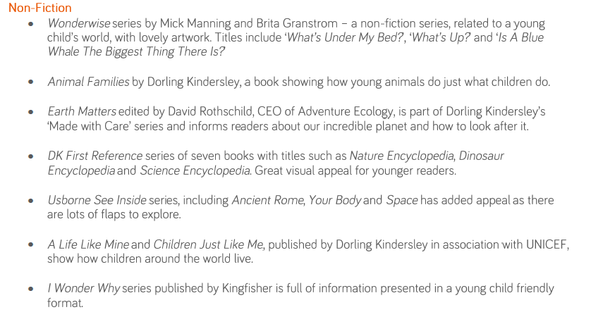
More Able EYFS

Slide 19
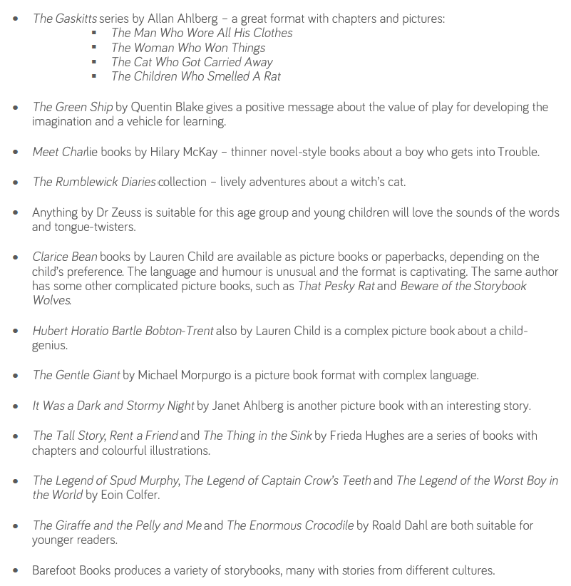
More able EYFS - Fiction

Slide 20
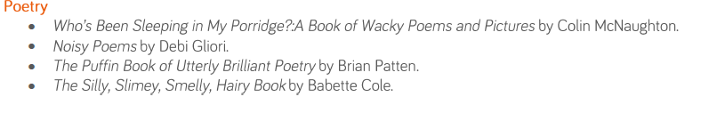
More Able EYFS

Slide 21
Key Stage 1
Standard Attainment Tests

Slide 22
"The more that you read, the more things you will know. The more you learn, the more places you'll go." — Dr. Seuss

