Slide 1
Maths Mastery
What does it mean for Hawridge and Cholesbury?

Slide 2
What is Mastery?
Mastery of maths means a deep, long-term, secure and adaptable understanding of the subject.
I know how to do it and why
It becomes automatic and I don’t need to think about it- for example driving a car
I’m really good at doing it – painting a room, or a picture
I can show someone else how to do it.
Notes:
Like driving a car – I no longer have to think about it.

Slide 3

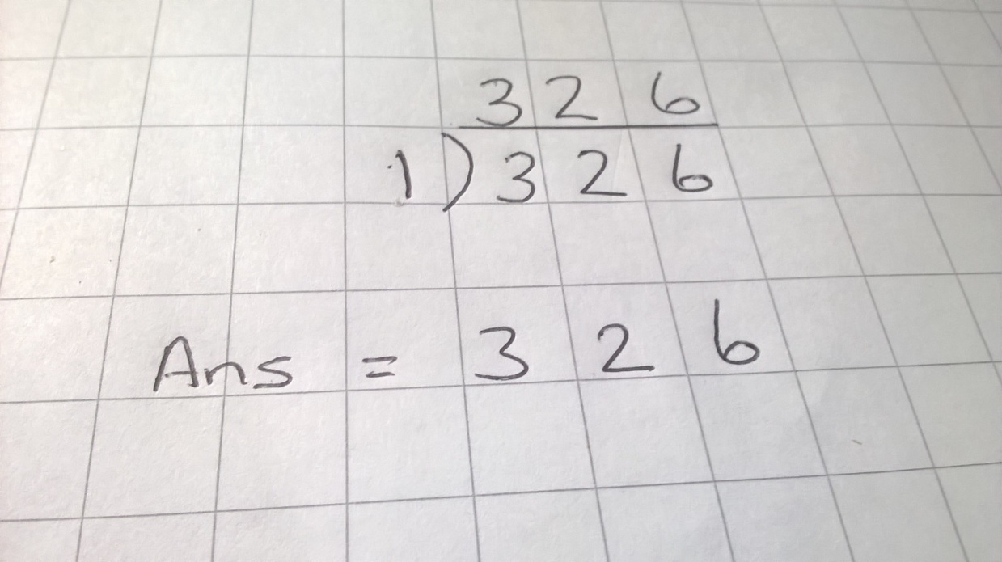
KS2 Arithmetic Paper
Does this demonstrate mastery?

Slide 4
The Background
Increasing concern that Britain is falling in international rankings for Maths attainment.
Growing evidence from other countries that there are better ways of teaching Maths than those used in the UK.
Inability of pupils at all levels to apply their knowledge.
Disconnection between Maths in the classroom and Maths in real life.

Slide 5
Key aims of national curriculum
fluency (rapid and accurate recall and application of facts and concepts)
a growing confidence to reason mathematically
the ability to apply maths to solve problems, to conjecture and to test hypotheses.
Notes:
These are the key aims for the new curriculum

Slide 6
What does a mastery curriculum look like?
Longer time on each topic – less jumping around
Fewer topics in the earlier years to allow for learning in depth
Greater use of practical resources, pictures and images to help children make connections and so retain knowledge more easily
Opportunities for reasoning and problem solving built in to every lesson
Lessons carefully planned to address possible misconceptions and to allow children to make links in their learning
Flexible groupings – all children given access to all tasks

Slide 7
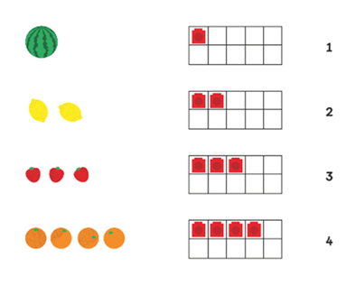
Concrete, Pictorial and Abstract
Mathematics is an abstract subject, representations have the potential to provide access and develop understanding.

Slide 8
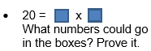
Reasoning
Year 2
Recall and use multiplication and division facts for 2,5 and 10 multiplication tables
Solve problems involving multiplication and division, using materials, arrays, repeated addition, mental methods, and multiplication and division facts

Slide 9
Reasoning
Year 4
• Complete these calculations:
7 x 8=
5 x 6 =
12 x 4 =
7 x 4 x 2=
5 x 3 x 2=
12 x 2 x 2=
Which calculations have the same answer? Can you explain why?
Solve problems involving multiplying and adding, including using the distributive
law to multiply two digit numbers by one digit…
Notes:
The Distributive Law says that multiplying a number by a group of numbers added together is the same as doing each multiplication separately

Slide 10
Reasoning
Year 6
Three pupils are asked to estimate the answer to the sum 4243 + 1734.
Andrew says, ‘To the nearest 100, the answer will be 5900.’
Bilal says, ‘To the nearest 50, the answer will be 6000.’
Cheng says, ‘To the nearest 10, the answer will be 5970.’
Do you agree with Andrew, Bilal or Cheng?
Can you explain their reasoning?
Round any whole number to a required degree of accuracy

Slide 11
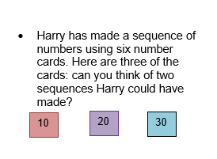
Problem Solving
Year 2

Slide 12
Problem Solving
Year 4
I am thinking of 2 secret numbers where the sum of the numbers is 16 and the product is 48. What are my secret numbers?
Can you make up 2 secret numbers and tell somebody what the sum and product are?

Slide 13
Problem Solving
Year 6
A scientist measured the temperature each day for one week at 06:00.
On Sunday the temperature was 1·6°C.
On Monday the temperature had fallen by 3°C.
On Tuesday the temperature had fallen by 2·1°C.
On Wednesday the temperature had risen by 1·6°C.
On Thursday the temperature had risen by 4·2°C.
On Friday the temperature had fallen by 0·9°C.
On Saturday the temperature had risen by 0·2°C.
What was the temperature on Saturday?
Notes:
1.6 c

Slide 14
Future Maths Lessons at H&C
Shared discussion and reasoning – encouraging children to share strategies and learn from each other
Greater use of resources to help children see what they are doing – give meaning to calculations
The whole class working on the objectives for their year group with multiple opportunities to apply their knowledge in different ways
Greater emphasis on pupils setting their own level of challenge
Move away from fixed groups

Slide 15
Assessment
On-going formative assessments in lessons – checking ability to apply knowledge
Learning Ladders tracking tool
Headstart Assessments
All used to inform future teaching

Slide 16
Assessment
National assessment at the end of Key Stages 1 and 2 aims to assess pupils’ mastery of both the content of the curriculum and the depth of their understanding and application of mathematics.
Notes:
76% H&C 72%bucks 70% nat

Slide 17

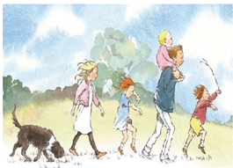





Teaching for Mastery
Martin Adsett
Mastery Specialist

Slide 18

Teaching for Mastery
Not Scared

