Slide 1
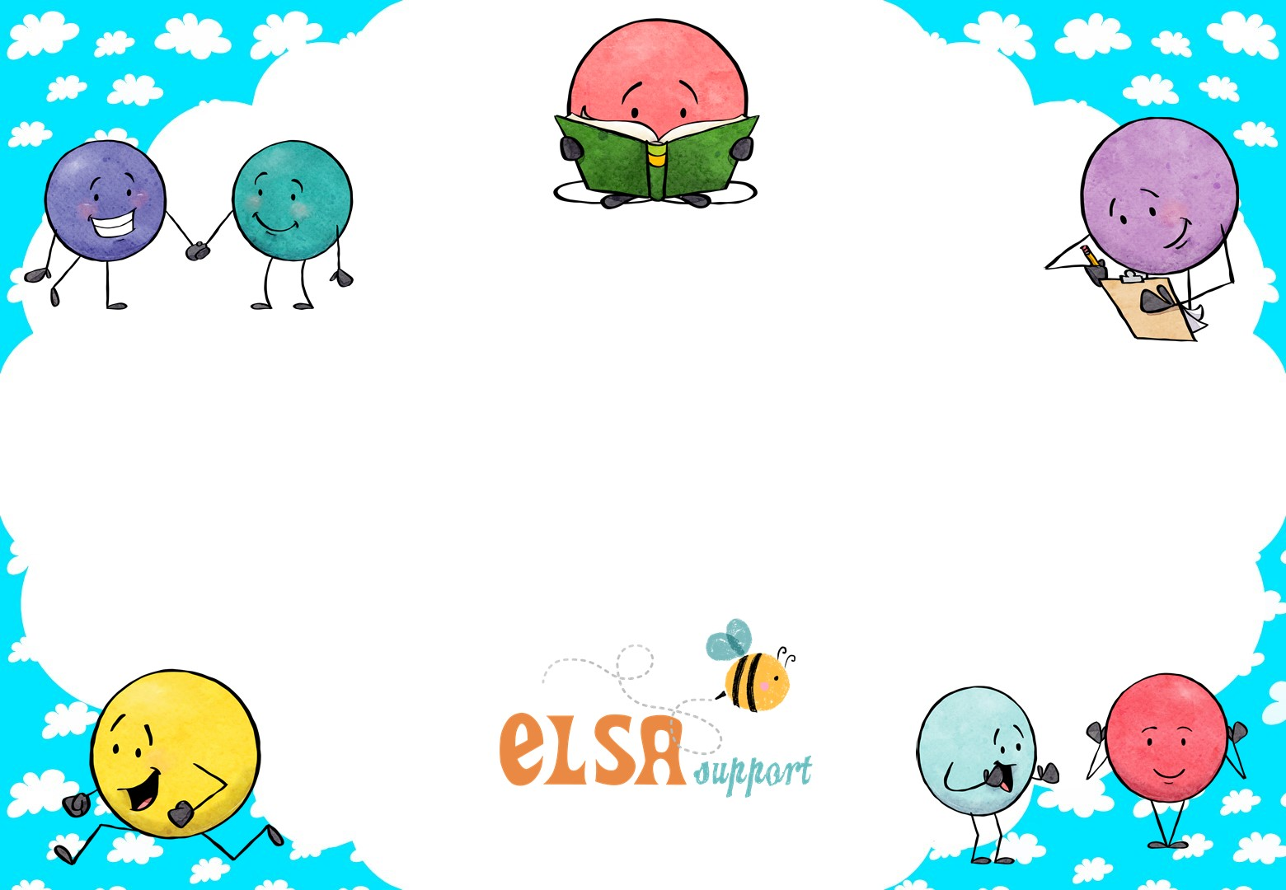
5 ways to wellbeing
www.elsa-support.co.uk

Slide 2
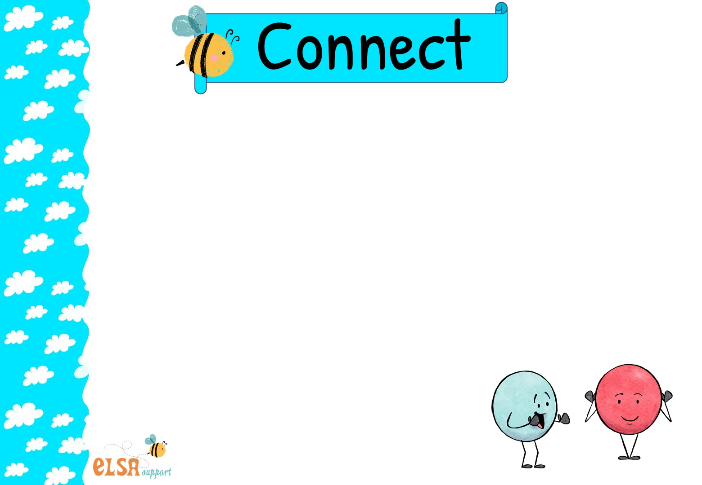
Making a connection with other people can feel AMAZING! Connecting with others makes you feel like you belong, you are important and you are valued. Belonging helps raise your self esteem.
You can connect with people in lots of different ways. Try and connect with someone EVERY day.
Talk to someone by telephone instead of texting or emailing
Speak to someone new in school that you haven’t spoken to before
Spend time talking to your sisters and brothers. Play a game with them or read a story and discuss the story.
Talk to your next door neighbour
Spend time listening, not just talking. Really listen to what others are saying.
Join a club or a group and get to know people who like the same things as you do

Slide 3
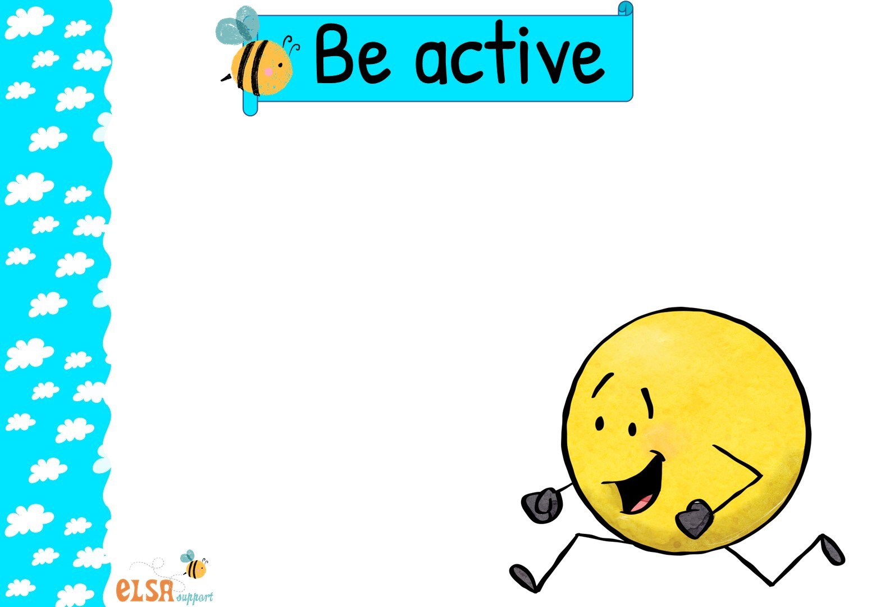
When you get physically active it can make you feel GREAT! People who exercise regularly have lower rates of sadness and depression and feel less anxious. It is a great way to reduce any anxiety you are feeling. You don’t have to do anything really intense or difficult.
You can fit exercise in your day in many ways. Try and exercise EVERY day.
Take up a sport
Go for a run or a walk
Do a silly dance
Make up a dance routine
Make up a daily exercise routine
Try your hand at gardening or growing things
Try yoga
Organise running races on the playground

Slide 4
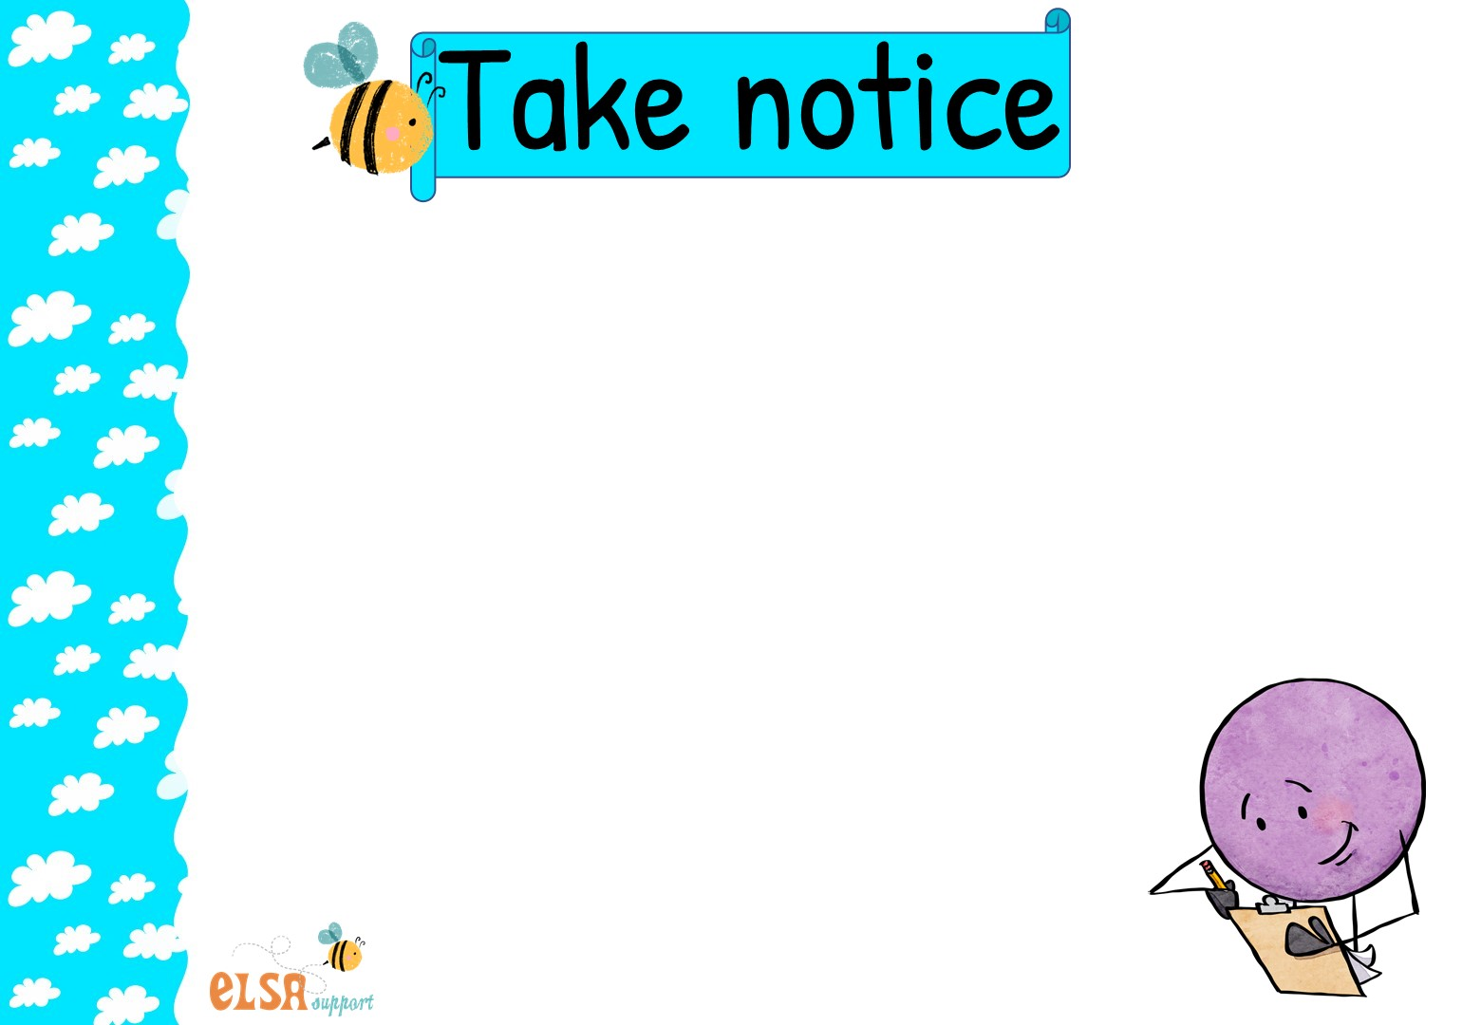
Taking notice is about appreciating things around you right now. This means being in the present moment, right now! No worries about the future no thoughts about past regrets, just observing and seeing what is there right now.
You can notice things every day in many ways. Try and take notice EVERY day
Look around the room and find something you haven’t noticed before
Notice your thoughts and feelings and accept them
Imagine you are an alien from another planet and see what you can notice about our planet earth
Go for a nature walk and notice things in nature
Get a camera and use it to take photos of things that are happening now
Notice colours, textures, sounds, smells, and shapes
Use your eyes, nose, ears, mouth and hands to see things around you
Notice the details in things. Try it with an every day object.

Slide 5
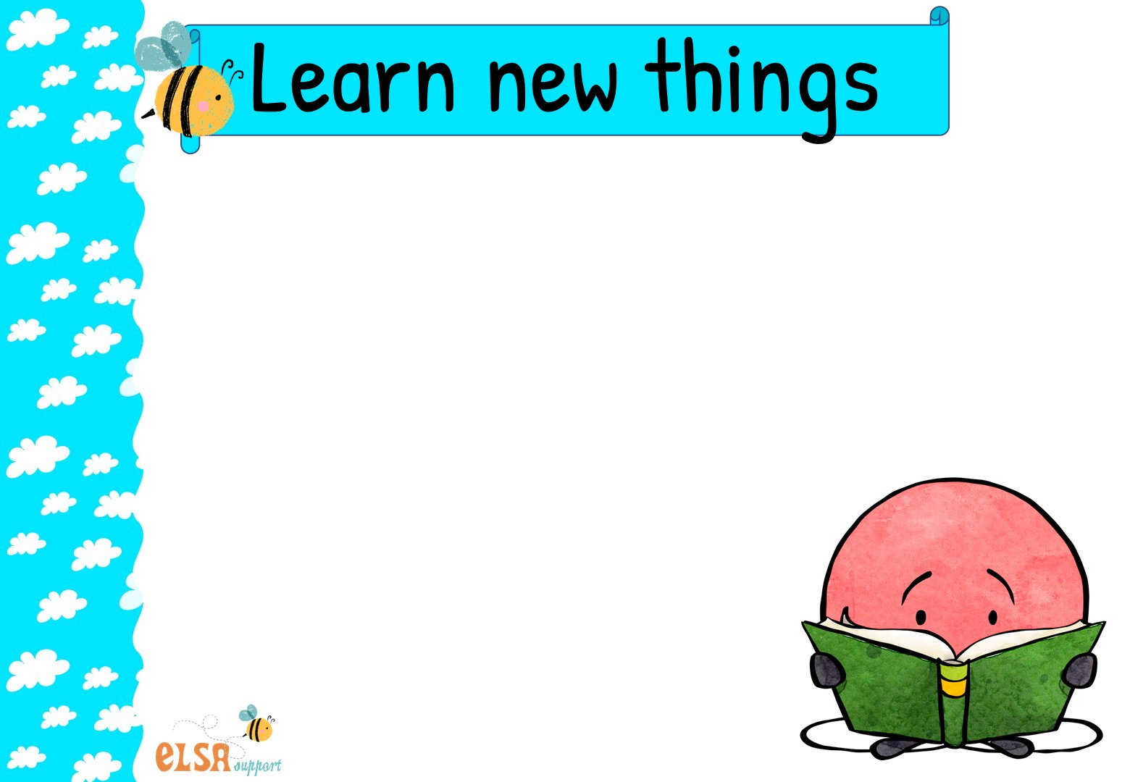
Learning new things feels GREAT! It doesn’t have to be much, just a little thing each day that you have learnt to do.
You can learn new things in many ways. Try and learn new things EVERY day.
Read books
Research on the computer
Listen to music
Practice a dance routine
Ask grandparents about how things used to be in their time at school
Watch documentaries on the TV
Find out more about something that interests you
Learn how to draw or paint

Slide 6
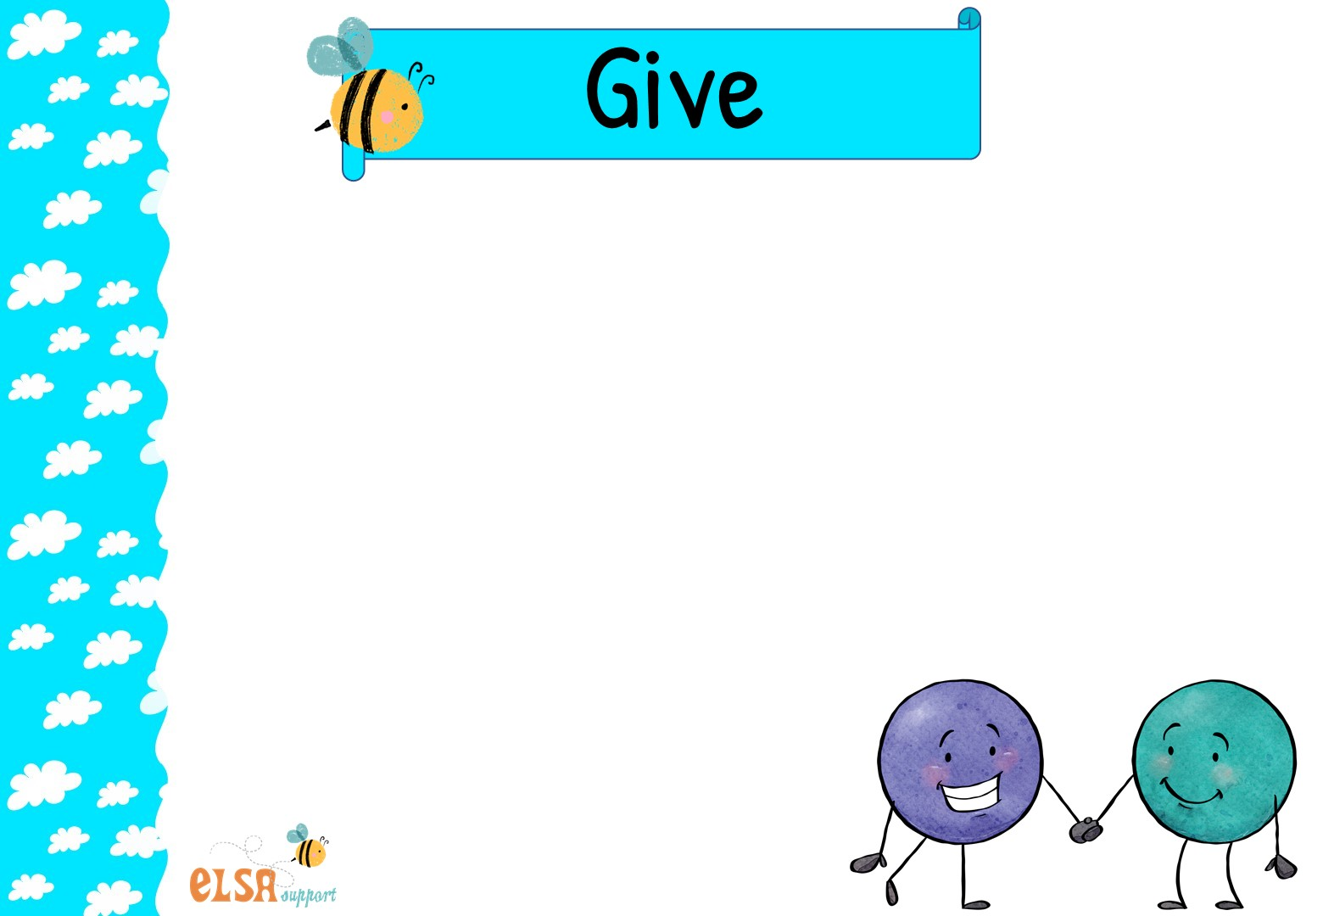
Giving or helping others feels GREAT! Have you noticed how you feel when you help someone?
You can fit giving or helping, in lots of ways. Try and give or help EVERY day.
Open a door for someone
Ask someone who is lonely to play or hang around with you
Do chores at home
Help your classmates or teacher in class
Do the shopping for an elderly neighbour
Offer to do some gardening for your grandparents
Compliment someone and make them feel good
Be kind to someone who looks sad
Raise money for a charity event

Slide 7
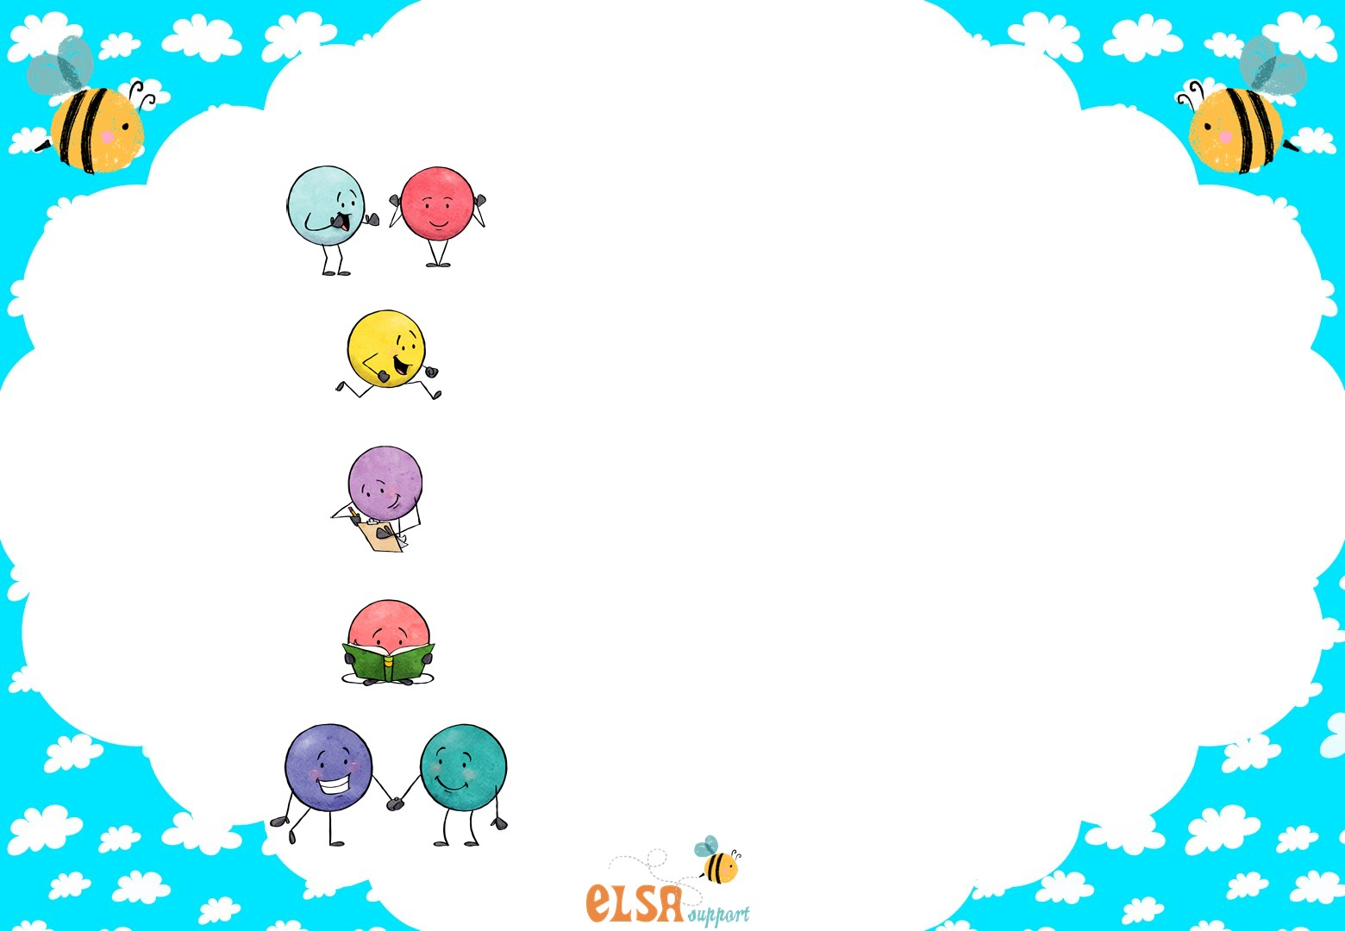
Remember
Connect
Be active
Take notice
Learn new things
Give

