Slide 1

Hawridge and
CHOLESBURY
Maths WORKSHOP
28th November 2019 Angela Hughes Maths Lead

Slide 2


Slide 3
Aims:
Its not taught the same as when I was at school!
    Times tables
    The four operations – whistle stop tour

Slide 4
Purpose of study
Aims
The national curriculum for mathematics aims to ensure that all pupils:
become fluent in the fundamentals of mathematics, including through varied and frequent practice with increasingly complex problems over time, so that pupils develop conceptual understanding and the ability to recall and apply knowledge rapidly and accurately.
reason mathematically by following a line of enquiry, conjecturing relationships and generalisations, and developing an argument, justification or proof using mathematical language
can solve problems by applying their mathematics to a variety of routine and non routine problems with increasing sophistication, including breaking down problems into a series of simpler steps and persevering in seeking solutions.

Slide 5
Mathematics in Early Years
Mathematics is classed as a specific area of learning.
It is divided into two areas:
Number
Shape, Space and Measure.
Maths is incorporated into the children’s everyday learning and they can access maths resources all day.

Slide 6
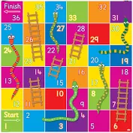
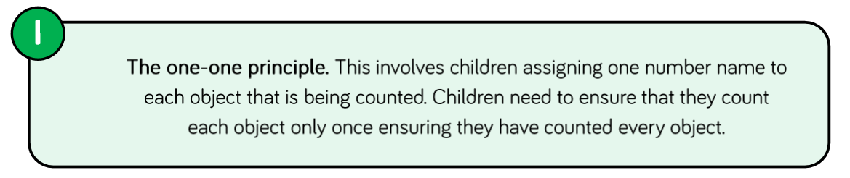

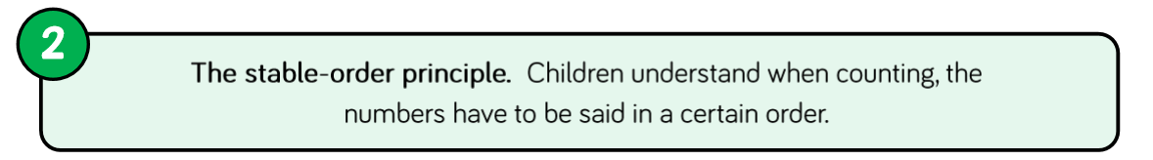
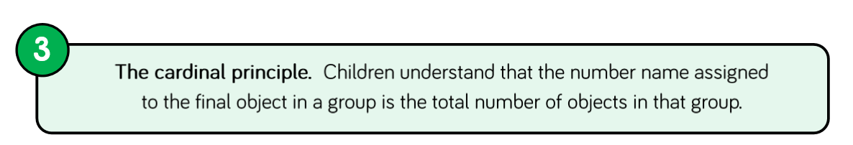
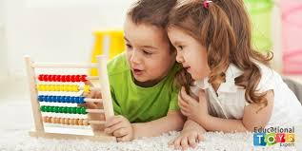
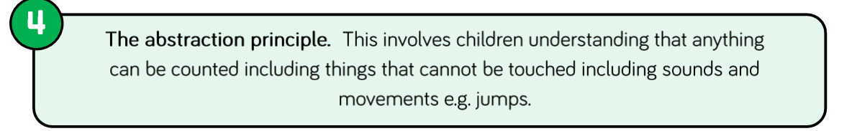
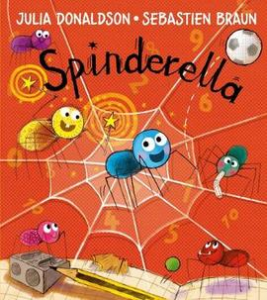
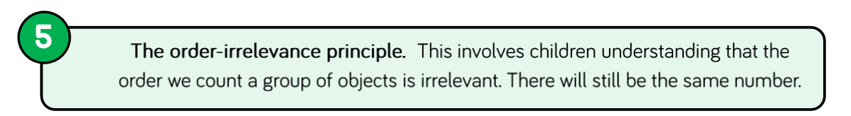
Current Curriculum

Slide 7
TIMES TABLES

Slide 8
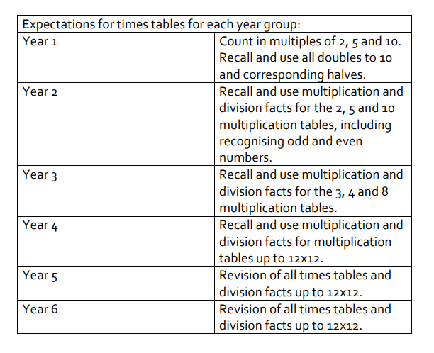
Year 4 MTC
June 2020
6 minute test online
25 question
6 secs to answer

Slide 9

Developing Pupils’ Reasoning And Understanding For Instant Recall
If we can develop children’s working memory with greater reasoning and understanding, there will be an increased transition to their long term memory and times tables can become an instantly recallable fact.
All children need to go through cognitive steps in order to achieve this. Some will only need a light touch whilst some will need significantly longer on particular points.

Slide 10
1. Repeated addition
4 x 5 is the same as 5 + 5 + 5 + 5.
This could be represented using concrete materials or pictures
2. Multiplication is commutative
4 x 5 is the same as 5 x 4.
3. Multiplication is the inverse of division
20 ÷ 5 = 4 can be worked out because 5 x 4 = 20.
4. Number families
4 x 5 = 20, 5 x 4 = 20, 20 ÷ 5 = 4, 20 ÷ 4 = 5
Due to their commutative understanding, by now children should also be able to see whole number families. For many children this will need to be pointed out and discussed. Most children will be able to explore this in its abstract form but if in doubt, go back to arrays.
From here it is only a short jump to understanding that any missing number can be worked out through knowledge of number families, e.g. 4 x [ ] = 20 or [ ] ÷ 4 = 5. There are other methods children can use to work out missing numbers but our goal is to increase working memory in order to increase instant recall from long term memory. Being able to bounce around a number family will achieve that.

Slide 11

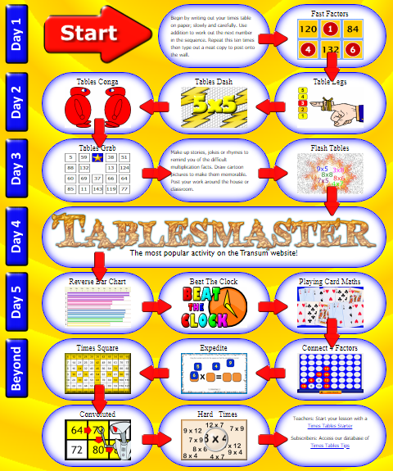

Transum…
http://www.transum.org/Tables/Times_Tables.asp

Slide 12
https://thirdspacelearning.com/blog/teach-times-tables-pupils-learn-instant-recall-ks1-ks2/

Slide 13
CALCULATION METHODS

Slide 14
addition
Mental maths
Number bonds (7+3, 17+3, 117+3)
Doubles and near doubles (9+8, 11+12)
Partitioning (27+7 20+14)
Written
Number line
Partitioning 25 + 38 (20+30) + (8+5) = 63
Formal written column methods
63
+52
115
Emphasis on self-checking - estimating, applying knowledge i.e. Odd + Odd= Even or using the inverse.
+5
+2
25+7 =
25
30
32

Slide 15
subtraction
Mental - adding on/finding the difference
84 - 67 = (67+3= 70 70 to 84, 14 so 14 +3)
Number line 65 – 54 =
Partitioning 60 5
- 50 4
10 1
Formal written column methods 65
- 54
                11
+ 6
+ 5
54
60
65

Slide 16
multiplication
x 10 x 100 place value
Groups of 2 x 3 =
The grid method 22 x13=
Formal written column methods
H | T | U
 | 1 | 3
1 | 3 | 0
x | 20 | 2
10 | 200 | 20
3 | 60 | 6
22
X 13
66
220
286

Slide 17

division
The ‘chunking’ or ‘repeated subtraction’ method
38
12 456
240 (12 x 20)
216
120 (12 x 10)
96
96 (12 x 8)
0
Formal written column methods
8 123 15 3/8 15.375
456
240
120
96
015 r3

Slide 18
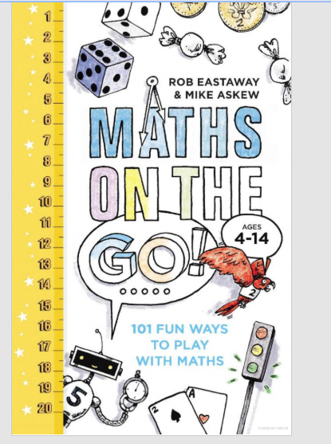
How you can support your child?
Make the most of opportunities at home – but in a relaxed way:
Talk about how many of something you can see? (Play the ‘truck game’ when travelling) Ask what’s one less and one more? Discuss whether it is an even or odd number?
Talk about why you choose a product because of the price when you shop. Especially 2 for 1, percentage discounts or multi buy.
Ask children to estimate how much you have spent . Allow them to handle small amounts of money and work out the change.

Slide 19
When you are travelling, talk casually about distance and time. How many miles you will get for the gallon? How much this will cost? Check it the next time you fill up?
When organising a party / play date let children work out quantities of plates, cups, cakes, biscuits etc.
Cooking with your child. Talk about estimates and total in grams etc.
One of the biggest barriers to becoming a mathematician is CONFIDENCE
These ideas can help your child to become confident with maths as part of their everyday lives.

