Slide 1
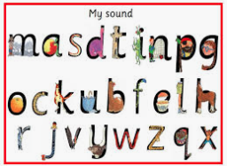
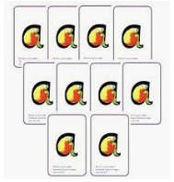
Phonics workshop for Parents/Carers
Thursday 24th October 2019

Slide 2
Aim:
To explain our approach to teaching phonics and early reading, enabling you as a parent/carer to support your child more easily and more effectively at home.
https://www.oxfordowl.co.uk/for-home/find-a-book/read-write-inc-phonics--1/

Slide 3
Summary of Phonics terminology
phoneme | the smallest unit of sound that can be heard in a word
grapheme | the recorded letters representing a phoneme, e.g. ai, igh, m
CVC words | consonant-vowel-consonant words, e.g. c-a-t, sh-ee-p
blend | joining phonemes together to read a word
segment | using phonetic knowledge to break down a word to read it
tricky words | words that cannot be segmented or blended using only phonics
digraph | a phoneme made of two letters e.g. sh, ee, oi.
trigraph | a phoneme made of three or more letters e.g. igh, air, eigh.

Slide 4
Phonics teaching
In our school we use Read Write Inc. Phonics programme. This is a national programme we find the children enjoy.
It also links in with our spelling programme which they begin in Year 2.

Slide 5


Pre Set 1
In this phase the children will develop their speaking and listening skills.
Some of the activities that the children will take part in during this phase are:
Going on a listening walk- ‘What can you hear?’
Listening to and joining in with rhyming stories
Playing I-Spy
Experimenting with different musical instruments
Using Fred Frog games

Slide 6
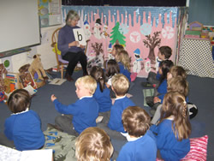
A Phonics Lesson
Phonics lessons are taught using the following structure:
- See/hear the new sound
Recognise the new sound
Write the new sound
Write previous sounds

Slide 7
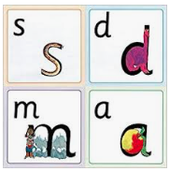
Speed Sounds
In this phase the children will learn groups of sounds each week:
Set 1:m – nk
Set 2: ay - oy
Set 3: ea – tious/cious
https://www.oxfordowl.co.uk/for-home/find-a-book/read-write-inc-phonics--1/
Notes:
Pure sounds
Cards on table – explore the sounds they make – Set 1, 2, 3
JW/CM lead demo (in packs words to good with it)

Slide 8
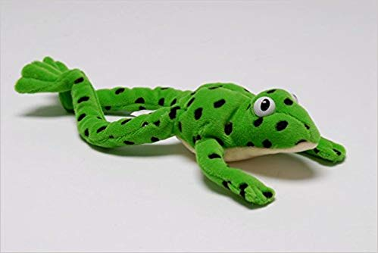
Blending
Green Words
c-a-t
The children will begin to blend simple words e.g. s-a-t,
s-i-t, m-a-t using Fred talk/sound buttons.
The children will then blend more complex words e.g.
b-l-ew, z-oo-m, s-n-ai-l, y-aw-n, b-oo-k
They will be able to read hundreds of words using the following 3 methods;
  Blending them aloud (Fred talk)
  Blending quickly and silently as blending and sounding is routine (Fred in your head)
  Automatically reading familiar words (including red words)
https://www.oxfordowl.co.uk/for-home/find-a-book/read-write-inc-phonics--1/
Notes:
Word build
Green word – fred talk, fred in your head, read the words
Teaching blending video

Slide 9
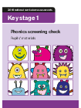
Phonics Screening
Takes place during the Summer term (June) for children in Year 1.
The check consists of 20 real words and 20 pseudo-words (which we call alien words) that a pupil reads aloud to the teacher.
Although this is a test we try to keep it as low key as possible for the children.
Notes:
CM to share examples of test.

Slide 10
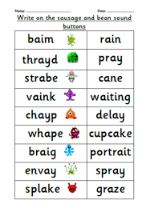

Slide 11
Blending
Supporting reading
c-a-t
When your child reads the story, ask him or her to sound out the words that he or she can’t read automatically. Don’t allow your child to struggle too much. Remind them to use Fred talk. Praise your child when he or she succeeds.
Read back each sentence or page to keep the plot moving. (Your child’s energy is going into reading the words not the story.)
Help your child to use the pictures and context to read the word
Ask your child questions about the book/story eg. What do they think will happen next? Can they relate it to their own life
Read the story more than once so that children become more confident and fluent readers
Do it all with patience and love!
Notes:
JW and CS act!!! Reading a book

Slide 12

Segmenting
Fred Fingers – Hold a word
Hold a sentence in your head
Children’s spelling may still be a bit unconventional at times but should start to be phonetically accurate

Slide 13
Our Spelling Scheme
We are using the Read Write Inc. spelling programme.
It is a robust, fast paced systematic spelling programme (starting in Year 2).
One of the main keys to spelling is to remember how to spell these sounds in different words.
This does not happen overnight!
Notes:
High frequency words for Year 1

Slide 14

How can you help your child at home?
Listen to your child read at least x5 a week
Regularly read to your child
Tricky word/phoneme bingo/word building games
I-Spy with initial sounds/Fred Games
Read Write Inc resources
Play phonic games on the following websites:
https://www.phonicsplay.co.uk/BuriedTreasure2.html

Slide 15
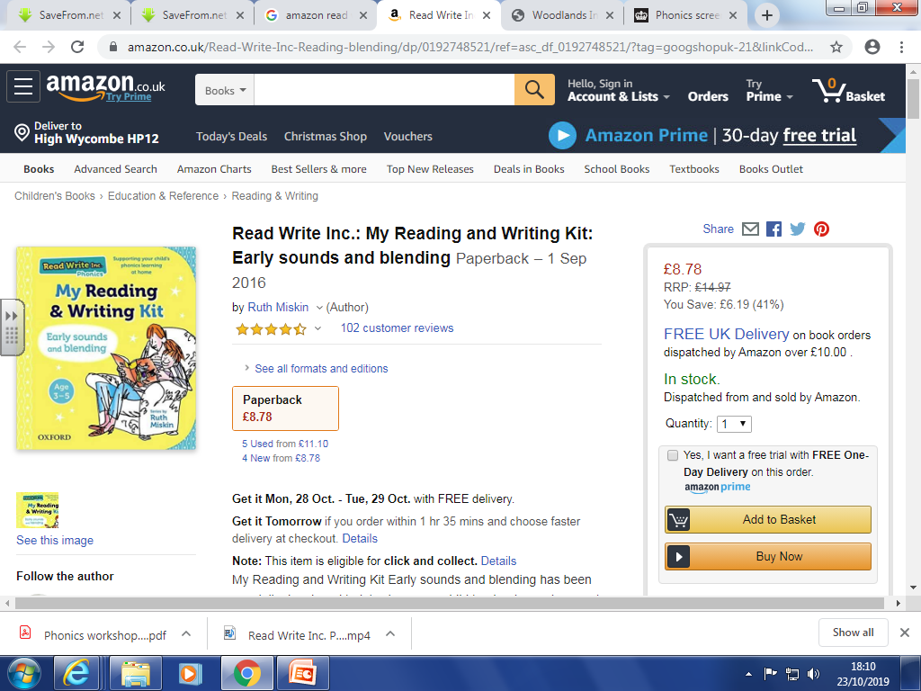

Slide 16
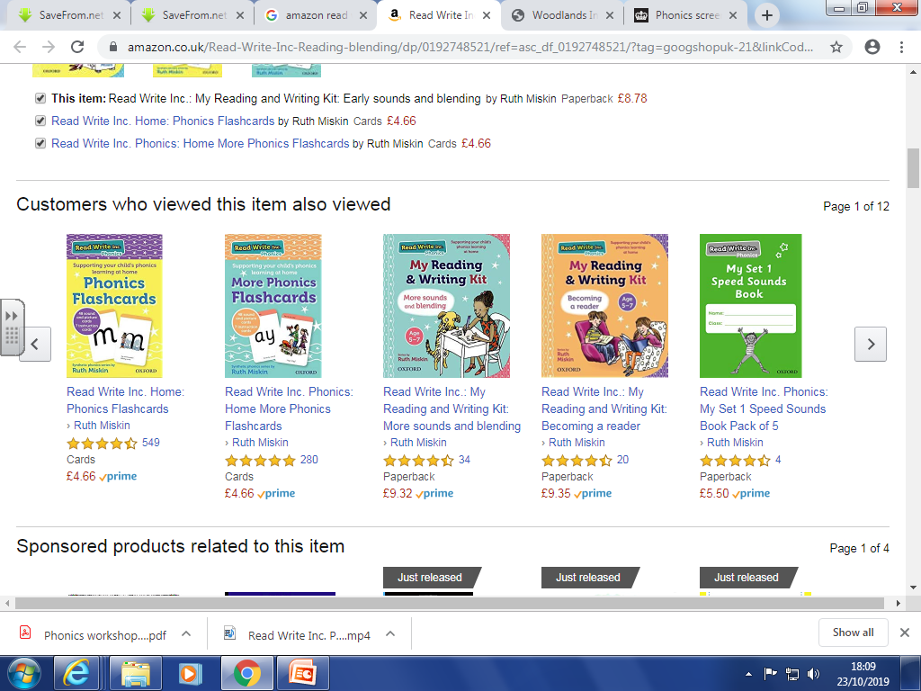

Slide 17

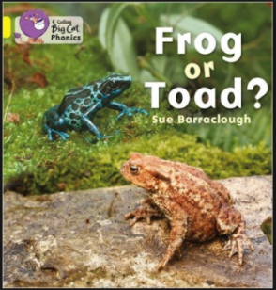




Phonics and Reading
At Hawridge and Cholesbury we aim to develop a reading community where children become confident and enthusiastic readers. For us to achieve this we need to take reading beyond the classroom. We want to create a rich reading environment where reading is encouraged by everyone and everywhere.

Slide 18

…and finally!
"The more that you read, the more things you will know. The more you learn, the more places you'll go.”
Dr. Seuss

