Slide 1
Y4. R2c: Can read and understand the meaning of words with prefixes from the Year 3/4 curriculum
.
Commissioned by The PiXL Club Ltd.
August 2019
This resource is strictly for the use of member schools for as long as they remain members of The PiXL Club. It may not be copied, sold nor transferred to a third party or used by the school after membership ceases. Until such time it may be freely used within the member school.
All opinions and contributions are those of the authors. The contents of this resource are not connected with nor endorsed by any other company, organisation or institution.
PiXL Club Ltd endeavour to trace and contact copyright owners. If there are any inadvertent omissions or errors in the acknowledgements or usage, this is unintended and PiXL will remedy these on written notification.
© Copyright The PiXL Club Limited, 2019

Slide 2
Teachers’ Notes
The PiXL therapies can be taught to a whole class or a target group. Each therapy is editable so that it can be adapted or extended.
Each therapy begins with a LORIC activity to develop relevant character attributes.
This is followed by a vocabulary task, which uses the PiXL 5-phase approach to teach key vocabulary. Further resources to develop vocabulary can be found in the Whole School area under the PiXL Unlock strategy.
Each therapy adopts the ‘Teach, model and apply’ process with plenty of opportunities for pupils to demonstrate the taught skill.
A range of question types are included to promote pupils developing security by testing the same skill in different ways.

Slide 3
Progress across amber – the 4 stage model
The three therapy tests which accompany this resource can be used to revisit the taught skill to check that the pupil is able to perform it independently and consistently.
A
A child has successfully completed a therapy test independently, following a set of therapy sessions.
A child has successfully completed a therapy test independently, a period after the relevant therapy sessions – we would advise about 2 weeks.
A child has successfully applied their knowledge or skill in an unfamiliar context. This may be application across the curriculum or in a problem.
A pupil has successfully re-visited the skills at a later point, and applies these in an unfamiliar context or problem, or across the curriculum.
A
DA
G

Slide 4
LORIC task
Which one of these definitions of resilience do you think is the best fit? Discuss as a class.
Resilience:
When you are trying incredibly hard to get better at something but it isn’t happening.
Resilience:
When you work incredibly hard to achieve something. Nothing will stop you!
Resilience:
When you give up because you realise that you can’t do something.
Resilience:
When you put little effort into getting better at something. You only do this if you can be bothered and it suits you. A low priority.

Slide 5
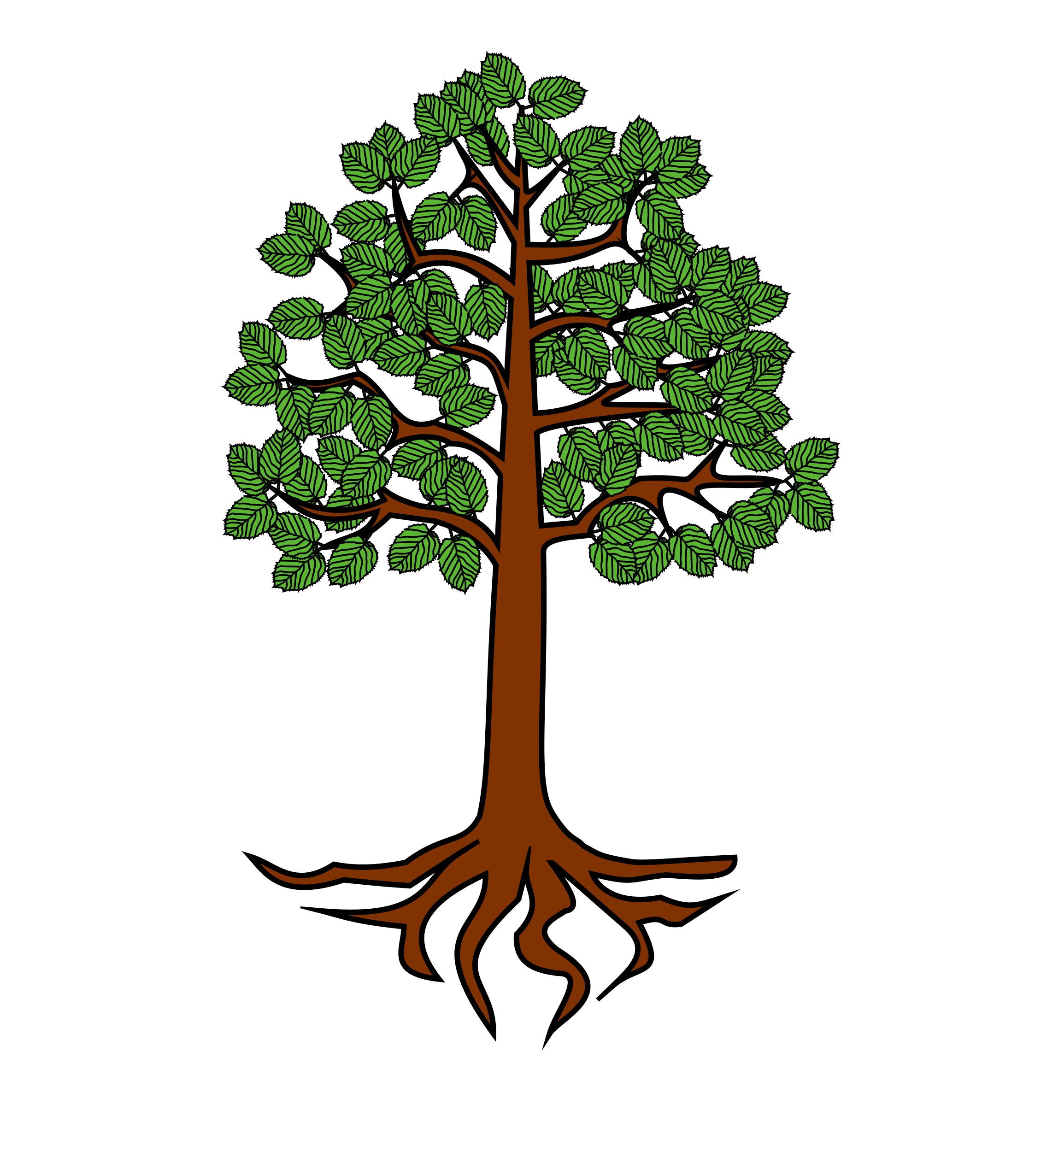
At the root of it
DECONSTRUCT IT
The prefix ‘un’ means not. Which root words can be added to this prefix to make a new word and what do the new words mean?
un
happy

Slide 6
Prefixes
Prefixes are letters which we add to the beginning of a word (this is known as the root word).
Adding this prefix makes a new word with a different meaning.
Prefixes can create a new word which is opposite in meaning to the word the prefix is attached to.
Prefixes can also make a word negative or express time, place or manner.

Slide 7
Prefixes
It is important that we know the definition of the different prefixes.
This allows us to read and understand words that have prefixes.
When we look for prefixes at the beginning of unfamiliar words it
helps us to know what part of the word means.
If we use our knowledge of the root word, and any other words in the sentence, then we can work out the meaning of the word with the prefix.

Slide 8
Prefixes
Here are definitions of those prefixes which do not require any changes to spelling when added to a root word.
Prefix | Definition
un | Means not. It gives a negative or opposite force.
dis | Means apart or away. Often has a negative or reversing force.
mis | Means wrong or incorrect. It is added to show that an action has been done badly.

Slide 9
Below are examples of how these prefixes change the definition of the root word.
Prefix | Root word | New word | Understanding the change in definition
un | happy | unhappy | The root word describes joy. By adding the prefix, the new word has the opposite meaning (antonym). It now means sad.
dis | appear | disappear | The root word means to become visible. By adding the prefix, the new word means the opposite. It now means to vanish or to go away from view.
mis | understand | misunderstand | The root word means to know the meaning of something. By adding the prefix, the new word means that someone thinks they know the meaning of something when they do not.

Slide 10
Prefixes
Here are some more definitions of prefixes which do not require any changes to spelling when added to a root word.
Prefix | Definition
re | Means again or back.
sub | Means under.
inter | Means between or among.

Slide 11
Below are examples of how these prefixes change the definition of the root word. Can you think of others?
Prefix | Root word | New word | Understanding the change in definition
re | decorate | redecorate | The root word means to make something more attractive. By adding the prefix, the new word means to go back and do this again differently or again.
sub | heading | subheading | The root word means a title for a main text. By adding the prefix, the new word means it is a title (underneath the main heading) for a part/section of the main text.
inter | national | international | The root word means existing in a country. By adding the prefix, the new word means existing between or among different countries.

Slide 12
Your turn
How many words can you list with the prefix ‘re’?
Notes:
R2c therapy after slide 11

Slide 13
Check how you did.
Here are some suggestions:
redo refresh revenge
return retrieve reflect
review react rebound
rewrite reverse recycle
Notes:
R42c therapy

Slide 14
Prefixes
Here are the definitions of some more prefixes which do not require any changes to spelling when added to a root word.
Prefix | Definition
super | Means above or beyond.
anti | Means against.
auto | Means self or own.

Slide 15
Below are examples of how these prefixes change the definition of the root word. Can you think of others?
Prefix | Root word | New word | Understanding the change in definition
super | star | superstar | The root word in this context means a famous person. By adding the prefix, the new word means an extremely famous person.
anti | social | antisocial | The root word means friendly, seeking companionship with others. By adding the prefix, the new word means offensive or showing unacceptable behaviour around others.
auto | biography | autobiography | The root word means an account of someone’s life written by someone else. By adding the prefix, the new word means an account of a person’s life written by that person.

Slide 16
Prefixes
Here are the definitions of some more prefixes which do not require any changes to spelling when added to a root word.
Prefix | Definition
non | Means not.
pre | Means before.
co | Means with.
ex | Means out.

Slide 17
Below are examples of how these prefixes change the definition of the root word. Can you think of others?
Prefix | Root word | New word | Understanding the change in definition
non | stop | nonstop | The root word means to cease moving. By adding the prefix, the new word means to never cease moving. Never stops.
pre | view | preview | The root word means to see something. By adding the prefix, the new word means to see something before someone else.
co | exist | coexist | The root word means to live. By adding the prefix, the new new word means to live with others.
ex | pose | expose | The root word means to present or take position. By adding the prefix, the new word means to bring something out into the open and reveal it.

Slide 18
Prefixes
Let’s look at the definition of a prefix which sometimes changes its spelling when added to root words.
Prefix | Definition
in | Means both ‘not’ and ‘in/into’. In these slides it will mean ‘not’.

Slide 19
Below are examples of how the prefix ‘in’ changes the definition of the root word. Can you think of others?
Prefix | Root word | New word | Explanation of the spelling rule and understanding the change in definition.
in | correct | incorrect | The root word means right or accurate. By adding the prefix, the new word means wrong or not accurate.
in | legal | illegal | Before a root word starting with l, in– becomes il. The root word means permitted by law. By adding the prefix, the new word means not permitted by law.

Slide 20
Your turn
How many words can you list with the prefix ‘pre’?
Notes:
R2c therapy after slide 11

Slide 21
Check how you did.
Here are some suggestions:
precaution prearrange
prewrite predecessor
preview premeditate
predetermine prepaid
Notes:
R42c therapy

Slide 22
Below are more examples of how the prefix ‘in’ changes the definition of the root word.
Prefix | Root word | New word | Explanation of the spelling rule and understanding the change in definition.
in | possible | impossible | Before a root word starting with m or p, in– becomes im–. The root word means to be able to. By adding the prefix, the new word means to not be able to.
in | regular | irregular | Before a root word starting with r, in– becomes ir–. The root word means uniform, consistent and even. By adding the prefix, the new word means not consistent or non-uniform or misshapen.

Slide 23
Your turn
Can you match the prefixes on the left with their meanings on the right?
super-
re-
ex-
un-
co-
out
above
with
again
not

Slide 24
Check how you did.
super-
re-
ex-
un-
co-
out
above
with
again
not

Slide 25
The prefix un- can be added to the word able to make the word unable.
What does the word unable mean?
Tick one
not steady
successful
does not have the skills
can do something

Slide 26
Check you answer.
What does the word unable mean?
Tick one
not steady
successful
does not have the skills
can do something
✓

Slide 27
What is the definition of the root word in the word below?
imperfect
Tick one
without any faults
has some flaws
exact
wonderful

Slide 28
What is the definition of the root word in the word below?
imperfect
Tick one
without any faults
has some flaws
exact
wonderful
✓

Slide 29
Use your understanding of the meaning of a prefix to answer the question below.
Tick the option below which is closest in meaning to this sentence.
The terrible rain undid all the work we did in the garden yesterday.
Tick one
The rain has really improved the appearance of the garden.
The rain has really helped us.
The rain will return again tomorrow.
The rain has destroyed everything we did yesterday.

Slide 30
Use your understanding of the meaning of a prefix to answer the question below.
Tick the option below which is closest in meaning to this sentence.
The terrible rain undid all the work we did in the garden yesterday.
Tick one
The rain has really improved the appearance of the garden.
The rain has really helped us.
The rain will return again tomorrow.
The rain has destroyed everything we did yesterday.
✓

Slide 31
Use your understanding of the meaning of a prefix to answer the question below.
Tick the option below which is closest in meaning to this sentence.
The children are very immature in this class.
Tick one
The children are very well behaved.
The children are very young.
The children behave younger than they are.
The children behave as if they are adults.

Slide 32
Use your understanding of the meaning of a prefix to answer the question below.
Tick the option below which is closest in meaning to this sentence.
The children are very immature in this class.
Tick one
The children are very well behaved.
The children are very young.
The children behave as if they are younger than they are.
The children behave as if they are adults.
✓

Slide 33
Reflection
Remember to use these tips to help you read and understand the meaning of words with prefixes.
Adding a prefix makes a new word with a different meaning.
Learn the definition of the different prefixes.
Use your knowledge of the root word, and any other words in the sentence to work out the meaning of the word with the prefix.

