Slide 1
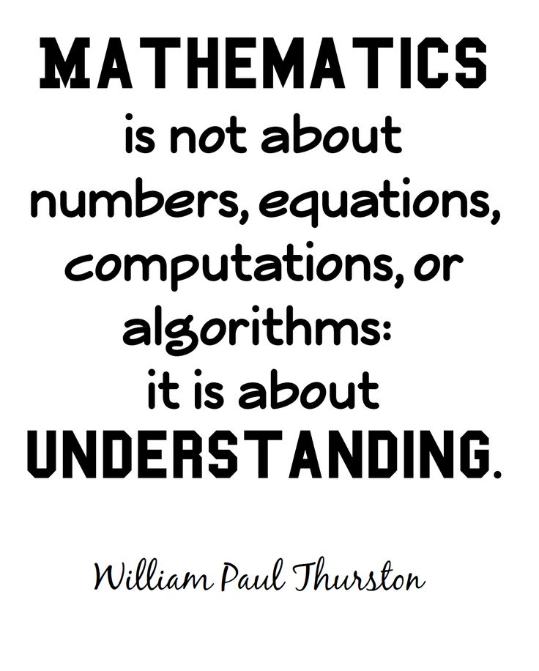
Hawridge and Cholesbury
Mastery Maths

Slide 2
Mathematics programmes of study key stage 1 and 2
Aims
The national curriculum for mathematics aims to ensure that all pupils:
become fluent in the fundamentals of mathematics, including through varied and frequent practice with increasingly complex problems over time, so that pupils develop conceptual understanding and the ability to recall and apply knowledge rapidly and accurately.
reason mathematically by following a line of enquiry, conjecturing relationships and generalisations, and developing an argument, justification or proof using mathematical language
can solve problems by applying their mathematics to a variety of routine and non-routine problems with increasing sophistication, including breaking down problems into a series of simpler steps and persevering in seeking solutions.

Slide 3
DOMAINS | Y1 | Y2 | Y3 | Y4 | Y5 | Y6
Number
Place Value | x | x | x | x | x | x
Addition and subtraction | x | x | x | x | x | x
Multiplication and Division | x | x | x | x | x | x
Fractions |  | x | x | x | x | x
Measurement | x | x | x | x | x | x
Geometry | x | x | x | x | x | x
Statistics |  | x | x | x | x | x
Ratio and proportion |  |  |  |  |  | x
Algebra |  |  |  |  |  | x

Slide 4
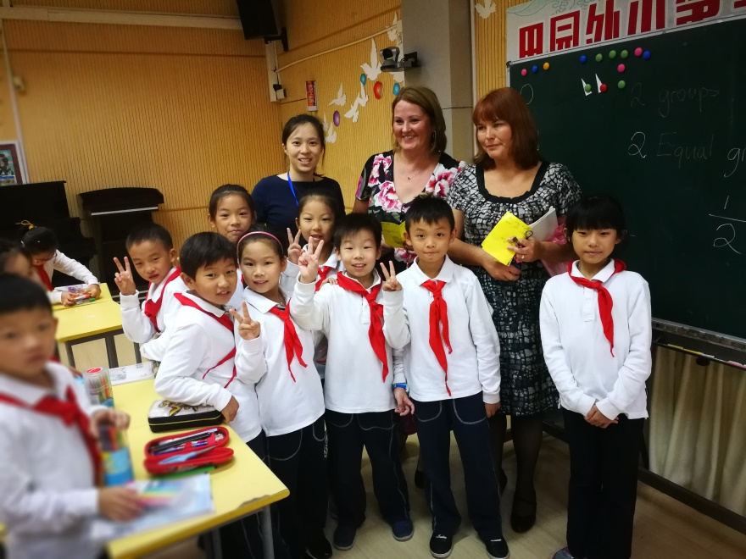
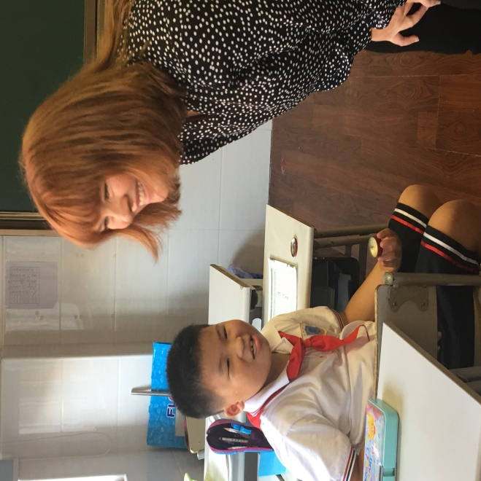
Why Shanghai?

Slide 5
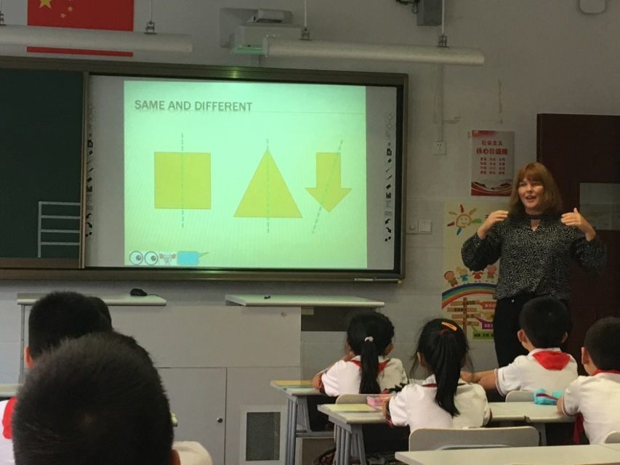
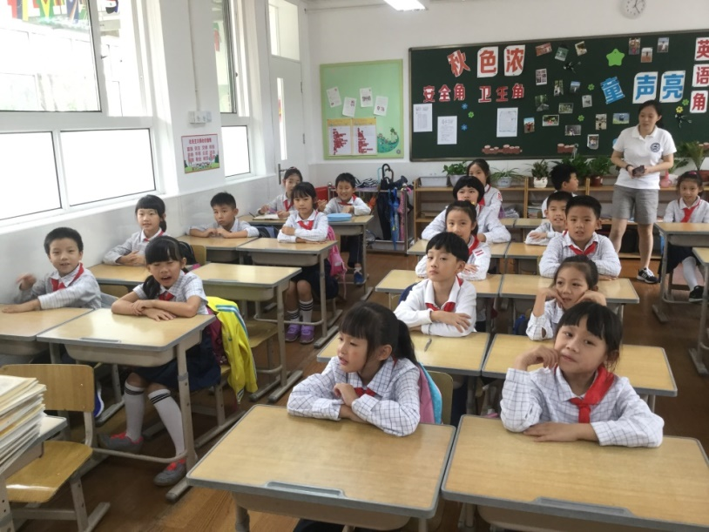
Shanghai observations
45 children per class
35 minute lessons
Homework set each night
Expectation that everyone one will complete
Small steps designed so all class can access learning
Expert questioning
Correcting misconceptions built into next lesson

Slide 6
Mastery approach to mathematics
Certain principles and features characterise this approach:
Teachers reinforce an expectation that all pupils are capable of achieving high standards in mathematics.
The large majority of pupils progress through the curriculum content at the same pace. Differentiation is achieved by emphasising deep knowledge and through individual support and intervention.
Teaching is underpinned by methodical curriculum design and supported by carefully crafted lessons and resources to foster deep conceptual and procedural knowledge.
Practice and consolidation play a central role. Carefully designed variation within this builds fluency and understanding of underlying mathematical concepts in tandem.
Teachers use precise questioning in class to test conceptual and procedural knowledge, and assess pupils regularly to identify those requiring intervention so that all pupils keep up.
The intention of these approaches is to provide all children with full access to the curriculum, enabling them to achieve confidence and competence – ‘mastery’ – in mathematics, rather than many failing to develop the maths skills they need for the future.

Slide 7
I had 13 balloons, 7 blow away…

Slide 8
13
– 7 =
3
4
13 is 10 and 3.
Partition 7 into 3 and 4.
Take away 3 and then take away 4.

Slide 9
Key Features of the mastery approach
Teaching resources
A coherent programme of high quality curriculum materials is used to support classroom teaching. Concrete and pictorial representations of mathematics are chosen carefully to help build procedural and conceptual knowledge together. Exercises are structured with great care to build deep conceptual knowledge alongside developing procedural fluency.
The focus is on the development of deep structural knowledge and the ability to make connections. Making connections in mathematics deepens knowledge of concepts and procedures, ensures what is learnt is sustained over time, and cuts down the time required to assimilate and master later concepts and techniques.

Slide 10
Key Features of the mastery approach
Lesson design
Lessons are crafted with care. Lesson designs set out in detail well-tested methods to teach a given mathematical topic. They include a variety of representations needed to introduce and explore a concept effectively and also set out related teacher explanations and questions to pupils.

Slide 11
Key Features of the mastery approach
Teaching methods
Teachers are clear that their role is to teach in a precise way which makes it possible for all pupils to engage successfully with tasks at the expected level of challenge. Pupils work on the same tasks and engage in common discussions. Concepts are often explored together to make mathematical relationships explicit and strengthen pupils’ understanding of mathematical connectivity.
Precise questioning during lessons ensures that pupils develop fluent technical proficiency and think deeply about the underpinning mathematical concepts. There is no prioritisation between technical proficiency and conceptual understanding; in successful classrooms these two key aspects of mathematical learning are developed in parallel.

Slide 12
Key Features of the mastery approach
Pupil support and differentiation
Taking a mastery approach, differentiation occurs in the support and intervention provided to different pupils, not in the topics taught, particularly at earlier stages. There is little differentiation in content taught, but the questioning and scaffolding individual pupils receive in class as they work through problems will differ, with higher attainers challenged through more demanding problems which deepen their knowledge of the same content. Pupils’ difficulties and misconceptions are identified through immediate formative assessment and addressed with rapid intervention – commonly through individual or small group support later the same day.

Slide 13
Key Features of the mastery approach
Productivity and practice
Fluency comes from deep knowledge and practice. Pupils work hard and are productive. At early stages, explicit learning of multiplication tables is important in the journey towards fluency and contributes to quick and efficient mental calculation. Practice leads to other number facts becoming second nature. The ability to recall facts from long term memory and manipulate them to work out other facts is also important.
All tasks are chosen and sequenced carefully, offering appropriate variation in order to reveal the underlying mathematical structure to pupils. Both class work and homework provide this ‘intelligent practice’, which helps to develop deep and sustainable knowledge.

Slide 14
Pupils who grasp concepts rapidly should be challenged through rich and sophisticated problems before any acceleration through new content. Those pupils who are not sufficiently fluent with earlier material should consolidate their understanding, including through additional practice, before moving on.
NRICH

Slide 15
Key Features of the mastery approach

Slide 16
Key Features of the mastery approach

Slide 17
Key Features of the mastery approach
Spoken language
The national curriculum for mathematics reflects the importance of spoken language in pupils’ development across the whole curriculum – cognitively, socially and linguistically. The quality and variety of language that pupils hear and speak are key factors in developing their mathematical vocabulary and presenting a mathematical justification, argument or proof. They must be assisted in making their thinking clear to themselves as well as others and teachers should ensure that pupils build secure foundations by using discussion to probe and remedy their misconceptions.
Notes:
There are three main ways in which children’s failure to understand mathematical vocabulary may show itself:
• children do not respond to questions in lessons
• they cannot do a task they are set
• they do poorly in tests.

Slide 18
Reasoning

Slide 19
Calculation methods

Slide 20
Calculation methods: addition
Mental maths
Number bonds (7+3, 17+3, 117+3)
Doubles and near doubles (9+8, 11+12)
Partitioning (27+7 20+14)
Written
Number line
Partitioning 25 + 38 = (20+30) + (8+5) = 63
Formal written column methods
63
+52
115
25+7 =
+5
+2
25
30
32

Slide 21
Calculation methods: subtraction
Mental
Number line 65 – 14 =
Partitioning 60 5 - 10 4
50 1
Formal written column methods 65
-54
11
-4
-10
51
55
65

Slide 22
Calculation methods: multiplication
Times table practice
x 10 x 100 place value x 10
Groups of 2 x 3 =
The grid method 22 x13=
Formal written column methods
H | T | U
 | 1 | 3
1 | 3 | 0
x | 20 | 2
10 | 200 | 20
3 | 60 | 6
22
X 13
66
220
286

Slide 23
Calculation: division
The ‘chunking’ or ‘repeated subtraction’ method
38
12 456
240 (12 x 20)
216
120 (12 x 10)
96
96 (12 x 8)
0
Formal written column methods
8 123 15 3/8 15.375
015 r3

Slide 24
Parent factor
The volume and statistical significance of the evidence, both quantitative and qualitative, strongly demonstrates that parental engagement leads to increased confidence and improved behaviours in maths and raises standards of attainment. Parents are indeed a significant factor in determining how well children learn maths, and schools should work towards improving the level and quality of parental engagement.
http://www.familymathstoolkit.org.uk/
Talk about time and schedules
Spend real money and work out the change
Measure out materials and ingredients
Estimate quantities, lengths, weights and percentages
Work on your child’s targets shared at parents eve
Support them when doing homework

Slide 25
Everyone can succeed
At Hawridge and Cholesbury we strongly believe that all students can succeed in mathematics. We don’t believe that there are individuals who can do maths and those that can’t. A positive teacher mindset and strong subject knowledge are key to student success in mathematics.

Slide 26
Classroom visits
We invite you now to go and spend 30 mins in your child’s class.
Please feel free to sit by your child and find out what they are doing as well as how.

