Slide 1
Securing Sentence Composition
What makes a sentence?
1b. Recognise when a sentence is not a complete thought.
Commissioned by The PiXL Club Ltd.
October 2018
This resource is strictly for the use of member schools for as long as they remain members of The PiXL Club. It may not be copied, sold nor transferred to a third party or used by the school after membership ceases. Until such time it may be freely used within the member school.
All opinions and contributions are those of the authors. The contents of this resource are not connected with nor endorsed by any other company, organisation or institution.
PiXL Club Ltd endeavour to trace and contact copyright owners. If there are any inadvertent omissions or errors in the acknowledgements or usage, this is unintended and PiXL will remedy these on written notification
© Copyright The PiXL Club Limited, 2018

Slide 2
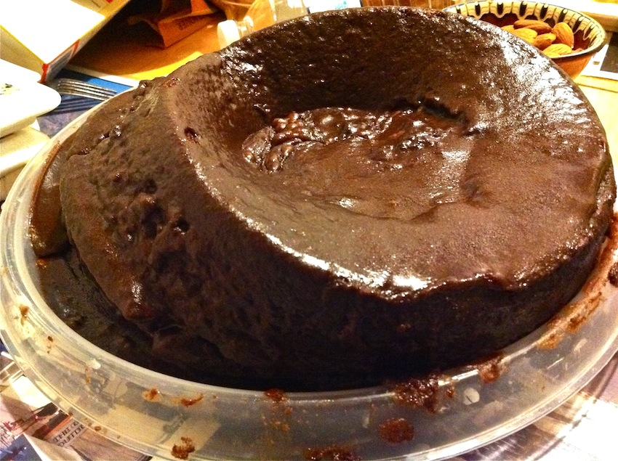
The right ingredients
To bake a cake, you need to mix in all the right ingredients. If an ingredient is missing, it is no longer a cake.
The same is true for composing a sentence. To be a sentence, it needs to have all the ingredients. If one element is missing, it is no longer a sentence.

Slide 3
Sentence ingredients
Linking words together to express complete thoughts creates sentences. A sentence needs a subject and a predicate. It should have a capital letter at the beginning and a punctuation mark at the end, like a full stop (.), a question mark (?) or an exclamation mark (!).
end mark
capital letter
predicate
subject
= a sentence
The kangaroo jumped across the road.
Expresses a complete thought.

Slide 4
Identify the sentences
Tip: Look for each sentence ingredient. If any are missing, it is not a sentence.
They found a baby bird. |  | It has a subject, predicate, expresses a complete thought and is correctly punctuated.
Strange, little creatures outside. |  | There is no predicate (verb).
There are no pens in the pot |  | This is missing a punctuation mark.
Sausage is down tree sit. |  | This does not express a complete thought, it does not make sense.

Slide 5
Practise
Identify the sentences in this list below.
Horses neigh.
A school of fish always together.
Becky cannot fish if she does not get up early.
Who is the most popular singer
Challenge: What changes need to be made to turn the incomplete sentences into complete sentences?

Slide 6
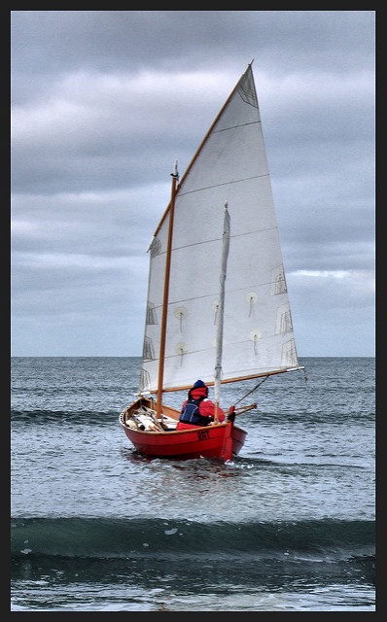
Find the incomplete sentences
I am a little red boat and I am travelling down the mighty Amazon River. Behind me, raging rapids down this unknown path. My sails have been shredded by the water. Bravely, I continue my journey through the thick jungle that is either side of me. The shrieking monkeys with long tails from tree to tree. In the grass, there is a slithering, slimy snake Ahead I a cave. Perhaps there is gold buried there. CRASH! I hit a jagged rock and a big hole appears in my side. Slowly and sadly, sink to the bottom. This dark and bumpy river bed now my home forever more.

Slide 7
Did you find them all?
I am a little red boat and I am travelling down the mighty Amazon River. Behind me, raging rapids down this unknown path. My sails have been shredded by the water. Bravely, I continue my journey through the thick jungle that is either side of me. The shrieking monkeys with long tails from tree to tree. In the grass, there is a slithering, slimy snake Ahead I a cave. Perhaps there is gold buried there. CRASH! I hit a jagged rock and a big hole appears in my side. Slowly and sadly, sink to the bottom. This dark and bumpy river bed now my home forever more.

Slide 8
One word sentences
It is possible to have a one-word sentence as the subject of the sentence is implied and understood. The one word in the sentence must be an imperative verb.
Perhaps there is gold buried there. CRASH!
The assumed subject is the boat.

Slide 9
Challenge
Rewrite the highlighted sections as complete sentences.

