Slide 1
.
Writing
Y4 W5c. Basic elements of story structure are present
Commissioned by The PiXL Club Ltd.
January 2020
This resource is strictly for the use of member schools for as long as they remain members of The PiXL Club. It may not be copied, sold nor transferred to a third party or used by the school after membership ceases. Until such time it may be freely used within the member school.
All opinions and contributions are those of the authors. The contents of this resource are not connected with nor endorsed by any other company, organisation or institution.
PiXL Club Ltd endeavour to trace and contact copyright owners. If there are any inadvertent omissions or errors in the acknowledgements or usage, this is unintended and PiXL will remedy these on written notification.
© Copyright The PiXL Club Limited, 2020

Slide 2
Teachers’ Notes
The PiXL therapies can be taught to a whole class or a target group. Each therapy is editable so that it can be adapted or extended.
Each therapy begins with a LORIC activity to develop relevant character attributes.
This is followed by a vocabulary task, which uses the PiXL 5-phase approach to teach key vocabulary. Further resources to develop vocabulary can be found in the Whole School area under the PiXL Unlock strategy.
Each therapy adopts the ‘Teach, model and apply’ process with plenty of opportunities for pupils to demonstrate the taught skill.
A range of question types is included to promote pupils’ developing security by testing the same skill in different ways.

Slide 3
Progress across amber – the 4-stage model
The three therapy tests which accompany this resource can be used to revisit the taught skill to check that the pupil is able to perform it independently and consistently.
A
A child has successfully completed a therapy test independently, following a set of therapy sessions.
A child has successfully completed a therapy test independently, a period after the relevant therapy sessions – we would advise about 2 weeks.
A child has successfully applied their knowledge or skill in an unfamiliar context. This may be application across the curriculum or in a problem.
A pupil has successfully re-visited the skills at a later point, and applies these in an unfamiliar context or problem, or across the curriculum.
A
DA
G

Slide 4
LORIC Task
Our Primary Edge attributes help us to become better learners and today is no exception. Before you start this activity, here are some ideas for how you will need your Izzy Initiative skills today:
Volunteering to take part
Developing your strategies
Making suggestions to the group
Command Words: Volunteer Develop Suggest

Slide 5
In small groups, join hands to form a circle. The objective is to pass a balloon around the circle whilst keeping it off the floor. If it touches the floor, the group loses the use of a body part – this part of the body will not be allowed to touch the balloon.
LORIC Task
Did you make any suggestions, volunteer ideas or develop different strategies?

Slide 6
Match it up
Put these words into pairs according to their meaning. Discuss the connections that you made.
awful strolled decline
derogatory rude disgusting
accept ambled
Vocabulary activity

Slide 7
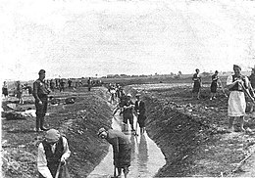
What’s missing?
Are there any missing parts to this story? What is missing?
Despite all our efforts, they came in the middle of the morning. Our seventeen days of freedom was about to end. It was a dark, grey day that reflected our mood perfectly. The basement door was ripped off its hinges as they swarmed in like an army of ants. One by one we were led outside to the truck and taken to the labour camp where we would spend the rest of our days.

Slide 8
What’s missing?
There is no beginning, build up or climax. The reader doesn’t know what happened before the characters were recaptured. In fact, they do not even know who the characters are. For a story to make sense and be complete it needs to have a beginning, middle and end.

Slide 9
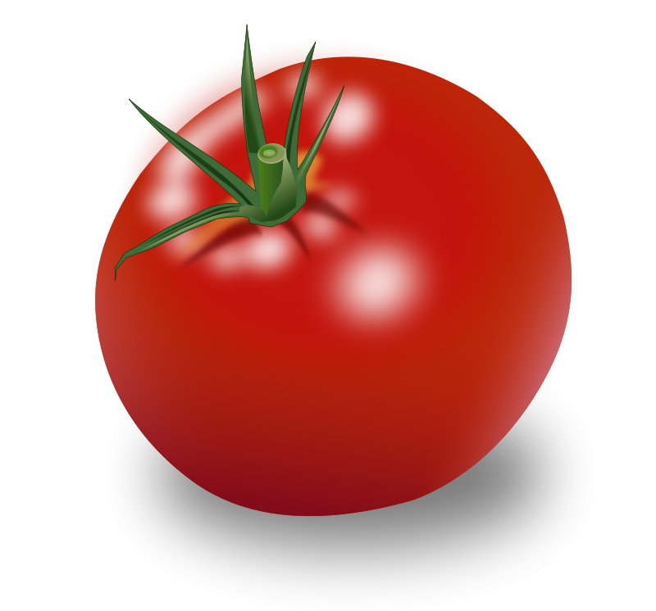
Story structure
Just like a good stew, a story needs several ingredients to make it complete.
Story Stew
Ingredients:
A beginning (character and setting)
A middle (build up and climax)
An ending (resolution)

Slide 10
Story structure
Each part has an essential role in making a story complete.
Beginning | This part introduces the reader to the characters and sets the scene.
Middle | The middle includes a build up to the problem or action and then the climax. The climax is where something goes wrong and is the peak of the action.
End | The resolution explains how the problem is solved and the ending explains the impact on the characters, the lesson learnt and thoughts about the recent events.

Slide 11
Story sequence
When writing a narrative, we need to get our ideas in the right order so that the reader can understand what’s going on. There are different ways of writing a story. However, one thing stays the same: you always need a beginning, middle and end.

Slide 12
Practise
Can you put these ideas into the right order?
“Why won’t this work,” Mike grumbled as he checked his circuits again.
Mike was bored of watching television, so he went outside to continue working on his secret project.
Suddenly, he heard a strange electronic noise EEEP HHHAAA IIIICC.
He had been building a radio receiver for a science competition.
Then there was silence. Did that really happen or was it his imagination?

Slide 13
How did you do?
Mike was bored of watching television, so he went outside to continue working on his secret project.
He had been building a radio receiver for a science competition.
“Why won’t this work,” Mike grumbled as he checked his circuits again.
Suddenly, he heard a strange electronic noise EEEP HHHAAA IIIICC.
Then there was silence. Did that really happen or was it his imagination?

Slide 14
Beginnings
A beginning introduces the reader to a character or a setting. It should be engaging and make the reader want to keep reading.
There are many ways to open a story:
You can begin by describing a character or setting.
You can start your story in the middle of some action.
You can begin with a question or a fronted adverbial to suggest the time period.
You can start with some dialogue.

Slide 15
Beginnings
Which of these could be a beginning?
A seven-year-old girl, rather small for her age, skipped cheerfully down the road, her long fair hair flying in the wind.
They all learnt their lesson and never ventured beyond the woods again.
At the base of the mountains, hidden behind some bushes, was the entrance to the haunted cave.

Slide 16
Practise
Can you think of an opening for a story based on this picture?

Slide 17
How did you do?
How did you start your opening?
This opening started with a description of the setting.
The sea glistened like a sparkling, silver mirror. Waves lapped steadily at the sides of the wooden pirate ship. Seagulls circled overhead, calling to each other. The sky was almost as blue as the sea with white clouds protecting the crew from the beating sun. No-one would guess that this peaceful scene would change in just a mere heartbeat.

Slide 18
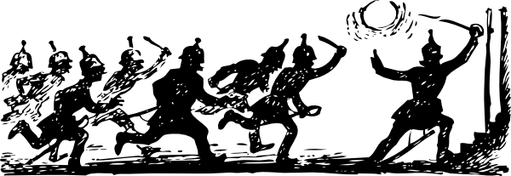
Middles
The middle is where we have the build up to a problem leading up to the climax. This is where the main action happens and is often the most exciting part.

Slide 19
Middles
What is missing from this story? How did it make you feel?
The sea glistened like a sparkling, silver mirror. Waves lapped steadily at the sides of the wooden pirate ship. Seagulls circled overhead, calling to each other. The sky was almost as blue as the sea with white clouds protecting the crew from the beating sun. No-one would guess that this peaceful scene would change in just a mere heartbeat.
The pirates made their way down the quay to celebrate their incredible success. They had looted enough treasure to buy at least a year's worth of rum. They will probably never have such an amazing adventure again.

Slide 20
Middles
There is no middle. We know there is a pirate ship and that something happened. We know they must have been victorious. However, we do not know what caused the problem or how they solved the problem.
As a reader you are likely to be very disappointed as all the most exciting parts are missing!

Slide 21
Practise
Which of these could be a middle?
Terrified, the children approached the ancient ruins, desperately looking for clues that could help them find their friend.
“Shark!” yelled the lifeguard, but Martha did not hear the warning. She continued to carelessly splash her feet off the edge of her lilo.
Finally, they rescued the baby hippo and reunited him with his mother.

Slide 22
How did you do?
Terrified, the children approached the ancient ruins, desperately looking for clues that could help them find their friend.
“Shark!” yelled the lifeguard, but Martha did not hear the warning. She continued to carelessly splash her feet off the edge of her lilo.
Finally, they rescued the baby hippo and reunited him with his mother.

Slide 23
Endings
Endings explain how the problem was solved and tell us all we need to know about what happened to the characters next and how they felt about it. They should leave the reader feeling satisfied that their questions have been answered or resolved.

Slide 24
Endings
Which of these could be an ending?
In a time before humans ruled the planet, a young chimpanzee was about to make a very significant discovery.
The president awarded each member of the rescue team with a medal for bravery in the face of extreme danger.
“Well, that’s the last time I say I am bored,” sighed Simon as he reflected on the adventure he had just had.

Slide 25
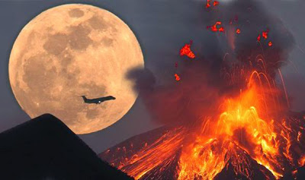
Practise
Write a short story (no more than ten sentences) inspired by this picture. Don’t forget to check that you have included all the basic elements of the story structure – a beginning, a middle and an end.

Slide 26
How did you do?
Swap your story with a partner to determine if they have included all the basic elements of the story structure.
Did their story …
Have a beginning that introduced a character or setting?
Have a build up that hinted at a problem?
Have a problem where everything started to go wrong?
Have a resolution which explained how the problem was solved?
Have an ending that explains the impact on the characters, the lessons learnt or thoughts about the recent events?

Slide 27
Review
When writing a story you need to ensure you have included each basic element (ingredient) of the story structure to make it complete.
Story Structure
Elements:
A beginning (character and setting)
A middle (build up and climax)
An ending (resolution)

