Slide 1
Phonics workshop for Parents/Carers
Tuesday 20th September 2016

Slide 2
Aim:
To explain our approach to teaching phonics and early reading, enabling you as a parent/carer to support your child more easily and more effectively at home.
Phonics and Spelling activities:
After the presentation you will have the opportunity to come into the classrooms and have a look at some of the activities that we do in class with the children. Lots of these activities can be recreated at home.

Slide 3
Summary of Phonics terminology
phoneme | the smallest unit of sound that can be heard in a word
grapheme | the recorded letters representing a phoneme, e.g. ai, igh, m
CVC words | consonant-vowel-consonant words, e.g. c-a-t, sh-ee-p
encode | using phonetic knowledge to spell a word
blend | joining phonemes together to read a word
segment | using phonetic knowledge to break down a word to read it
tricky words | words that cannot be segmented or blended using only phonics
digraph | a phoneme made of two letters e.g. sh, ee, oi.
trigraph | a phoneme made of three or more letters e.g. igh, air, eigh.

Slide 4
Phonics teaching
In our school we use Bug Club Phonics to teach the children phonics. It uses the same structure as letters and sounds.
The National Curriculum uses ‘Letters and Sounds’ and is divided into 6 different phases that the children follow from Nursery to the end of Year 2. Bug club is based on Letters and Sounds.
Reception – Phase 1, 2, 3 and 4
Year 1- Phase 5
Year 2- Phase 6

Slide 5
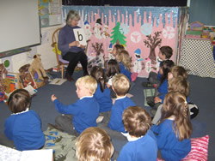
A Phonics Lesson
Phonics lessons are taught using the following structure:
Revisit and review
Teach
Practise
Apply

Slide 6
Phase 1
In this phase the children will develop their speaking and listening skills. It lays the foundation for the phonic work that is taught in phase 2.
Some of the activities that the children will take part in during this phase are:
Going on a listening walk- ‘What can you hear?’
Listening to and joining in with rhyming stories
Playing I-Spy
Experimenting with different musical instruments.
Playing toy talk/ using your robot voice

Slide 7
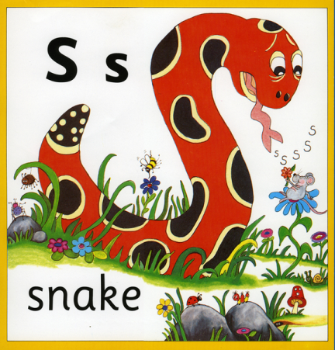
Phase 2
In this phase the children will learn groups of phonemes each week:
Set 1: s, a, t, p Set 2: i, n, m, d Set 3: g, o, c, k Set 4: ck, e, u, r Set 5: h, b, f, ff, l, ll, ss
The children will begin to segment and blend simple words containing the above phonemes e.g. r-a-t, s-i-p, l-i-c-k

Slide 8
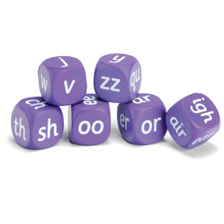
Phase 3
Now that the children have been taught the 23 phonemes from Phase 2 they will now learn:
Set 6: j, v, w, x
Set 7: y, z, zz, qu
Consonant digraphs: ch, sh, th, ng
Vowel digraphs: ai, ee, igh, oa, oo, ar, or, ur, ow, oi, ear, air, ure, er
The children will also begin to learn a range of tricky words (words that cannot be decoded).

Slide 9
Phase 3 - Tricky Words
No
Go
I
Into
He
She
We
Me
Be
Was
You
They
All
Are
My
Her

Slide 10
Phase 4
By this stage, children will know the 42 phonemes, be able to segment and blend CVC words.
Phase 4 consolidates children’s knowledge of the graphemes by reading and spelling polysyllabic words and those containing adjacent consonants.
Children are also taught further tricky words.
Phase 4 lasts for four weeks.

Slide 11
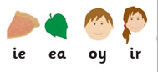
Phase 5
Phase 5 is taught throughout Year 1.
The purpose of this phase is to broaden children’s knowledge of graphemes and phonemes for use in reading and spelling.
Children will learn new graphemes and alternative pronunciations for both these and graphemes they already know.

Slide 12
Phase 6
By the beginning of phase 6 children should know most of the common grapheme - phoneme correspondences.
They become fluent readers and increasingly accurate spellers.
-Prefixes
-Suffixes
-Past tense

Slide 13
They will be able to read hundreds of words using the following 3 methods;
Automatically reading familiar words
Decoding quickly and silently as blending and sounding is routine
Decoding them aloud.
Children’s spelling may still be a bit unconventional at times but should start to be phonetically accurate.

Slide 14
Our New Spelling Scheme
We are using the Read Write Inc. spelling programme.
It is a robust, fast paced systematic spelling programme. That starts in Year 2.
Read Write Inc. spelling is a programme based on the understanding that we do have a sound based writing system.
One of the key keys to spelling is to remember how to spell these sounds in different words.
This does not happen overnight.

Slide 15
Phonics Screening
Takes place during the Summer term (June) for children in Year 1.
The check consists of 20 real words and 20 pseudo-words (which we call alien words) that a pupil reads aloud to the teacher.
Although this is a test we try to keep it as low key as possible for the children.
Last year we had 83% a pass rate. (National was 77%)

Slide 16
How can you help your child at home?
Regularly read to and listen to your child read.
Revise the phonemes that we have learnt using your
child's phoneme book.
Listen to the Jolly phonic songs on YouTube or on the Jolly learning website.
Play beat the timer.
Tricky word/phoneme bingo.
I-Spy with initial sounds.
Interactive Bug Club books online
Play phonic games on the following websites:
http://www.letters-and-sounds.com/phase-1-games.html
http://www.phonicsplay.co.uk/
http://www.ictgames.com/dinosaurEggs_phonics/
http://www.kenttrustweb.org.uk/kentict/content/games/literacy_menu.html

