Slide 1
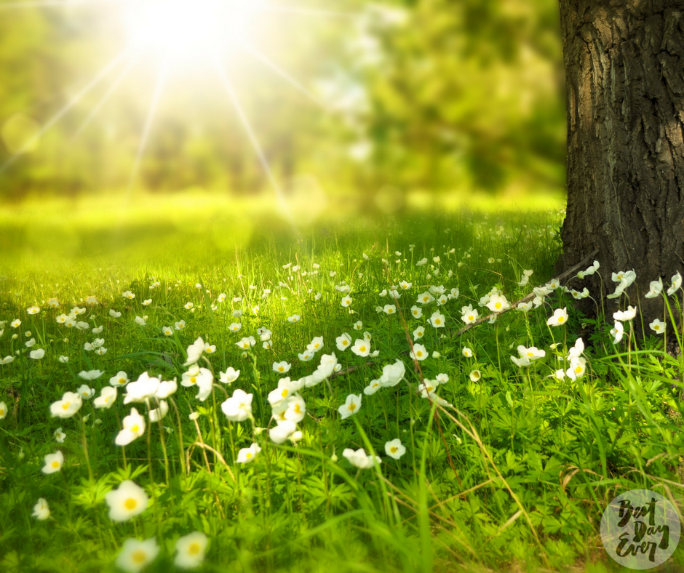

Notes:
RP

Slide 2
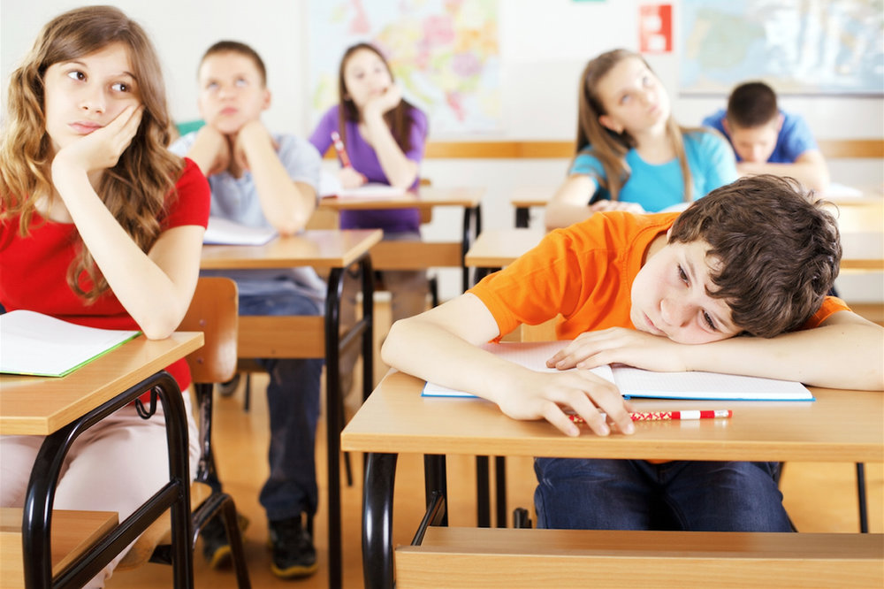
Ofsted says narrow curriculum is risk to quality of education
27 November 2018
‘Where we do have clearer evidence of a decline in the quality of education are in the narrowing of the curriculum in schools and an endemic pattern of prioritising data and performance results, ahead of the real substance of education.’
Amanda Spielman
Notes:
RP

Slide 3
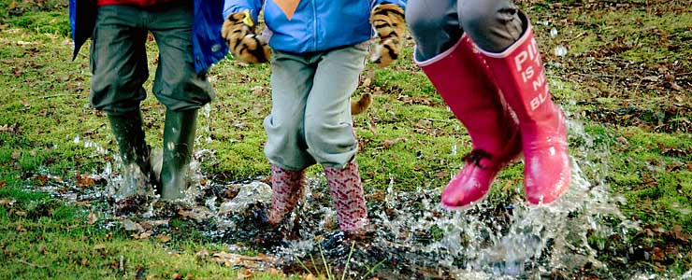
WHO ARE WE?
Respect Teamwork Responsibility Understanding Peace Honesty
Respect Teamwork Responsibility Understanding Peace Honesty
Respect Teamwork Responsibility Understanding Peace Honesty
Respect Teamwork Responsibility Understanding Peace Honesty
Every child is part of the H&C family on an exciting journey towards being rounded, aspirational, spiritual people with a fascination for the world; yearning to make a difference.
Notes:
RP

Slide 4
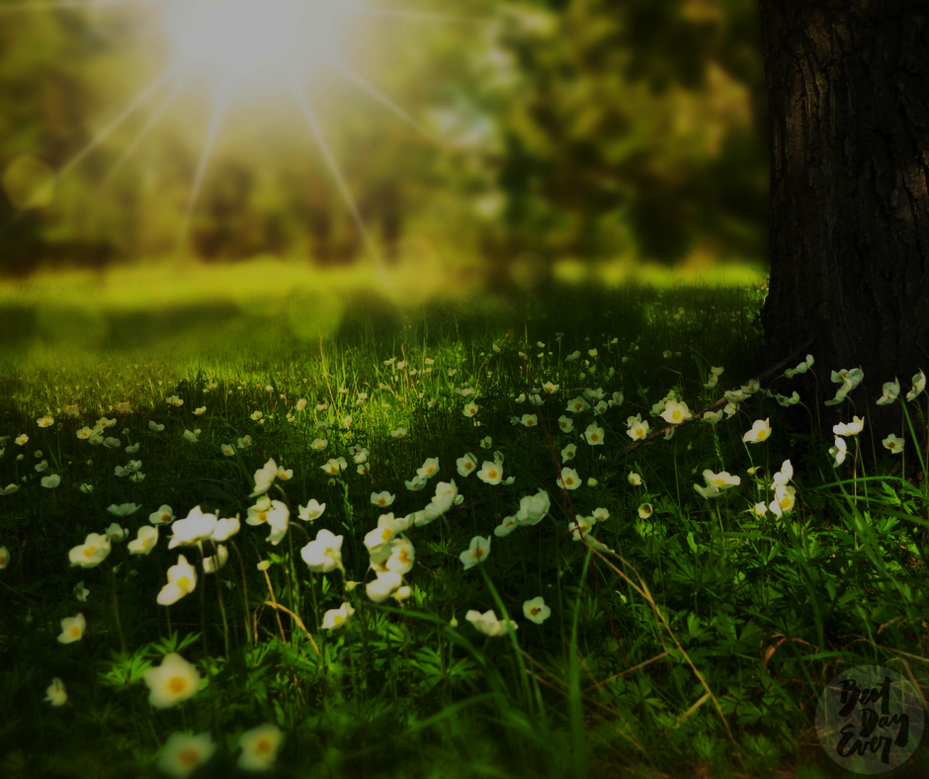
Fascinating
Rounded
Everyone yearning to make a difference
Spiritual
Highly aspirational
…through nature.
Notes:
AH

Slide 5
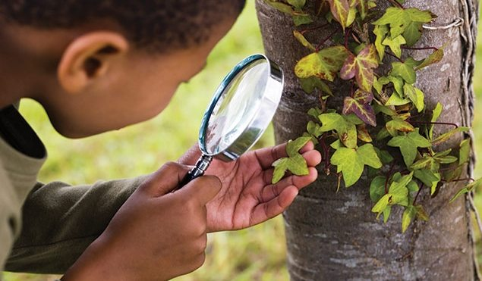
Rounded
Everyone yearning to make a difference
Spiritual
Highly Aspirational
Fascinating
Experiences we share
Things we do
Books we read
Facts we learn
…through nature.
Notes:
AH

Slide 6
Rounded
Everyone yearning to make a difference
Spiritual
Highly Aspirational
Fascinating
Presenting opportunities through the design of lessons that captivate children's imagination and attention. Using and drawing from the outdoor environment to intrigue children to learn about the world and their immediate environment. Explorative, practical opportunities to learn.
…through nature
Examples: Kenning poems written in Y4 as a response to being outside amongst the trees
Notes:
AH

Slide 7
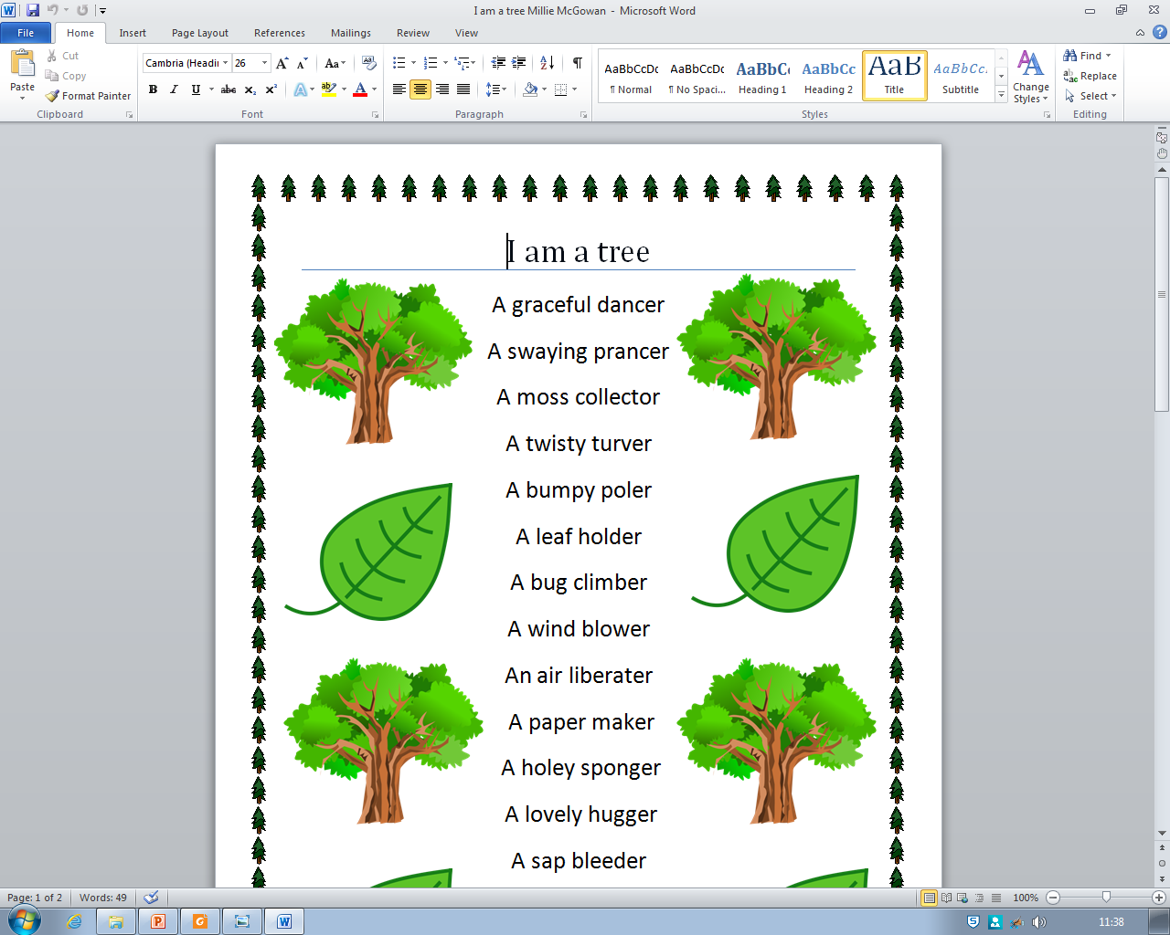
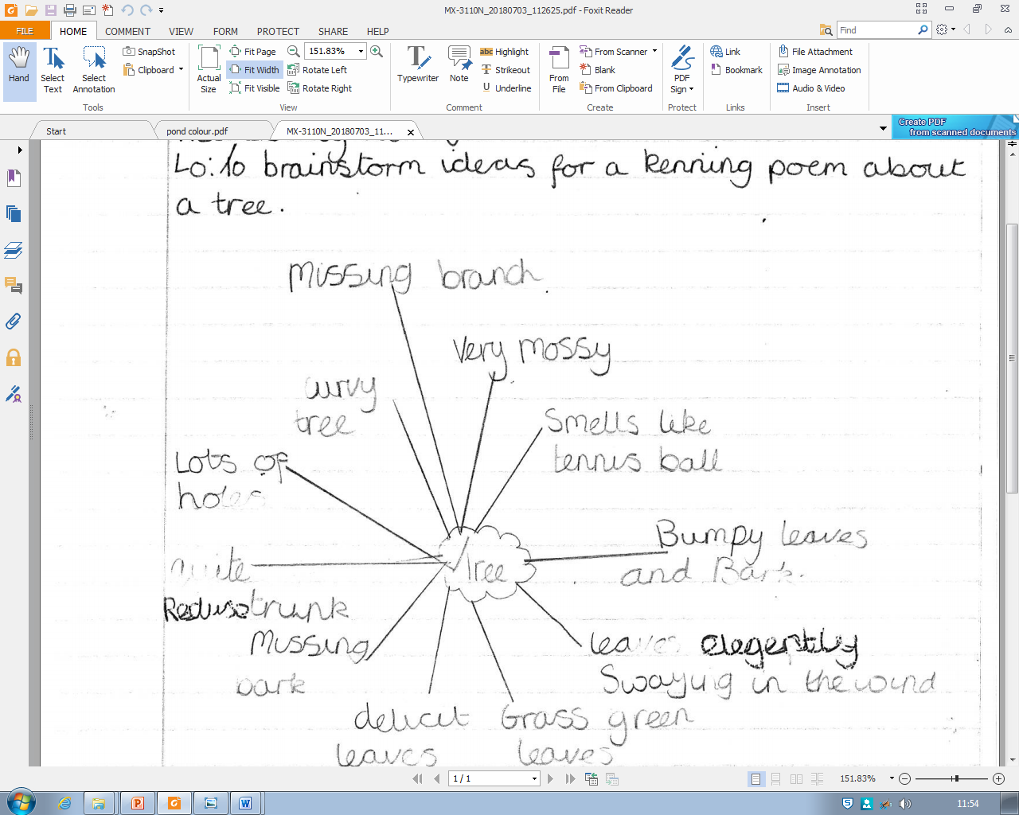
Kennings year 4 : children spent time observing and ‘experiencing’ a tree by touching it, lying underneath it etc. and brainstorming ideas.
Notes:
AH

Slide 8
Fascinating
Everyone yearning to make a difference
Spiritual
Highly Aspirational
Rounded
The opportunity to explore and celebrate individual's strengths as well as provide good scaffolding to help them achieve in areas they find more challenging so that a child is well rounded in all areas of the curriculum. As well as addressing breadth of experience. It will provide a breadth of experience beyond the normal experience for children which builds resilience.
…through nature
Examples: Year 1 work on Magic Pencil Malala story. Boys and girls report on the injustice of Malala’s life giving them a more rounded, global perspective. The text is challenging and not one they are likely to have come across.
Notes:
RP

Slide 9
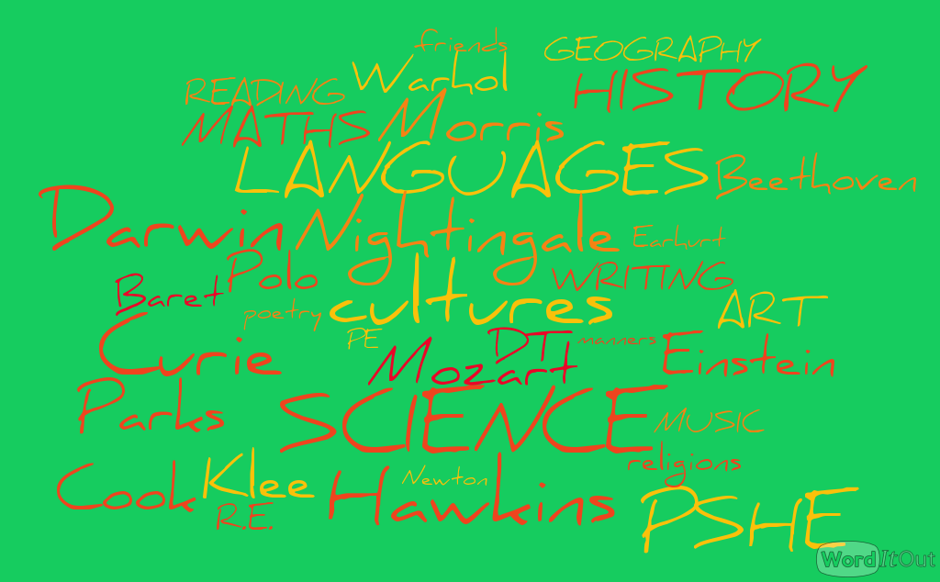
Fascinating
Everyone yearning to make a difference
Spiritual
Highly Aspirational
Rounded
…through nature.
Notes:
RP

Slide 10
Fascinating
Rounded
Spiritual
Highly Aspirational
Everyone yearning to make a difference
Growth mind set, leadership opportunities (values) helping children to see the virtues of being an active part of a community (and British Values)
…through nature
Examples: Year 5 work on Pig Heart Boy. Visit from scientist parent to discuss lab work and ethical debate on experimenting with animals. Link with Go Givers
Notes:
AH

Slide 11
Fascinating
Rounded
Spiritual
Highly Aspirational
Everyone yearning to make a difference
PIG HEART BOY – Malorie Blackman
”I personally don’t enjoy seeing animals being tested this way because they don’t really have much of a choice, they’re just tested on.”
“I think that animal testing should not be going on. Cam should have a human heart so then the donor would be able to decide if they want to give an organ or not. I think this because animals have as much right to live on this earth as we do, so why should we be killing them for our purposes? Animals can’t stand up for themselves so we have to.”
Notes:
AH

Slide 12
Fascinating
Rounded
Everyone yearning to make a difference
Highly Aspirational
Spiritual
Presenting opportunities for children to ponder and question their connection to something bigger than ourselves using the outdoor environment - awe and wonder.
Using our outdoor space, ensuring that our children go out into nature regularly to learn as part of their weekly educational experience ( not just Forest Schools ). That we actively care for this nature in practical ways, such as recycling, sustainment, river Chess involvement, public education(Woodland Trust, RSPB etc.), conservation.
…through nature
Notes:
RP

Slide 13
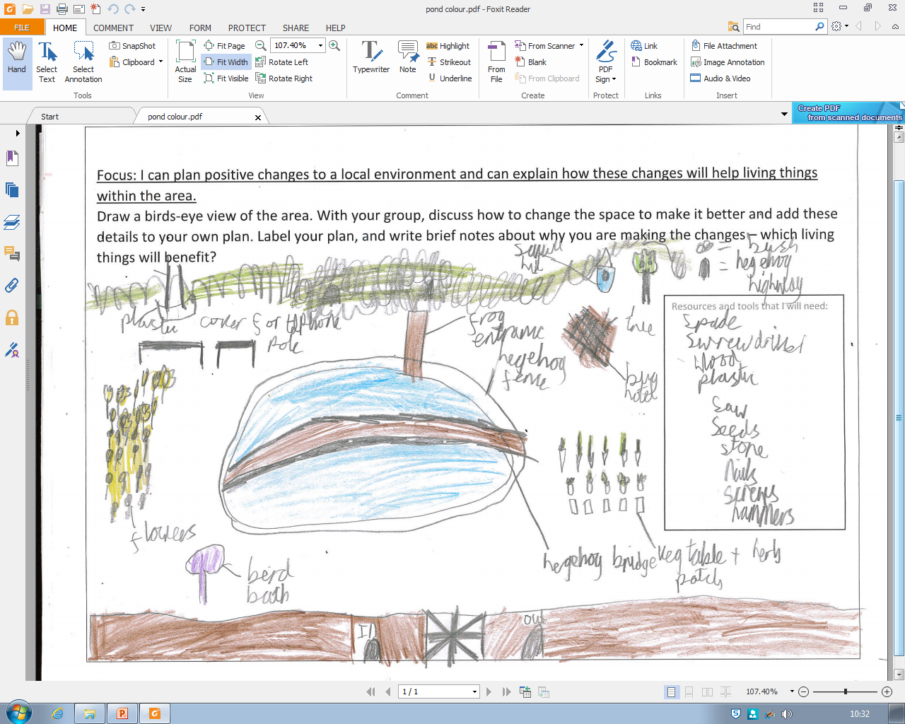
Fascinating
Rounded
Everyone yearning to make a difference
Highly Aspirational
Spiritual
Year 4 - Pond designs
Notes:
RP

Slide 14
Fascinating
Everyone yearning to make a difference
Spiritual
Highly Aspirational
Rounded
Opportunities are offered that everyone can achieve. challenging texts/ resources, high expectations, clear progression, pitched to individual needs & interests. Providing additional resources/ support in order to achieve.
…through nature
Examples: Years 4, 5 and 6 take part in Battle of the Books when they access books which will challenge and inspire them.
Notes:
AH

Slide 15
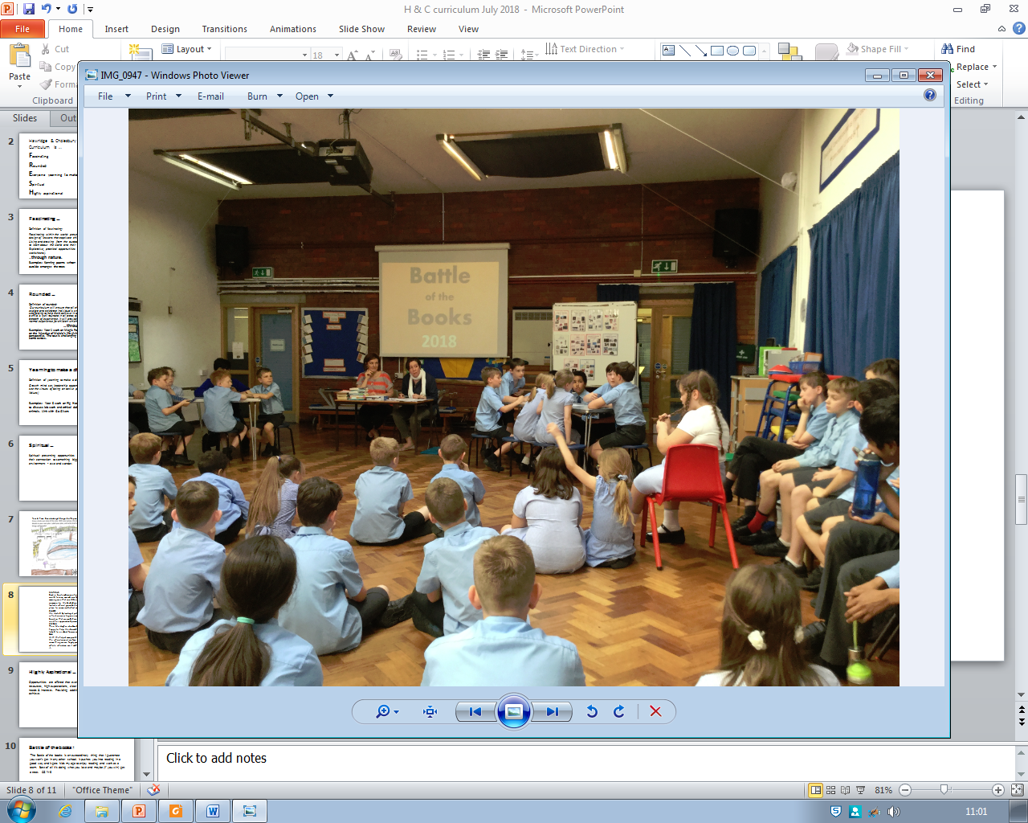
Fascinating
Everyone yearning to make a difference
Spiritual
Highly Aspirational
Rounded
Annual Battle of the Books
“The Battle of the books is an extraordinary thing that I guarantee you won’t get in any other school. It pushes you into reading in a good way and it gets kids my age to enjoy reading and work as a team. Best of all it’s doing what you love and maybe (if you win) get a treat.”
Notes:
AH

Slide 16

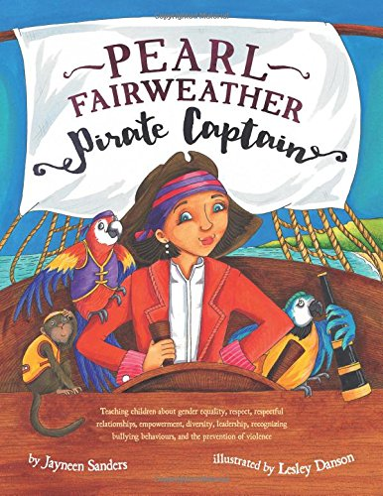


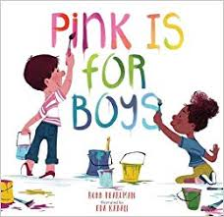
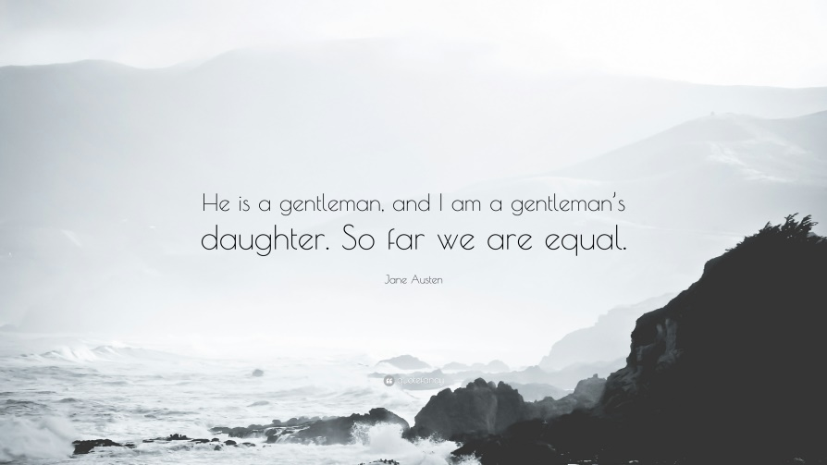
Notes:
AH

Slide 17
Please go into your child’s class and look for these features of FRESH within this mornings lesson.

