Slide 1
Securing Sentence Composition
What makes a sentence?
1a. Identify the subject and verb in a sentence.
Commissioned by The PiXL Club Ltd.
October 2018
This resource is strictly for the use of member schools for as long as they remain members of The PiXL Club. It may not be copied, sold nor transferred to a third party or used by the school after membership ceases. Until such time it may be freely used within the member school.
All opinions and contributions are those of the authors. The contents of this resource are not connected with nor endorsed by any other company, organisation or institution.
PiXL Club Ltd endeavour to trace and contact copyright owners. If there are any inadvertent omissions or errors in the acknowledgements or usage, this is unintended and PiXL will remedy these on written notification
© Copyright The PiXL Club Limited, 2018

Slide 2
What is a subject?

Slide 3
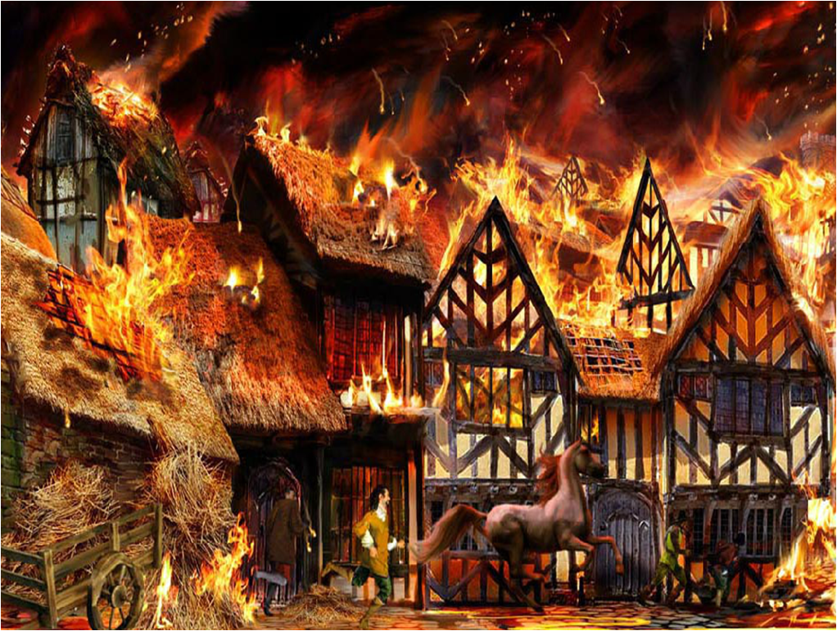
Circle the subject
Tip: To find the subject, ask who or what is doing the action.
London was burning.
The baker left glowing embers in the oven.
The brave townsfolk frantically fought the raging fire.
Within a few hours, houses were smothered in billowing smoke.

Slide 4
What is a verb?

Slide 5
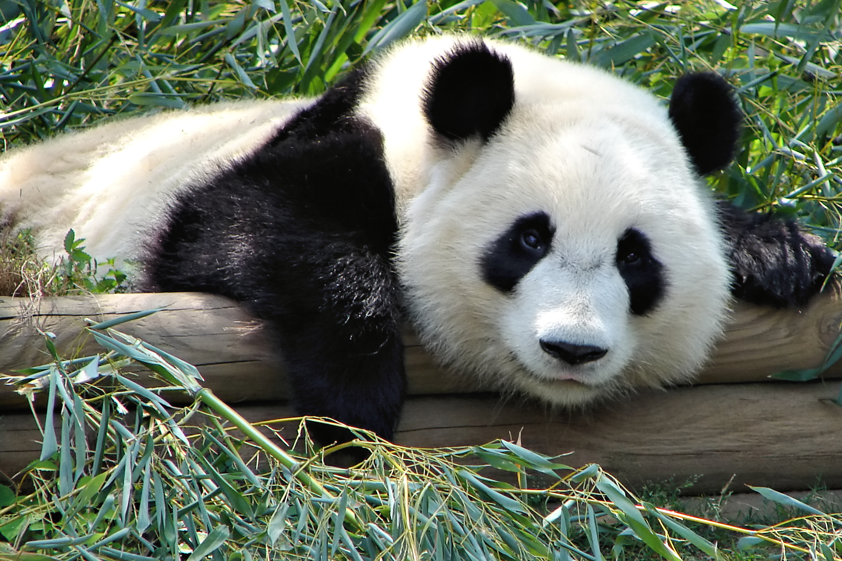
Circle the verb
Tip: To find the verb, ask what is the subject doing or feeling.
Pandas live in the mountains and forests of China.
The panda nibbled on the bamboo.
Pandas eat bamboo for about 12 hours a day.
Giant pandas don’t hibernate.

Slide 6
Practise
Now circle the subject and underline the verb in each sentence.
Once the fuse was lit, sparks spluttered at the end of the rope.
The stuntman shot out of the cannon in a cloud of smoke.
Following a moment of stunned silence, the audience broke out in rapturous applause.

Slide 7
Every sentence has two parts: the subject and the predicate.
sentence = subject + predicate
Who or what the sentence is about.
What the subject is, has or does. Predicates begin with a verb.
The band rocked at the concert.

Slide 8
Practise
Complete these sentences by adding a subject.
__________ , ____________, and __________ were selected for the swimming team.
Fortunately, ____________, explained the homework to me.
Complete these sentences by including a predicate. Don’t forget a predicate starts with a verb.
The joker _____________________________________________ .
The suitcase ___________________________________________ .

Slide 9
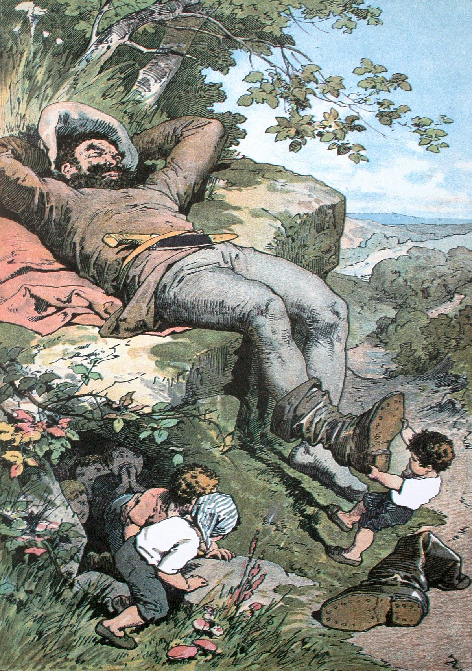
Practise
Write three sentences inspired by this picture.
Once you have completed your sentences, circle the subject/s and verb/s in each of your sentences.

