Slide 1
Suffixes.
-ate, -ify, -ise

Slide 2
What is a suffix?
A suffix is a group of letters added to a root word, to form a new word.

Slide 3
What is a root word?
A root word is a basic word with no prefix or suffix added to it, which makes sense on its own.
e.g. pure, active, material, real

Slide 4
There are verbs that can be created by taking a root word (that is a noun or an adjective) and adding one of the given suffixes
pure + the suffix -ify = purify
active + the suffix -ate = activate
real + the suffix -ise = realise.

Slide 5
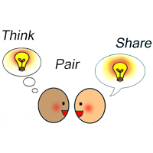
What verbs can you think of that are made up of a root word + one of the given suffixes?
-ify -ate -ise
Can you and someone else at home think of any words that end in these suffixes?
Take care not to just think of a word with that ending, it needs to be a root word with a suffix: ‘late’ and ‘advise’ are not examples.

Slide 6
How many did you think of?
Here are some possibilities together with their root words:
intensify [intense]
motivate [motive]
pressurise [pressure]
notate [note]
fossilise [fossil]
realise [real]
captivate [captive]
materialise [material]

Slide 7
Spelling Rules!
If the root word ends in ‘y’, change to ‘i’.
If the root word ends in ‘e’ remove the ‘e’.
If the root word has a short vowel sound, double the consonant before adding the suffix.

Slide 8
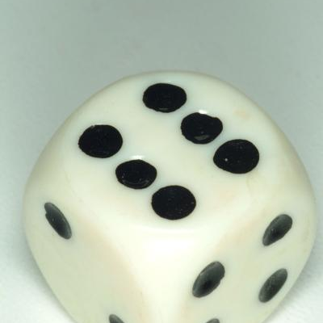
Time to play!
You will need:
A dice
The rules sheet
Your yellow book

