Slide 1
FRESH meets Beowulf

Slide 2
The aim
The children had written setting and character descriptions but had not managed to bring their characters alive.
Through role play, the aim was to help them understand the feelings of their main character as they went into battle.

Slide 3
Let’s pretend...
We are heroes from their stories. A battle with an evil monster looms, a monster whose lair lies in the woods ahead.
Shh...let’s creep silently and slowly. We don’t want to alert him to our presence.
What was that? I heard a noise!

Slide 4
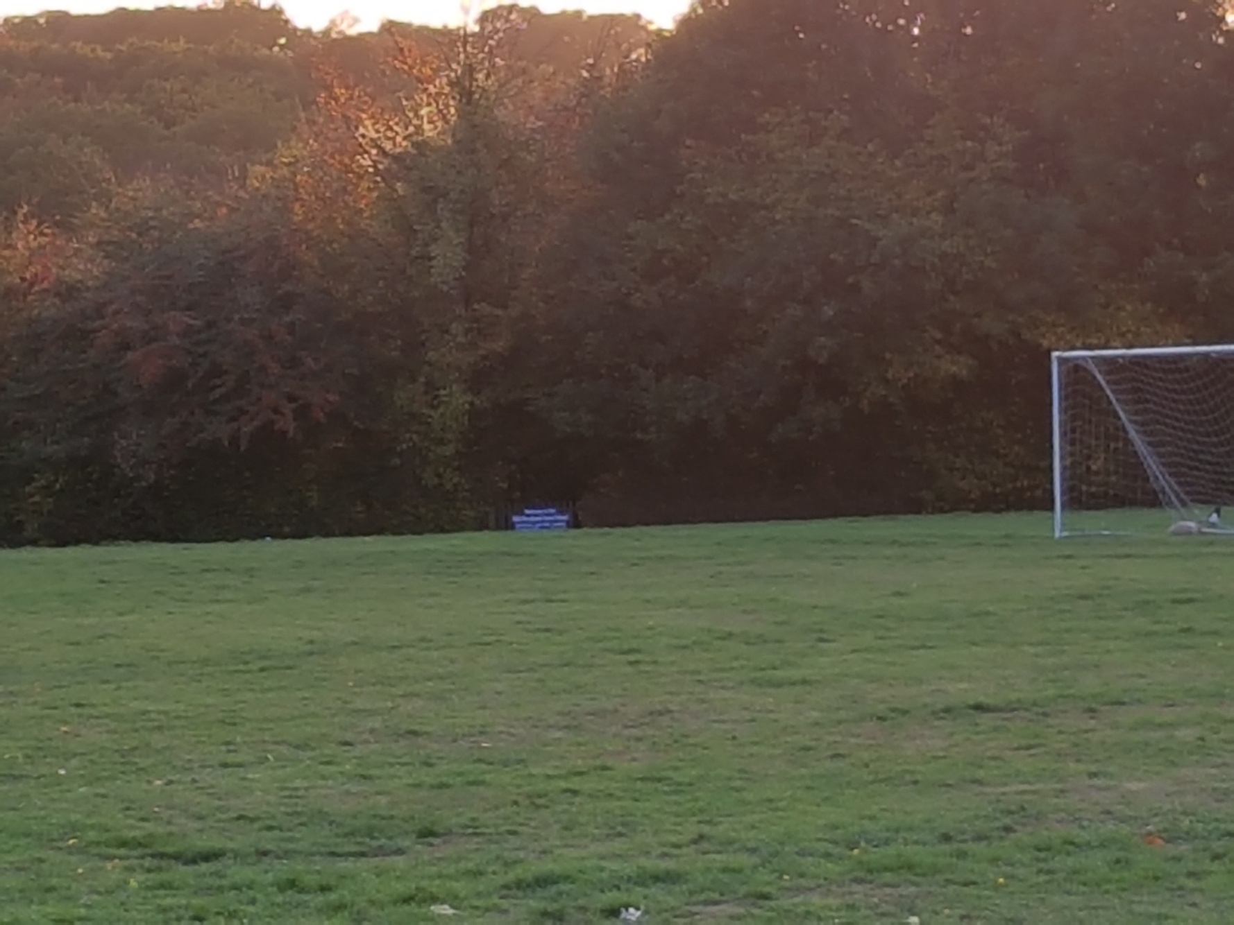
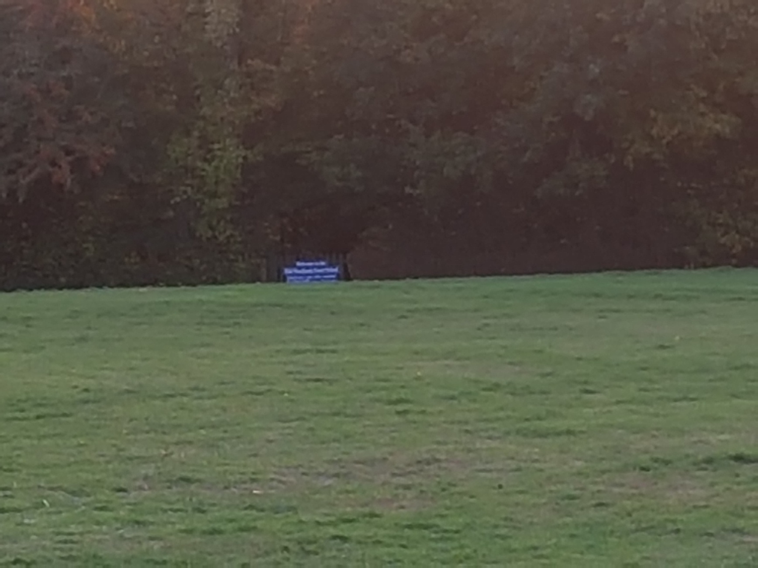
The children crept towards the woods and as they reached the gate, a dragon roared. (Mrs Hughes had hidden herself with a set of speakers).

Slide 5
Did it have an effect?
For the girls and boys that got into role and allowed their imagination to take over, it had a definite impact on their descriptive writing.

Slide 8
The overall outcome
The book completely engaged all of the class.
The stories have been action-packed and reflect that all feel able to write their own exciting legend.
The books are full of editing in red pen, demonstrating the eagerness of the class to create a great story.
Links with History and Art have enabled us to cover the Spiritual elements of the Anglo Saxons and also to continue with the opportunities to fascinate the class.

