Slide 1


M8h: Can solve problems involving conversion between units of time
Commissioned by The PiXL Club Ltd.
July 2018
This resource is strictly for the use of member schools for as long as they remain members of The PiXL Club. It may not be copied, sold nor transferred to a third party or used by the school after membership ceases. Until such time it may be freely used within the member school.
All opinions and contributions are those of the authors. The contents of this resource are not connected with nor endorsed by any other company, organisation or institution.
PiXL Club Ltd endeavour to trace and contact copyright owners. If there are any inadvertent omissions or errors in the acknowledgements or usage, this is unintended and PiXL will remedy these on written notification.
© Copyright The PiXL Club Limited, 2018

Slide 2
Vocabulary: Units of time
convert
pm / am
digital clock
analogue clock
Teacher’s Note:
See ‘Vocabulary Shorts’ resource below for ideas and games to develop and embed vocabulary.
Vocabulary Shorts
Notes:
To locate Vocabulary Shorts resource click on:
Currency
Whole School Materials
English
Writing
PiXL Vocabulary
Vocabulary Shorts PP

Slide 3
Can solve problems involving conversion between units of time
In mathematics, we often use time to solve problems, calculate durations of events (such as the length of TV programmes) and read different timetables. To solve problems involving time, we must be able to tell the time and calculate time differences on both analogue and digital clocks.

Slide 4

Reasoning
Before we start…
How would you teach someone to convert between the 12-hour and 24-hour clocks?
Notes:
Pupils need to be reasonably secure in this before continuing with this therapy. Spend time revising this area if required.

Slide 5
Can solve problems involving conversion between units of time
Sometimes problems involve calculating time differences that go over an hour. These are often written as word problems.
Let’s look at some examples…

Slide 6

Can solve problems involving conversion between units of time
Some problems are straightforward in that we just have to think about the hours rather than minutes. Look at this example. Here, we have to calculate what the time will be after a given amount of time has passed.
What time is it ten hours after 8pm?
We know that 8pm is in the evening. A quickly drawn time number line can help us to solve this problem.
So, ten hours after 8pm is 6am.
Notes:
Explain: We can count up in our heads until we get to midnight which is 4 hours but the questions asks us to add on 10 hours. So we need to add another 6 hours which takes us to 6 in the morning which is 6am.

Slide 7

Can solve problems involving conversion between units of time
In this example, we have to calculate the time difference to work out the length of a flight.
An aeroplane takes off on Tuesday at 22:47. It lands on Wednesday at 07:05. How long in hours and minutes is the flight?
Again, a number line can help.
1 hour + 13 mins + 7 hours 5 mins =
8 hours 18 mins
The duration of the flight is 8 hours and 18 minutes.

Slide 8

Your turn
Can solve problems involving conversion between units of time
A film starts at 6:45pm.
It lasts 2 hours and 35 minutes.
What time will the film finish?
You could count up in your head or draw a time number line to help!
Notes:
Explain:
We can count up in our heads.
2 hours after 6.45pm is 8.45pm.
If we add another 35 minutes, we get to 9.20pm.
So the film finishes at 9.20pm
If necessary, work through together on a timeline.

Slide 9
Can solve problems involving conversion between units of time
Sometimes we may be asked to read timetables.
Derek caught the 11.45 bus from Croxton to Braytown. What time did he arrive in Braytown? How long did the journey take?
We can see by reading the timetable that the 11.45 bus arrives in Braytown at 12.30.
 | Bus timetable: Croxton to Braytown
Depart | 11.30 | 11.45 | 12.20 | 12.45 | 13.30
Arrive | 12.15 | 12.30 | 13.05 | 13.30 | 14.15
This means that it has taken 45 minutes.
Notes:
Use practical equipment to support if required.

Slide 10
Can solve problems involving conversion between units of time
Before getting on the 11.45 bus, Derek took 15 minutes to walk to the bus stop and he waited 5 minutes for the bus. What time did he leave his house?
We know that Derek caught the 11.45 bus.
We know he waited 5 minutes so he must have arrived at the bus stop at 11.40.
 | Bus timetable: Croxton to Braytown
Depart | 11.30 | 11.45 | 12.20 | 12.45 | 13.30
Arrive | 12.15 | 12.30 | 13.05 | 13.30 | 14.15
We know that he took 15 minutes to walk to the bus stop so we need to subtract 15 minutes from 11.40 which gives us 11.25.
Derek left his house at 11.25.
Notes:
Use practical equipment to support if required.

Slide 11
Can solve problems involving conversion between units of time
Ruth must get to Braytown for 13.20. What buses could she get?
To answer this question, we must read the timetable and decide which buses arrive in Braytown by 13.20.
 | Bus timetable: Croxton to Braytown
Depart | 11.30 | 11.45 | 12.20 | 12.45 | 13.30
Arrive | 12.15 | 12.30 | 13.05 | 13.30 | 14.15
We can see that Ruth could catch either the 11.30, the 11.45 or the 12.20 buses from Croxton.
Notes:
Use practical equipment to support if required.

Slide 12
Can solve problems involving conversion between units of time
Ruth is 15 minutes late for the 12.20. How long does she wait for the next bus?
To answer this question, we must work out what time Ruth got to the bus stop.
 | Bus timetable: Croxton to Braytown
Depart | 11.30 | 11.45 | 12.20 | 12.45 | 13.30
Arrive | 12.15 | 12.30 | 13.05 | 13.30 | 14.15
She was 15 minutes late for the 12.20 so she arrived at the bus stop at 12.35.
The next bus departs at 12.45 so Ruth must wait 10 minutes for the bus.
Notes:
Use practical equipment to support if required.

Slide 13
Your turn
Can solve problems involving conversion between units of time
What time does the 09.40 from Birmingham New Street arrive at Reading?
At how many stations does the 10.15 from Birmingham International stop before it reaches Reading?
How long does it take the 13:55 from Oxford to reach Reading?
You have to arrive at Oxford at 2:00pm. Which train would you catch from Coventry?
Notes:
Use practical equipment to support if required.

Slide 14
Can solve problems involving conversion between units of time
Sometimes we may need to solve problems involving calendars.
Tyrone’s birthday is on December 18th. What day of the week is Tyrone’s birthday?
Using the calendar, we can calculate that Tyrone’s birthday would fall on a Saturday.
Notes:
Explain that we should know how many days there are in each month.
Use the rhyme ‘thirty days hath September, April, June and November. All the rest have thirty one, except for February all alone which has 28 (leap year 29) days.’

Slide 15
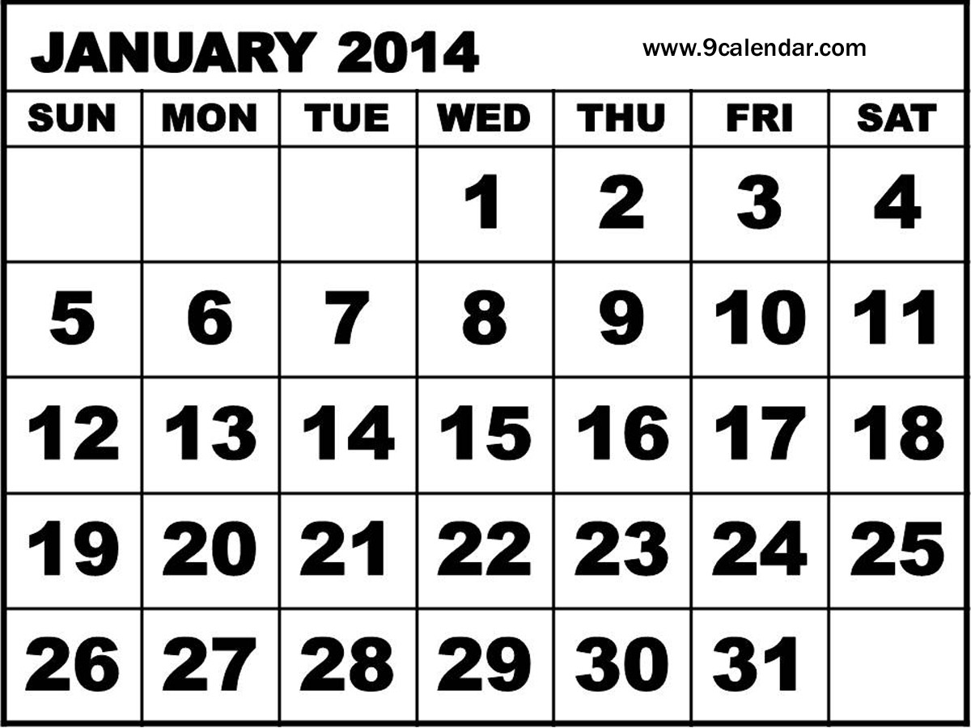
Your turn
Can solve problems involving conversion between units of time
What day is it two days before 27th January?
How many full weeks are there in January?
What is the date one week after 13th January ?
Sophie goes on holiday on the 4th January for 10 days. What date does she return?
Daniel goes on holiday the 2nd Saturday in January. What date did he leave?

Slide 16
Can solve problems involving conversion between units of time
Sometimes we may need to solve problems involving converting between units of time.
There are two ways to do this:
Krishan’s plane departs at 20:20. He arrives at the airport at 5.45pm. How long until his plane departs?
Convert 20:20 to a pm time. 20:20 can be written as 8.20pm. It is now easier to calculate the time duration between 5.45pm and 8.20pm.
5.45 to 6.00 = 15 minutes
6.00 to 8.20 = 2 hours and 20 minutes.
Total waiting time = 2 hours and 35 minutes.
Notes:
Use practical equipment to support if required.

Slide 17
Can solve problems involving conversion between units of time
Sometimes we may need to solve problems involving converting between units of time.
Or we could do this:
Krishan’s plane departs at 20:20. He arrives at the airport at 5.45pm. How long until his plane departs?
Convert 5.45pm to the 24-hour clock.
5.45pm can be written as 17.45.
17.45 to 18:00 = 15 minutes
18.00 to 20:20 = 2 hours and 20 minutes.
Total waiting time = 2 hours and 35 minutes.
Notes:
Use practical equipment to support if required.

Slide 18
Your turn
Can solve problems involving conversion between units of time
I start watching a film at 9.35pm.
My TV guide says it finishes at 00:15.
How long is the film?
Start by converting both times to either the 24-hour clock or the 12-hour (pm) clock!
Notes:
00:15 can also be written as 12.15am.
9.35 to 10.00 = 25 minutes
10.00 to 12.15 = 2 hours and 15 minutes.
The film lasts for 2 hours and 40 minutes.
9.35 can also be written as 21:35.
21:35 to 22:00 = 25 minutes
22:00 to 00:15 = 2 hours and 15 minutes.
The film lasts for 2 hours and 40 minutes.

Slide 19
Reasoning
This graph shows the height of a candle as it burns.
What is the height of the candle after two hours?
How long does it take for the candle to burn down from 16cm to 4cm?

Slide 20
Reasoning
A doctor started work at 06:00. His shift finished at 4:00. Then he started his next shift at 8:30. How long was it after he finished his first shift until his second one started?

