Slide 1
Hawridge & Cholesbury C of E School
Vision to Curriculum

Slide 2
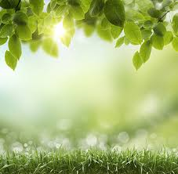
Hawridge & Cholesbury c of E School Curriculum is …
Fascinating
Rounded
Everyone yearning to make a difference
Spiritual
Highly aspirational …through nature.

Slide 3
Fascinating …
Definition of fascinating:
Fascinating within the world: presenting opportunities through the design of lessons that captivate children's imagination and attention. Using and drawing from the outdoor environment to intrigue children to learn about the world and their immediate environment. Explorative, practical opportunities to learn (limited pre-created worksheets). …through nature.
Examples: Kenning poems written in Y4 as a response to being outside amongst the trees

Slide 4
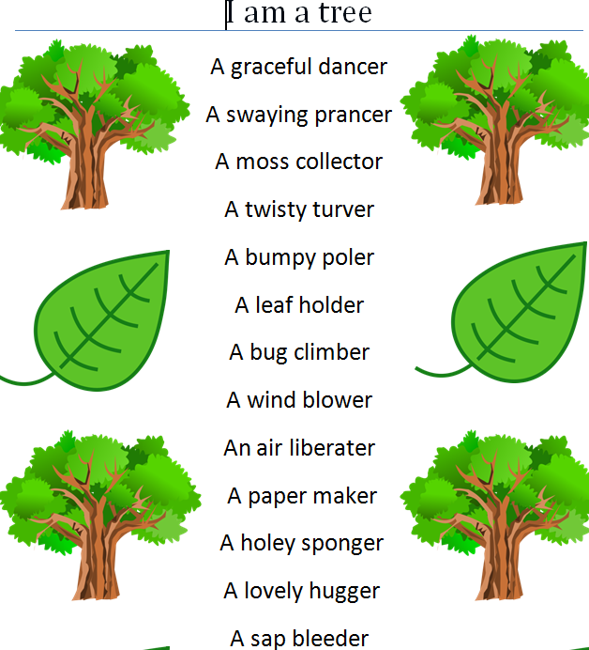
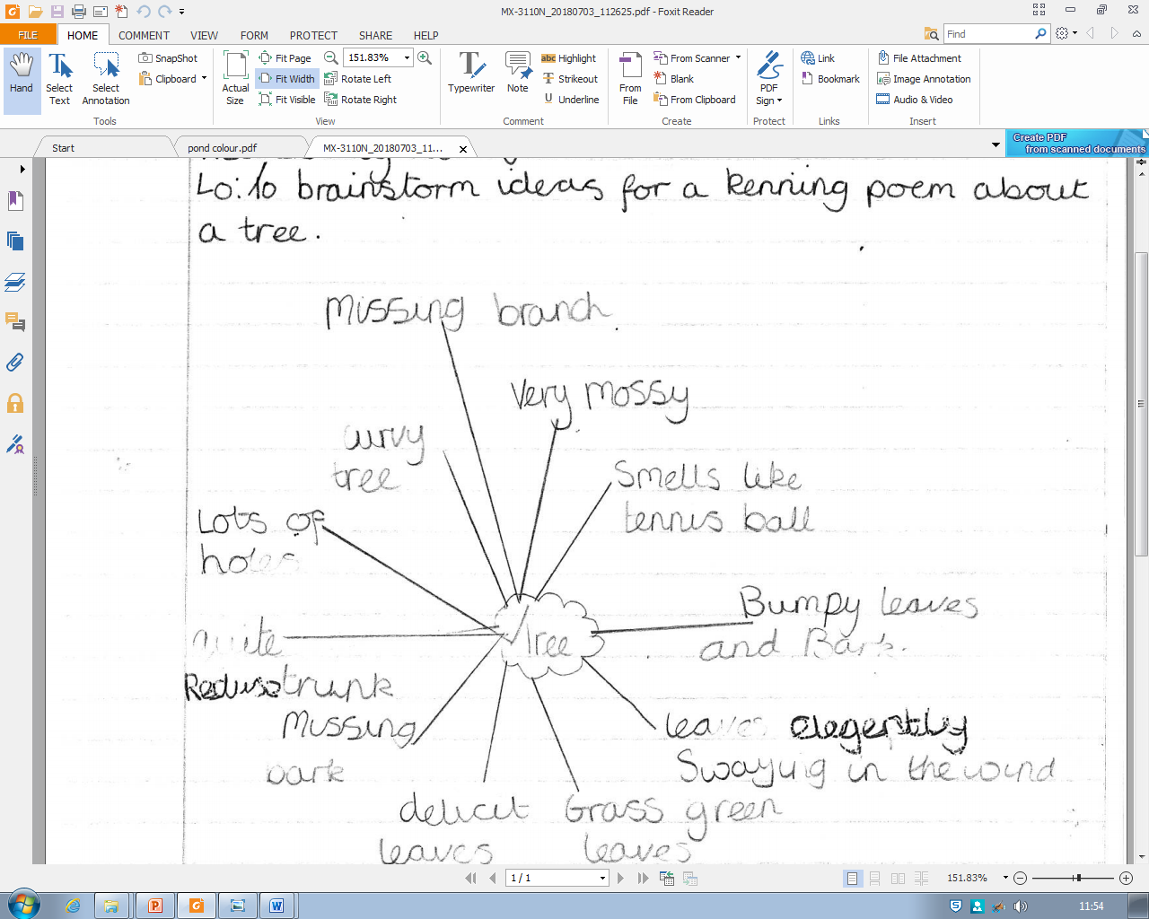
Kennings year 4 : children spent time observing and ‘experiencing’ a tree by touching it, lying underneath it etc. and brainstorming ideas.

Slide 5
Rounded …
Definition of rounded:
Our curriculum will ensure that all children are given the opportunity to explore and celebrate individual's strengths as well as provide good scaffolding to help them achieve in areas they find more challenging so that a child is well rounded in all areas of the curriculum. As well as addressing breadth of experience. It will provide a breadth of experience beyond the normal experience for children which builds resilience.
…through nature.
Examples: Year 1 work on Magic Pencil Malala story. Boys and girls report on the injustice of Malala’s life giving them a more rounded, global perspective. The text is challenging and not one they are likely to have come across.

Slide 6
Malala’s powerful voice
Malala is 19, she has a powerful voice and she is from Pakistan. Malala loved going to school and loved writing but bad people stopped her from going to school . Malala wrote about herself and people cheered for her. Her voice became more powerful and the bad people were furious. They tried to silence her, instead they wanted to shoot her. Soon Malala got shot. She had to go to hospital for a long time. She wrote about herself and she won a Nobel prize. CR (Yr 1)

Slide 7
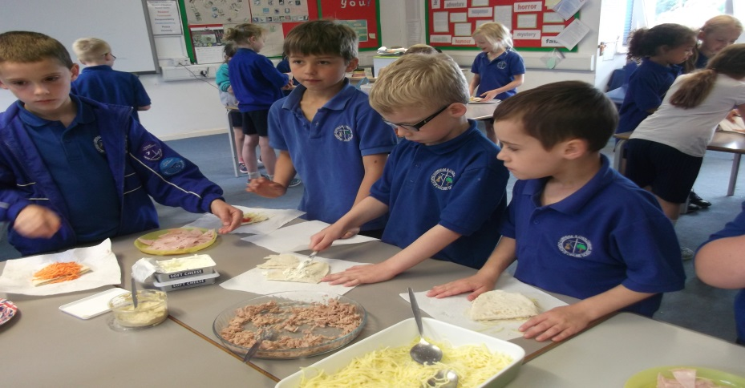
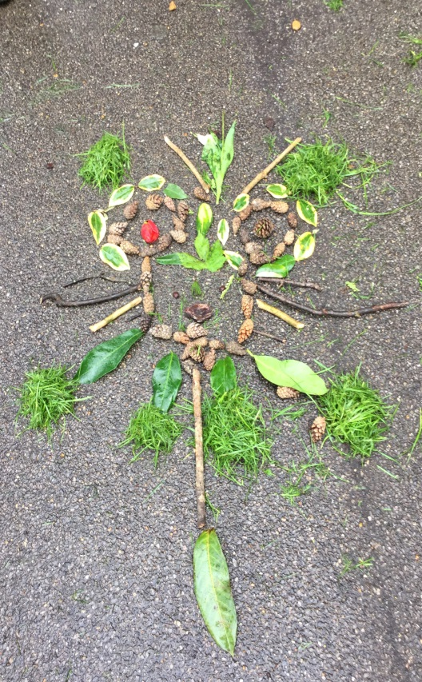
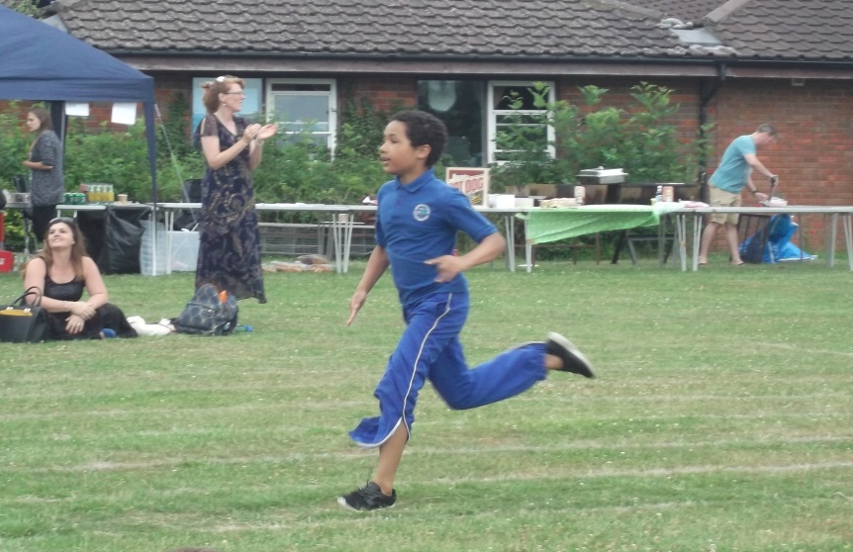
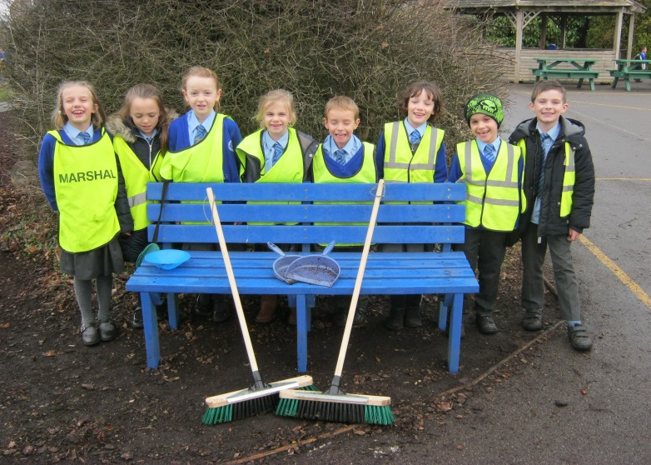
Breadth of experience….
To include healthy eating, art in nature, fitness (daily run a mile?) and caring for the environment ……

Slide 8
Yearning to make a difference …
Definition of yearning to make a difference:
Growth mind set, leadership opportunities (values) helping children to see the virtues of being an active part of a community (and British Values)
…through nature.
Examples: Year 5 work on Pig Heart Boy. Visit from scientist parent to discuss lab work and ethical debate on experimenting with animals. Link with Go Givers

Slide 9
Pig Heart Boy
‘I personally don’t enjoy seeing animals being tested this way because they don’t really have much of a choice, they’re just tested on. ‘ LL (Yr 5)
‘I think that animal testing should not be going on. Cam should have a human heart so then the donor would be able to decide if they want to give an organ or not. I think this because animals have as much right to live on this earth as we do, so why should we be killing them for our purposes? Anuimalds can’t stand up for themselves so we have to.’ MP (Yr 5)
‘I feel that animal testing is not a very good thing. Since we have been reading ‘Pig Heart Boy’, my opinions have altered slightly and I think that animal testing is bad and there should be a stop to it.’ GW (Yr 5)

Slide 10
Spiritual …
Spiritual: presenting opportunities for children to ponder and question their connection to something bigger than ourselves using the outdoor environment - awe and wonder.
…through nature.
‘Using our outdoor space, ensuring that our children go out into nature regularly to learn as part of their weekly educational experience ( not just Forest Schools ). That we actively care for this nature in practical ways, such as recycling.’ Clare Hardy - outdoor learning coordinator

Slide 11
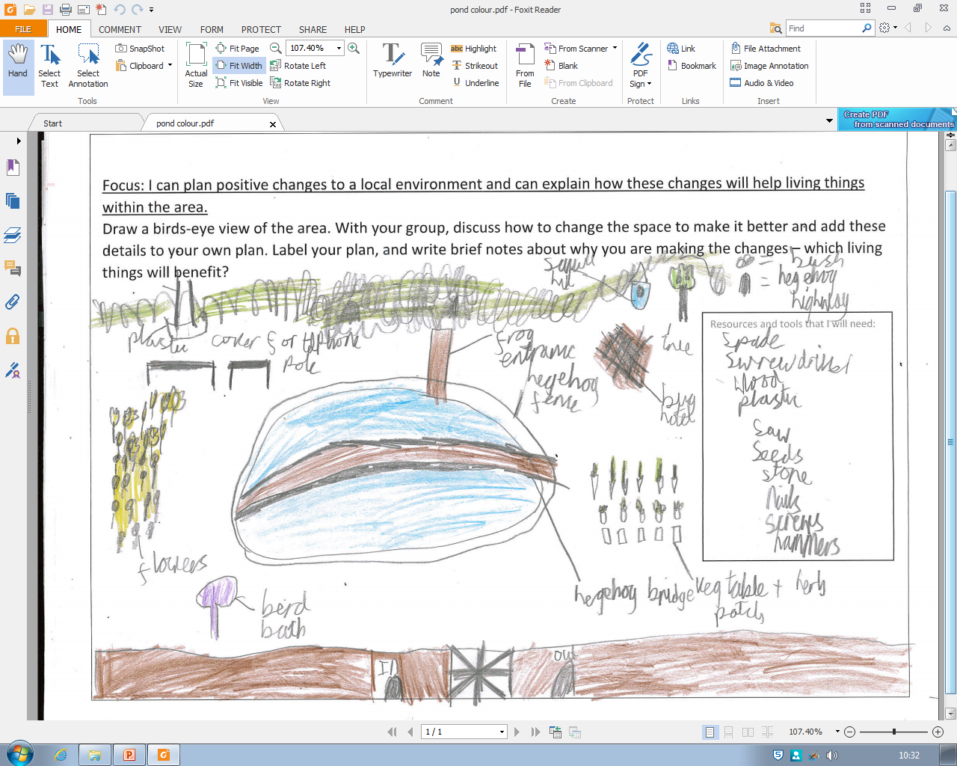
Year 4 have been looking at designs for the pond.
Many children suggested a bench in the shade where they could sit and observe nature.

Slide 12
FRESH ideas for a commitment to the environment
This is a school which prides itself on its outdoor learning. Here are a few low-cost, low-management ideas for boosting its commitment to the environment and making it a leader in building awareness among all ages for issues such as recycling:
Recycling monitors – appoint two monitors per class to take charge of recycling in each classroom. They would be in charge of emptying recycling bins at the end of each week. Classes could be rewarded in some way (marbles? Catch-me cards?)for the amount they recycle per term. There could be a display somewhere prominent for monitors to chart the number of bags of paper/plastic bottles/batteries per class to show progress and introduce an element of competition between classes.
Recycling bins in each classroom clearly marked – not just for paper but for plastic, batteries etc and in the kitchen and on the playground perhaps, so the message is reinforced to parents.
Posters around school promoting recycling – local recycling (what we can do) rather than just Blue Planet bigger picture stuff.
School trips- at the moment, the school stipulates that children should bring disposable packed lunches in a plastic bag so that nothing has to be brought back to school. This results in children being given licence to throw away a huge amount of single-use plastic when most of it could be recycled (eg: plastic bottles, bags, yoghurt pots, drinks cartons, straws). Many children on recent trips have shown that they are not even aware of what is recylclable and what is rubbish
Food Waste- school lunches result in at least one black bin bag full of waste per session. Bucks homes are provided with cooked food waste bins which are collected each week. Many people compost at home, but we do not compost at school.

Slide 13
All the fruit waste from KS1 at break time could go into a compost bin (monitors to collect?).
There could be several bins in the hall at lunchtime: 1) rubbish 2) cooked food waste 3) raw fruit and veg for composting 4) plastic
School Council could take this on as a special project – writing letters to the Council about the possibility of having waste food bins at school/collections each week.
Bird feeders – caring for our birds. It would be lovely to set up bird feeding stations in the quiet garden to attract more birds into the school. Cake sale to buy feeders and bird food? Making fat balls for winter? More monitors, perhaps in KS1, to take responsibility for the bird feeders – cleaning regularly, filling up, checking on stock.

Slide 14
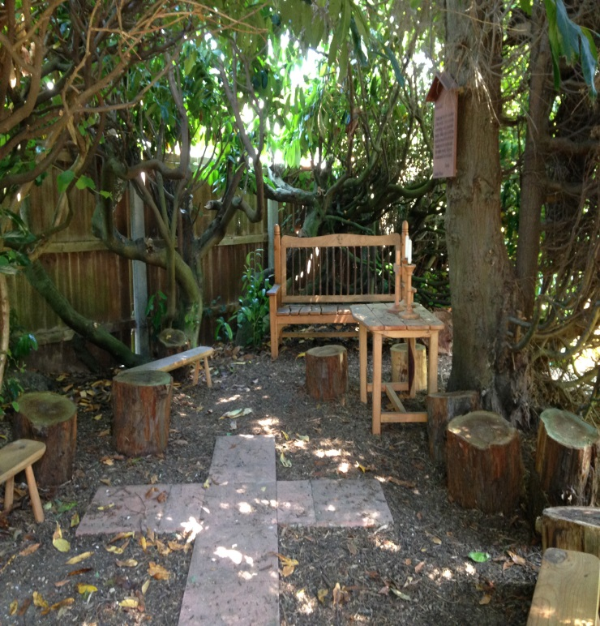
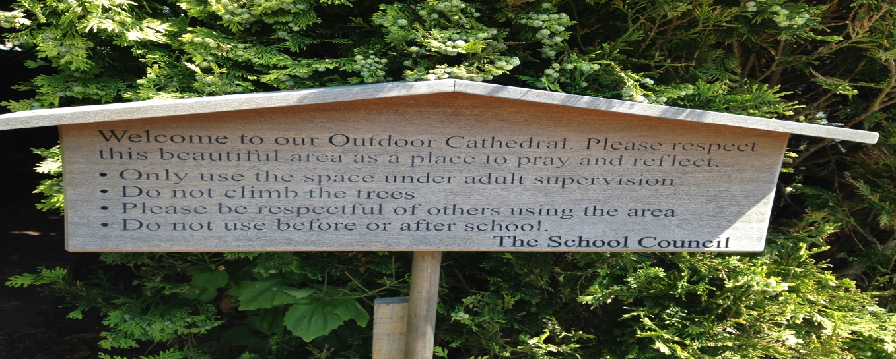
Outdoor cathedral
MARCUS
Back in September one of our first jobs was to look at how we could turn an unused, scruffy part of our school into an amazing area that could be used by the whole school community. We decided we wanted a place that utilised our fantastic school grounds. We wanted something peaceful, a place to come, and reflect and think.
CHLOE
We started by looking at pictures on the internet of outdoor reflection areas to give us inspiration. We put together a scrap book so that we could share our ideas with Mrs Phillips and to seek her approval and permission.
AMELIA
Then Mrs Hughes introduced us to some people who were happy to help. We showed them our scrap book and they talked to us about how we could realise our ambitions.
ELLA
With the help of many, and lots of hard work from them and the school council, we have been able to turn this into something we are hugely proud of and we can’t wait until the whole school can use it and feedback to us how much they like it.

Slide 15
Highly Aspirational …
Opportunities are offered that everyone can achieve. challenging texts/ resources, high expectations, clear progression, pitched to individual needs & interests. Providing additional resources/ support in order to achieve.
…through nature.
Examples: Years 4, 5 and 6 take part in Battle of the Books when they access books which will challenge and inspire them.

Slide 16
Book Selection
10 books are selected each year based roughly on the following criteria:
Books are to inspire and challenge. The book list will not include works by Jacqueline Wilson or any of the Harry Potter series, for example, because children are naturally drawn to these.
The aim is to provide a range of books, of different genres, to draw children out of their natural comfort zone. The hope is that they will surprise themselves. There will always be at least: one autobiographical book (I am Malala); one classic (eg: Tom’s Midnight Garden) one set in a historical time period (usually one featuring World Wars I or II); one fantasy/fantastical novel; one which deals with contemporary issues (eg: Oranges in No Man’s Land – politics, war, learning about another culture); one book written by an overseas author (Revolution is not a Dinner Party); something amusing; something to appeal to boys.
Usually at least two of the books chosen are the first in a series, which means that if the first one appeals, the children have got a number of others to move on to.
Because the aim is to read as many books as possible, children should be covering areas they wouldn’t naturally otherwise have chosen.

Slide 17
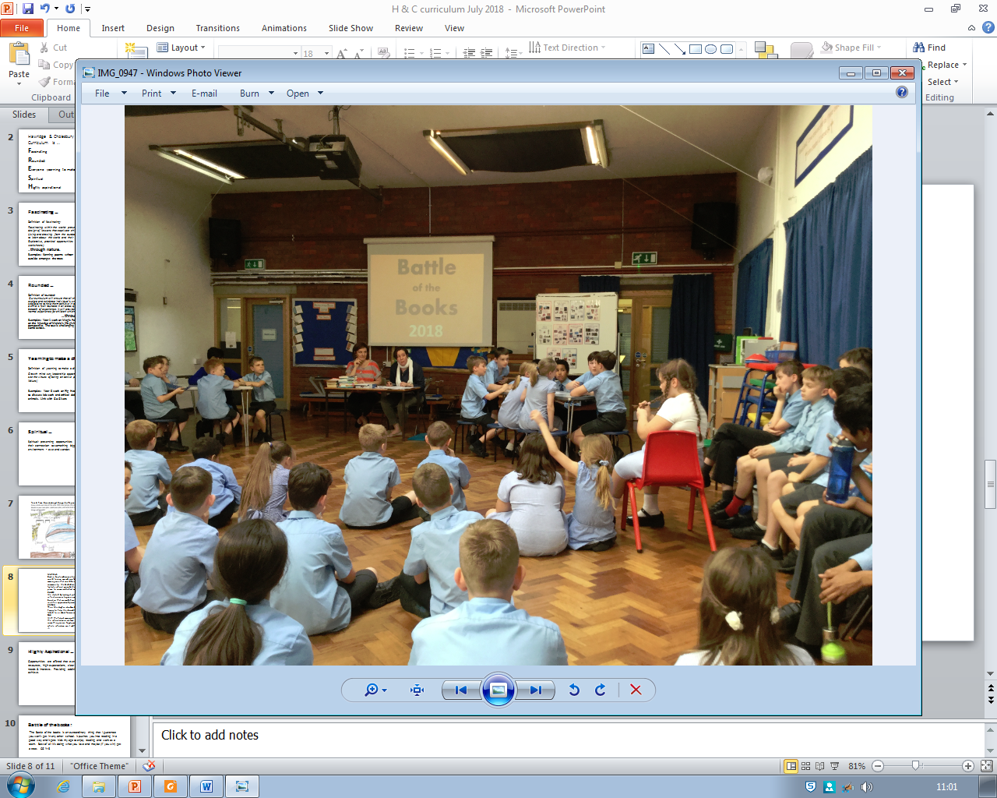
Battle of the books :
‘The Battle of the books is an extraordinary thing that I guarantee you won’t get in any other school. It pushes you into reading in a good way and it gets kids my age to enjoy reading and work as a team. Best of all it’s doing what you love and maybe (if you win) get a treat.’ CG Yr 6

