Slide 1
How to train a Dragon
By Year 4

Slide 2
First gather the gang!

Slide 3
First gather the gang!

Slide 4
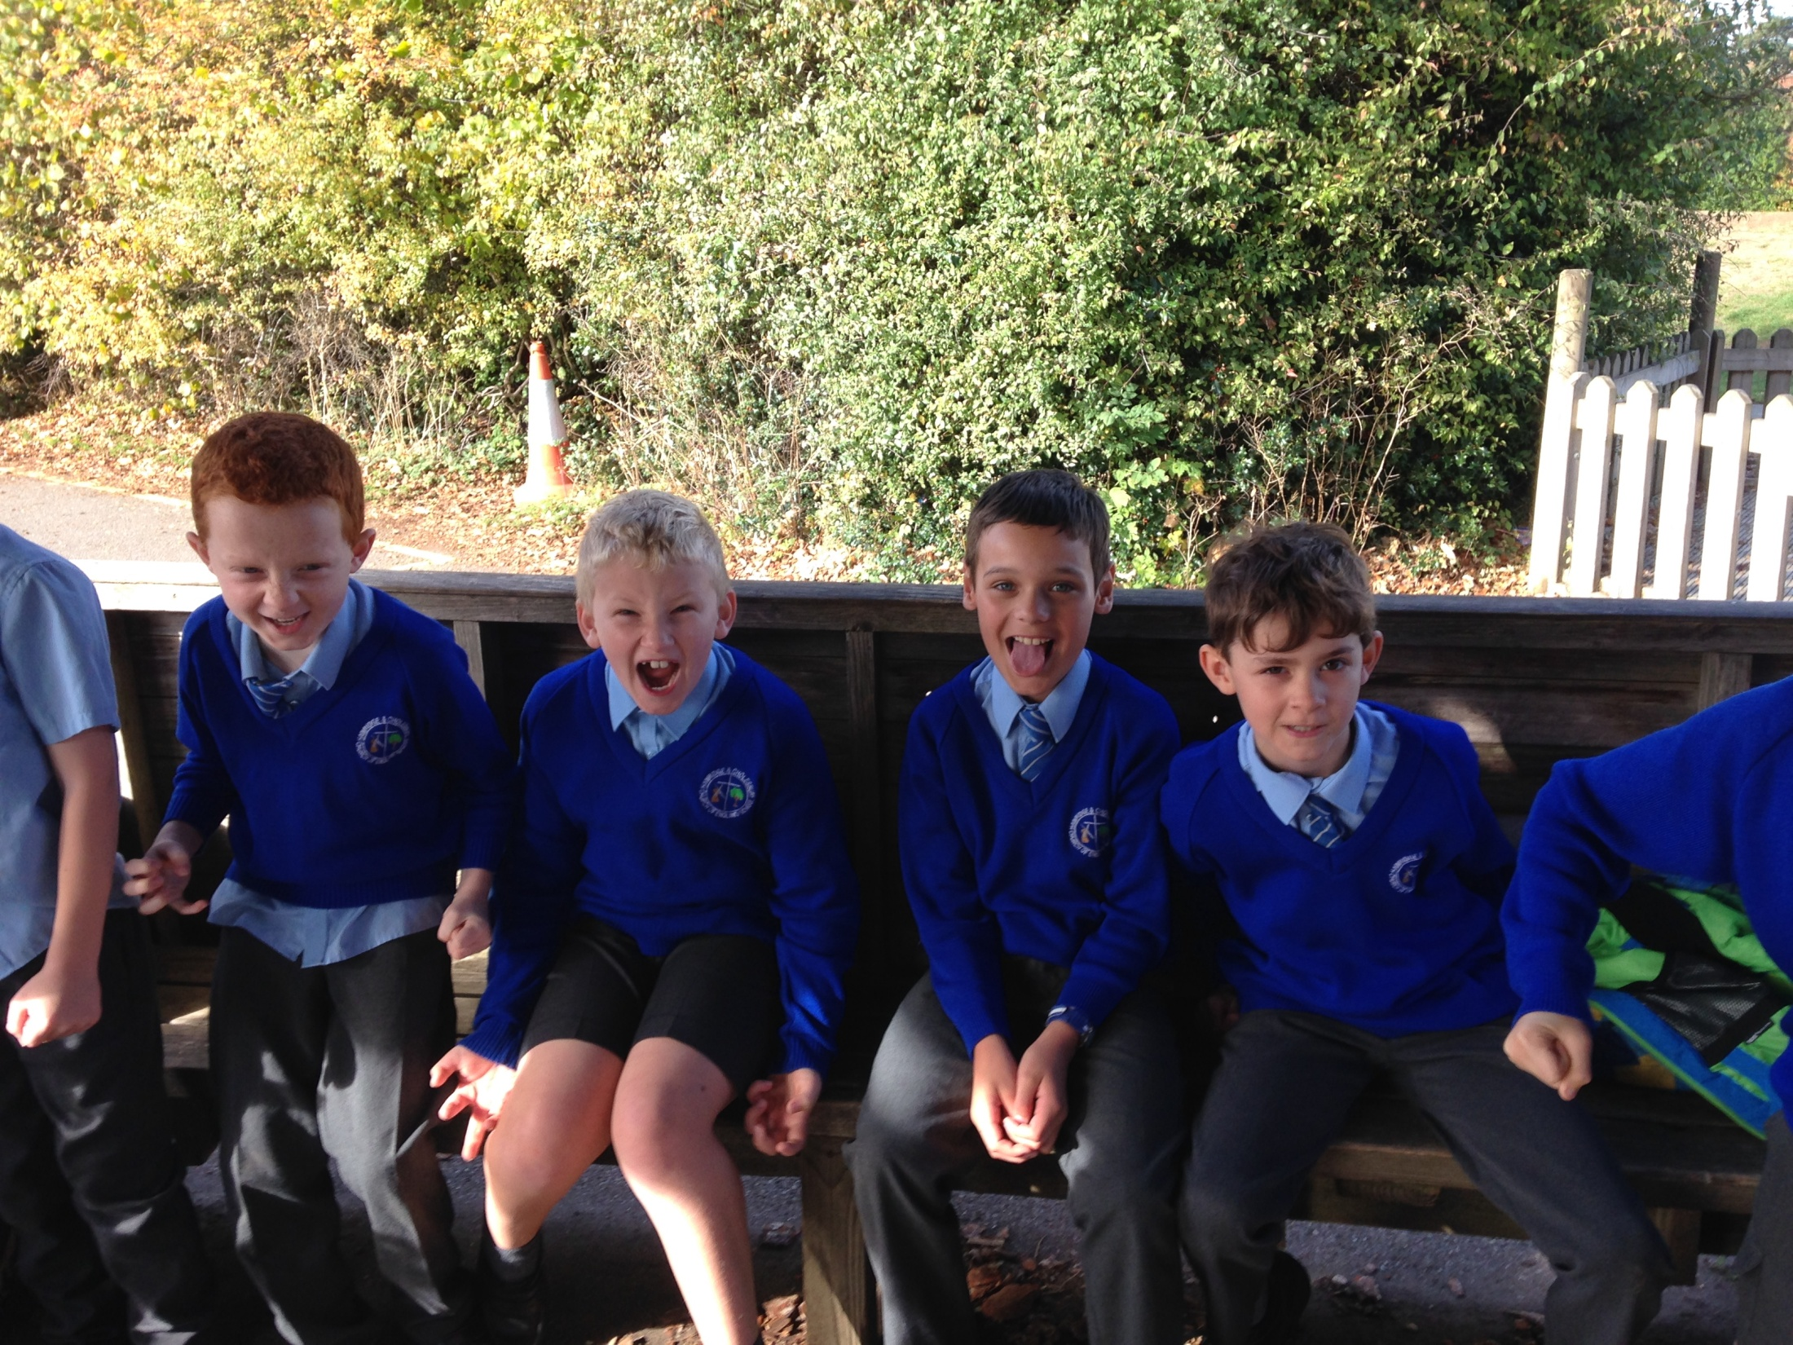

Slide 5
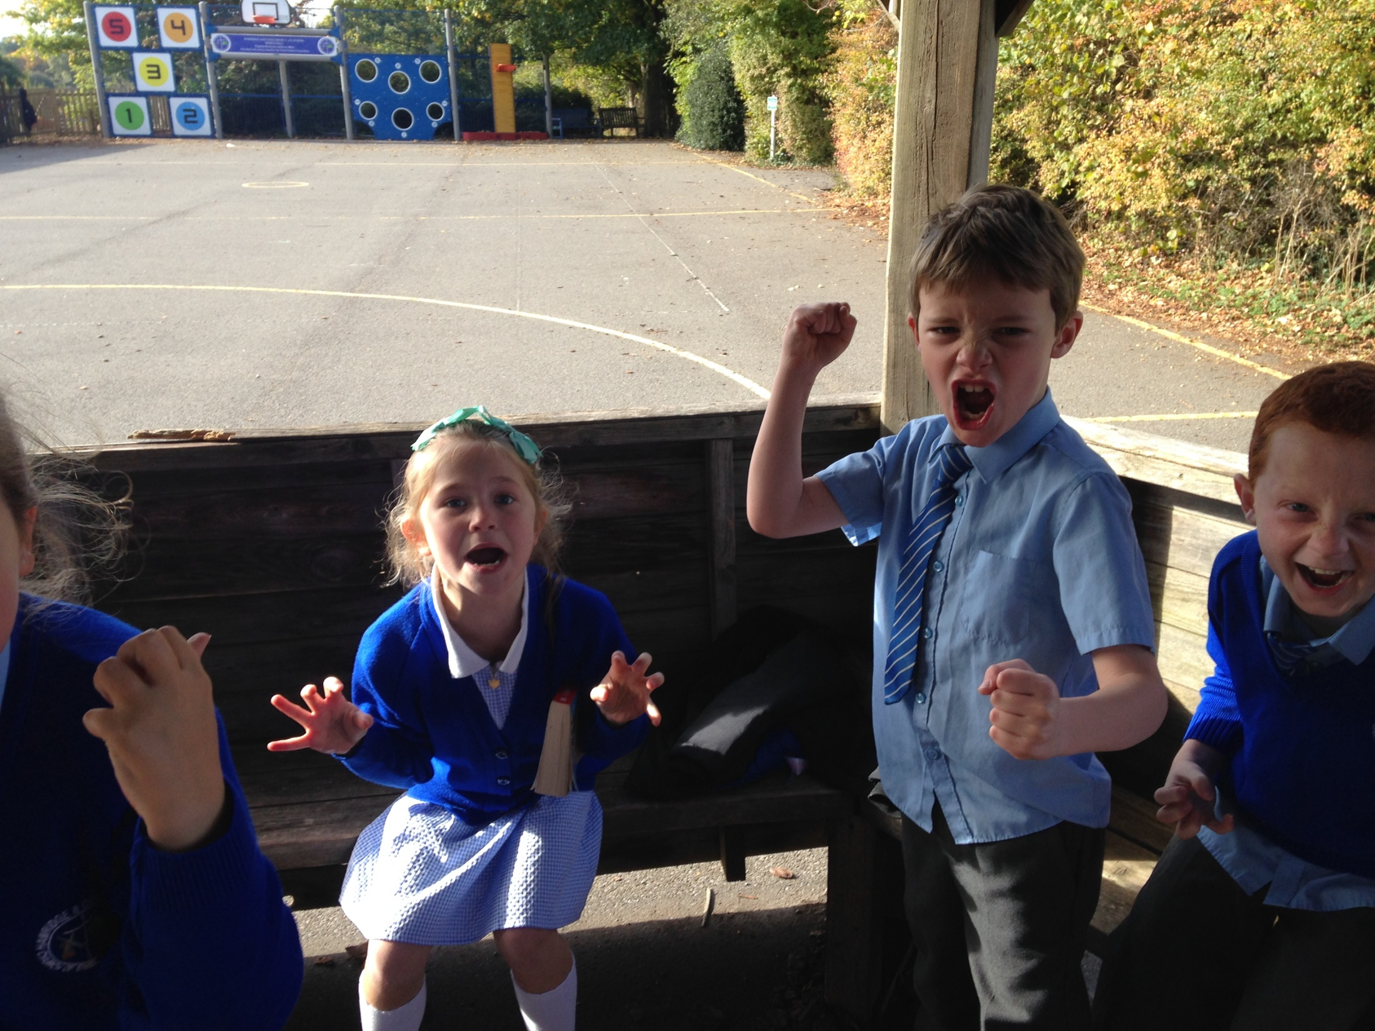

Slide 6
Climb the Mountain of Death

Slide 7
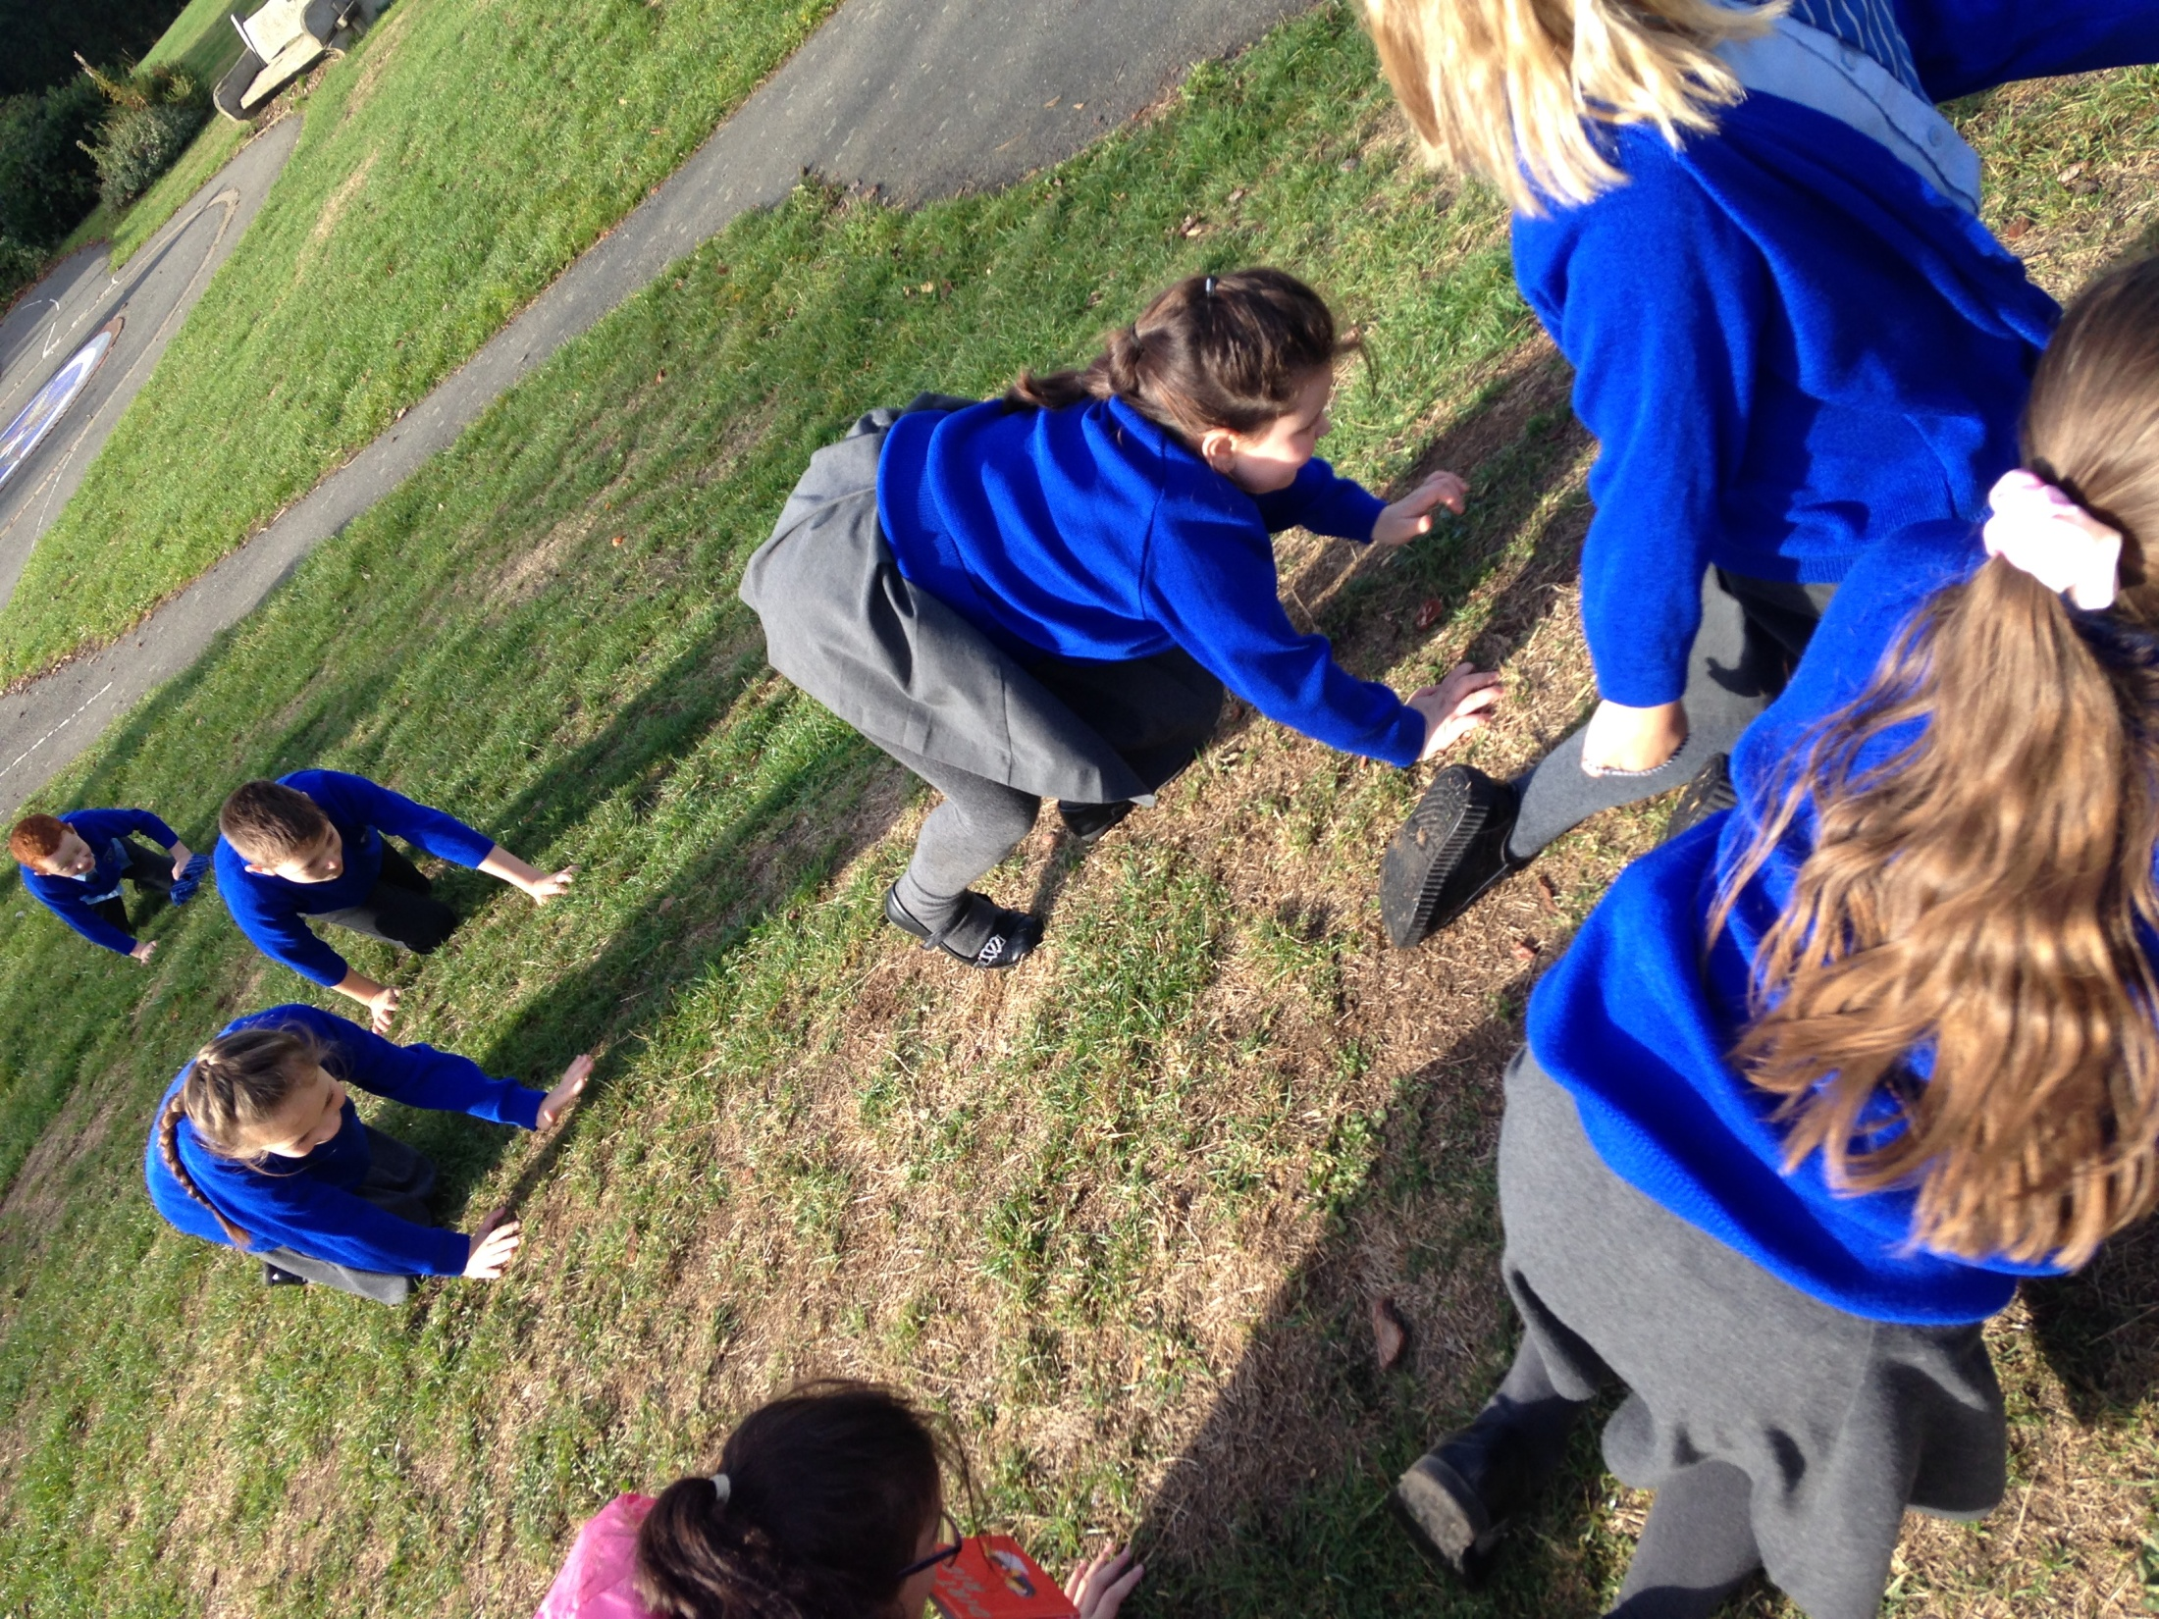

Slide 8
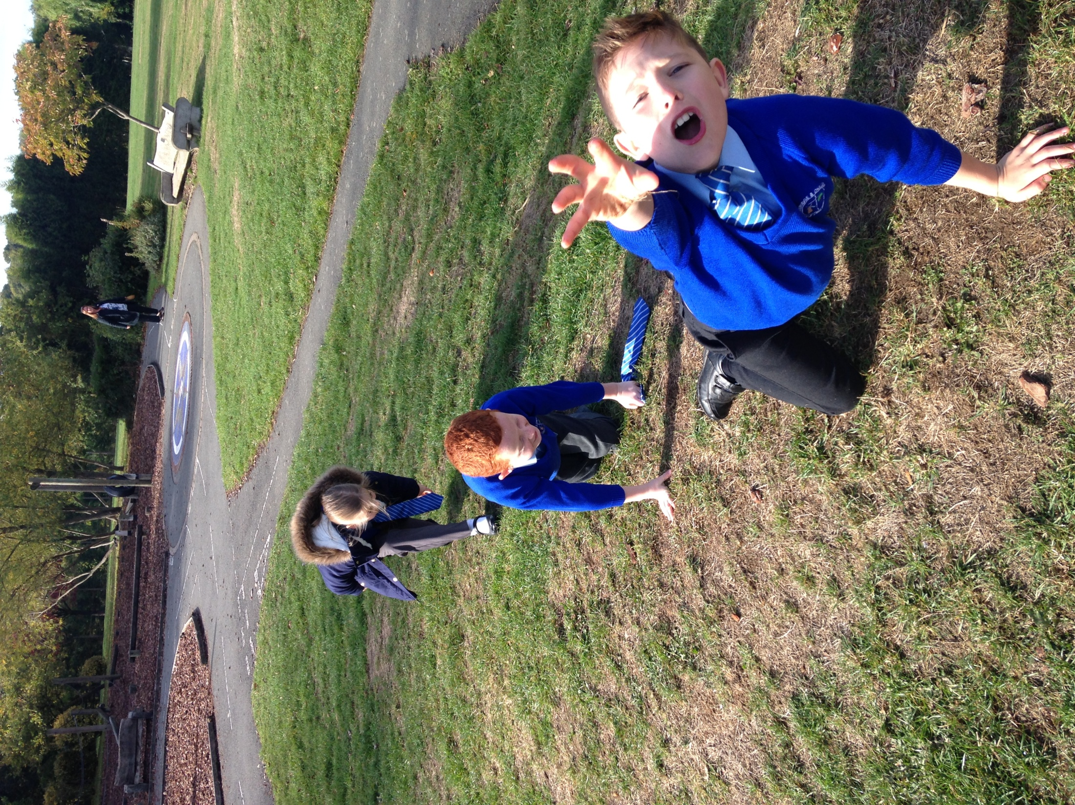

Slide 9
Run round the Isle of Berk

Slide 10
Through the tyres of DOOM

Slide 11
Across the back of Seadragonous Giganticous

Slide 12
Inside the Willow Tunnel of Sharp Teeth

Slide 13
To reach the Dragon’s nest...

Slide 14
...and capture our Dragon’s eggs

Slide 15
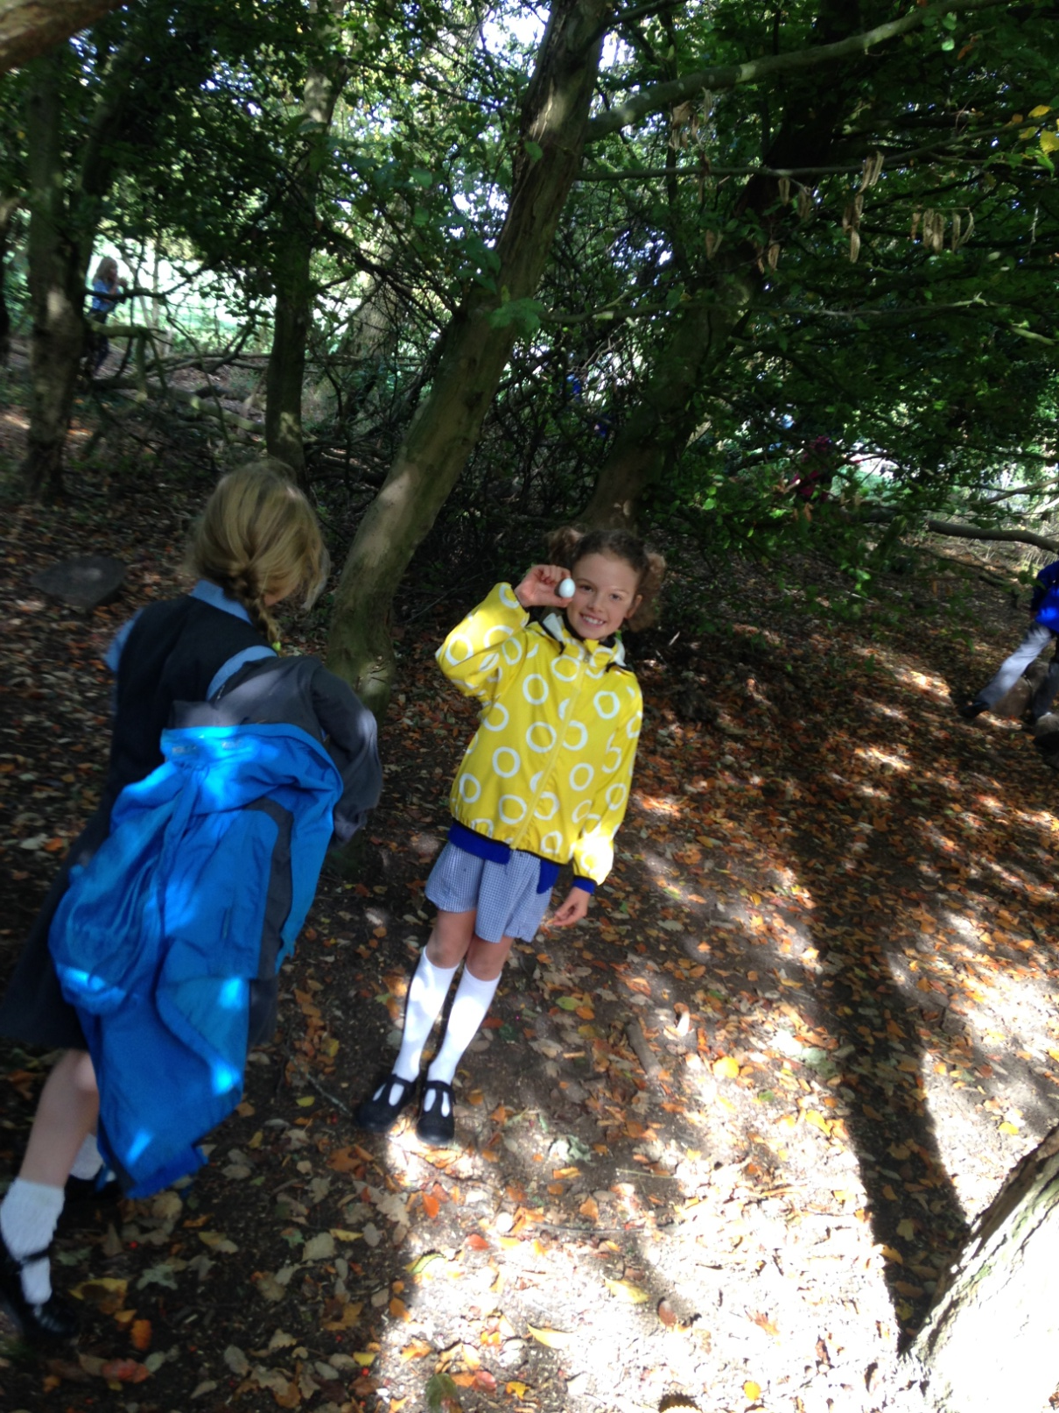

Slide 16
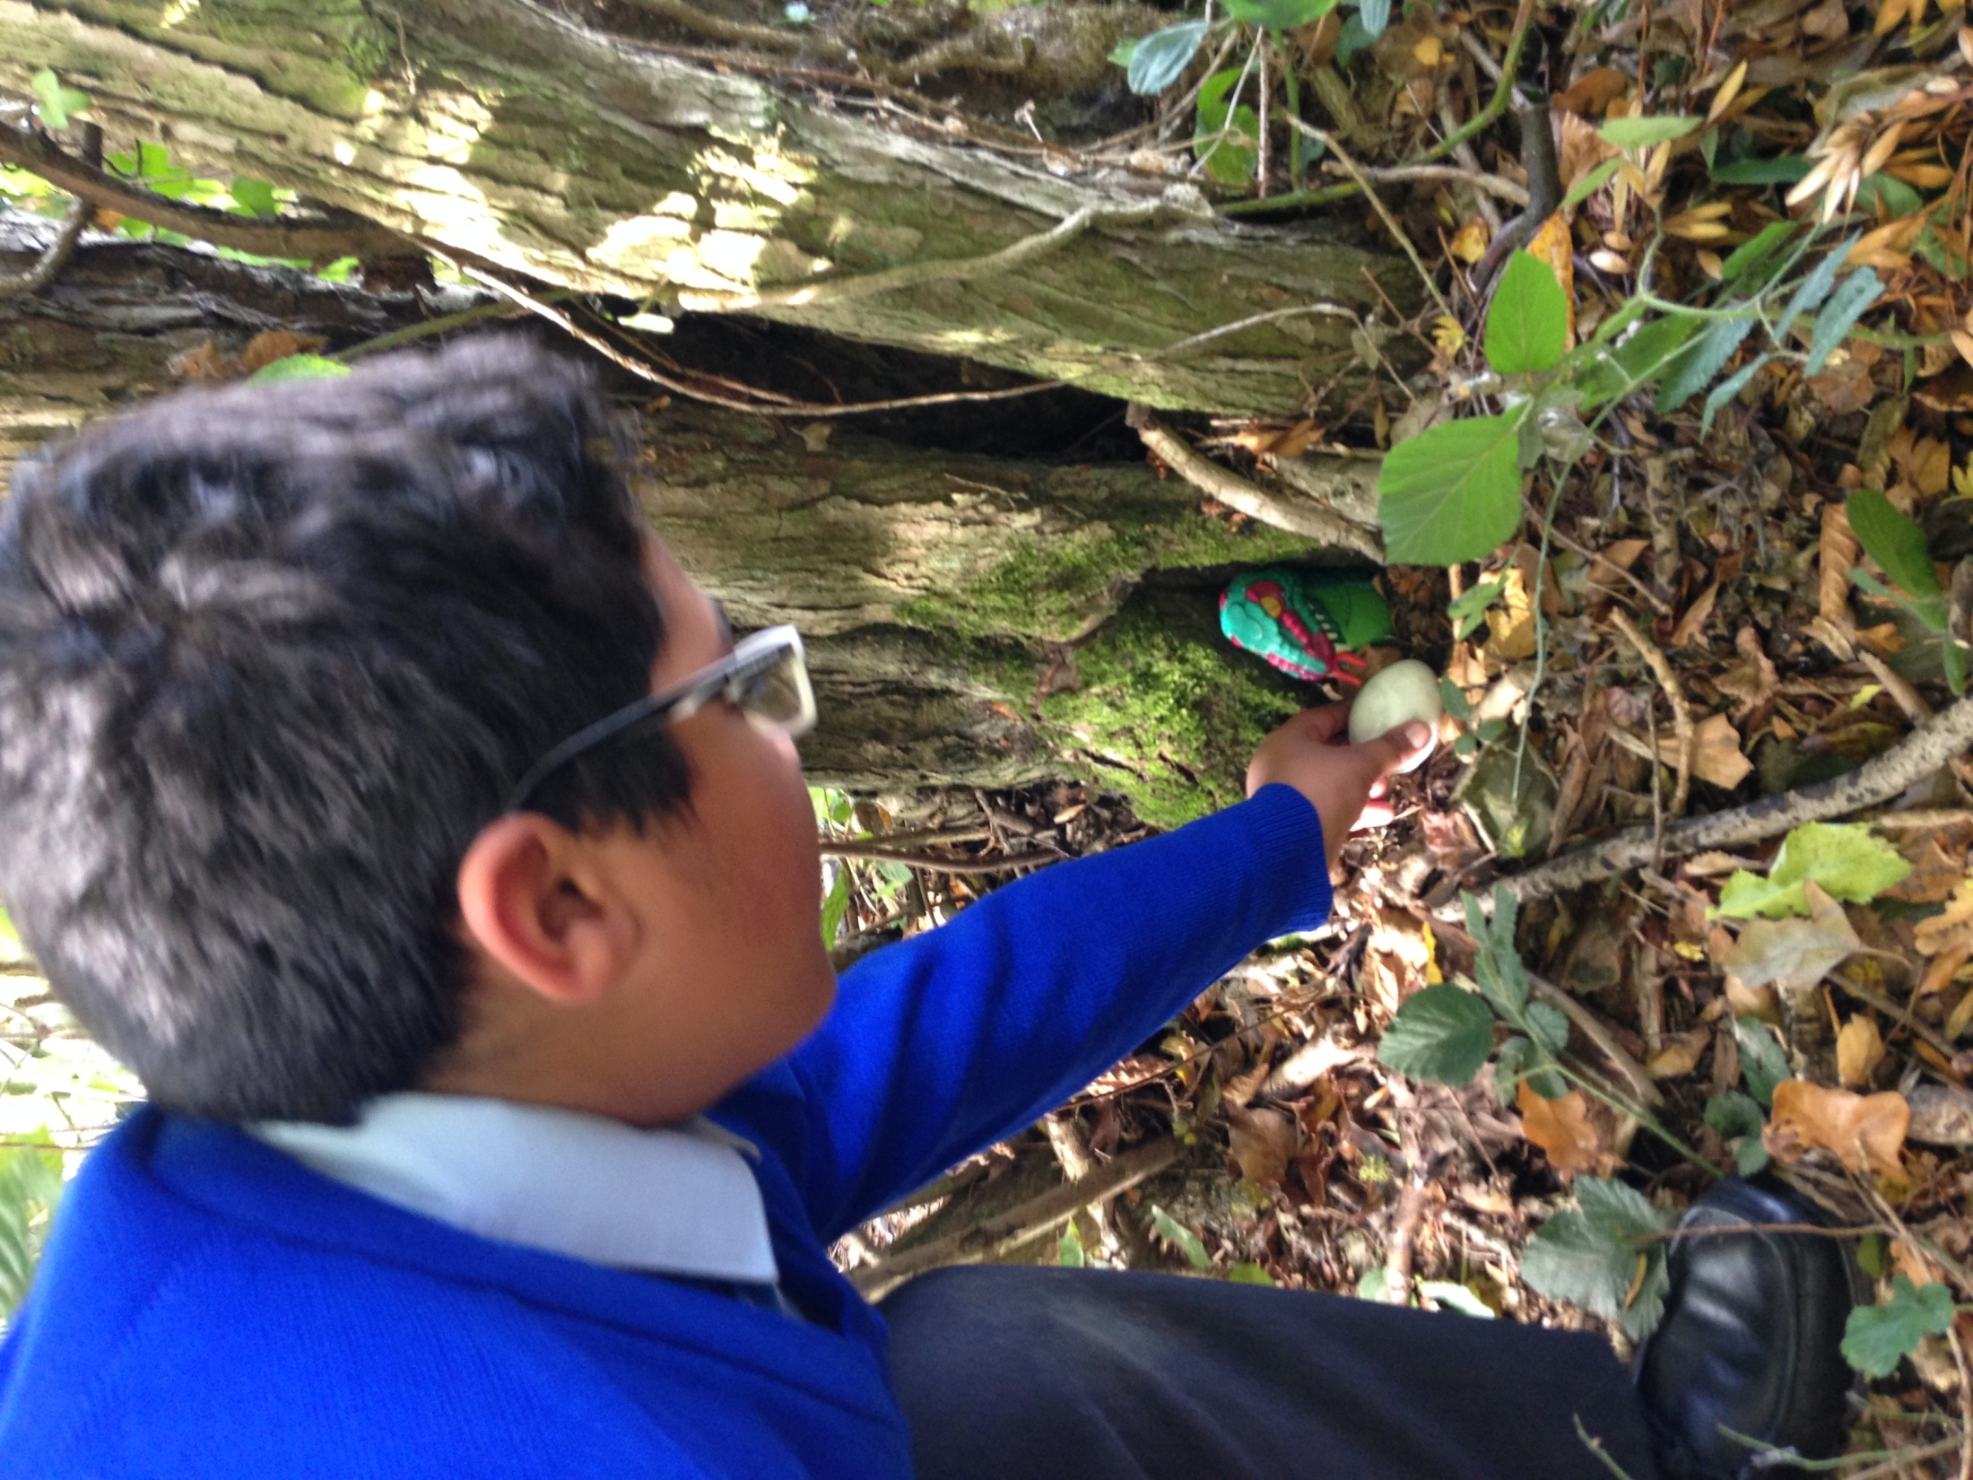

Slide 17
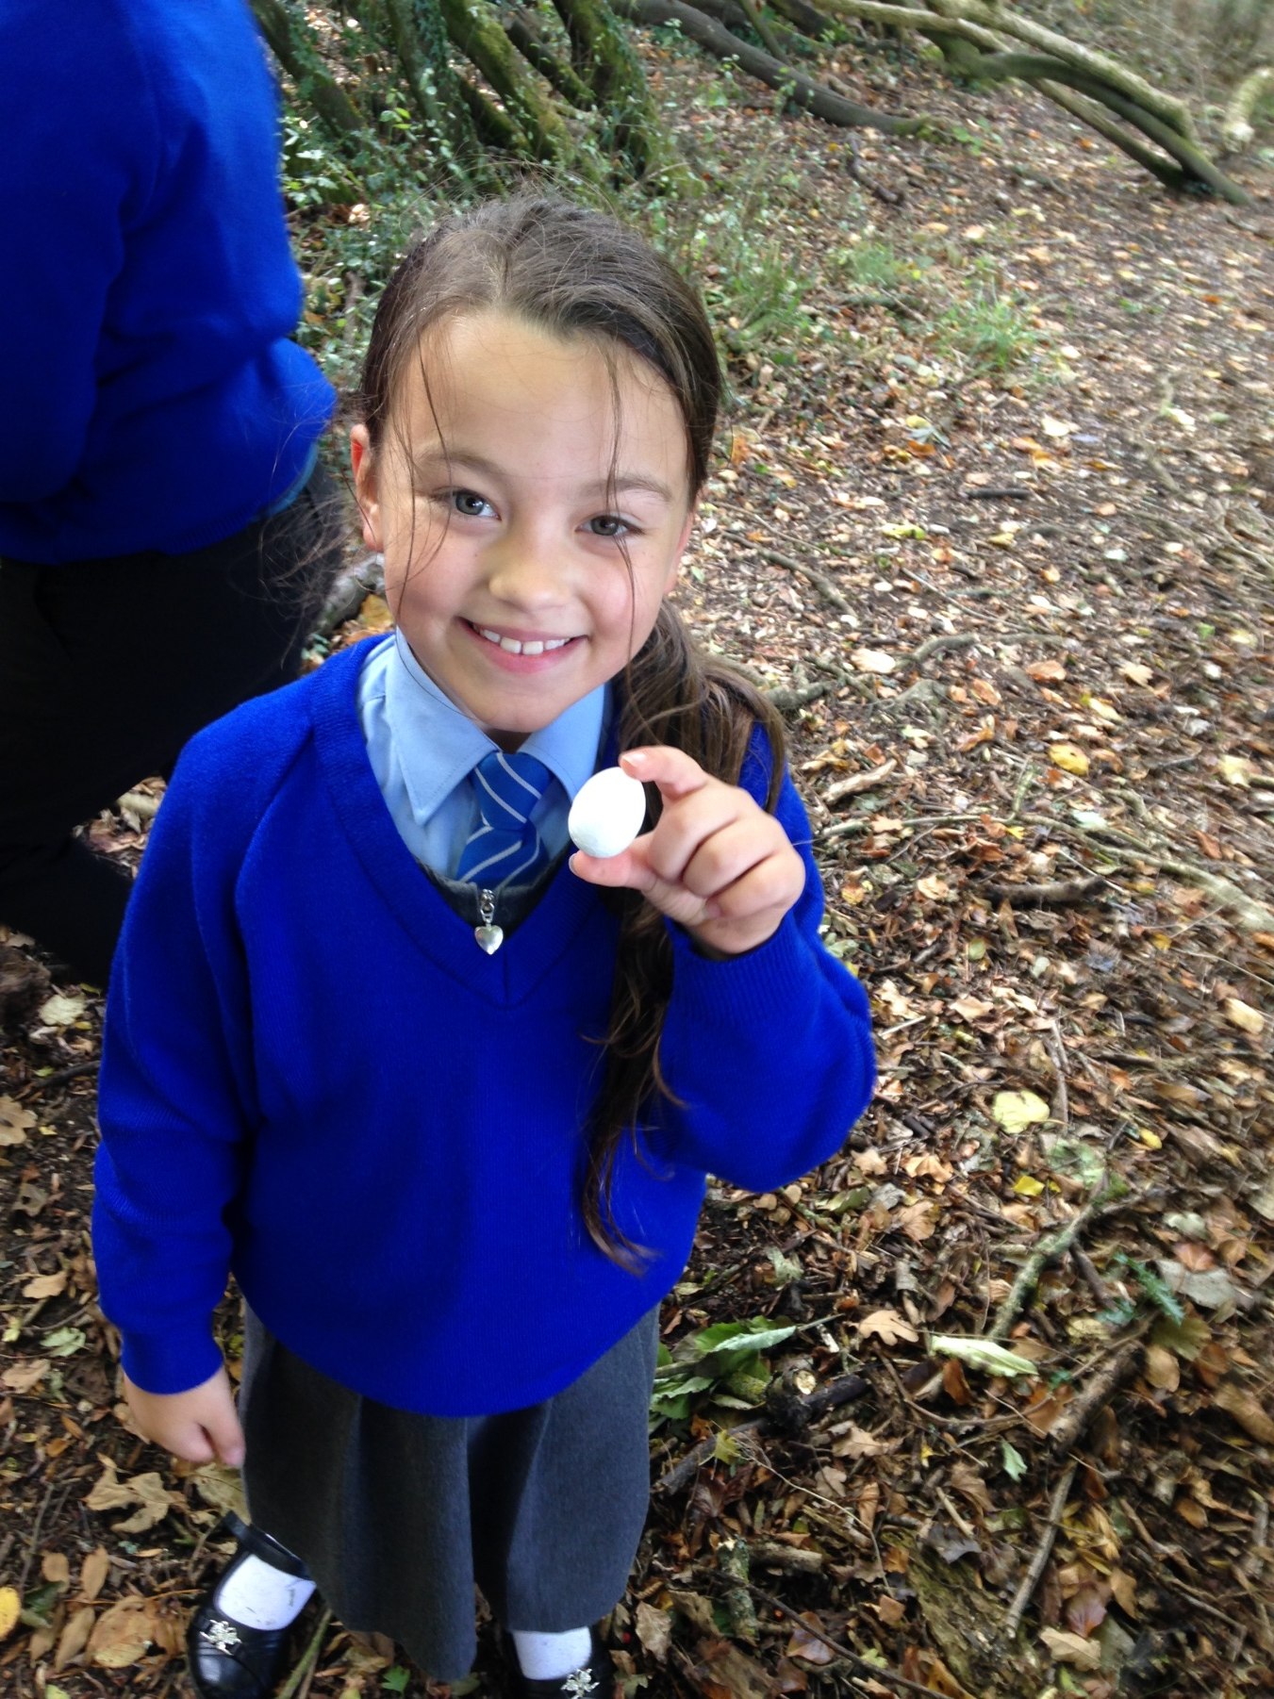

Slide 18
Then wait for them to hatch
and see what they get up to!!!!

Slide 19
A little bit of English

Slide 20
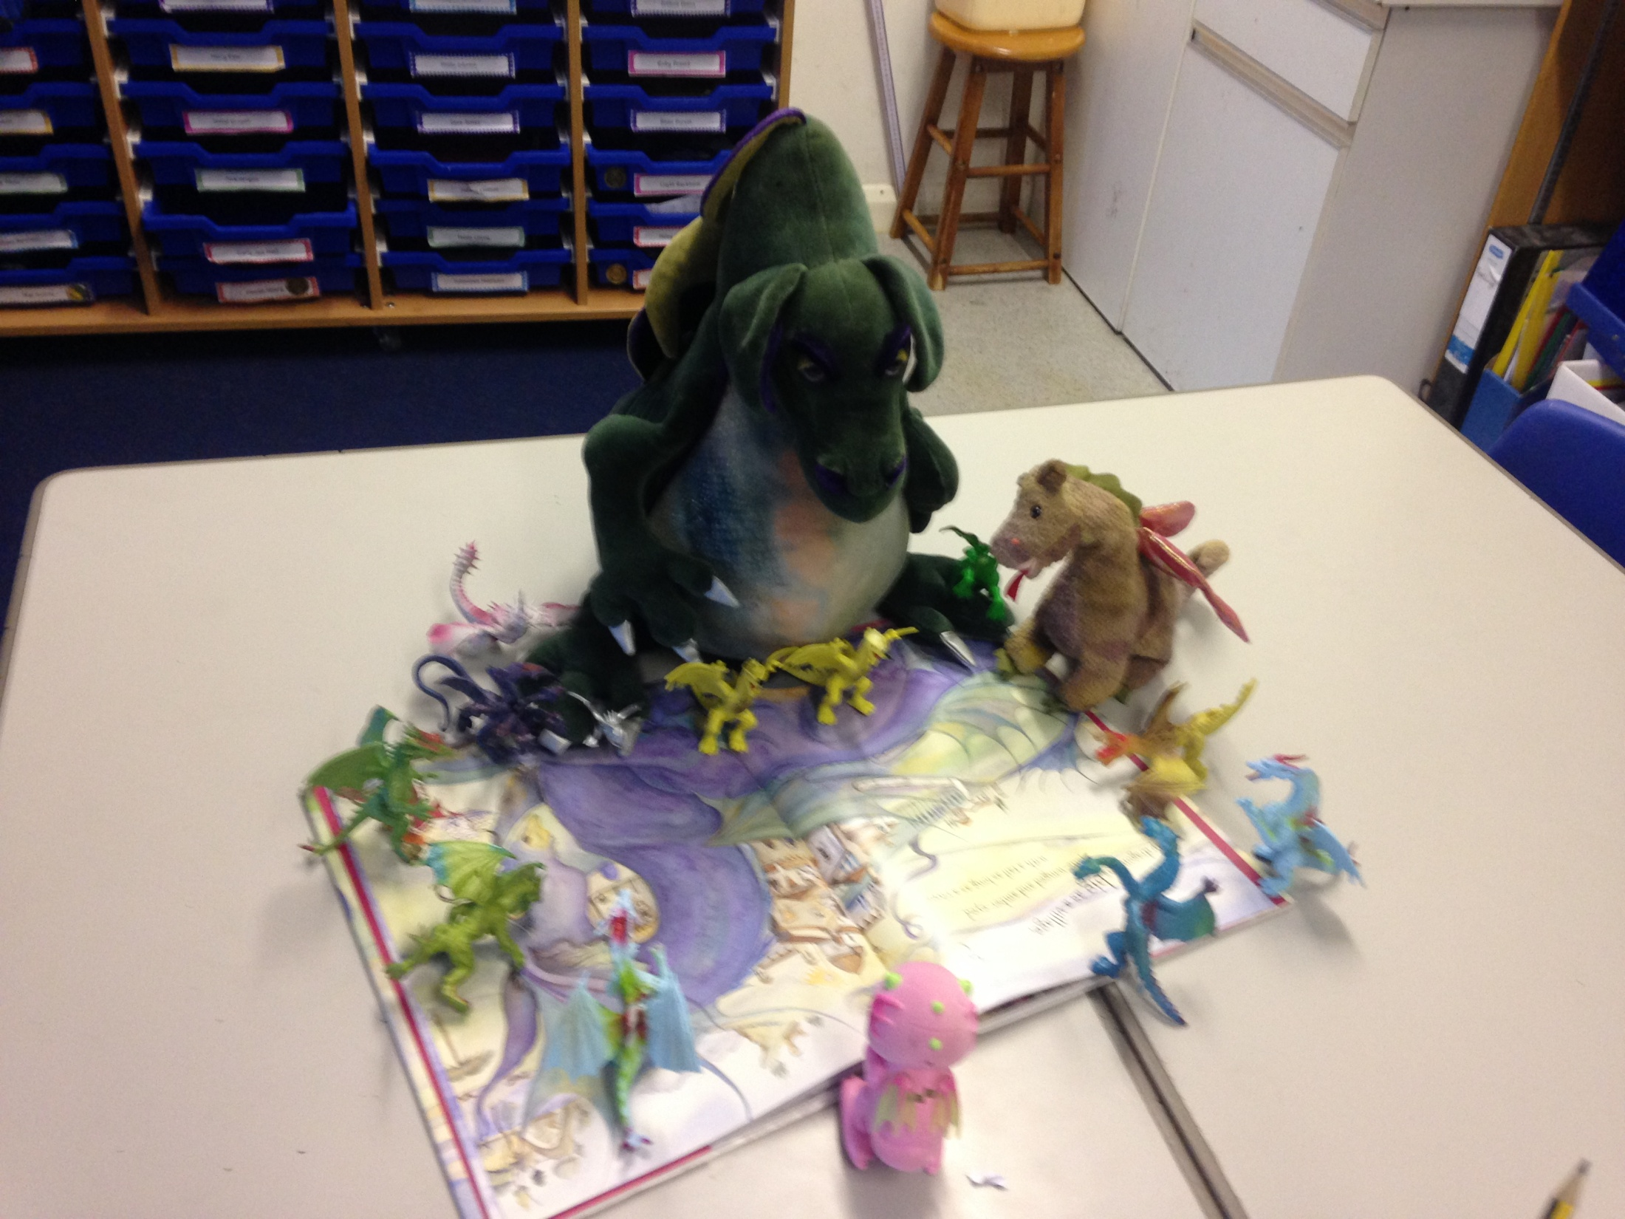

Slide 21
Some Geography

Slide 22
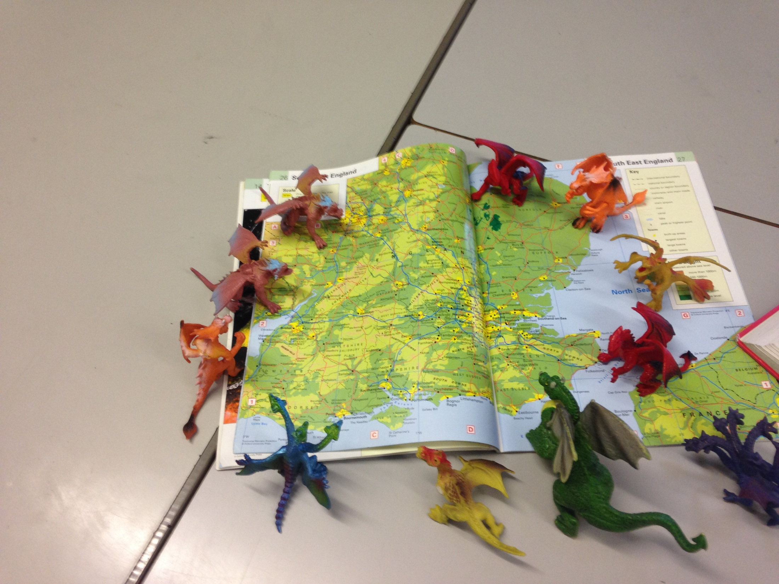

Slide 23
History

Slide 24
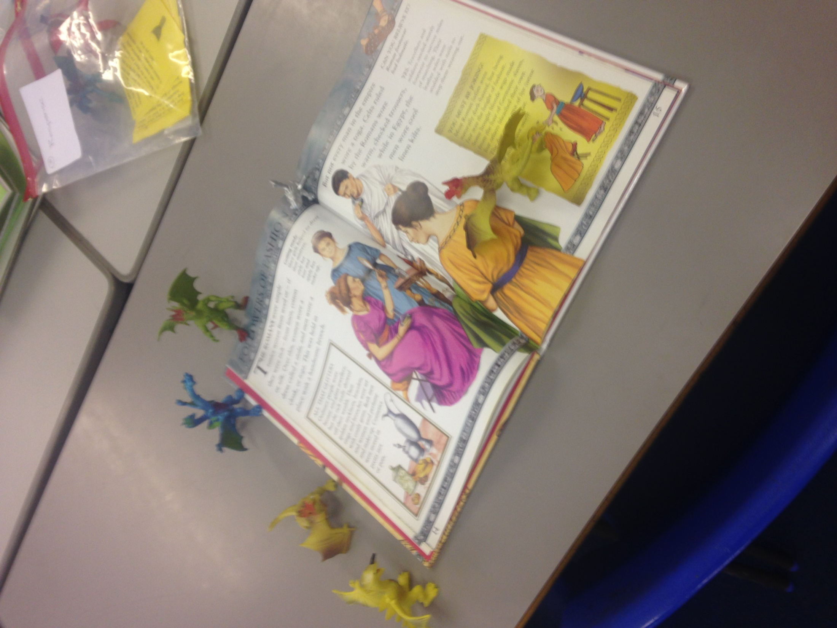

Slide 25
Collective Worship

Slide 26
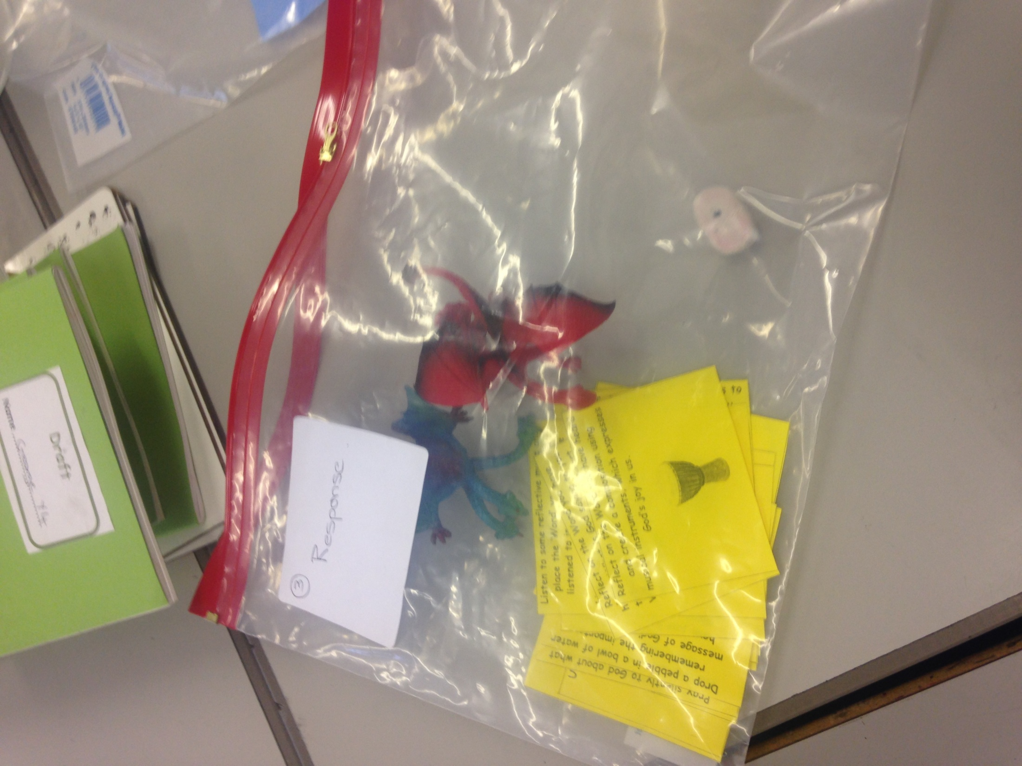

Slide 27
Art!

Slide 28
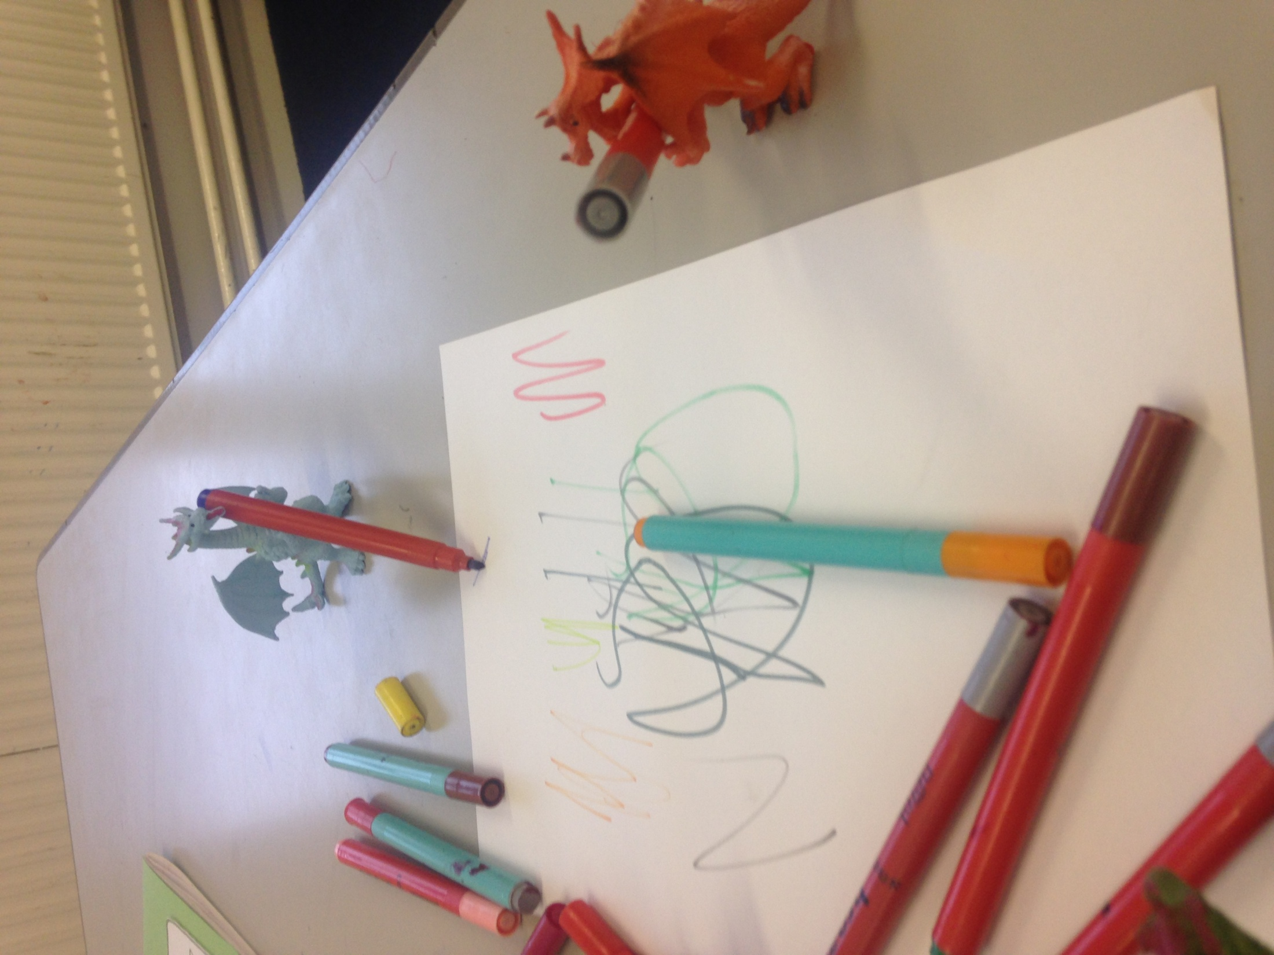

Slide 29
Then let our imaginations go wild….
and our vocabulary astound!

Slide 30
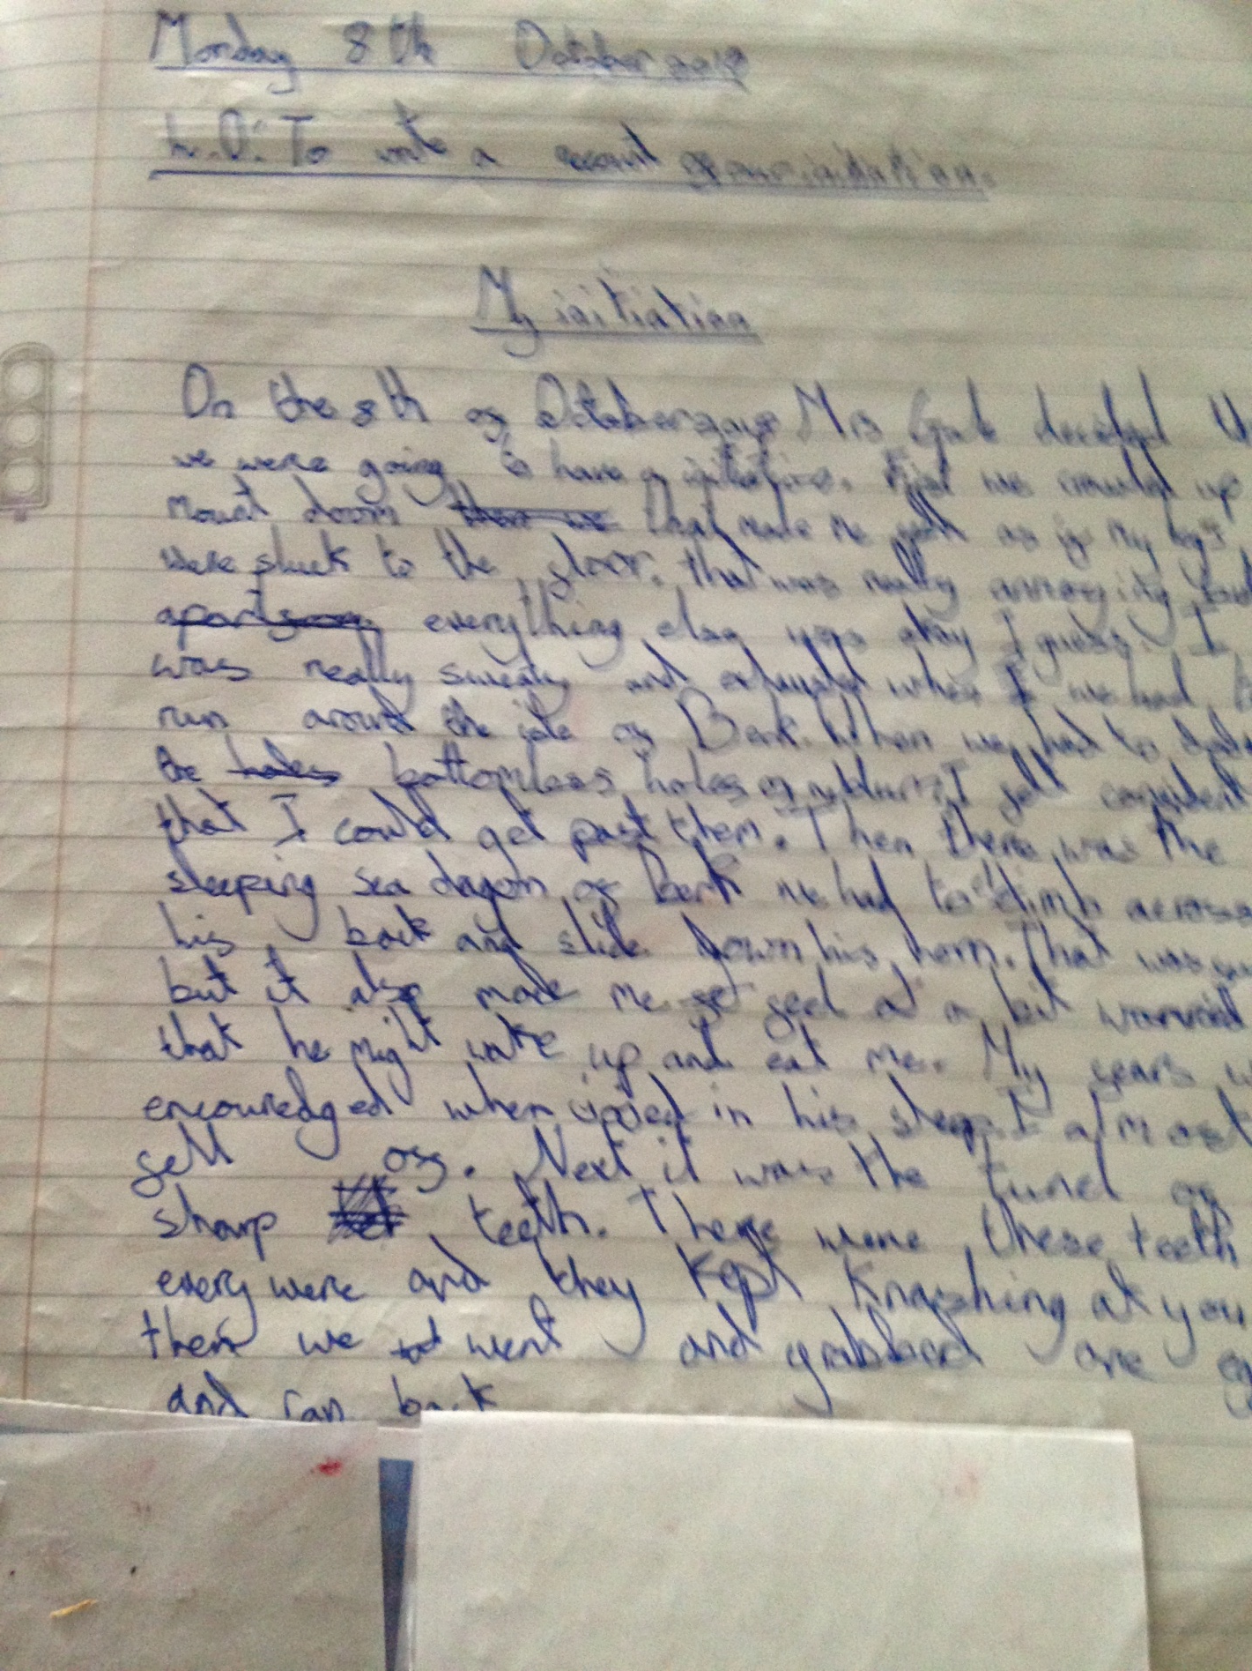

Slide 31
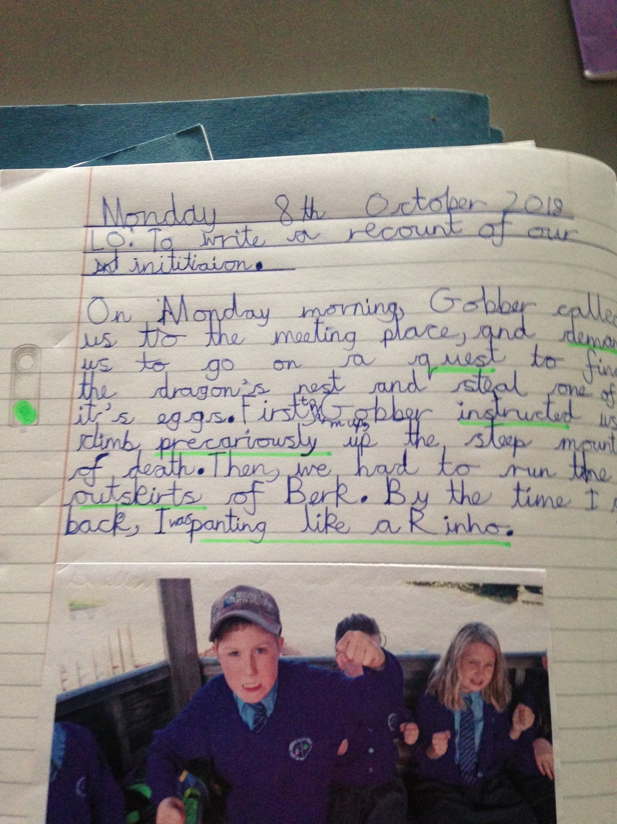

Slide 32
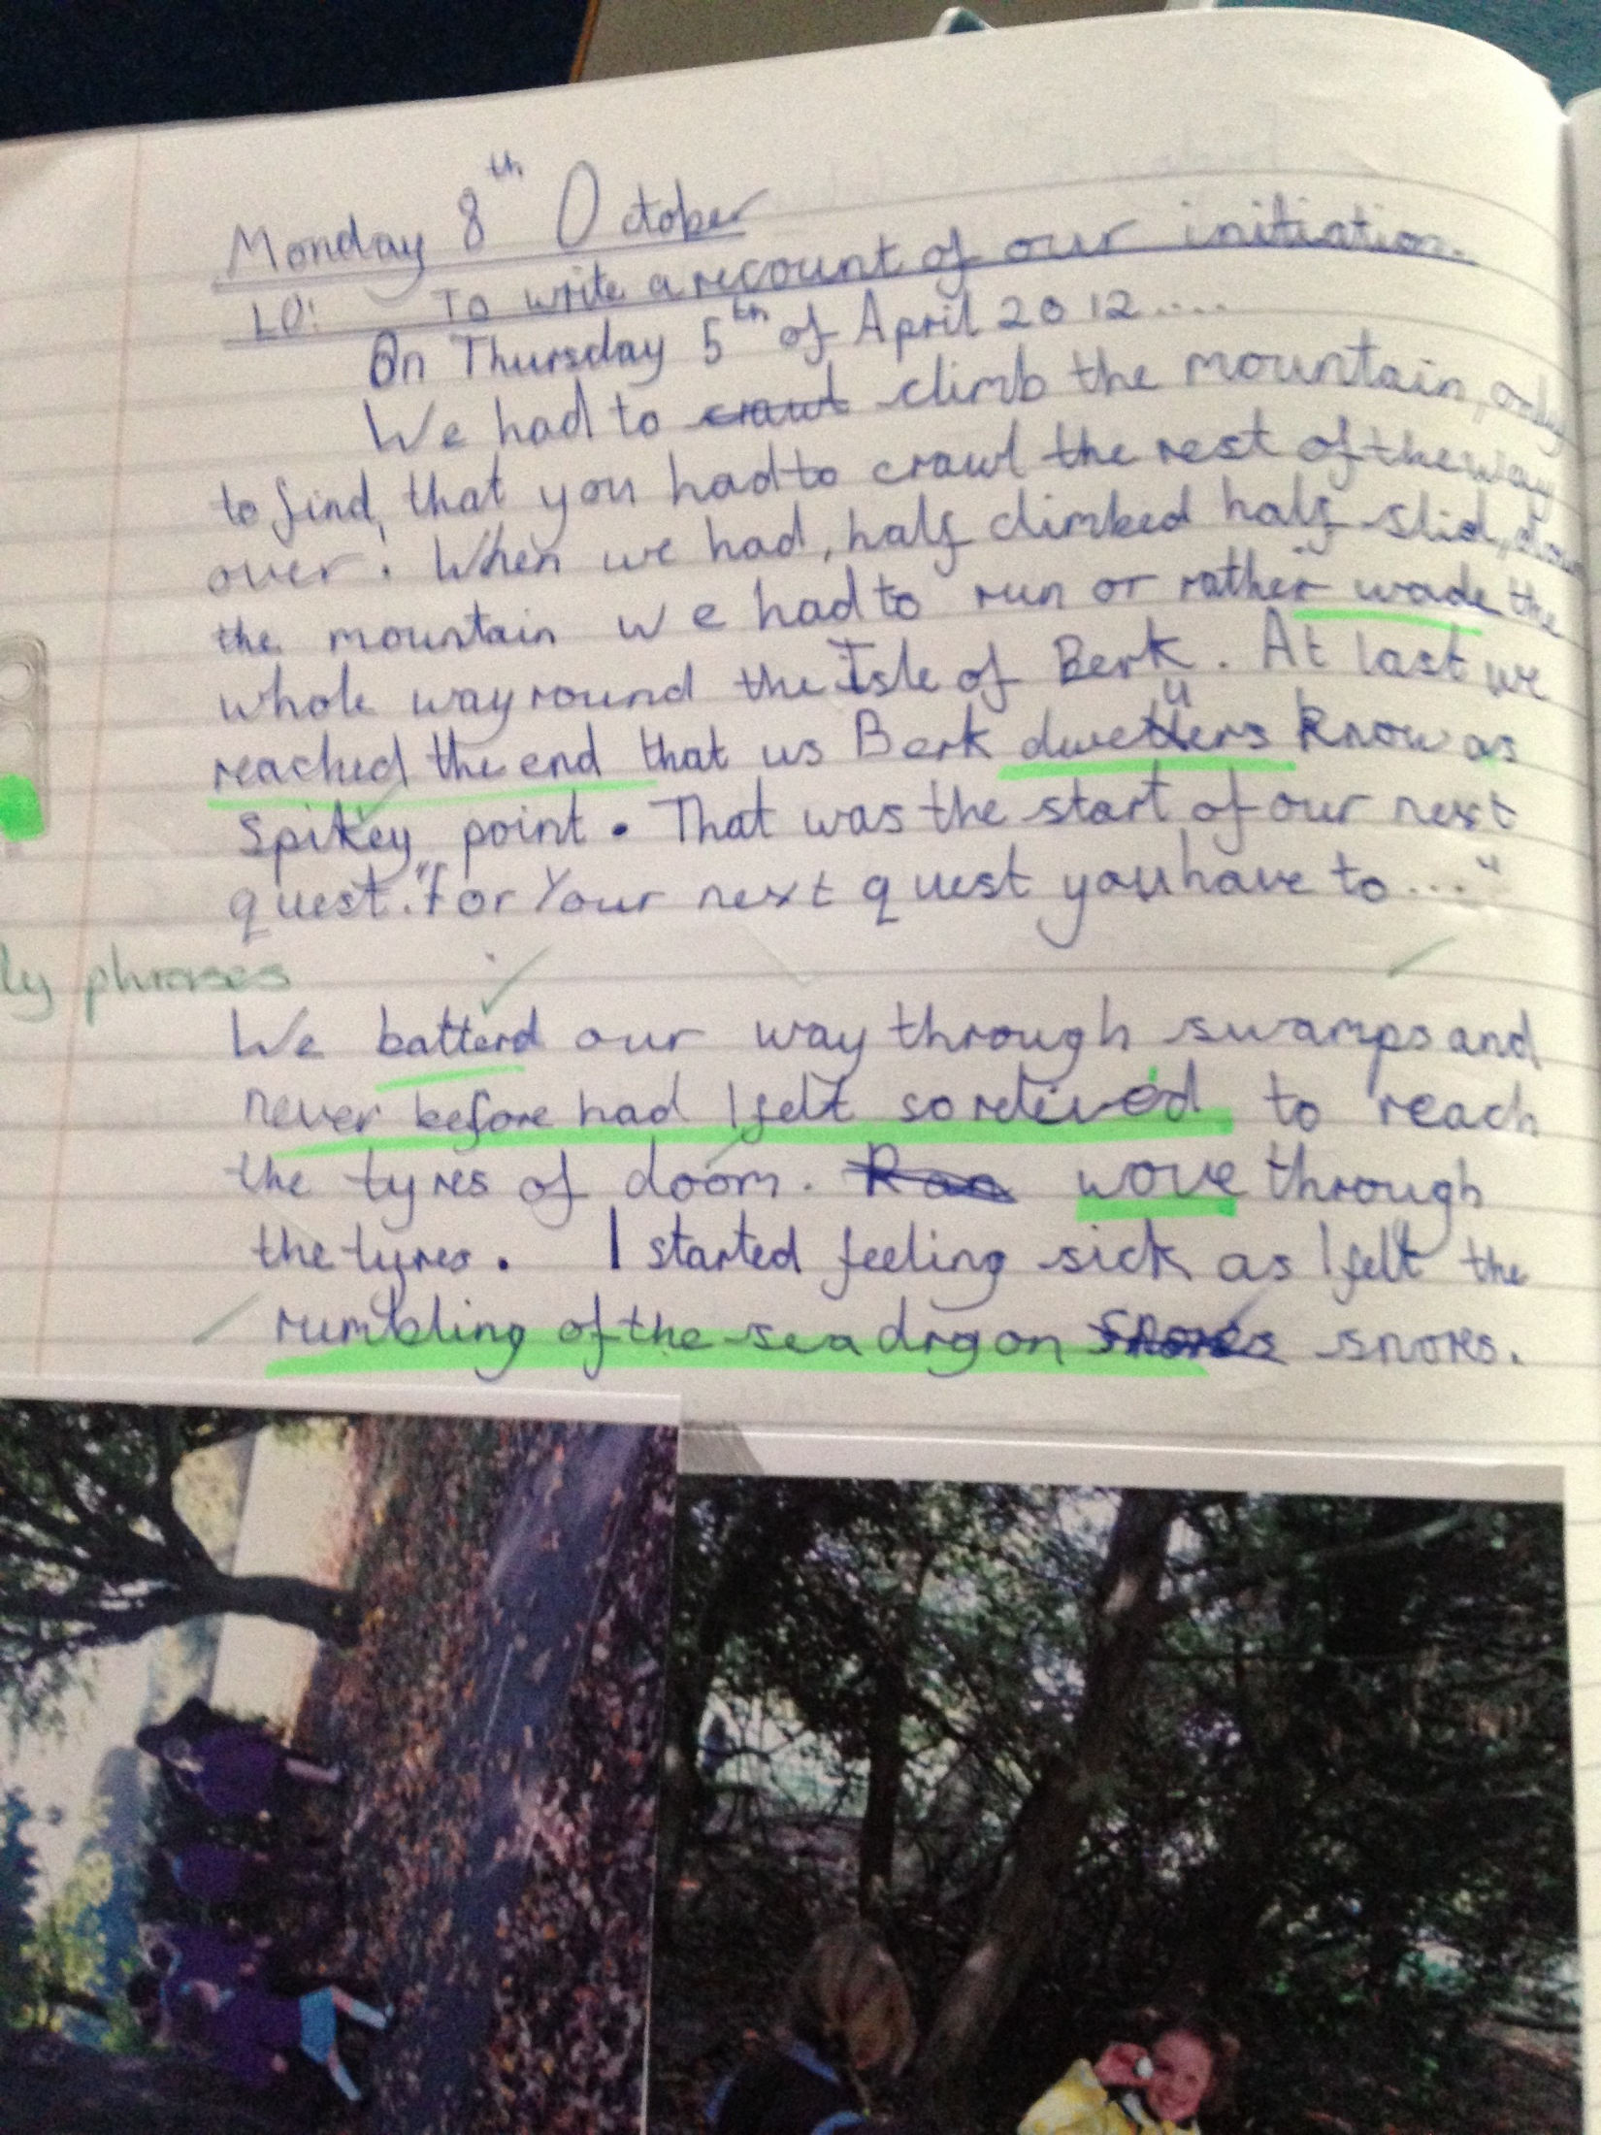

Slide 33
