Slide 1
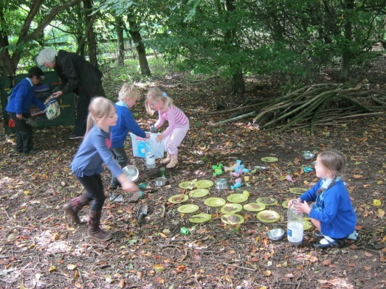
Welcome to our Parents Forum
Please sign in and help your self to a drink, take a seat at a table and introduce yourself to your neighbours. If possible - a mixture of EYs/ KS1/ KS2 parents on each table please.

Slide 2
Agenda
Introductions and the purpose of Parent Forums
Our children’s education: what is the impact of good/ bad attendance on our children? When should a child miss school?

Slide 3
Purpose of Parent Forums and
Why?: To engage parents/ carers, staff and governors in consideration and discussion of aspects of the school .
To develop a cohesive picture of the school we want Hawridge & Cholesbury C of E School to be.

Slide 4
Ground Rules
School is considered as a whole, with general issues being discussed rather than specific concerns.
Specific issues/ concerns should be addressed with the class teacher initially.
Be positive.

Slide 5
Attendance
You have to buy a ticket to win the lottery!

Slide 6
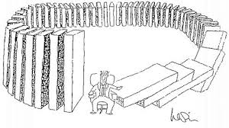
Persistent absentees – children who miss 15% or more
School monitors, OFSTED check
Consequences – for the child?
- for parents?
-for school?

Slide 7
Absence from School: A study of its causes and effects in seven LEAs Heather Malcolm, Valerie Wilson, Julia Davidson and Susan Kirk The SCRE Centre, University of Glasgow
LEAs and teachers and parents thought attendance was important
LEAS & teachers - attainment, disruptive behaviour and children’s safety.
LEAs felt school were too lenient
Primary school children who missed school liked it, whereas Secondary tended to be bored.
Some children (27%) gave school reasons for their absences – friendship issues, tests, teacher issues
Teachers, particularly Primary felt that absences were more likely due to ‘home factors’ including parenting

Slide 8
Nick Gibb: “Children who miss school, miss out as adults.”
Children who attend school regularly are four times more likely to achieve five or more good GCSEs, including English and Maths, than those who are persistently absent

Slide 9
Nick Gibb: “Children who miss school, miss out as adults.”
400,000 pupils miss at least a month of school
There is clear evidence of a link between poor attendance at school and low levels of achievement. Figures from 2009/10 show that:
Of pupils who miss more than 50 per cent of school, only three per cent manage to achieve five A* to Cs, including English and maths.
Of pupils who miss between 10 per cent and 20 per cent of school, only 35 per cent manage to achieve five A* to C GCSEs, including English and maths.
Of pupils who miss less than five per cent of school, 73 per cent achieve five A* to Cs, including English and maths.

Slide 10
What happens at Hawridge & Cholesbury C of E
Current attendance = 96.4% (target = 97%)
Every child ‘s attendance is entered on an electrical system.
Any child who flags up with 15% or more absenteeism: report is sent to the Head teacher
This is investigated and tracked. HT may speak to parents where there is a concern. Where this appears to persist, parent receives a letter.
If issue continues, Education Welfare Officer (EWO) is contacted . A penalty notice may be issued.

Slide 11
Holidays/ Sickness/ Health
No holidays are authorised – all sent to EWO who may instigate a penalty notice
On going health issues: child will be supported through a Health Care Plan. School nurse may be involved.
Sickness and diarrhoea – 48 hours strict rule (Health Dpt)

Slide 12
How can we help?
What can school do?
What can parents do?

