Slide 1
Expectation: Uses a wide range of co-ordinating and subordinating conjunctions to develop and extend their ideas.
Commissioned by The PiXL Club Ltd.
Example 2017
© Copyright The PiXL Club Limited, 2017

Slide 2
Teachers’ Notes
This Powerpoint begins by clarifying types of co-ordinating and subordinating conjunctions.

Slide 3
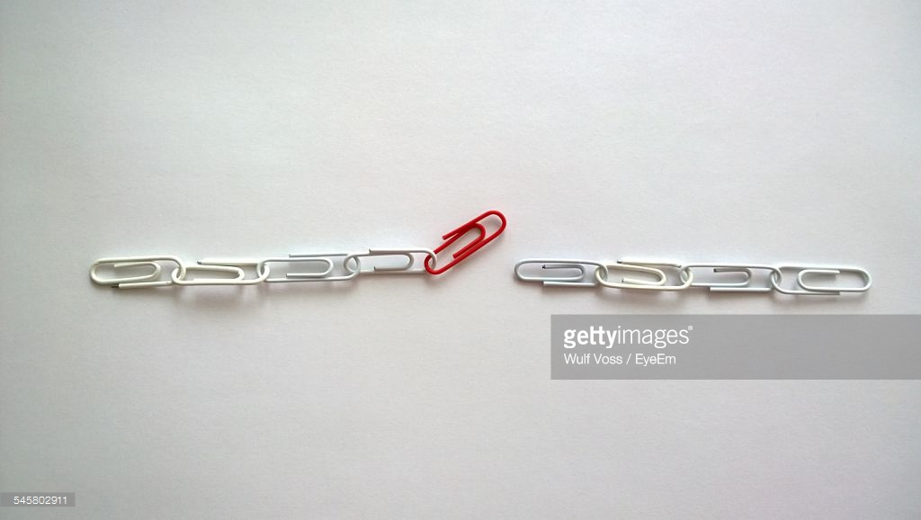
Conjunctions are used to join clauses in a sentence.
We can think of them as LINKING ideas.
By using them, our writing flows better and the reader can make connections between ideas.

Slide 4
Conjunctions can link ideas between two main clauses. In this case, they are called co-ordinating conjunctions.
Remember – a main clause makes sense on its own.
The brown cat was scared.
It hid behind the sofa.
The brown cat was scared SO it hid behind the sofa.
Two main clauses linked by a co-ordinating conjunction.

Slide 5
CO-ORDINATING CONJUNCTIONS
F
for
A
and
A good way to remember what these are is FANBOYS.
N
nor
B
but
O
or
Y
yet
S
so

Slide 6
Now we are going to look at SUBORDINATING CONJUNCTIONS.
These are conjunctions which join a MAIN CLAUSE and a SUBORDINATE CLAUSE.
Even though it was raining, we went outside.
Even though
This is the subordinating conjunction.
Even though it was raining
This is the subordinate clause (it doesn’t make sense on its own).
we went outside
This is the main clause (it makes sense on its own).

Slide 7
So our multi-clause sentence looks like this:
SUBORDINATE CLAUSE
,
MAIN CLAUSE
. ? or !
Although the skill was difficult, she practised it again and again.
Subordinating conjunction
Subordinate clause
Main clause

Slide 8
Some subordinating conjunctions are:
Although …
Even though …
Unless…
Because …
When …
While …
Firstly …
After …

Slide 9
Your turn: identify the conjunctions in each sentence. Decide if they are co-ordinating or subordinating.
Although the creature looked terrifying, James approached it.
She had worked hard so she felt she deserved a treat!
Unless he concentrated harder, he would never solve the puzzle.
It was raining hard yet it was sunny at the same time.

Slide 10
Your turn: identify the conjunctions in each sentence. Decide if they are co-ordinating or subordinating.
Although the creature looked terrifying, James approached it.
subordinating
conjunction
She had worked hard so she felt she deserved a treat!
co-ordinating
conjunction
Unless he concentrated harder, he would never solve the puzzle.
subordinating
conjunction
It was raining hard yet it was sunny at the same time.
co-ordinating
conjunction

Slide 11
Your turn: Now write your own sentences using each of the subordinating conjunctions. Can you use the subordinate conjunctions at the start and also in the middle of a sentence?
Although, unless, despite
subordinating
conjunction
So, yet, but
co-ordinating
conjunction

