Slide 1
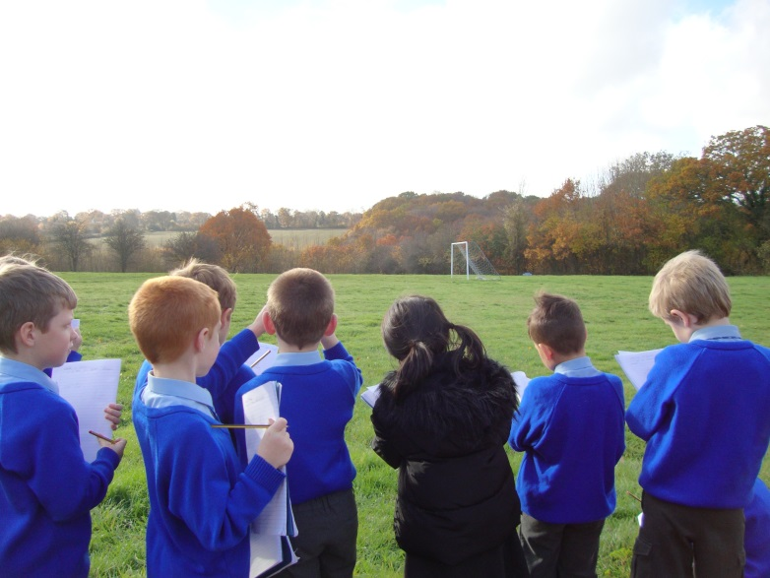
Year 3 FRESH Curriculum

Slide 2
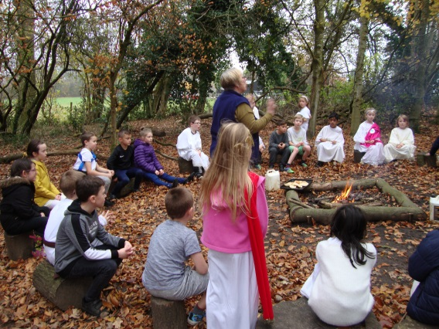
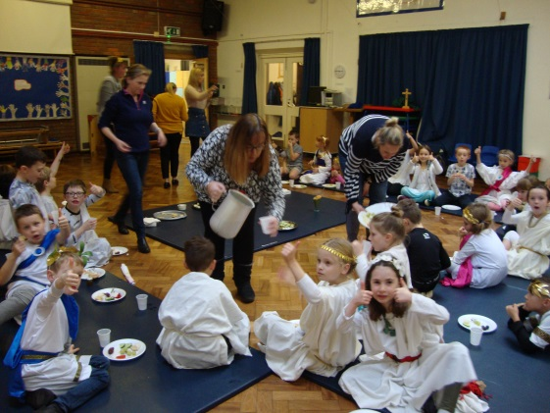
How are we making our lessons….
Fascinating
Rounded
Everyone yearning to make a difference
Spiritual
Highly inspirational, through nature
?

Slide 3
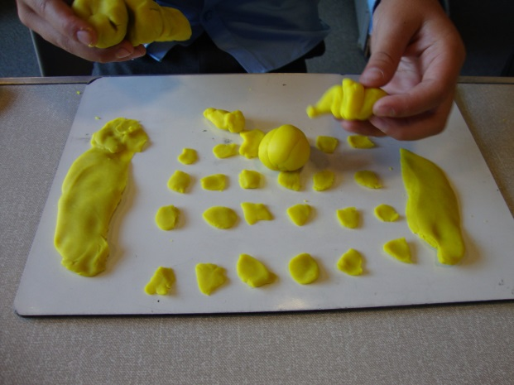
Maths
Children moving round and physically demonstrating.
Children teaching their peers – student helpers – be the teacher!
Practical work with physical objects…
Making it real!

Slide 4
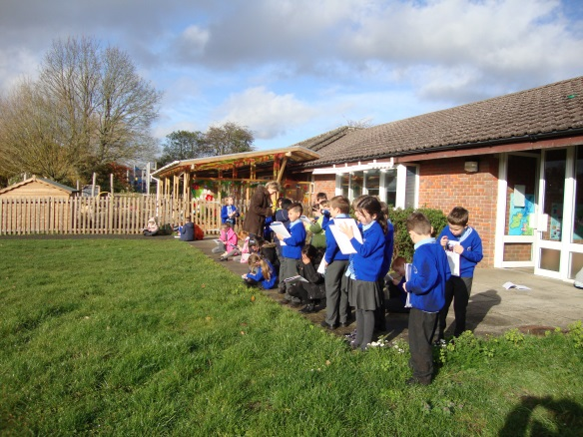
English
Exciting starters! Eg. A shoe….
Stories that capture the imagination – enthusiastic story telling!
Great stimuli and texts from other cultures
Use of drama, outside learning, role play

Slide 5
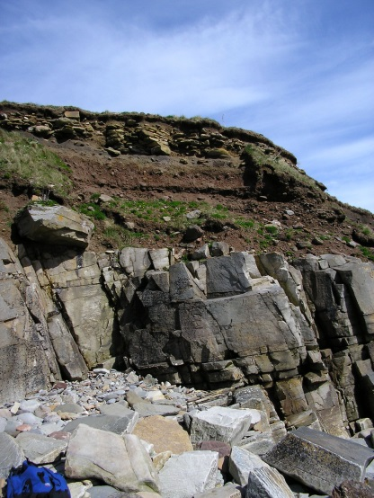
Science
Use of the school grounds
Lots of physical objects
Experiments – hands on
Autonomous working – researching to share with their peers

Slide 6
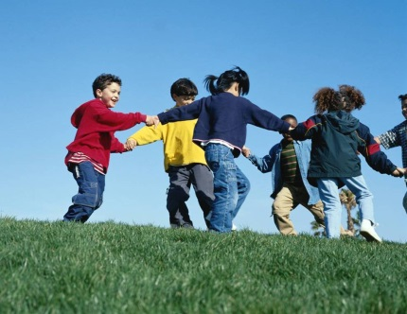
PE
Use of the school equipment – we love climbing and overcoming our fears!
Pushing ourselves to master new skills (everyone will be able to do a forward roll by half term if Mrs Hardy has her way!)
Use of our wonderful grounds to run and enjoy as we exercise

Slide 7
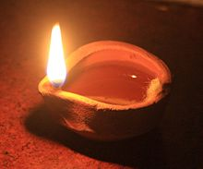
RE
Use of video so we can see things happening for real
Cross-curricular links with PSHE – empathy
Opportunities to experience awe and wonder and think about what others believe as well as expressing our own beliefs – a safe environment to learn and question
Using our grounds
Making physical objects

Slide 8
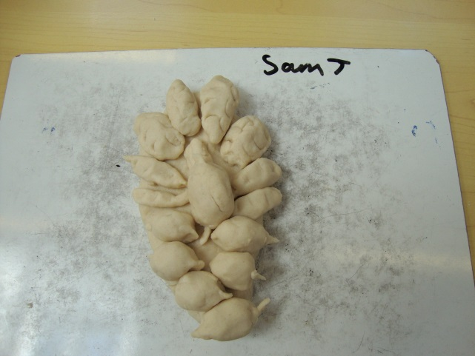
Art
Cross curricular links
Using lots of different media
Taking charge of our own learning
Making it current and relevant (eg. Emoji art!)

Slide 9
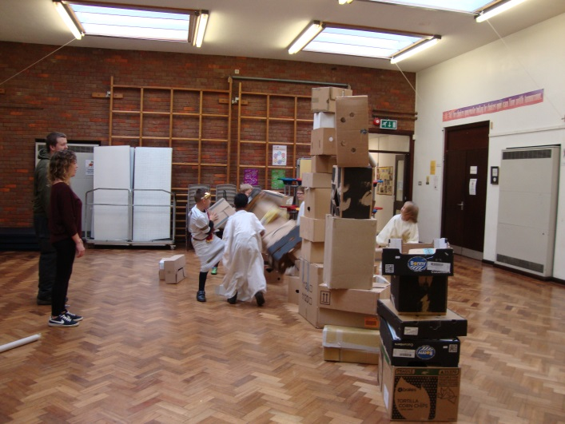
Topic
Lots of cross curricular links
Thinking about other cultures
Exciting characters!
How is it relevant to us?
Learning we can take with us for the rest of our lives!
Whole day of emersion learning to look forward to!
Planning this ourselves – taking charge

Slide 10
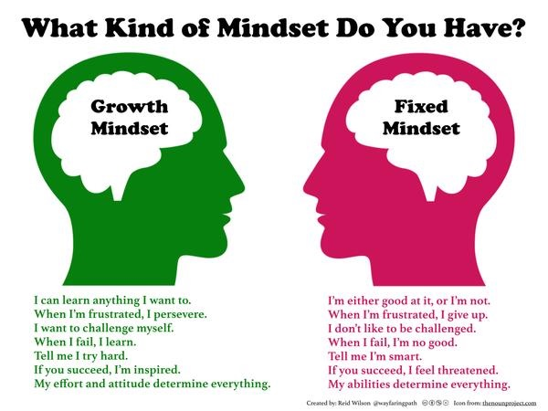
How does FRESH fit in with our class expectations?
It is implicit in all we do and the expectations we set, both for the children and ourselves, in what we plan for every day.
Our class ‘rules’
PSHE

Slide 11
Overall
We aim to capture the children’s interest and excitement at the start of every lesson.
We have meaningful tasks that they can carry out independently .
We aim for them to learn not just the objective but the skills to be a good member of our community, making progress every lesson.

