Slide 1
Maths Workshop Nov 2018
Hawridge and Cholesbury
Angela Hughes

Slide 2
MASTERY MATHS ‘teaching for mastery’
Longer time on each topic – less jumping around
Fewer topics in the earlier years to allow for learning in depth
Greater use of practical resources, pictures and images to help children make connections and so retain knowledge more easily
Opportunities for reasoning and problem solving built in to every lesson
Lessons carefully planned to address possible misconceptions and to allow children to make links in their learning
Flexible groupings – all children given access to all tasks

Slide 3
End of Key Stage results
GD 7% higher than Bucks

Slide 4
Progression of the operations

Slide 5
EYFS – Early Learning Goals
NUMBER
•Children count reliably with numbers from one to 20, place them in order and say which number is one more or one less than a given number.
•Using quantities and objects, they add and subtract two single-digit numbers and count on or back to find the answer.
•They solve problems, including doubling, halving and sharing.
SHAPE, SPACE & MEASURE
•Children use everyday language to talk about size, weight, capacity, position, distance, time and money to compare quantities and objects and to solve problems.
•They recognise, create and describe patterns.
•They explore characteristics of everyday objects and shapes and use mathematical language to describe them.

Slide 6
Progression of the operations

Slide 7
Addition

Slide 10
Lets try…
15 + 26 =

Slide 11
Lets try…
15 + 26 =
10
5
20
6

Slide 12
Lets try…
15 + 26 =
10
5
20
6

Slide 13
Lets try…
15 + 26 =
10
5
20
6

Slide 14
Lets try…
15 + 26 =
10
5
20
6

Slide 15
15 + 26 =
TENS
ONES
TENS
ONES
x
1
2
5
6
11

Slide 16
Reasoning
1
Complete the blanks
6
4
1

Slide 17
Subtraction

Slide 19
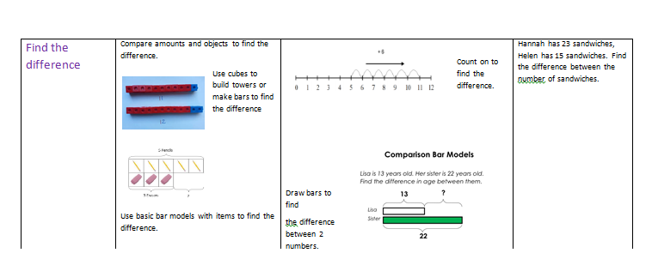

Slide 20
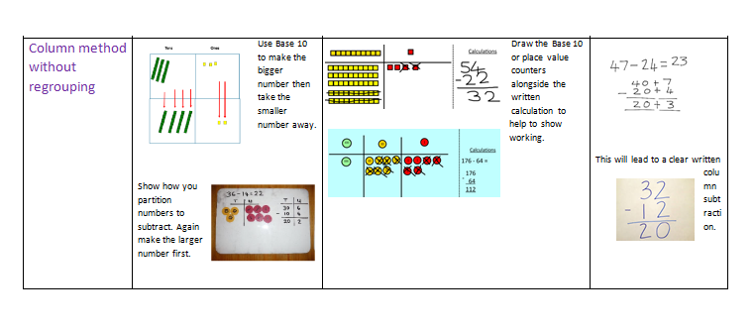

Slide 21
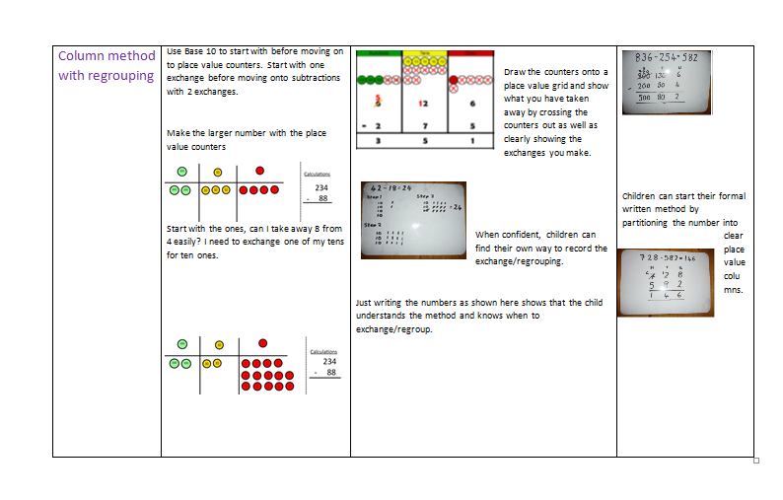

Slide 22
Lets try…

Slide 23
13

Slide 24
Quick Response
11

Slide 25
14
14-5

Slide 26
= 9
14-5
4
1
14 is 10 and 4.
Partition 5 into 4 and 1.
Take away 4 and then take away 1.

Slide 27
34 - 18 =
TENS
ONES
TENS
ONES
X
2
3
1
1
4
8
X

Slide 28
Multiplication

Slide 33
Lets try …
A
67 x 23 =
x | 60 | 7
20 | 1200 | 140
3 | 180 | 21
DON’T SAY ADD ‘0’
B
67
x 23
21 (3 x 7)
180 (3 x 60)
140 (20 x 7)
(20 x 60)
1541
C
67
x 23
201
1340
1541

Slide 34
Reasoning
if
678
x 88
59, 664
then explain how you could work out 678 x 89 =
59664+ 678 = 60, 342

Slide 35
Division

Slide 36
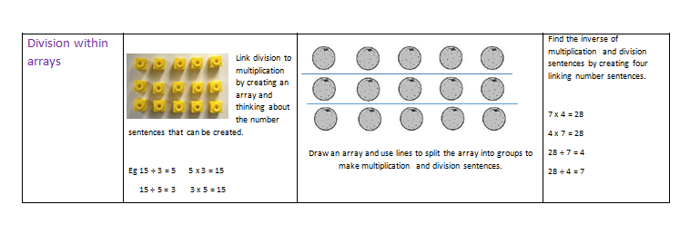

Slide 38
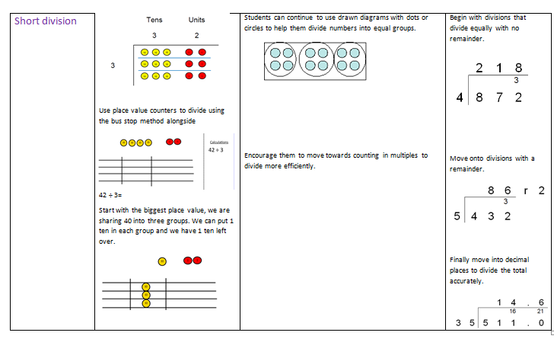

Slide 39
Lets try…
342 ÷ 13 =
26 r 4
026 r4
342
342
26
8 2
78
4
212
130
(13 x 10)
130
(13 x 10)
82
78 (13 x6)
4

Slide 40
Reasoning

Slide 41
Oral and mental
Year 1 Counting in multiples of 2,10 and 5.
By the end of the year 1, children can start learning the 2,10 and 5 times tables.
Count and read, to and across 100 forwards and backwards beginning with any given number (0-100).
Year 2 Recall 2,10 and 5 times table. Learn 3 times tables.
Year 3 Recall 2,10,5 and 3 times table. Learn 4 and 8 times tables.
Year 4 Recall 2,10,5,3, 4 and 8 times table. Learn 6,7,9,11 and 12 times table
Year 5/6 Continue to practise of all times table up to 12 x 12.
Each class will carry out a Terrific Times Table test weekly.

Slide 42
PARENTS ROLE
Why parents find it hard to engage in Maths
It can be particularly hard for parents to know how to help support their children with Maths at home. Often they complain that they themselves are “bad” at Maths or that they “never learned anything useful in Maths at school”. Unfortunately some are also willing to say these negative comments in front of their child, which then passes a negative attitude towards Maths or their ability in Maths onto the child.
Parents sometimes also complain that the mathematics curriculum doesn’t teach their children any life skills which again can quickly influence a child’s own attitude to Maths.
The final most common reason is that parents are scared of Maths or of teaching their child the wrong method or getting the wrong answer.
THIRD SPACE LEARNING

